Slide 1
P3

Slide 2
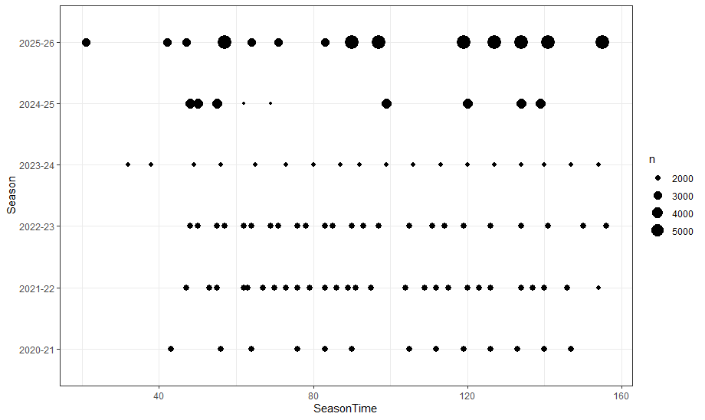
Phenomics data at different stages
Yield data at different stages
Genomic data
Phenomic data
Seasons are not aligned
Some seasons are sparse
Some are dense

Slide 3
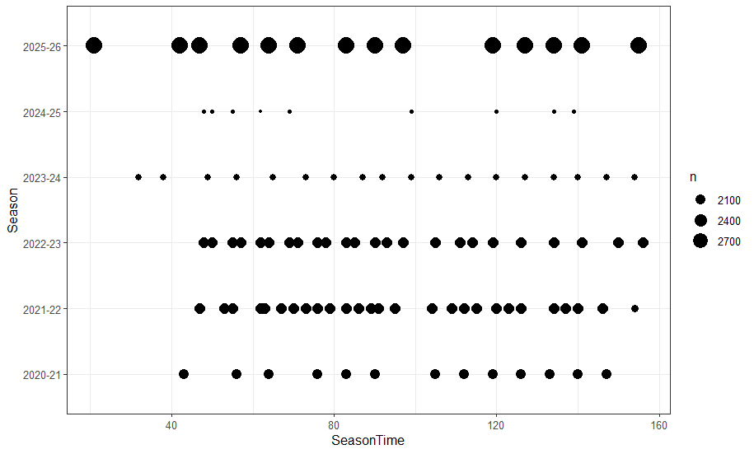

Slide 4
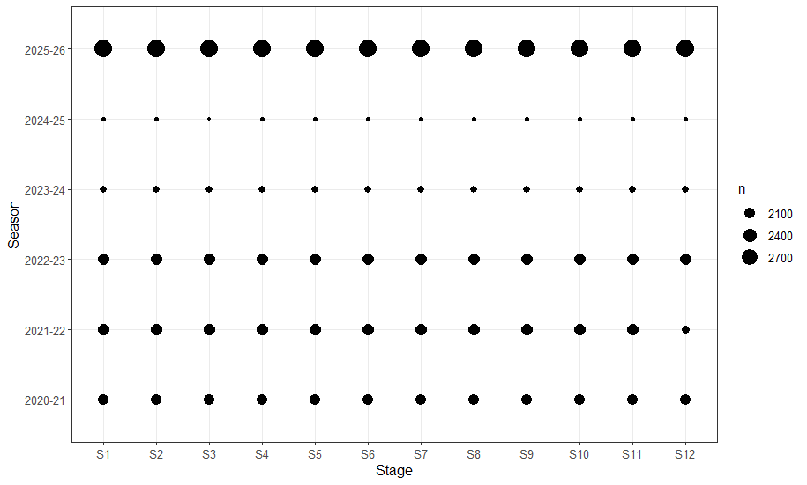

Slide 5
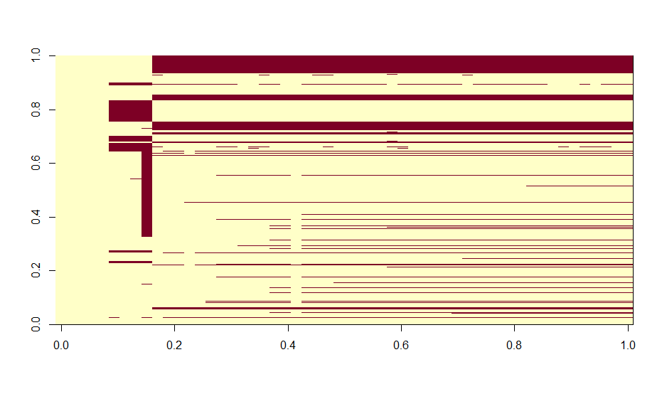
Pheno

Slide 6
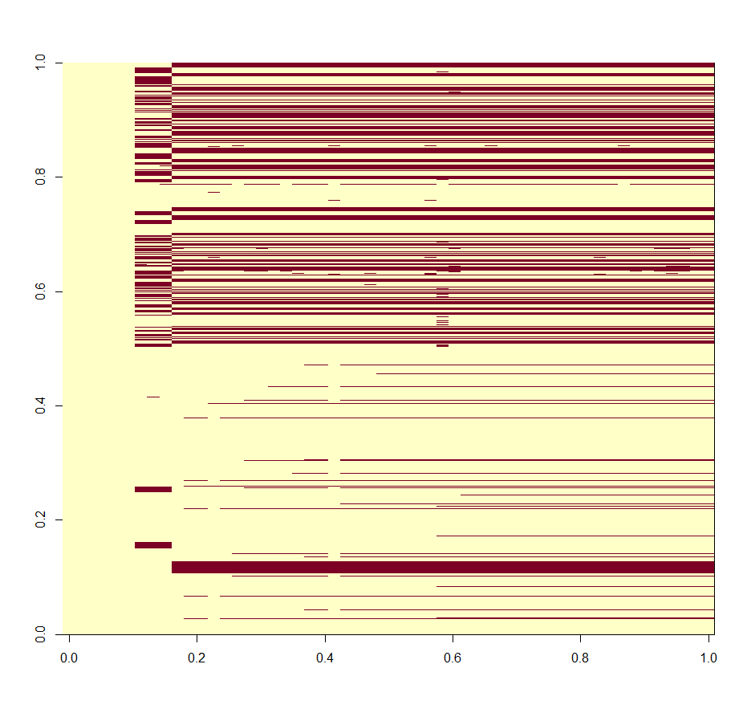
Pheno1

Slide 7
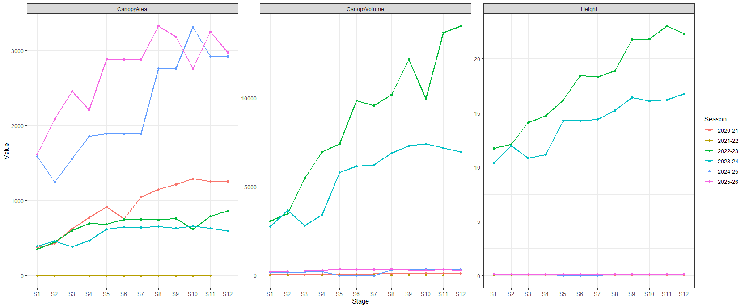
Scaling and standardizing is need for structural traits like canopy area, volume, height….but indices are already partially standardized and if we do that we may remove biologically meaningful variation and that may hurt longitudinal modeling/trajectory interpretation

Slide 8
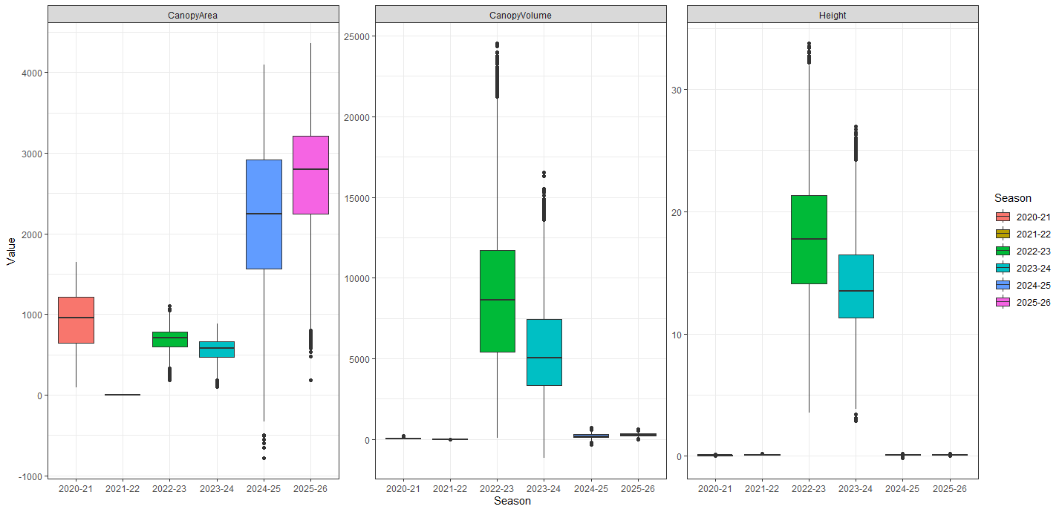

Slide 9
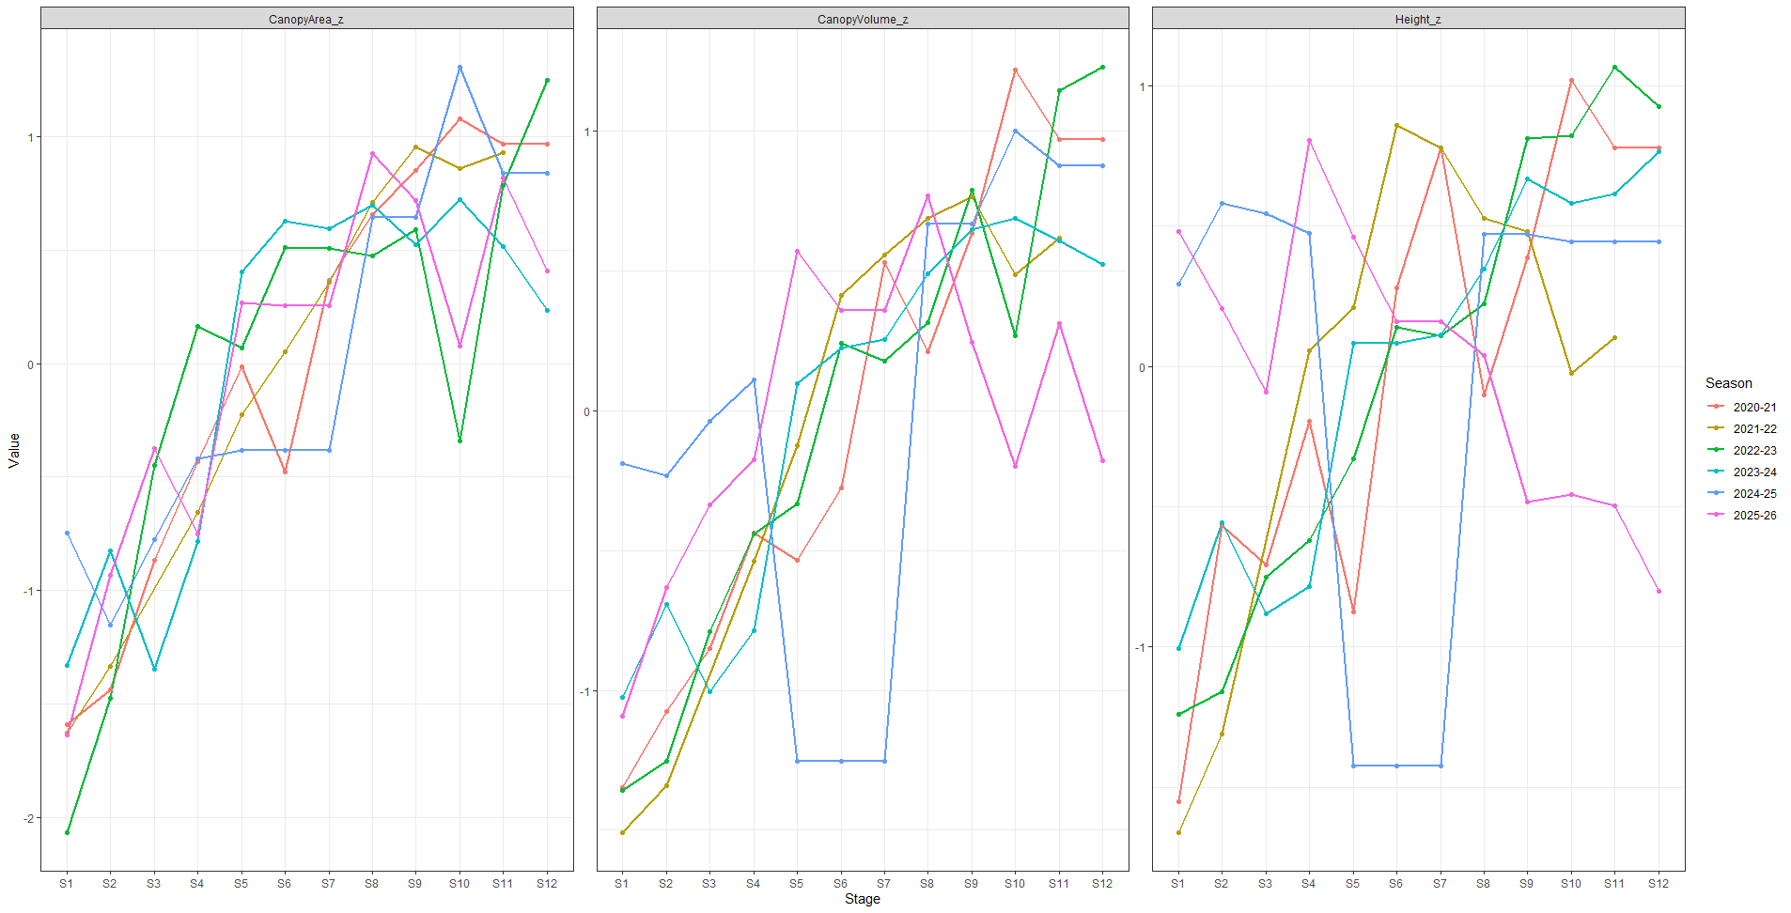

Slide 10
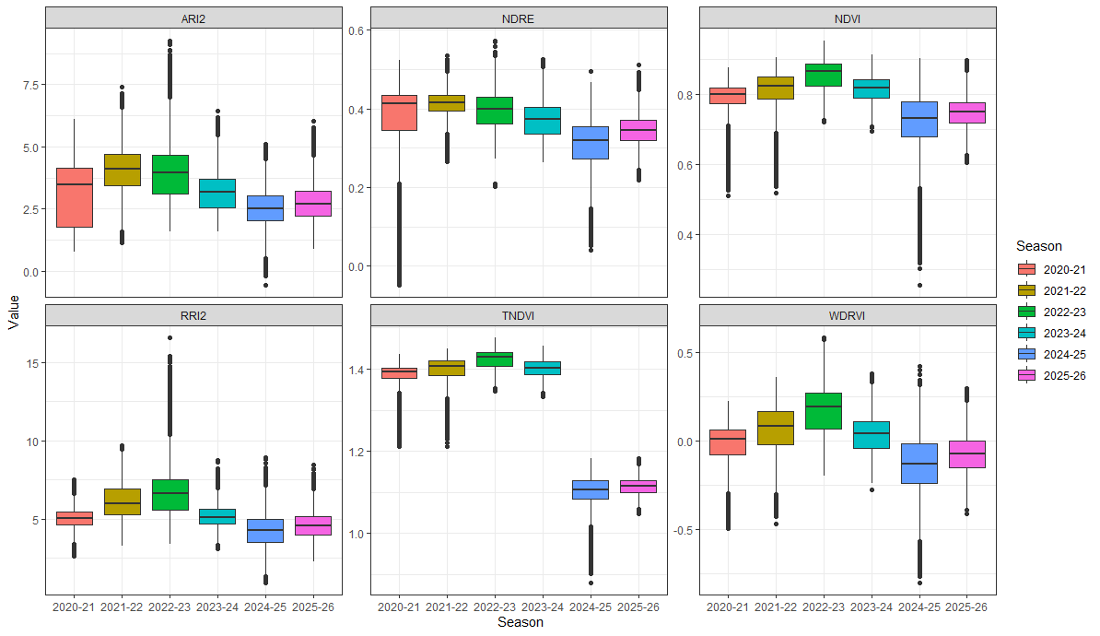

Slide 11
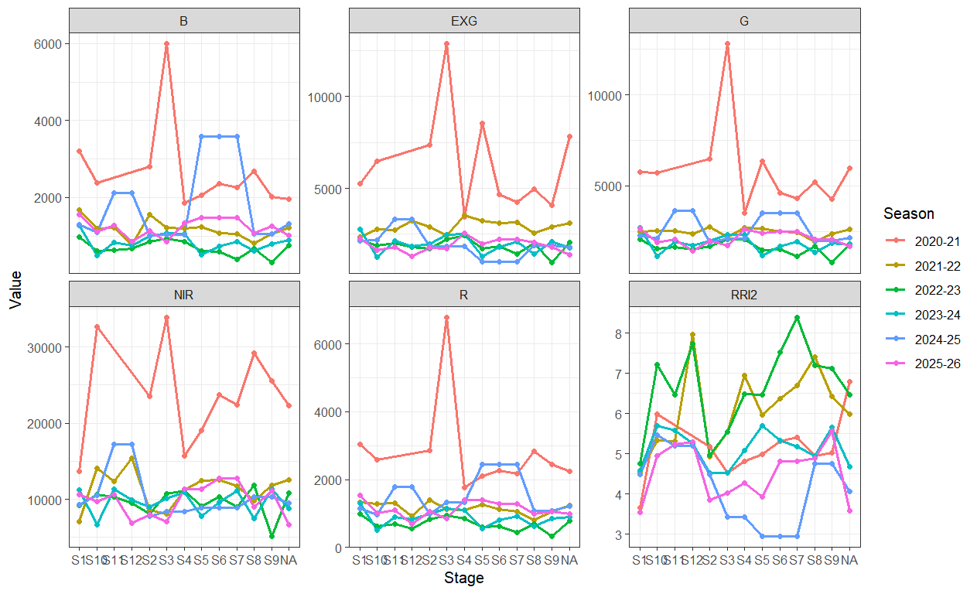

Slide 12
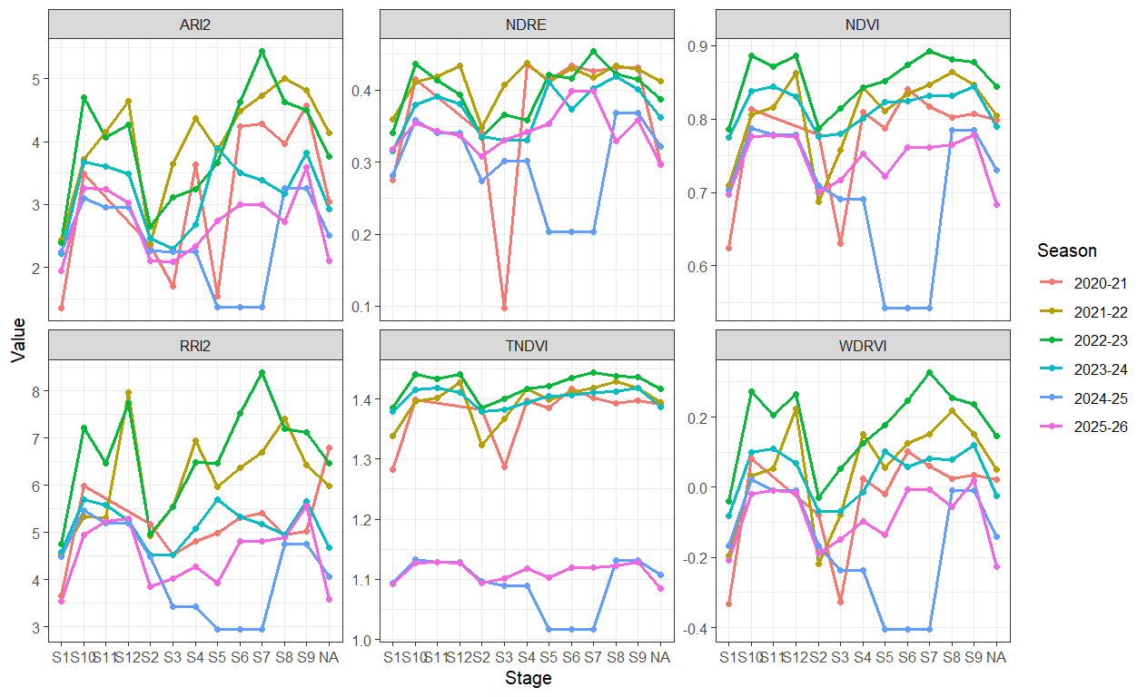

Slide 13
different drones
different flight heights
different reconstruction scales
possibly different units
Different people and pipeline
If I standardize by season, it preserve temporal signal but absolute magnitude information gets removed (meaningful development trends removed)

