Slide 1

Inferring Leading Interactions in the p53/Mdm2/Mdmx Circuit through Live-Cell Imaging and Modeling
Mathias L. Heltberg, Sheng-hong Chen, Alba Jiménez, Ashwini Jambhekar, Mogens H. Jensen, Galit Lahav
cels
Volume 9 Issue 6 Pages 548-558.e5 (December 2019)
DOI: 10.1016/j.cels.2019.10.010
Copyright © 2019 Elsevier Inc. Terms and Conditions

Slide 2
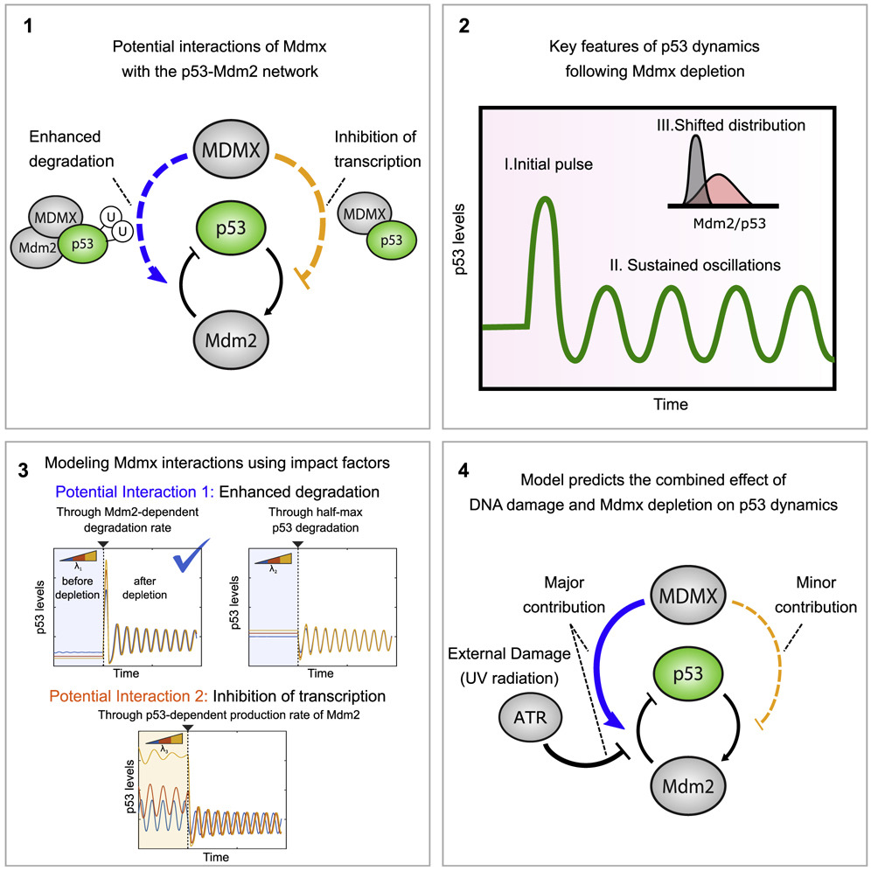
cels 2019 9548-558.e5DOI: (10.1016/j.cels.2019.10.010)
Copyright © 2019 Elsevier Inc. Terms and Conditions

