Slide 1



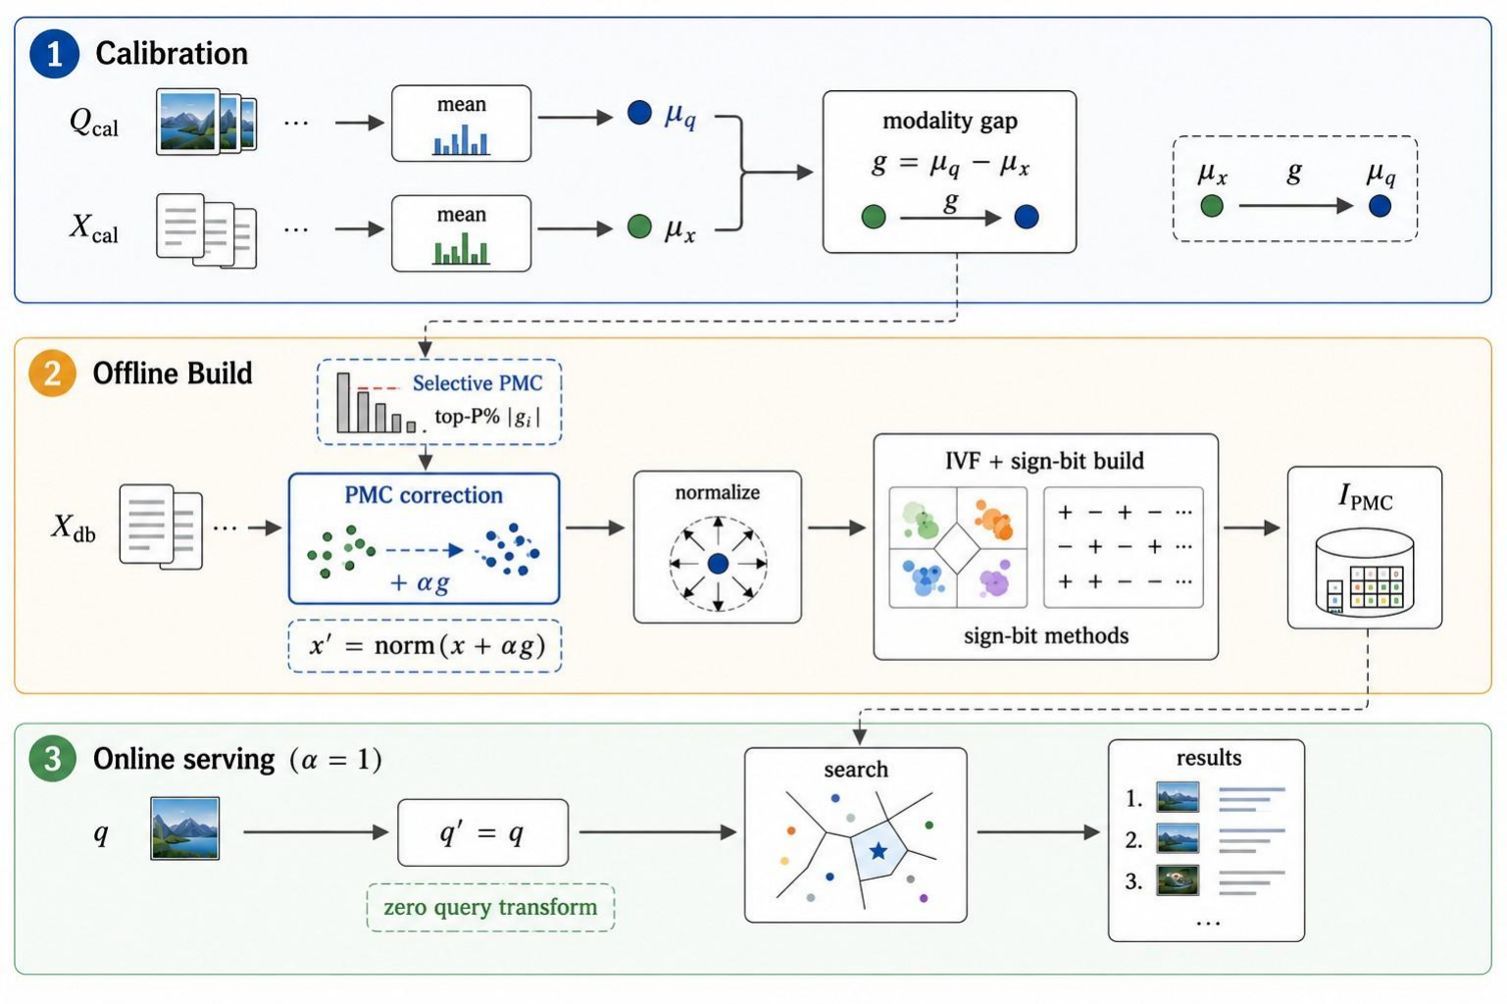
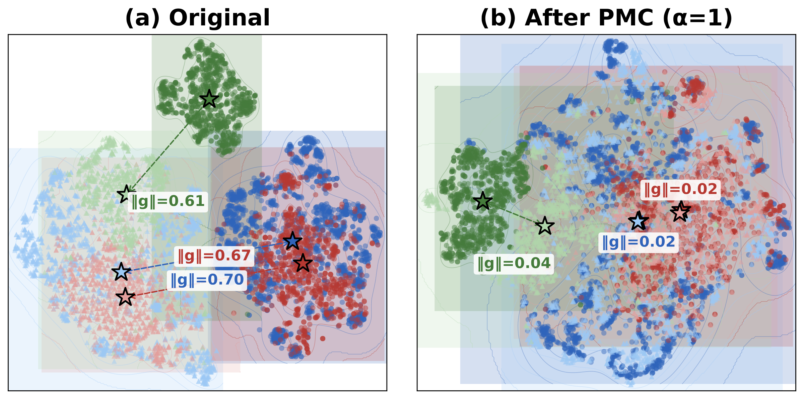
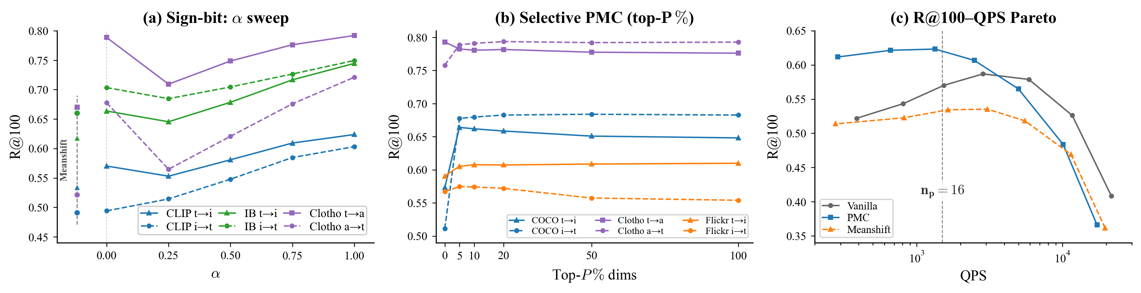

PMC: Build-Time Per-Modality Centroid Correction
for Cross-Modal Binary-Quantized Retrieval
Se Hoon Kim, Jun Hyung Lee, Soonyoung Jung*
Department of Computer Science and Engineering, Korea University · Intelligence Engineering Lab
{sehoon787, junicus, jsy}@korea.ac.kr
Paper + code: github.com/sehoon787/PMC
Abstract. Approximate nearest neighbor search is a core operator in large-scale retrieval, where vector quantization is widely used to reduce memory cost. Binary quantization methods encode each dimension as a single bit, but they assume queries and database vectors share a common centroid. This assumption fails in cross-modal retrieval, where each modality clusters around a different centroid, producing a modality gap that corrupts the centroid's dual role as inverted-file routing pivot and sign-bit decision boundary. We propose Per-Modality Centroid Correction (PMC), which shifts database vectors toward the query centroid at build time, rewriting routing and code boundaries at the source rather than merely adjusting queries at serving time. A selective variant confirms that concentrated gap energy in a few dimensions drives most recall loss. PMC adds no index memory or serving overhead; at α=1, the correction is fully absorbed into the index with zero query-time cost. Experiments on five cross-modal benchmarks, three encoders, and four binary-quantized index types show gains over uncorrected and query-shifted baselines that scale with modality-gap magnitude, up to a 400M-vector deployment.
3. PMC workflow
1. The problem: the modality gap
A frozen multimodal encoder φ maps both modalities into d-dimensional space: the database holds modality-b embeddings, queries come from modality a. Their means differ — the modality gap g = μ_{q} − μ_{x} is stable and large, ‖g‖ = .61–.82 on our benchmarks.
Calibration estimates μ_{q}, μ_{x} and g = μ_{q} − μ_{x}; the offline build shifts and renormalizes database vectors before BQ index construction; at α = 1 online serving uses q′ = q and searches the corrected index — zero query-time transform, zero extra index memory.
4. Results
Five benchmarks (MSCOCO, Flickr30K, Clotho, AudioCaps, LAION-400M — up to 407 M vectors), three frozen encoders (CLIP-B/32, CLIP-L/14, ImageBind) and four BQ index types; FAISS IVFRaBitQFastScan at 72–136 B/vec, n_{list} = ⌈√n⌉, n_{probe} ≈ n_{list}/4; R@100 against exact ground truth, single-thread CPU.
Every configuration, ordered by ‖g‖ (Vanilla → PMC)
‖g‖
Dataset · Enc.
q→db
db→q
t-SNE of ImageBind embeddings: each modality forms its own cluster; after PMC the paired points overlap.
.82
MSCOCO CL-L
R@10
R@100
R@10
R@100
BQ encodes each dimension as sign(x_{i} − c_{i}) relative to a centroid c (RaBitQ, Lucene BBQ). With one bit the decision boundary passes exactly through c with zero error margin — and the same centroid routes queries to IVF lists, so one offset corrupts codes and routing at once. Let δ_{i} = x_{i} − c_{i} be the residual; shifting the centroid by αg flips dimension i's sign iff
.82
MSCOCO CLIP
.36→.48 +33%
.55→.65 +18%
.26→.44 +69%
.47→.63 +34%
.77
Flickr30K CL-L
.40→.46 +15%
.58→.63 +9%
.29→.39 +34%
.50→.60 +20%
.72
LAION-400M CLIP
.31→.38 +23%
.41→.48 +17%
.22→.38 +73%
.33→.48 +45%
δ_{i} (δ_{i} − α g_{i}) < 0 , i.e., 0 <
δ_{i}
< 1
.70
MSCOCO IB
.075→.086 +15%
.108→.143 +32%
.035→.048 +37%
.069→.073 +6%
α g_{i}
.61
Clotho IB
.55→.63 +15%
.67→.75 +12%
.57→.64 +12%
.71→.75 +6%
δ_{i}: residual x_{i} − c_{i} · g_{i}: gap component · α: shift strength
.61
AudioCaps IB
.59→.60 +2%
.72→.73 +1%
.48→.54 +13%
.62→.69 +11%
Under smooth symmetric residual densities, a first-order expansion gives the expected number of flipped bits,
.39→.44 +13%
.75→.78 +4%
.44→.48 +9%
.83→.83 +0%
E[F] ≈ α Σ_{i} p_{i}(0) |g_{i}|
Gains scale with ‖g‖: the largest-gap rows improve most, exactly as Eq. (2) predicts. At 407 M vectors (LAION-400M, 29.3 GB of codes, 28× compressed) PMC lifts R@100 from .108 to .143 (+32%); with exact reranking the lead carries over, .198 → .277 (+40%). Exact rescoring cannot rescue Vanilla — it only re-scores what the corrupted codes already retrieved.
E[F]: expected bit flips · p_{i}(0): residual density at the code boundary
a density-weighted ℓ₁ norm of the gap: flip risk grows with |g_{i}|. On CLIP-L the top 10% of dimensions carry ≈90% of ‖g‖², so the corruption is structured rather than random, biasing Hamming distances systematically.
Oracle test — MSCOCO, CLIP-L, RaBitQ. Same-modality queries (‖g‖ = 0) reach R@100 = 0.71; cross-modal queries (‖g‖ = .82) fall to 0.54. The loss is the gap, not the quantizer.
2. Method: PMC correction
PMC applies a one-time centroid alignment before index construction. From a small paired sample we compute g and shift database vectors toward the query centroid:
(a) R@100 vs shift strength α (α = 0: MeanShift, α = 1: full DB-side PMC): α = 1 is best or near-best, justifying the default. (b) Selective PMC: on concentrated-gap MSCOCO, top-P = 5% already reaches peak R@100; diffuse gaps require broader correction. (c) R@100–QPS Pareto: PMC dominates Vanilla across throughput levels.
x′ =
x + α g
, q′ =
q − (1−α) g
‖x + α g‖
‖q − (1−α) g‖
5. Analysis
x: database vector · q: query · g: modality gap · α ∈ [0,1]: shift strength (α = 1 → q′ = q)
Every binary index has the same wound (R@100, Vanilla → PMC)
α interpolates between full query-side correction (α = 0, mean shift) and full database-side alignment (α = 1). The BQ index is built on {x′}; at α = 1 the query-time transform is identity, so serving incurs no extra cost. Per-vector renormalization preserves the unit-norm structure, and the α-sweep confirms α = 1 is best or near-best in every setting.
Method
MSCOCO t→i
AudioCaps a→t
BinaryFlat
.51 → .57
.51 → .64
Algorithm 1 PMC Index Construction
BinaryIVF
.51 → .57
.50 → .63
Require: database X (modality b), query sample Q (modality a), interpolation α
Ensure: IVF-based quantized index I and gap g
1: μ_{q} ← mean(Q); μ_{x} ← mean(X)
2: g ← μ_{q} − μ_{x}
3: for each x ∈ X do
4: x′ ← normalize(x + α g)
5: end for
6: I ← BuildIndex({x′}) — RaBitQ · BBQ · BinaryFlat
7: return I, g
RotatedBinary
.29 → .58
.63 → .69
RaBitQ
.58 → .64
.67 → .75
Rotation (BBQ-style) spreads the concentrated gap energy across every bit, so RotatedBinary collapses hardest without correction — and gains most from it. PMC improves or matches R@100 in all 16 method × direction configurations: the wound is in the centroid, so the same one-line fix serves every sign(x − c) method. Multi-bit quantizers (IVFPQ, OPQ) absorb part of the displacement yet still gain +1–56%.
Where to correct (MSCOCO · CLIP-B/32 · R@100 t→i)
Vanilla
.578
Query-only
.541
Selective PMC as a mechanism test. Correction restricted to the top-P% of dimensions ranked by |g_{i}|,
Both sides
.599
g_{sel,i} = g_{i} if |g_{i}| ≥ |g|_{(P)} , 0 otherwise ; x′_{sel} =
x + α g_{sel}
DB-only (PMC)
.637
‖x + α g_{sel}‖
Shifting both sides re-displaces the routing pivot, and random, shuffled or sign-flipped directions of the same norm all fall below Vanilla — the direction of g is what matters. Correct the centroid where it controls both routing and code formation.
g_{sel}: truncated gap · |g|_{(P)}: top-P% magnitude threshold
E(P) =
Σ_{i ∈ S(P)} g_{i}²
, S(P) = { i : |g_{i}| ≥ |g|_{(P)} }
‖g‖²
Correct the index, not the query: a one-time, database-side centroid correction repairs IVF routing and binary quantization together — zero query-time transform, zero extra index memory, QPS unchanged at every n_{probe}.
Future work: drift-adaptive α, graph-based ANN, billion-scale deployment.
E(P): captured gap-energy fraction · S(P): top-P% index set
isolates the mechanism. Since flip risk concentrates in high-|g_{i}| dimensions, correcting only the highest-energy ones suffices: for CLIP the top 10% carry 86–92% of gap energy, so P = 5% already recovers peak recall; ImageBind's diffuse gap (≈72%) requires full-vector correction.
The 35th ACM International Conference on Information and Knowledge Management · November 07–11, 2026 · Rome, Italy
CC-BY 4.0 · Code and reproduction package: github.com/sehoon787/PMC

