Slide 1
Wildfire Suppression via Reinforcement Learning
Comparing RL Algorithms on a Forest Fire Cellular Automaton Environment
MMAI-845 | Team Union

Slide 2
Why Wildfire Suppression?
The problem and why RL is the right approach
Wildfire containment is a time-critical, spatially constrained resource routing problem
Fire spreads stochastically — every timestep of inaction expands the fire front
Incident commanders must make real-time routing decisions under extreme cognitive load
RL agents can learn adaptive suppression policies through thousands of simulated episodes
This project compares 4 agent strategies on a standardized forest fire environment
2,200+
Wildfires in BC (2023)
$720M
Suppression Costs
2.84M ha
Area Burned

Slide 3
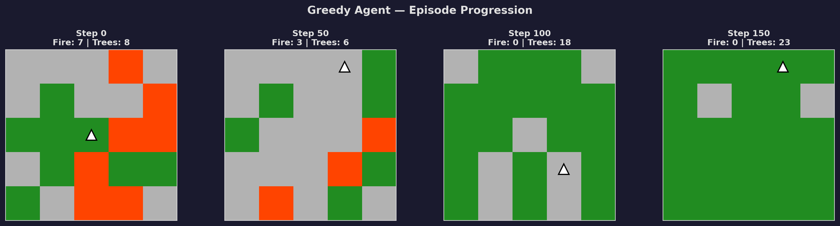
Environment: ForestFireHelicopter5x5-v1
Pre-defined Gymnasium environment from gym-cellular-automata
5x5 grid | Drossel-Schwabl cellular automaton
Cell states: Empty (0), Tree (1), Fire (2)
Fire spreads to adjacent trees, burns out after 1 step
Random lightning strikes (p=0.033) start new fires
Trees regrow randomly (p=0.333)
Helicopter extinguishes fire by flying over burning cells
9 actions: 8 directions + stay
Reward = (trees − fires) / 25 + extinguish bonus + proximity bonus

Slide 4
Four Agents, Four Strategies
From trivial baseline to deep reinforcement learning
Random
Greedy (BFS)
Trivial Baseline
Heuristic Baseline
Uniformly random actions. Establishes the performance floor. No intelligence whatsoever.
BFS to nearest fire, move toward it. Perfect grid information access. Smart but not learning.
DQN
PPO
Deep RL — Value-Based
Deep RL — Policy Gradient
Learns Q-values via replay buffer. Off-policy: reuses past experience. Neural net predicts action values.
Learns action probabilities directly. On-policy with clipped updates. Entropy bonus for exploration.

Slide 5
DQN — Deep Q-Network
Off-policy, value-based deep reinforcement learning
Neural network approximates Q(s, a) — the expected reward of taking action a in state s
Replay buffer (100K experiences) enables learning from past transitions
Epsilon-greedy exploration: starts random, gradually becomes greedy
Target network updated every 250 steps for training stability
Network: 30 inputs → 128 → 128 → 9 outputs (one Q-value per action)
Key Hyperparameters
Learning Rate
5e-4
Buffer Size
100,000
Batch Size
128
Gamma (γ)
0.995
Exploration
50% → 5%
Training Steps
500,000

Slide 6
PPO — Proximal Policy Optimization
On-policy, policy gradient deep reinforcement learning
Learns a policy π(a|s) — the probability distribution over actions given state
On-policy: collects fresh trajectories (1,024 steps), then updates
Clipped surrogate objective prevents destructive large policy updates
Entropy bonus (0.02) encourages continued exploration
Network: 30 inputs → 128 → 128 → 9 action probabilities + value estimate
Key Hyperparameters
Learning Rate
3e-4
Rollout Steps
1,024
Update Epochs
15
Gamma (γ)
0.995
Clip Range
0.2
Entropy Coeff
0.02

Slide 7
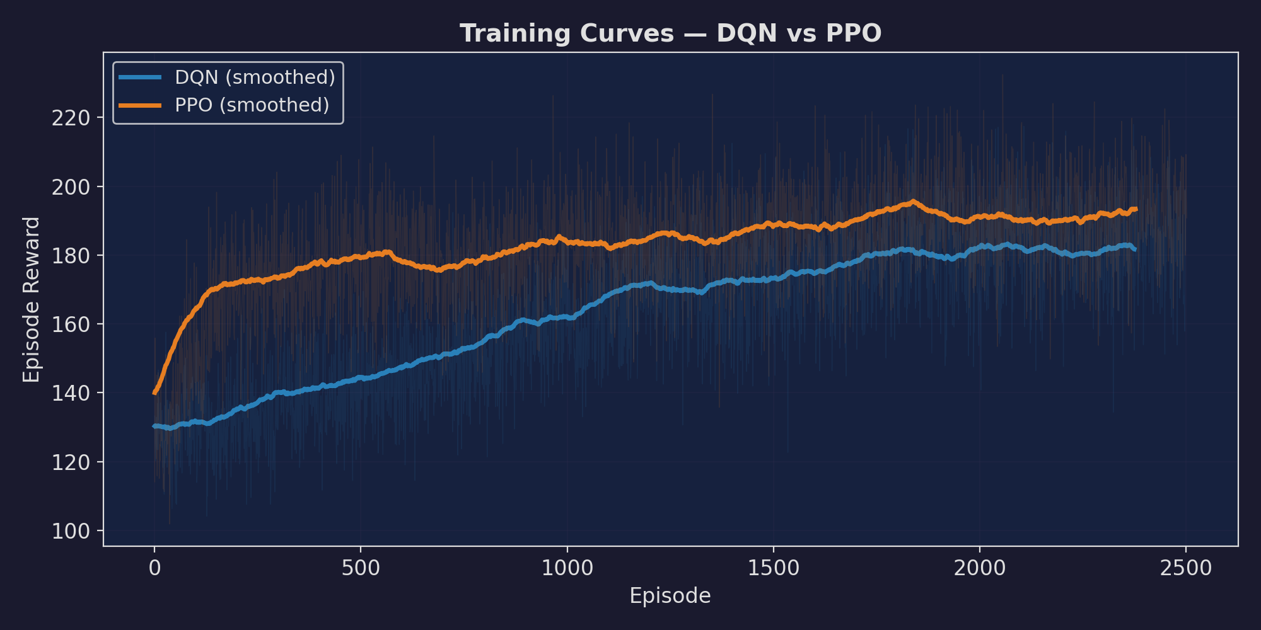
Training Curves — Learning Progression
Both agents improve significantly over 500K timesteps (~2,500 episodes)
Key Insight Both DQN and PPO show clear learning progression. DQN improves steadily via replay buffer. PPO shows more variance due to on-policy rollouts but converges to similar performance.

Slide 8
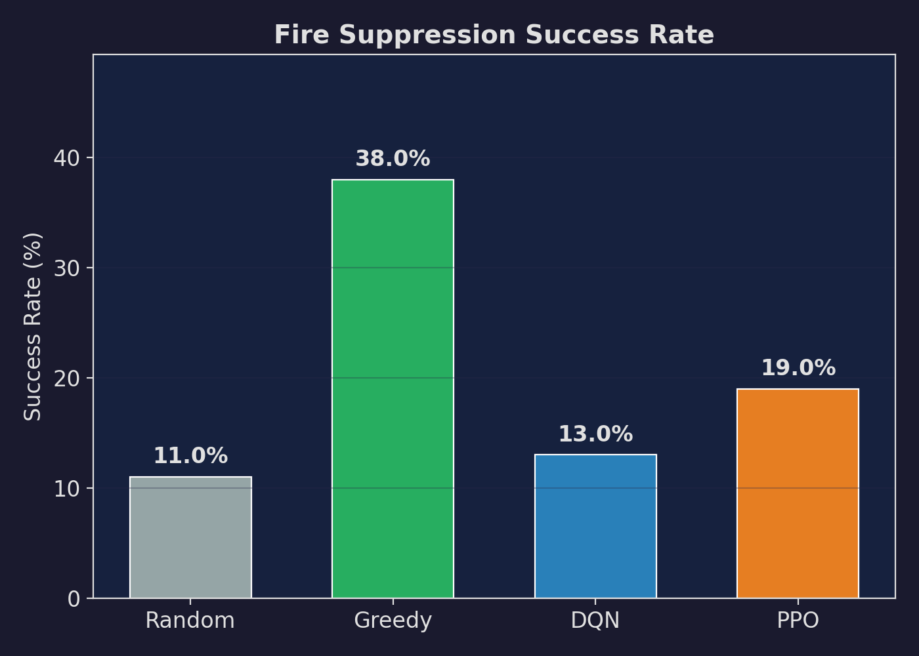
Results — Fire Suppression Success Rate
Percentage of episodes where all fire was extinguished
38%
11%
Greedy (Best)
Random (Floor)
19%
PPO
13%
DQN

Slide 9
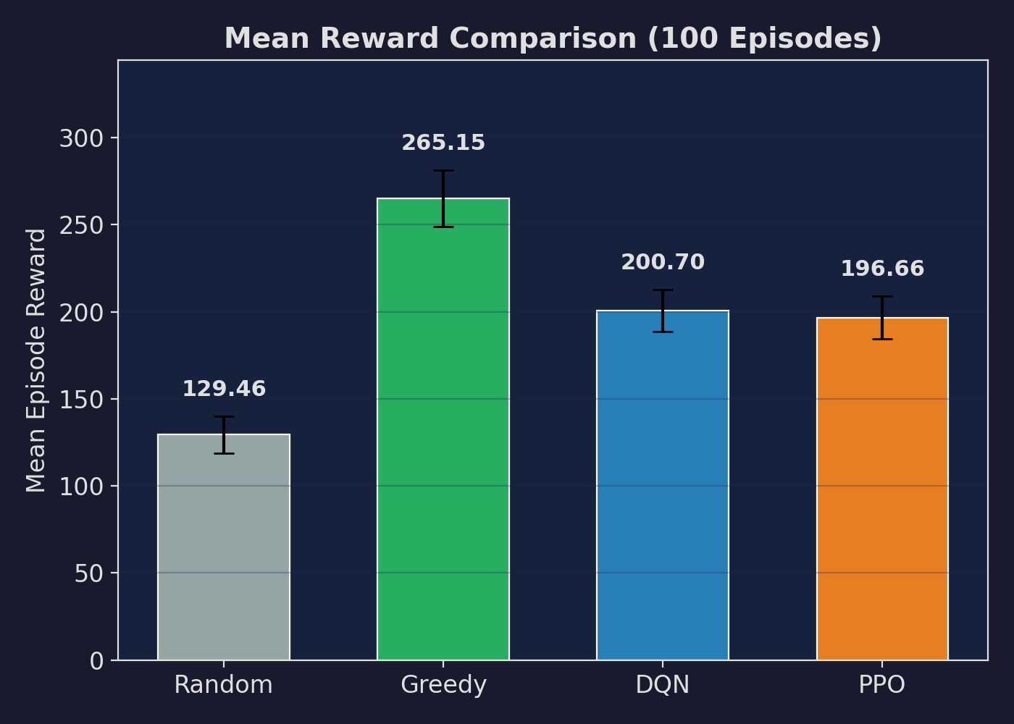
Results — Mean Episode Reward
100-episode evaluation with error bars (±1 std)
Greedy: 265.1 (benchmark)
DQN: 200.7 (+55% vs Random)
PPO: 196.7 (+52% vs Random)
Random: 129.5 (floor)

Slide 10
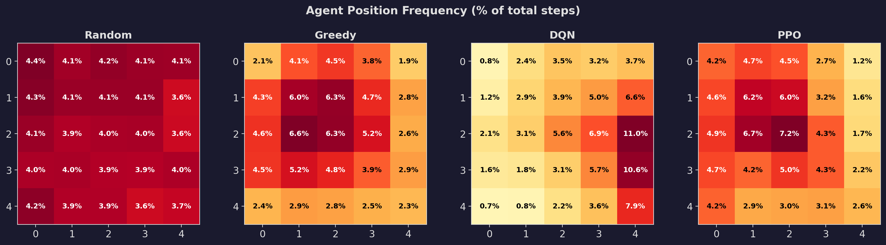
Behavioral Analysis — Where Does Each Agent Go?
Position frequency heatmaps across 100 evaluation episodes
Random spreads uniformly | Greedy concentrates on fire zones | RL agents develop spatial preferences through learning

Slide 11
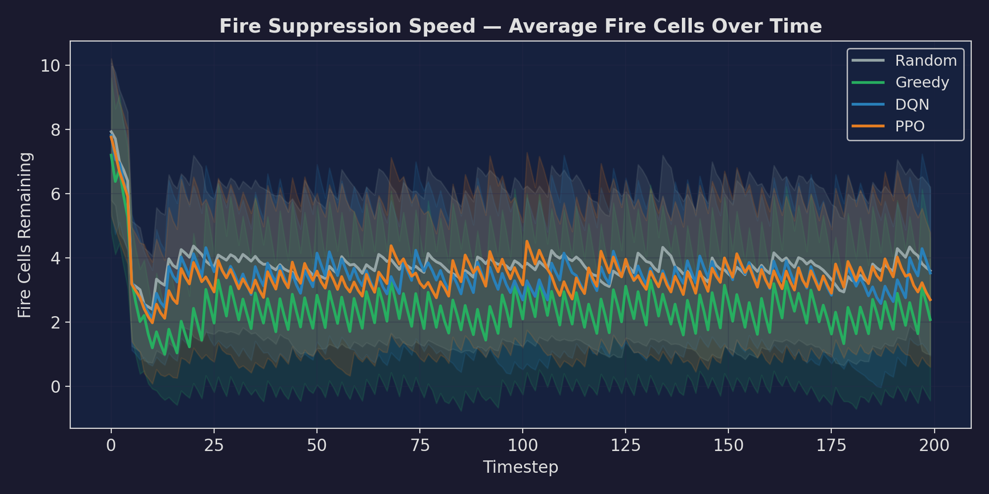
Fire Suppression Speed
Average fire cells remaining over the episode timeline
Key Insight Greedy suppresses fire fastest due to direct BFS targeting. RL agents show intermediate performance — they learn to move toward fire but without perfect grid access, they are less efficient.

Slide 12
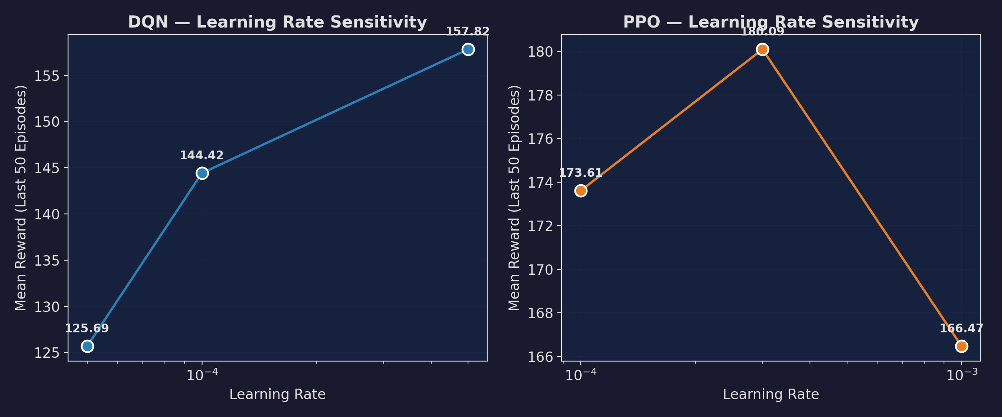
Hyperparameter Sensitivity — Learning Rate
How learning rate affects final performance (100K timesteps, last 50 episodes)
Both algorithms are sensitive to learning rate | Too low = slow convergence | Too high = instability

Slide 13
Reward Shaping — A Critical Design Decision
Why the base reward wasn't enough, and how we fixed it
The Problem:
Base reward = (trees − fires) / 25 per step
Dominated by stochastic fire spawning (random lightning)
Agent's actions had tiny marginal effect on reward
Result: DQN and PPO failed to learn (= Random performance)
The Fix:
+2.0 bonus for extinguishing a fire cell (direct action reward)
+0.5 proximity bonus for being close to fire (guidance signal)
Result: 2x reward gap between Greedy and Random
DQN and PPO now learn clearly (+55% above Random)
Lesson: In highly stochastic environments, the agent needs a reward signal that directly reflects its actions, not just the global system state. Reward engineering is as important as algorithm selection.

Slide 14
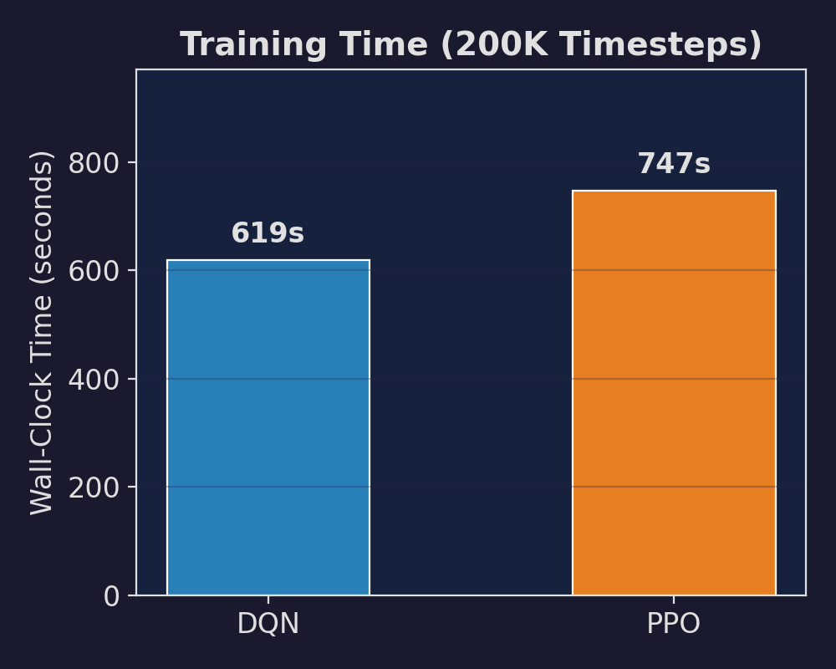
Training Efficiency
Wall-clock time for 500K timesteps on a single machine
DQN: Off-policy replay is computationally cheaper per step
PPO: On-policy rollouts + multiple gradient epochs add overhead
Both trained on a single CPU — no GPU required for this environment
The 5x5 grid keeps state space small enough for efficient training

Slide 15
Key Takeaways
1. RL agents can learn fire suppression strategies from scratch — both DQN and PPO significantly outperform random baselines
2. Domain heuristics (Greedy BFS) outperform general-purpose RL on small, fully-observable problems — but RL scales to scenarios where heuristics break down
3. Reward shaping is critical in stochastic environments — the agent needs a signal that reflects its actions, not just the system state
4. PPO shows better success rate than DQN (19% vs 13%) despite similar mean reward — on-policy learning may produce more consistent suppression behavior
5. Hyperparameter sensitivity is real — both algorithms are sensitive to learning rate, reinforcing the need for systematic tuning
Future Work
Scale to larger grids (16x16, 32x32) where heuristics fail
Add wind dynamics and terrain features
Multi-agent coordination (multiple helicopters)
Transfer learning across environment configurations

Slide 16
Thank You
Questions?
Environment: gym-cellular-automata | Framework: Stable-Baselines3 | Code: github.com/team-union/wildfire-rl

