Slide 1
Designing Classes
Prelude
Data Structures and Abstractions with Java, 4e
Frank Carrano
© 2015 Pearson Education, Inc., Upper Saddle River, NJ. All rights reserved.

Slide 2
Object Oriented Programming
Encapsulation,
Inheritance
Polymorphism
© 2015 Pearson Education, Inc., Upper Saddle River, NJ. All rights reserved.

Slide 3
Encapsulation
Information hiding
Enclose data and methods within a class
Hide implementation details
Programmer receives only enough information to be able to use the class
© 2015 Pearson Education, Inc., Upper Saddle River, NJ. All rights reserved.

Slide 4
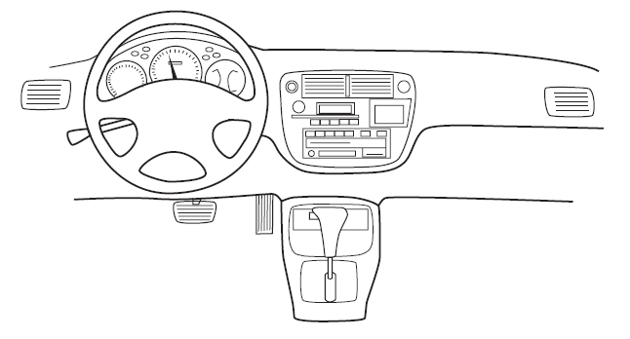
Encapsulation
FIGURE P-1 An automobile’s controls are visible to the driver, but its inner workings are hidden
© 2015 Pearson Education, Inc., Upper Saddle River, NJ. All rights reserved.

Slide 5
Abstraction
Focus on what instead of how
  What needs to be done?
  For the moment ignore how it will be done.
Divide class into two parts
  Client interface
  Implementation
© 2015 Pearson Education, Inc., Upper Saddle River, NJ. All rights reserved.

Slide 6
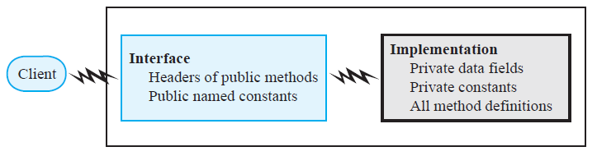
Abstraction
FIGURE P-2 An interface provides well-regulated communication between a hidden implementation and a client
© 2015 Pearson Education, Inc., Upper Saddle River, NJ. All rights reserved.

Slide 7
Specifying Methods
Preconditions
  What must be true before method executes
  Implies responsibility for client
Postconditions
  Statement of what is true after method executes
Use assertions
  In comments or with assert statement
© 2015 Pearson Education, Inc., Upper Saddle River, NJ. All rights reserved.

Slide 8
Java Interfaces
Program component that declares a number of public methods
  Should include comments to inform programmer
  Any data fields here should be public, final, static
© 2015 Pearson Education, Inc., Upper Saddle River, NJ. All rights reserved.

Slide 9
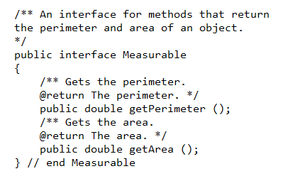
Listing 2-1 Interface Measurable
© 2015 Pearson Education, Inc., Upper Saddle River, NJ. All rights reserved.

Slide 10
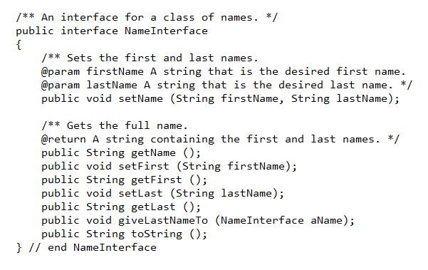
Listing 2-2 Interface NameMeasurable
© 2015 Pearson Education, Inc., Upper Saddle River, NJ. All rights reserved.

Slide 11
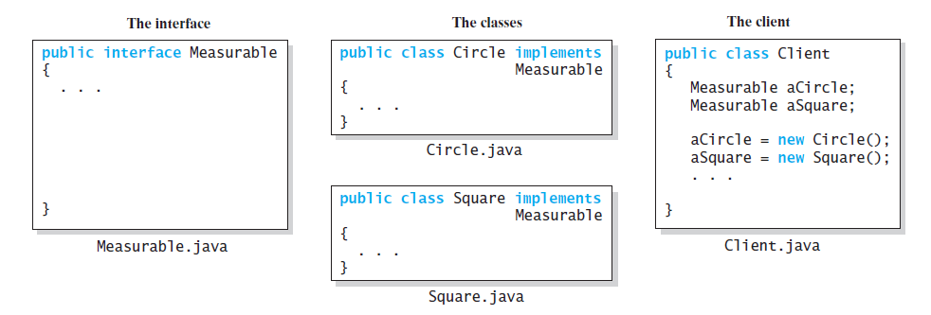
Implementing an Interface
FIGURE P-3 The files for an interface, a class that implements the interface, and the client
© 2015 Pearson Education, Inc., Upper Saddle River, NJ. All rights reserved.

Slide 12
Implementing an Interface
A way for programmer to guarantee a class has certain methods
Several classes can implement the same interface
A class can implement more than one interface
© 2015 Pearson Education, Inc., Upper Saddle River, NJ. All rights reserved.

Slide 13
Interface as a Data Type
You can use a Java interface as you would a data type
Indicates variable can invoke certain set of methods and only those methods.
An interface type is a reference type
An interface can be used to derive another interface by using inheritance
© 2015 Pearson Education, Inc., Upper Saddle River, NJ. All rights reserved.

Slide 14
Interface vs. Abstract Class
Purpose of interface similar to that of abstract class
  But an interface is not a class
Use an abstract class …
  If you want to provide a method definition
  Or declare a private data field that your classes will have in common
A class can implement several interfaces but can extend only one abstract class.
© 2015 Pearson Education, Inc., Upper Saddle River, NJ. All rights reserved.

Slide 15
Named Constants
Within an Interface
An interface can contain named constants,
  Public data fields that you initialize and declare as final.
Options:
  Define the constants in an interface that the classes implement
  Define your constants in a separate class instead of an interface
© 2015 Pearson Education, Inc., Upper Saddle River, NJ. All rights reserved.

Slide 16
Choosing Classes
Consider a registration system for your school …
Issues:
Who, what will use the system?
What can each actor do with the system?
Which scenarios involve common goals?
© 2015 Pearson Education, Inc., Upper Saddle River, NJ. All rights reserved.

Slide 17
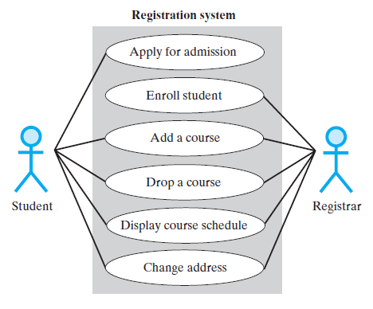
Choosing Classes
FIGURE P-4 A use case diagram for a registration system
© 2015 Pearson Education, Inc., Upper Saddle River, NJ. All rights reserved.

Slide 18
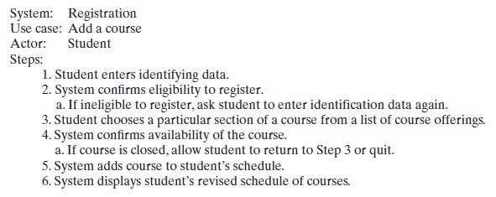
Identifying Classes
FIGURE P-5 A description of a use case for adding a course
© 2015 Pearson Education, Inc., Upper Saddle River, NJ. All rights reserved.

Slide 19
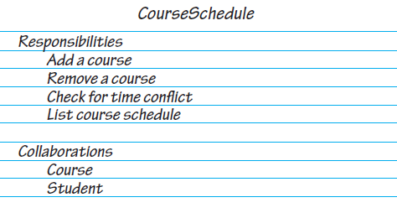
CRC Cards
FIGURE P-6 A class-responsibility-collaboration (CRC) card
© 2015 Pearson Education, Inc., Upper Saddle River, NJ. All rights reserved.

Slide 20
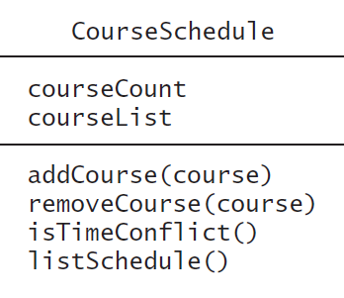
The Unified Modeling Language
FIGURE P-7 A class representation that can be a part of a class diagram
© 2015 Pearson Education, Inc., Upper Saddle River, NJ. All rights reserved.

Slide 21
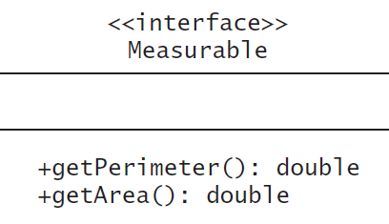
The Unified Modeling Language
FIGURE P-8 UML notation for the interface Measurable
© 2015 Pearson Education, Inc., Upper Saddle River, NJ. All rights reserved.

Slide 22
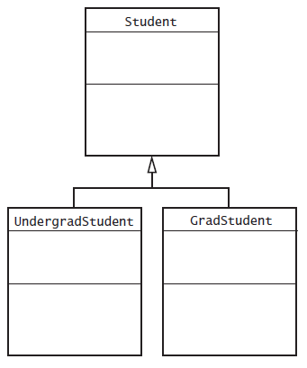
The Unified Modeling Language
FIGURE P-9 A class diagram showing the base class Student and two subclasses
© 2015 Pearson Education, Inc., Upper Saddle River, NJ. All rights reserved.

Slide 23
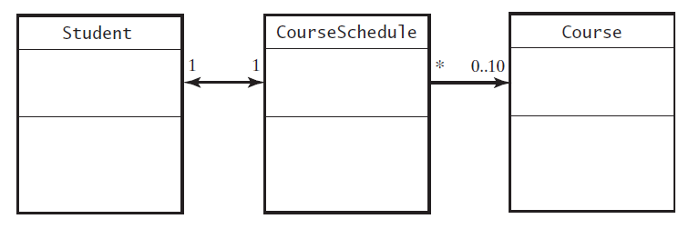
The Unified Modeling Language
FIGURE P-10 Part of a UML class diagram with associations
© 2015 Pearson Education, Inc., Upper Saddle River, NJ. All rights reserved.

Slide 24
Reusing Classes
Not all programs designed and written “from scratch”
Actually, most software created by combining
  Already existing components with
  New components
Saves time and money
Reused components are already tested
© 2015 Pearson Education, Inc., Upper Saddle River, NJ. All rights reserved.

Slide 25
End
Prelude
© 2015 Pearson Education, Inc., Upper Saddle River, NJ. All rights reserved.

