Slide 1
INVENTORY MANAGEMENT SYSTEM
DEVELOPED BY
AAKASH SHARMA

Slide 2
LOGIN
DASHBOARD
EMPLOYEE
SUPPLIER
BILLING
CATEGORY
PRODUCT
RESET PASSWORD

Slide 3
LOGIN
DASHBOARD
BILLING

Slide 4
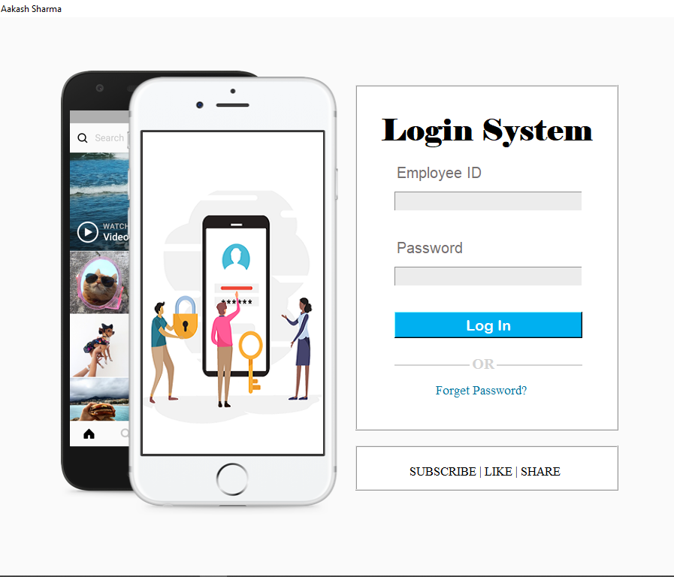
LOGIN PAGE
This page is made up of a small window having a mobile image whose image changes after every two seconds.
A small window having two text boxes in which we have to fill the Employee ID as User Name and Password. Both of the fields are required to login to our page.
If any of the field is missing, then we will get an error showing that “All Fields are Required.”
If any User forgot his/her password, then he/she can use forgot password option.
If any ADMIN logins our system, then he will go to the DASHBOARD page and if any of the EMPLOYEE logins our system, then he will go to the BILLING page.

Slide 5
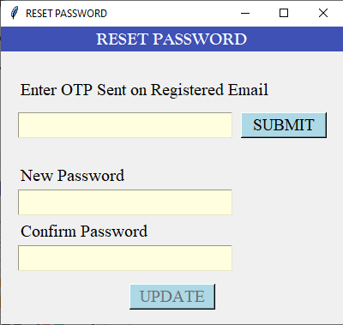
RESET PASSWORD
This Window is used to set a new password.
A OTP will be sent on the registered email address.
We have to enter the correct OTP. If we enter a wrong OTP, then the status of UPDATE Button will not change.
If we enter a correct OTP, and press the SUBMIT Button, then the status of SUBMIT Button will change to disabled and the status of UPDATE Button will change to enabled.
We have to enter the same password in “New Password” and “Confirm Password” text boxes. If we fill different password, then we will get an error saying “Password Mismatched”.
Then the new changed password will be saved in the employee table database in the backend.

Slide 6
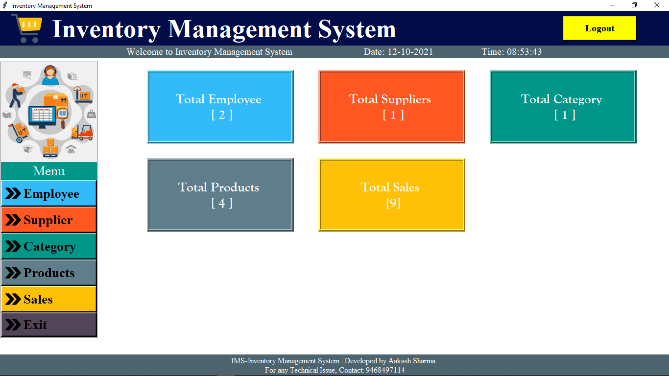
DASHBOARD
We can have a brief summary of our project.
We have six buttons in the left menu (Employee, Supplier, Category, Product, Sales and Exit).
A new small window will open by pressing each of the button.
When we press EXIT button, our System will close and when we press Logout button, the dashboard will close and login page will reopened.
In the middle of the window, we have a brief summary showing our database of how many employees, suppliers, category, products we have and how many sales we have done till now.

Slide 7
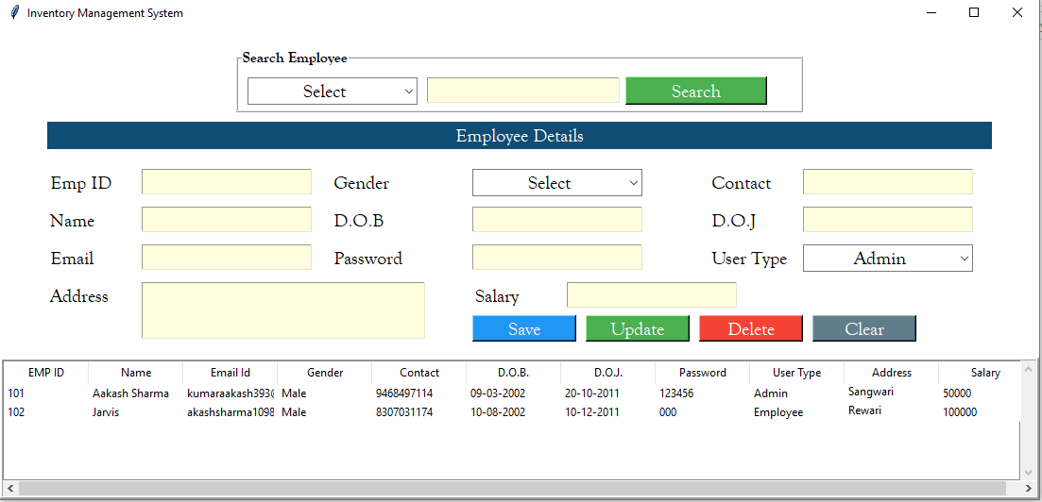
EMPLOYEE
We have got a new small window by pressing EMPLOYEE button in the DASHBOARD page.
In this window, we have a table in the bottom of the window showing the numbers of employees in the database.
We will have the Employee ID, Employee Name, D.O.B., and Date of Joining(D.O.J.), email(used to forget the password), Password( the Password used to login our system; if we change our password, then it will update here),User Type(ADMIN or EMPLOYEE: the ADMIN will have the access to update the employee details and he will only have the access to go to the dashboard window whereas EMPLOYEE will directly go the BILLING page.), Address and Salary.
We have a search engine above, We can search the details of the Employee. We have a Drop Down Menu having fields (Name, Email and Contact).

Slide 8
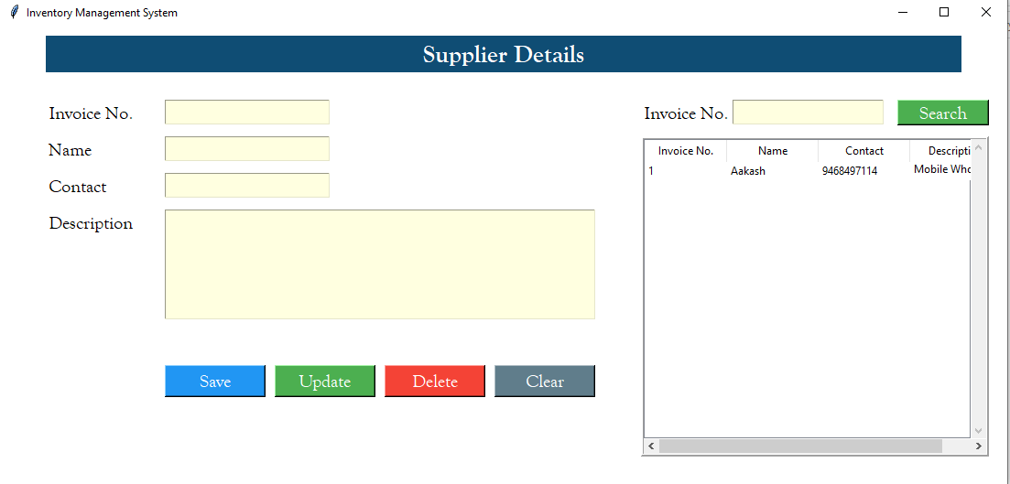
SUPPLIER
We will get the details of the Suppliers with the help of the Window.
We will create the supplier by filling the Name and Contact.
We can Save, Update, Delete the Suppliers.
By pressing the Clear Button, the whole window will reset. All of the fields will get empty.
We can search the suppliers with the help of the search engine by Invoice No. INDEX.

Slide 9
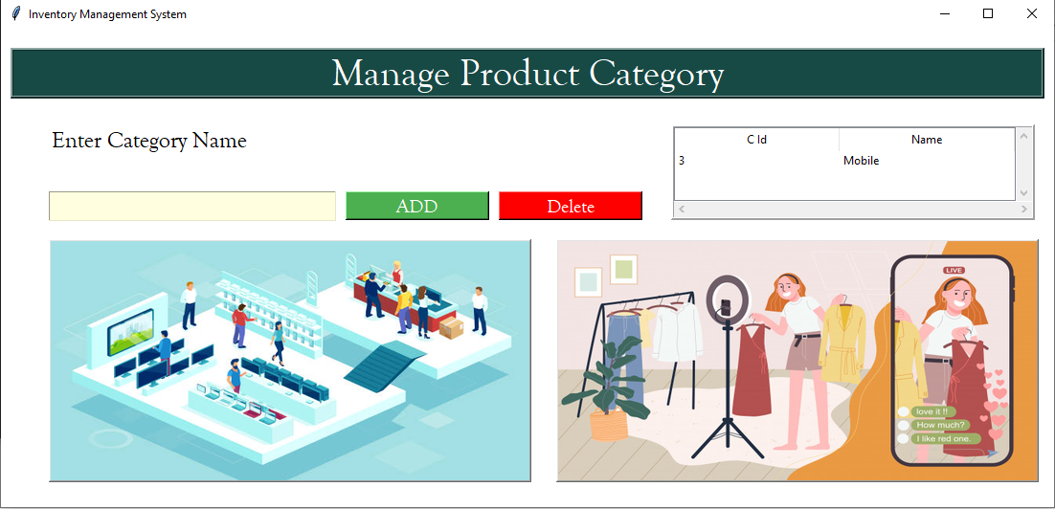
CATEGORY
We will get the details of the Category of the products provided in the system.
We can create or delete the Category of the Products.
A Table is also provided in the Right of the Window which states the Database of the categories.

Slide 10
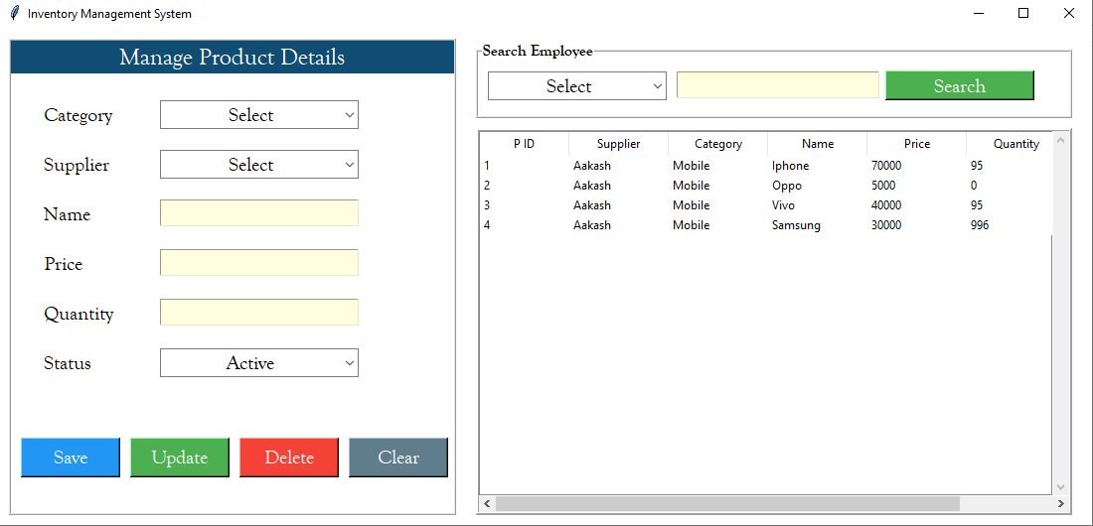
PRODUCTS
We will have the details of the Product in this window.
We can create/update/delete the Products in the Database.
We can create the Product with the help of these fields: Category(from the Category window and will have in a drop down menu of the categories),Supplier(from the Supplier Window, and will have in a drop down menu of the suppliers), Name, Price, Quantity and Status(ACTIVE OR INACTIVE).
We can search the product with the help of Search Engine by the INDEX ( Category, Suppliers and Name).

Slide 11
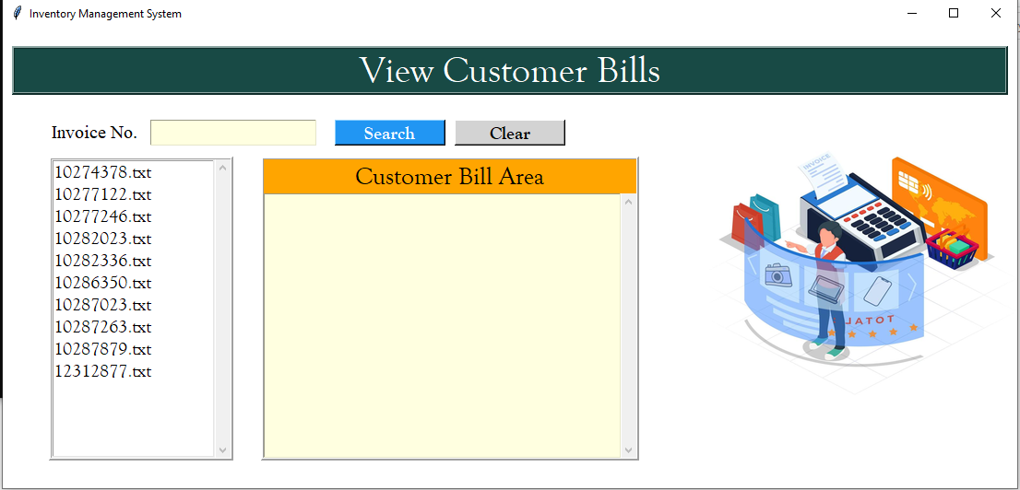
SALES
This Window gives the details of the Sales done by us till date.
We can view and fetch the customer bills by INDEX (Invoice No.).

Slide 12
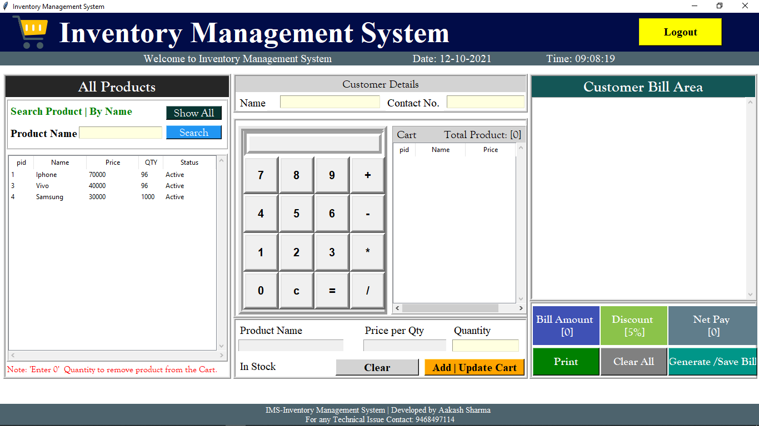
BILLING
All of the Employees except ADMIN who login will go to this page.
This window helps us to create and print the bills. It acts as a cart window. We will have the product list and the calculator where we can calculate the bill amount.
Customer Name and Contact No. are the required fields for generating the bill.
Once the bill is generated, we can print the bill.
Whenever we add a product in the cart, the stock of the product will decreased.
When we logout the page, we will returns to the Login Page back.

Slide 13
Thanks for visiting…
Regards,
Aakash Sharma
9468497114,8307031174
Sehwal.Aakash@gmail.com

