Slide 1
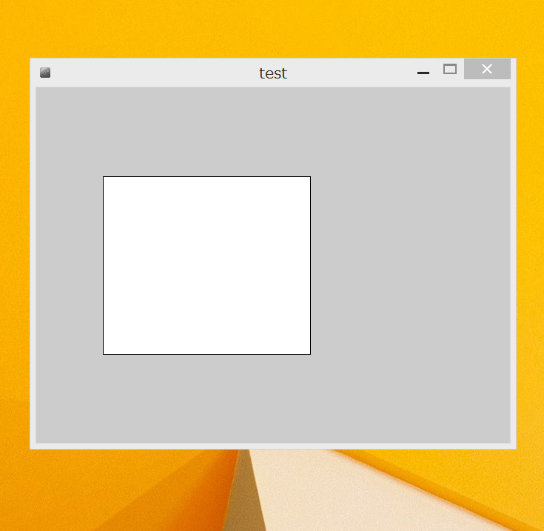
(120)
(90)
(240)
(280)

Slide 2
(y)
(x)
(h)
(w)

Slide 3
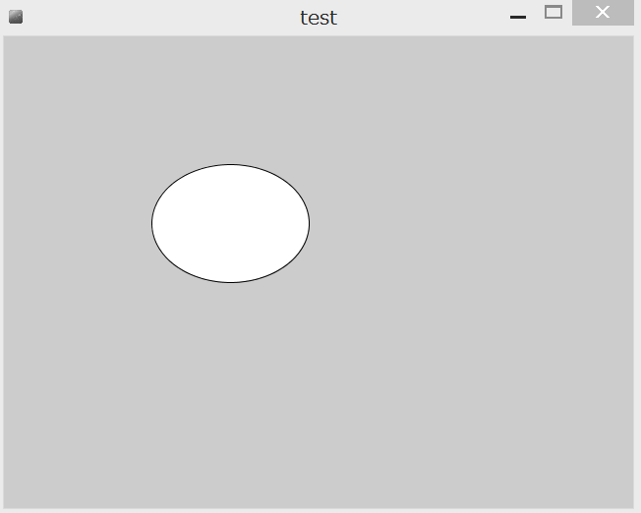
(y)
(y)
(x)
(w)

