Slide 1
CSCI 4061 Lecture 3 Programs and Processes
Instructor: Ali Anwar and Sam Fountain
Slides By: Jack Kolb

Slide 2
Course Logistics
Lab 1 due tomorrow at 9:59pm on Gradescope
Quiz 2 posted on Canvas now
Project 1 is out
Project Quiz due Friday at 9:59pm on Canvas

Slide 3
Data Types in C
Sizes here are for Linux computer with 64-bit architecture
Type T | Description | sizeof(T)
int | Positive or Negative Number | 4
unsigned | Non-negative Number | 4
long | Large Positive or Negative Number | 8
unsigned long | Large Non-Negative Number | 8
long long | Large Pos/Neg Number | 8
unsigned long long | Large Non-Neg Number | 8
short | Small Pos/Neg Number | 2
unsigned short | Small Non-Neg Number | 2
float | Fractional Value | 4
double | Fractional Value, More Range and Precision | 8
char | Single Letter or Small Number | 1

Slide 4
C Pointers
Pointers give you full visibility into a program’s memory
The value of any pointer is a memory address - where some specific piece of data lives
The type of a pointer tells you what is stored at that address
int * - stores address of an int value
double * - stores address of a double value
Remember, memory addresses are just binary numbers, regardless of what lives at that an address
sizeof(double *) == sizeof(int *) == sizeof(char *) == … == 8

Slide 5
Structs: Heterogeneous Data
typedef struct { // Declare Type
double height;
int age;
char name[16];
} person_t;
In an array: all elements have the same type
Structs are C’s way of defining a heterogeneous collection of data (fields)
Reminiscent of objects
Access elements with dot notation
Pointer to a struct: use arrow notation: ptr->age
person_t wizard; // Declare var
wizard.height = 6.023;
wizard.age = 542542754;
wizard.name = “Gandalf”;
person_t wizard = { // Decl & Def
.height = 6.023;
.age = 542542754;
.name = “Gandalf”
};

Slide 6
Using Heap Memory
Data on the heap exists outside the scope of any function call
We can ask for exactly the space we need at runtime
How? Memory Allocate Function: void *malloc(size_t size)
Argument: Number of bytes you need
Return type: void *, so we can assign it to any type of pointer
Often used in combination with sizeof: malloc(n * sizeof(int))
But, you also must free any memory you allocate!
Only once you are done using that memory

Slide 7
stdio File Operations
Any actively used file in a C program has a “file handle” of type FILE *
You must pass a file handle as a parameter for any file-related function calls (rough equivalent to methods in object-oriented programming)
To open a new file: FILE *fopen(char *name, char *mode)
mode is “r” for reading, “w” for writing, “a” for append
To close a file: fclose(FILE *handle)
Text Files: fprintf and fscanf
Binary Files: fread and fwrite

Slide 8
Reading/Writing Text Files
Use fscanf to read, fprintf to write
Note f in front: Just like scanf and printf but need a FILE * param
int fscanf(FILE *fh, char *format, addr1, addr2, …)
Returns a special EOF value when end of file is reached
Can literally write: if (fscanf(…) == EOF) …
int fprintf(FILE *fh, char *format, arg1, arg2, …)
The remaining arguments (format, addresses, etc.) work the way you already know

Slide 9
Reading/Writing Binary Files
A little bit different, uses fread and fwrite
size_t fread(void *dest, size_t byte_size, size_t count, FILE *fh)
Attempts to read byte_size * count bytes from open file to location at dest
Returns number of bytes actually read (e.g., we may hit EOF early)
Note the void * -- we can read into whatever pointer type we want
size_t fwrite(void *src, size_t byte_size, size_t count, FILE *fh)
Attempts to write byte_size * count bytes to open file from location at src
Returns number of bytes actually written
Note the void * -- we can write from whatever pointer type we want

Slide 10
Writing to a Text File
#include <stdio.h>
int main() {
FILE *fh = fopen("my_integer.txt", "w");
if (fh == NULL) {
printf("Failed to open file\n");
return 1;
}
int my_integer = 42;
fprintf(fh, "%d\n", my_integer);
fclose(fh);
return 0;
}

Slide 11
Writing to a Binary File
#include <stdio.h>
int main() {
FILE *fh = fopen("my_integer.bin", "w");
if (fh == NULL) {
printf("Failed to open file\n");
return 1;
}
int my_integer = 42;
fwrite(&my_integer, sizeof(int), 1, fh);
fclose(fh);
return 0;
}
Notes:
What’s missing from this example and the previous example?
Error Handling!

Slide 12
Writing an Array of Structs
Say we have the following struct definition:
typedef struct {
double age;
int height;
char initial;
} person_t;
Implement the following functions to write arrays of these structs to a text and to a binary file. Return 0 on success and -1 on failure.
int write_people_to_text(char *file_name, person_t *people, int n_people)
int write_people_to_binary(char *file_name, person_t *people, int n_people)

Slide 13
Writing an Array of Structs
Say we have the following struct definition:
typedef struct {
double age;
int height;
char initial;
} person_t;
Implement the following functions to write arrays of these structs to a text and to a binary file. Return 0 on success and -1 on failure.
int write_people_to_text(char *file_name, person_t *people, int n_people)
int write_people_to_binary(char *file_name, person_t *people, int n_people)
Code from each lecture is posted to our Canvas site
Including solutions to this exercise
Complete working implementation
Error Handling

Slide 14
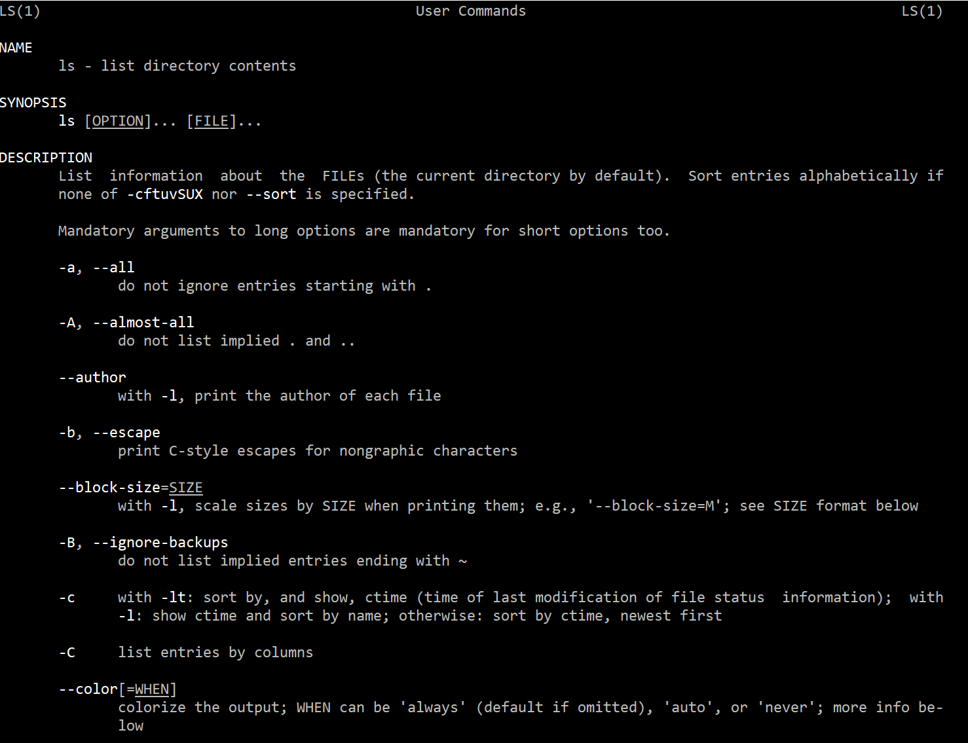
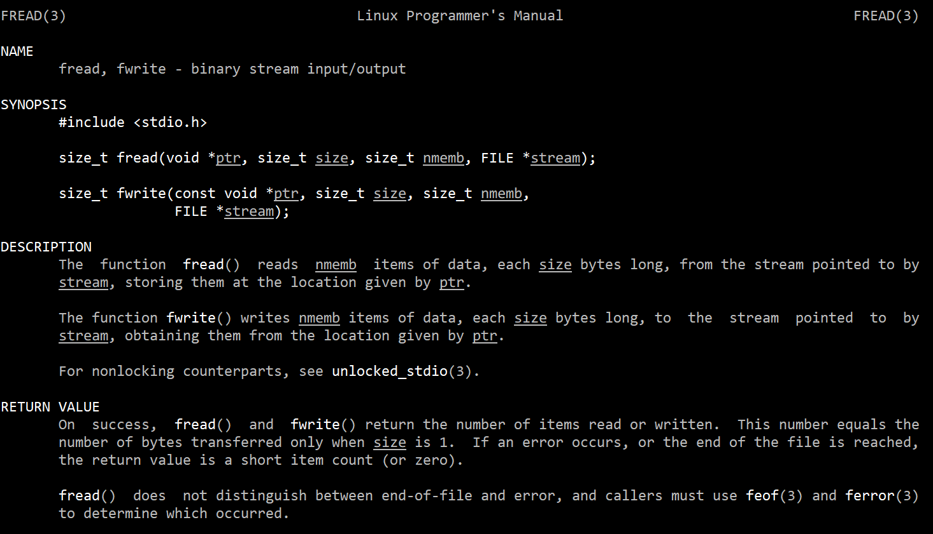
Great Resource: man (“manual”) Pages
Lots of documentation on both commands you can use and systems programming functions to use in C code
Just type man <command/function> on the terminal
man ls
man fwrite

Slide 15
The File Interface is Important
It’s worth getting comfortable with file I/O
We’ll learn what’s underneath functions like fprintf, fwrite, …
Systems programming saying: “Everything in Unix [and Posix] is a file”
OS API very elegantly unifies many things under an interface that looks like reading/writing to a file
Printing to Screen, Reading from Keyboard
Interprocess Communication
Network Communication
…

Slide 16
Short Exercise: Reading from Binary File
Assume we have a binary file storing an array of people_t structs
Assume we know the format of this file
How would you write code to read every fourth struct in the file?
Read one person’s data, skip three, then read next person’s data, and repeat
What is good or bad about fread() in this situation?

Slide 17
Moving Around in a File
Any open file keeps track of a position: Starting point for the next read/write operation
Usually measured as number of bytes from file’s start
Usually start at position 0 when a file is first opened
Reads and writes implicitly advance this position by number of bytes consumed/produced
fread()
fread()
fopen()

Slide 18
Moving Around in a File
We can also explicitly ask to adjust the current position
int fseek(FILE *f, long offset, int whence)
offset: How far to move
whence: Fancy term for our starting point
Use the ftell() function to ask what the current position is
fseek()
fread()
fread()
fopen()

Slide 19
More on fseek()
Offset argument can be positive or negative
Positive: Move forwards towards the end
Negative: Move backwards towards the beginning
whence determines starting point for the seek (what value offset is added to)
SEEK_SET: offset is relative to beginning of file
SEEK_CUR: offset is relative to current position in file
SEEK_END: offset is relative to end of file
SEEK_SET
SEEK_CUR
SEEK_END
fread()
fread()

Slide 20
What happens when we run a program?
Every standard C program has some basic setup built into it
Your program’s entry point isn’t main(), it is _start()
Reminder: Every executable declares an entry point => first instruction to run
_start()’s job is to get everything ready for your code to run, invoke your code, then clean up after your code is finished
Your main() is really just like any other C function
_start() handles calling this function
Sets up heap, stack, etc.
Issues a call instruction
C compiler will give you a fully-featured _start(), but can write your own if you want (see Lecture 1 assembly code)

Slide 21
How do we produce an executable?
Linking: The task of combining multiple binary code files into a unified executable program
Happens at the very end of the compilation process
C Source Code -> Assembly -> Machine Code -> Linked Executable
C Source Files, Header Files
Compiler
Assembly Code
Assembler
Machine Code
Linker
Executable Program
Library Files

Slide 22
Linking
Recall: structure of C projects
Header (.h) files store type definitions, function declarations, constants and are shared across modules
Source (.c) files contain function implementations or internal values, #include incorporates definitions from .h files
Linking is the process of combining machine code compiled from multiple source files into one executable file
Main challenge: resolving dependencies across files
Example: C code in one file references a variable/calls a function defined in a different (and separately compiled) file

Slide 23
Static Linking
Almost any C program calls functions defined in libraries (printf, scanf, malloc, free, …)
In Linker terminology: code references symbols that are not defined in any of the programmer-provided files
Static Linking: All symbols must be resolved to generate executable
Bundle definitions for all library functions right into ELF file
Running program is self-contained: all code/data is in its own address space
gcc is set up to look in certain directories for standard libraries
The traditional/simple way to do things

Slide 24
Libraries: Dynamic Linking
Almost any C program calls functions defined in libraries (printf, scanf, malloc, free, …)
In Linker terminology: code references symbols that are not defined in any of the programmer-provided files
Dynamic Linking: Allow symbols from dynamic libraries to be left undefined in linker-produced ELF file (executable)
When program is loaded, add symbol definitions to program’s address space
Made possible by virtual memory
Program’s code is spread across its own text pages and library pages
Dynamic libraries also live in files, system knows where these are
.so files on Linux, .dll files on Windows
The modern way to do things

Slide 25
Makefiles
Simplified Makefile for Lecture 1 Code
A Makefile is a way to specify how a group of files is compiled
Organized as a set of targets
Each target has dependencies and actions to build the target
Be smart: Only do the work to rebuild a target if its dependencies have changed
all: hello_print hello_write hello_asm
hello_print: hello_print.c
gcc -o hello_print hello_print.c
hello_write: hello_write.c
gcc -o hello_print hello_print.c
hello_asm: hello_asm.s
as -o hello.o hello_asm.s
ld -o hello_asm hello.o
clean:
rm -f hello_print hello_write hello_asm

Slide 26
Makefile in Action
clean: No dependencies, so target always runs. Conventional target name to get rid of everything and start over
> make clean
rm -f hello_print hello_write hello_asm
> make
gcc -o hello_print hello_print.c
gcc -o hello_write hello_write.c
as -o hello.o hello_asm.s
ld -o hello_asm hello.o
edit hello_print.c
> make
gcc -o hello_print hello_print.c
> make
make: Nothing to be done for ‘all’.
When no target is specified, default to first target listed in file. Generates everything we need for hello programs
Only run a target if its dependencies have changed since last build Only need to recompile hello_print
If everything is up to date, don’t do any work (it’s all unnecessary)

Slide 27
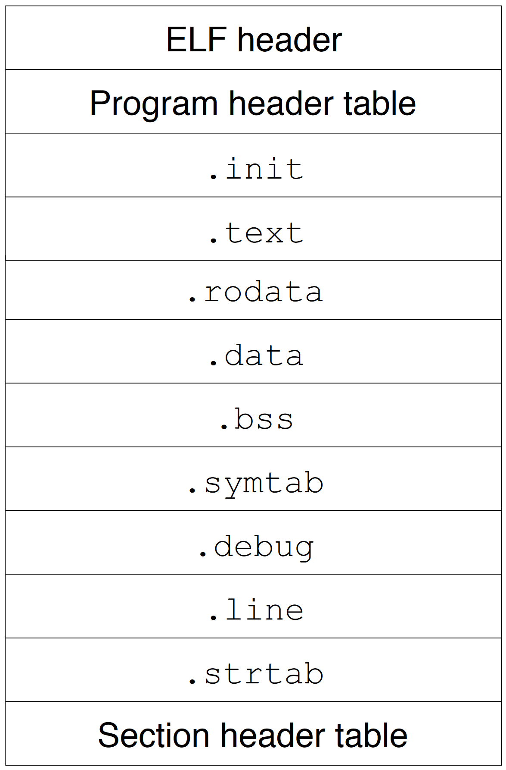
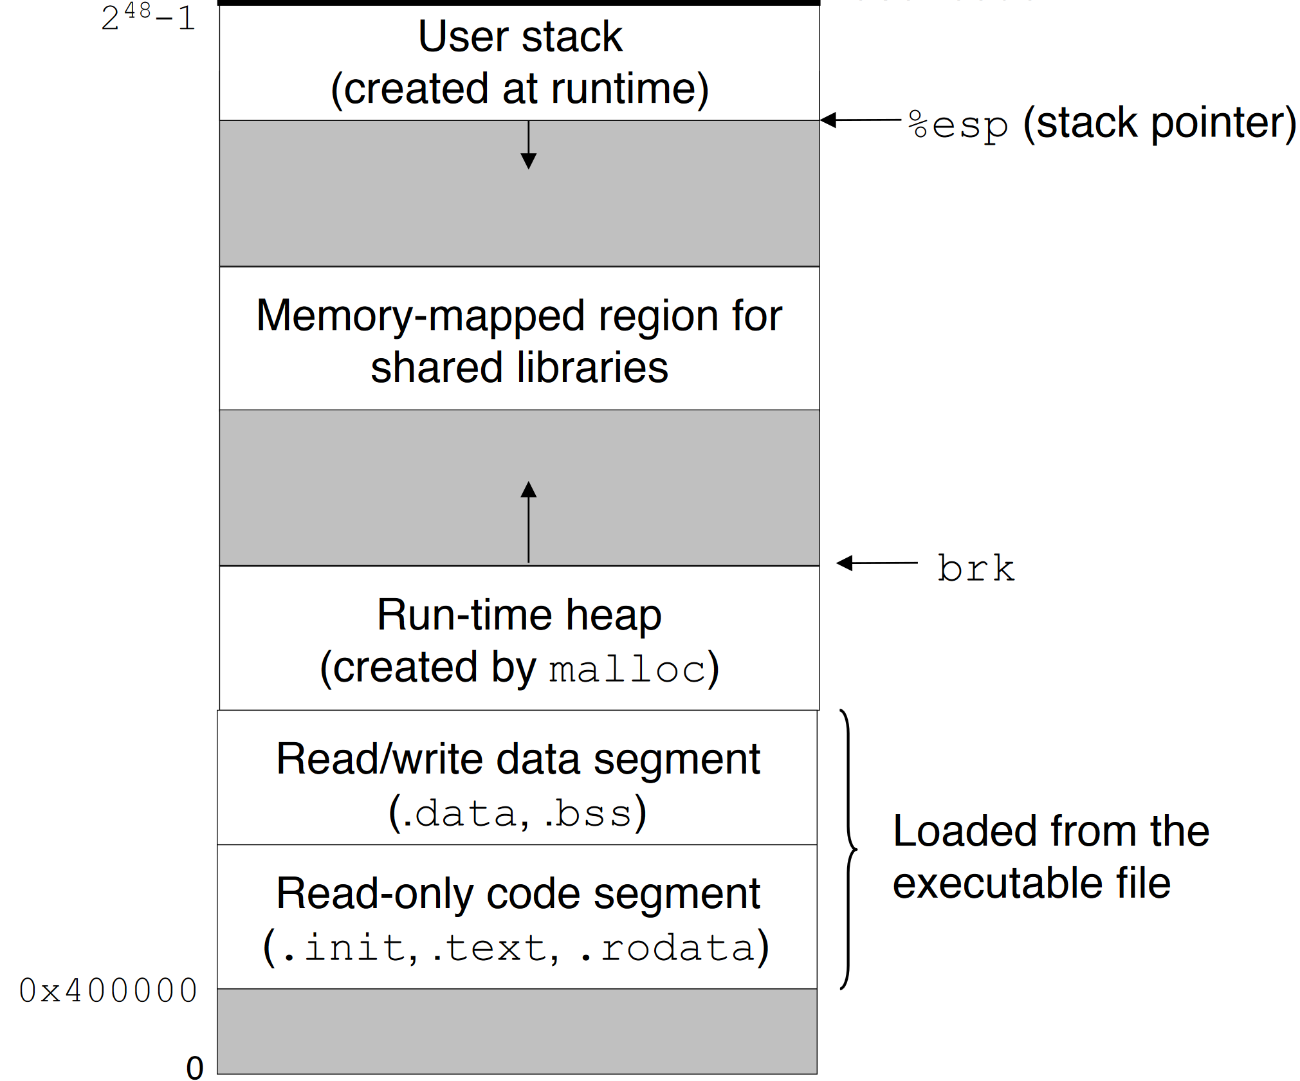
Setting up Process View of Memory
CSAPP 7.15

Slide 28
Memory Image of a Program
High Address
4
“csci”
18.93
Stack
#2048
Text: Instructions to execute
Global: Variables declared outside any function, static variables
Heap: Memory manually allocated and managed by the programmer
Stack: Automatic, push/pop frames with function calls
Stack and heap grow towards each other as they expand
If they collide => Stack Overflow Error
“hello”
Heap
“book”
19.93
Global
4815
cmpq (%rdx)
jmp #484
Text
movq %rax
Low Address

Slide 29
From Program to Process
(1) What does hardware give you?
Execution of a sequence of instructions
Storage in RAM
Other devices for input, persistent storage
(2) What does the operating system give you?
Multiple running programs taking turns on the CPU
An isolated address space through virtual memory
Files for persistent storage
(3) What does the C “runtime” give you?
Higher-level memory concepts like the stack and heap
Process

Slide 30


What is a Process?
If the OS is a “referee” then processes are the “players”
If the OS is an “illusionist” then processes are the clueless audience members
A process is an actively executing program and a live set of resources needed to support this execution
A unit of work
A unit of resource allocation and accounting
A boundary restricting and protecting running code
A process contains:
Its own address space (code, data, stack, heap, …)
An execution state (register values, including program counter)
A view of the file system (current working directory, set of open files and their positions, etc.)

Slide 31
Multiprogramming - Sharing CPU
There are far more active processes (~500-1000) on a typical OS than there are CPU cores
So: The OS enforces safe sharing of a CPU by giving processes finite-length turns to execute on the CPU
When do we switch from one process to another?
Current proc hits maximum turn length (quantum), typically 5-10 msec
Or it starts an operation it will have to wait for (e.g., read from disk, page fault)
P₁
P₂
P₃
P₄
P₃
P₁
Time

Slide 32
Multiprogramming - Sharing CPU
There are far more active processes (~500-1000) on a typical OS than there are CPU cores
So: The OS enforces safe sharing of a CPU by giving processes finite-length turns to execute on the CPU
Which process goes next? Up to the OS scheduler
Lots of algorithms for making this decision, take 5103 for more info
Bottom line: Programmer can’t control how their code will be scheduled
P₁
P₂
P₃
P₄
P₃
P₁
Time

Slide 33
Possible Process States
New: Being created
Ready: Eligible for execution but waiting for a turn
Running: In the middle of its turn on the CPU
Blocked: Waiting for some event, e.g., input from the user or completion of a disk operation
Done: Finished executing, no longer eligible for execution

Slide 34
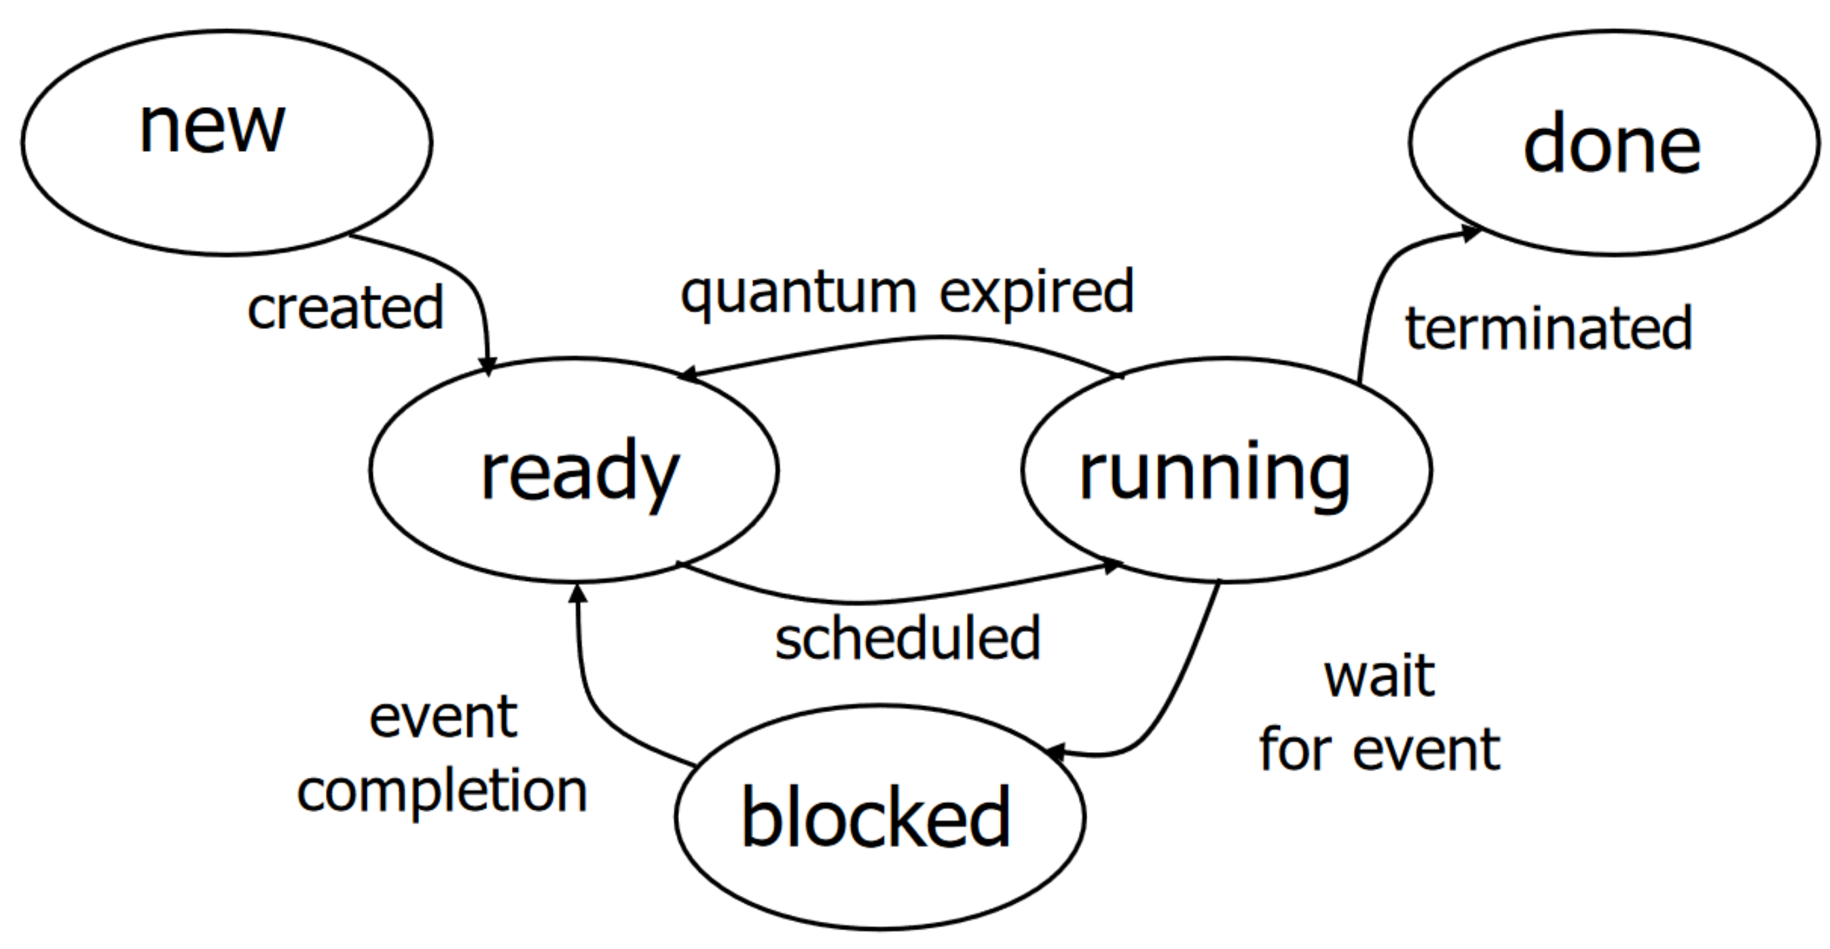
Process Lifecycle

Slide 35
Working with Processes
Each process has a unique numerical process ID (pid)
Lots of tools for managing your system are based around these IDs
Terminal commands for listing processes
ps: Show all running processes associated with this terminal session
ps a: Show all running processes on the machine
ps u: Show all processes for me (the current user)
Commands for signaling (usually terminating) processes
kill 1234: Send process with ID 1234 the TERM signal
kill -9 1234: Send process 1234 the KILL signal (you really mean it this time!)
<Ctrl-C>: Send current shell process the INT (interrupt) signal

Slide 36
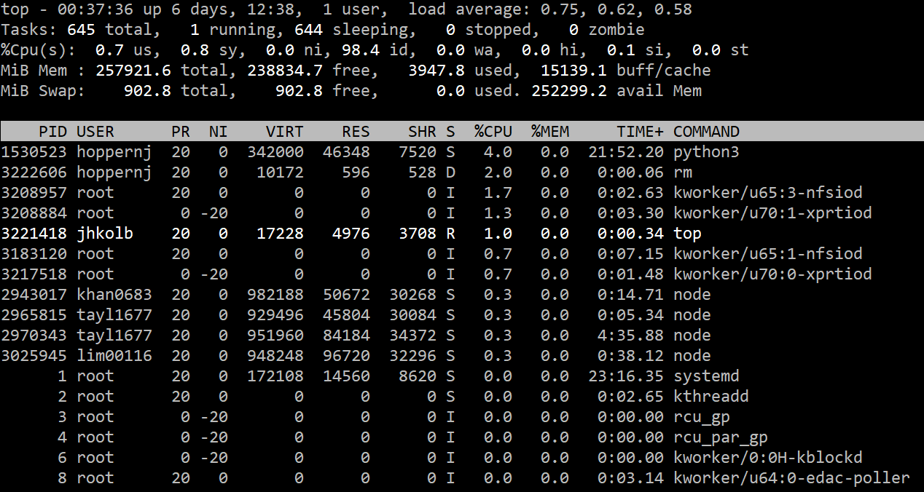
Monitoring Processes
Use the top command - comes installed by default

Slide 37
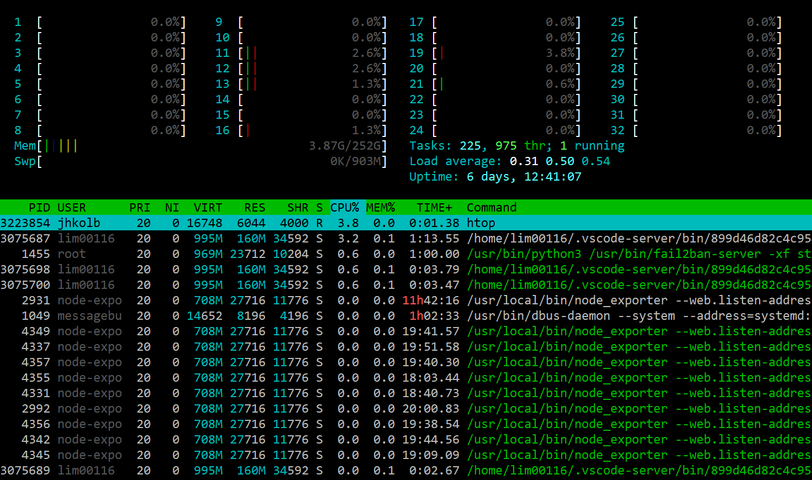
Monitoring Processes
But htop is better if it’s available to you

Slide 38
Our first system calls
Many system calls are just for retrieving info about current process
Get working directory: char *getcwd(char *buf, size_t size)
Get process ID: pid_t getpid()
Get parent’s process ID: pid_t getppid()
pid_t: A typedef for some numerical type
Any process is allowed to create other, new processes
Strictly speaking, allowed to ask OS to do this (system call)
This is what happens whenever we launch a new program
When one process creates another, it is the parent of the new process
All processes have just one parent

Slide 39
Process Family Tree
Say we run ./list_main from a graphical terminal window
Some process has to be at the root of this tree
Historically called init
Now, systemd
Started as part of the system’s boot procedure
Guaranteed to have pid 1
Treated specially by OS
Can’t be killed
Graphical Login (e.g., gnome)
Web Browser
Shell (bash)
VS Code
list_main

Slide 40
Process Creation: fork
System call to create a new process: pid_t fork();
Creates a complete copy of the calling process that inherits:
Parent’s address space contents (stack, heap, code, etc.) and register state
Parent’s current working directory
Parent’s open files
With one important exception: The return value of fork
In parent: return value is process ID of new child
In child: return value is 0
Negative return value: Error occurred, no child created
Weird way to think about this: fork is called once, but returns twice
Both parent and child continue on their ways, starting at return from fork call

Slide 41
Thinking Through fork
…
pid_t id = fork();
if (id == 0) {
printf(“Child process\n”);
} else {
printf(“Parent process\n”);
}
…
…
pid_t id = fork();
if (id == 0) {
printf(“Child process\n”);
} else {
printf(“Parent process\n”);
}
…
Takes a while to get used to this.
You now have to keep track of two separate paths through the same body of code!

Slide 42
What will get printed?
#1
Child process
Parent process
…
pid_t id = fork();
if (id == 0) {
printf(“Child process\n”);
} else {
printf(“Parent process\n”);
}
…
#2
Parent process
Child Process
#3
ChiParldent ProcProcess
ess
Super Important Systems Programming Principle: Program with weakest set of assumptions possible
No way to know what OS scheduler will pick to run first or how consistent this will be, so assume anything could happen

Slide 43
Exercise: Brain Melting with fork
For each of the three code snippets below:
How many processes are there by the end?
Draw a “family tree” of these processes
Assume fork always succeeds
#2
pid_t child_pid;
for (int i = 0; i < 3; i++) {
child_pid = fork();
if (child_pid == 0) {
break;
}
}
pid_t child_pid;
for (int i = 0; i < 3; i++) {
child_pid = fork();
}
#1
pid_t child_pid;
for (int i = 0; i < 3; i++) {
child_pid = fork();
if (child_pid != 0) {
break;
}
}
#3

Slide 44
Exercise: Brain Melting with fork
#1
pid_t child_pid;
for (int i = 0; i < 3; i++) {
child_pid = fork();
}
Original
i = 0
i = 1
i = 2
i = 1
i = 2
i = 2
i = 2

Slide 45
Exercise: Brain Melting with fork
#2
pid_t child_pid;
for (int i = 0; i < 3; i++) {
child_pid = fork();
if (child_pid == 0) {
break;
}
}
Original
i = 0
i = 1
i = 2

Slide 46
Exercise: Brain Melting with fork
#3
pid_t child_pid;
for (int i = 0; i < 3; i++) {
child_pid = fork();
if (child_pid != 0) {
break;
}
}
Original
i = 0
i = 1
i = 2

Slide 47
Exercise: What will get printed?
…
int x = 4061;
pid_t id = fork();
if (id == 0) {
printf(“Child x (%p) = %d\n”, &x, x);
x = 100;
printf(“Child x (%p) = %d\n”, &x, x);
} else {
printf(“Parent x (%p) = %d\n”, &x, x);
x = 200;
printf(“Parent x (%p) = %d\n”, &x, x);
}
Parent x (0x7fff908fe1c0) = 4061
Parent x (0x7fff908fe1c0) = 200
Child x (0x7fff908fe1c0) = 4061
Child x (0x7fff908fe1c0) = 100

