Slide 1
CSCI 4061 Lecture 4 Process Management
Instructor: Ali Anwar and Sam Fountain
Slides By: Jack Kolb
2025

Slide 2
Course Logistics
Quiz 2 posted on Canvas now,
Project 1 is out!
Significant C programming, File I/O
Lab 2 will help you prepare
Quiz due Friday on Canvas

Slide 3
Moving Around in a File
We can also explicitly ask to adjust the current position
int fseek(FILE *f, long offset, int whence)
offset: How far to move
whence: Fancy term for our starting point (e.g., SEEK_CUR means current spot)
Use the ftell() function to ask what the current position is
fseek()
fread()
fread()
fopen()

Slide 4
From Program to Process
(1) What does hardware give you?
Execution of a sequence of instructions
Storage in RAM
Other devices for input, persistent storage
(2) What does the operating system give you?
Multiple running programs taking turns on the CPU
An isolated address space through virtual memory
Files for persistent storage
(3) What does the C “runtime” give you?
Higher-level memory concepts like the stack and heap
Process

Slide 5
Multiprogramming - Sharing CPU
There are far more active processes (~500-1000) on a typical OS than there are CPU cores
So: The OS enforces safe sharing of a CPU by giving processes finite-length turns to execute on the CPU
When do we switch from one process to another?
Current proc hits maximum turn length (quantum), typically 5-10 msec
Or it starts an operation it will have to wait for (e.g., read from disk, page fault)
P₁
P₂
P₃
P₄
P₃
P₁
Time

Slide 6
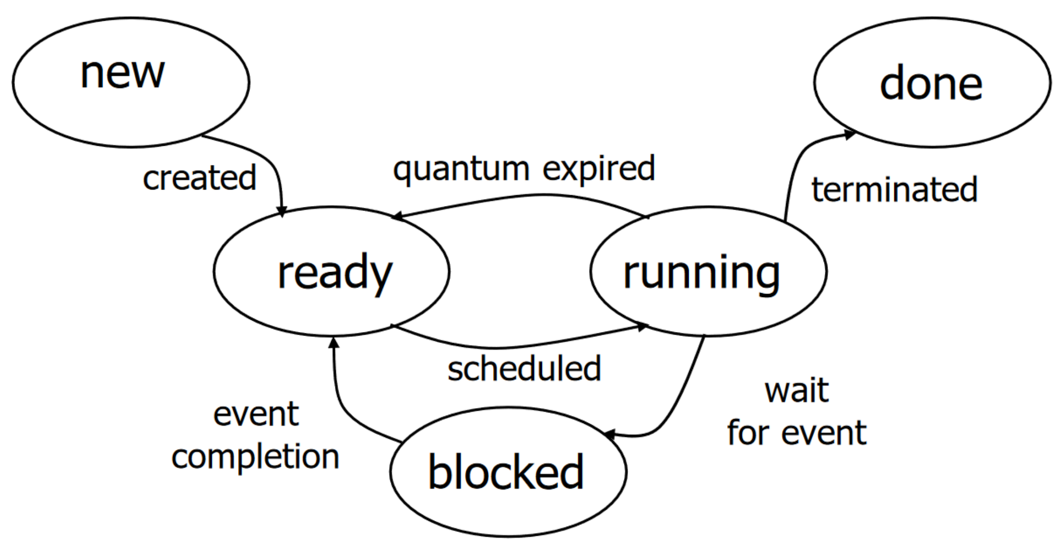
Process Lifecycle

Slide 7
Working with Processes
Each process has a unique numerical process ID (pid)
Lots of tools for managing your system are based around these IDs
Terminal commands for listing processes
ps: Show all running processes associated with this terminal session
ps a: Show all running processes on the machine
ps u: Show all processes for me (the current user)
Commands for signaling (usually terminating) processes
kill 1234: Send process with ID 1234 the TERM signal
kill -9 1234: Send process 1234 the KILL signal (you really mean it this time!)
<Ctrl-C>: Send current process the INT (interrupt) signal

Slide 8
Some Clarification on Signals
The kill command sounds cool but is a bad name
It doesn’t terminate a process, it sends that process a signal
Unfortunately, system call for sending a signal has the same name ☹
Signal: Software event notification
Receiving a signal doesn’t mean instant death for a process
Could be for information purposes: “That thing you care about has actually happened now”
We’ll learn how to customize our code’s response to signals later on
Yes, this means you can write code to ignore Ctrl-C
But it’s usually considered bad form
Notes:
Signal is a software event notification. An interupt is a hardware event notification.

Slide 9
Process Family Tree
Say we run ./list_main from a graphical terminal window
Some process has to be at the root of this tree
Historically called init
Now, systemd
Started as part of the system’s boot procedure
Guaranteed to have pid 1
Treated specially by OS
Can’t be killed
Graphical Login (e.g., gnome)
Web Browser
Shell (bash)
VS Code
list_main

Slide 10
Process Creation: fork
System call to create a new process: pid_t fork();
Creates a copy of the calling process that inherits:
Parent’s address space (stack, heap, code, etc.) and register state
Parent’s current working directory
Parent’s open files
With one important exception: The return value of fork
In parent: return value is process ID of new child
In child: return value is 0
Negative return value: Error occurred; no child created

Slide 11
Recall: Brain Melting with fork
#1
pid_t child_pid;
for (int i = 0; i < 3; i++) {
child_pid = fork();
}
Original
i = 0
i = 1
i = 2
i = 1
i = 2
i = 2
i = 2

Slide 12
Exercise: What will get printed?
…
int x = 4061;
pid_t id = fork();
if (id == 0) {
printf(“Child x (%p) = %d\n”, &x, x);
x = 100;
printf(“Child x (%p) = %d\n”, &x, x);
} else {
printf(“Parent x (%p) = %d\n”, &x, x);
x = 200;
printf(“Parent x (%p) = %d\n”, &x, x);
}
Parent x (0x7fff908fe1c0) = 4061
Parent x (0x7fff908fe1c0) = 200
Child x (0x7fff908fe1c0) = 4061
Child x (0x7fff908fe1c0) = 100

Slide 13
Something Else to Consider
When I run a built in command, we can just type its name > ls > make
But when we run our own programs, we have to specify an exact file > ./list_main > ./minitar …
But many commands are programs just like anything else > which ls /usr/bin/ls
What makes built in commands special?
Notes:
22 Minutes

Slide 14
Environment Variables
The operating system maintains a list of configuration options called environment variables
Each environment variable has a name and a value
Example: The EDITOR variable specifies the default text editor
Launched by, e.g., git when you need to write a commit message
Each process has its own environment (values for env. vars)
A process inherits the environment of its parent

Slide 15
The PATH Environment Variable
Environment variables often tell the OS where to look for things
LD_PRELOAD: Look for custom libraries to interpose
LD_LIBRARY_PATH: Look for libraries to use for linking (besides default folders)
PATH is arguably the most important environment variable
Tells OS where to look for “built in” programs
These programs implement the commands we all know and love: ls, make, …
If you invoke a command without specifying a directory path, OS searches through the folders in PATH to find program with matching name
ls, cp etc. aren’t magic
They are programs like anything else
But they are stored in a directory listed in the PATH environment variable

Slide 16
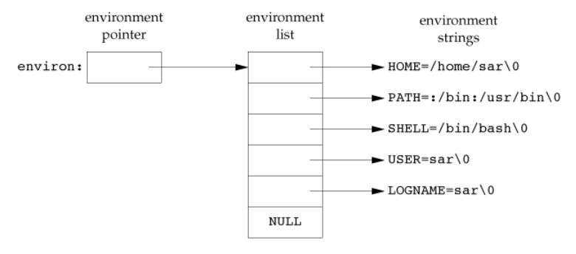
Changing Your Environment
Environment is available in a global variable char **environ
Better to use library functions to set/get variables instead:
setenv()
getenv()
unsetenv()

Slide 17
Becoming More than a Clone: exec
Don’t do what your parents do, become an instance of any program you want to be!
int execv(char *path, char *argv[])
path: Executable file to load from
argv: Command-line arguments this process should see, with NULL sentinel
There are 6 (!) variants of exec, each with different arguments
execl: Pass program arguments as individual parameters, not array
execle/execve: e is for Environment -- specify custom env vars
execlp/execvp: p is for PATH -- search for program name in PATH folders
execvpe: Use PATH for search, specify environment

Slide 18
Running a command
execl(“/bin/ls”, “ls”, “-l”, NULL)
By convention, first argument is name of program
NULL comes at end as a sentinel value (kind of like strings in C)
What happens to the process now?
exec overwrites process memory image inherited from parent
Process starts again from scratch with clean slate:
New code, program counter, stack
New arguments, (possibly) new environment
Notable Exception: Open Files
exec doesn’t return unless an error has occurred

Slide 19
Ending a Process
One way you have probably seen: return from main()
Can achieve same effect from any function by calling exit(int status)
Exit value of 0 means success
Any non-zero value means an error occurred
Lots of cleanup happens on an exit: close any open files, tear down virtual address space
In bash shell, type echo $? to get exit code of last command
If you just want to bail out ASAP, can call abort() function
exit with nonzero: Something undesirable happened (e.g., file to open didn’t exist) but we can get to a clean stopping point
abort: Just give up now

Slide 20
“Waiting” for a Process
An exit code is like a very limited “return” capability
Allows process to communicate a number indicating what happened
How do we obtain this code and react to it? pid_t wait(int *status);
Called by a parent to wait for a child
The process ID of the child is returned
Child’s exit code is placed in location pointed to by status
Great example of a blocking operation
Process calls wait, cannot make progress until child terminates
Its turn on CPU is over, OS won’t run it again until wait can return

Slide 21
Exercise: Writing a Program to Run Programs
Say we want to write code that does the following:
Wait for the user to type in a program to run and arguments for that program
Run the program with the provided arguments
Once the program is done, print out its exit code on the screen
Repeat: wait for more input and run another program
How would you write this? Which functions/sys calls would you use?
Notes:
Start 37 Min
End 40

Slide 22
Exercise: Writing a Program to Run Programs
Say we want to write code that does the following:
Wait for the user to type in a program to run and arguments for that program -> scanf(), strtok()
Run the program with the provided arguments -> fork(), exec()
Once the program is done, print out its exit code on the screen wait()
Repeat: wait for more input and run another program

Slide 23
Waiting for a Child
wait()
Parent
Running
Blocked
Ready
fork()
exec()
exit()
Child
New
Running
Running
Done

Slide 24

The Shell
When you are using “the terminal”, you are interacting with a shell process
On Ubuntu and many other places, this is bash by default
Main job of the shell: read your input, launch a program, repeat
No magic here
Not part of the OS, just a regular old program

Slide 25
“Waiting” for a Specific Process
wait will block until any child exits
An alternative allows you to wait for a specific child: pid_t waitpid(pid_t pid, int *status, int opt)
Wait for pid and store exit code at status
Also some special values you can pass in, see the man page for info
opt allows for some interesting customization
WNOHANG: Don’t block. Check if child is done, but if not return 0 and continue on to next line of code
Quick check: in our simple shell from before, do we need waitpid or is wait sufficient?

Slide 26
Thinking about Ordering
Parent calls fork()
Child runs for a bit, maybe calls exec()
Parent calls wait()
Child runs, calls exit()
Parent’s call to wait() can now return with child’s exit code
Remember: we can’t assume order in which the scheduler gives the CPU to processes
Parent calls fork()
Child runs for a bit, maybe calls exec()
Child runs, calls exit()
Parent calls wait()
???
Need to keep a dead process around in case its parent will wait for it

Slide 27
Where Operating Systems Naming Gets Weird
Processes can fall into one of the following categories in certain circumstances
Daemons
Orphans
Zombies
Depends on timing of when process terminates and when/if its parent waits on it

Slide 28

Zombie Processes
Parent forks a child
Child exits before parent waits
Child becomes a zombie
Parent waits for child
Zombie eliminated
Why? Need to keep child around so we can provide its exit code
Only once wait is done can we fully remove child and all of its info from the system
Just wait and all the zombies will be gone

Slide 29

Daemon Processes
A daemon is a process that is always running in the background to provide a service
Parent forks child, never waits for it (it’s never expected to exit)
Often sits and waits for input, then does work on that input
Web Server (httpd)
Print Server (lpd)
SSH Server (sshd)
Acting as Referee and Illusionist for a Daemon

Slide 30

Orphan Processes
If a parent terminates while its child is still running, that child becomes an orphan
Implies: Parent never waited on the child
So when orphans die, they all become zombies?
When a process becomes an orphan, it is adopted by init (or systemd)

Slide 31

init: Hero or Villain?
Root of the process tree: ancestor of all other procs
Generously adopts all those orphans
Then acts as a “reaper” when those orphans die (waits for them to allow full cleanup)
But they would’ve been zombies otherwise

Slide 32
fork() without an exec()
May seem as if a call to fork() is nearly always followed by a call to exec() in the new child process
Programs that use fork() without exec() are quite useful
Case 1: Enables a simple means of parallelism -- doing multiple streams of work at the same time
Example: Analyzing data from multiple files at once
Primary Process
fork()
Worker Process 1
Worker Process 2
…
Worker Process n
file 1
file 2
file n

Slide 33

Multi-Process Web Browsers
Another prominent example: web browsers
Chrome introduced the model of one OS process per tab with its release back in 2008
Primary Process
Tab Process 1
Tab Process 2
…
Tab Process n

Slide 34
Multi-Process Web Browsers
Why did Chrome do this?
Each process gets its own address space => better isolation between different browser tabs
One tab can’t read/write another tab’s data
Fault in one tab doesn’t crash entire browser
Google marketed this heavily in Chrome’s early days
A bit humorous to see their hand-wavy explanations of isolation
And attempting to market the concept of a process (an OS idea for 50 years at this point) as a cutting-edge innovation

Slide 35
Threads and Processes
Both are ways to enable multiple streams of execution at once
Threads in same process share an address space
Saw this in our exercise earlier when all threads could access same array
Easy cooperation, better efficiency, but less isolation
Browsers originally used threads for multiple tabs
Each process gets its own address space
Better isolation, but less efficient
This is part of why Chrome consumes so much memory
Chrome is one application supported by multiple processes
Blurs the idea of one process per “running program”

Slide 36
Multi-Process Browsers
Primary Process
Tab Process 1
Tab Process 2
…
Tab Process n
How do processes coordinate their work?
Can’t see each other’s memory, so we need some way to exchange data between different processes
Only way we’ve seen so far: exit() and wait() to “return” a number
We’ll see much more flexible tools when we cover Interprocess Communication (IPC)

