Slide 1
CSCI 4061 Lecture 6 Advanced I/O, Redirection
Instructor: Ali Anwar and Sam Fountain
Slides By: Jack Kolb
2025

Slide 2
Course Logistics
Quiz 3 posted on Canvas now
Project 1 is out
Significant C programming, File I/O
Final Submission on (Gradescope)

Slide 3
Moving from stdio to I/O System Calls
Major changes when we want to use system calls directly:
Function names drop leading f, e.g., fopen() -> open()
We have to get much more specific on how file is opened
O_CREAT|O_TRUNC|O_WRONLY as opposed to “w”
S_IRUSR|S_IWUSR What’s the deal with that?
Sizes to read and write are directly in bytes as opposed to “elements”
Each write we invoke corresponds directly to a system call

Slide 4
Options for open()
Important Options:
O_RDONLY: Read only O_WRONLY: Write Only O_RDWR: Read/write
O_CREAT: Create the file if it doesn’t exist already
O_TRUNC: If the file already exists, “truncate” it to length 0 (delete old version)
O_APPEND: Open the file with current position at end
O_EXCL: Return an error if trying to create a file that already exists
This gives you much more control than fopen()
Want to make a file only if it isn’t already there? O_CREAT | OEXCL
Want to update a file starting from beginning? O_WRONLY
fopen() with “w” mode is equivalent to O_CREAT | O_WRONLY | O_TRUNC

Slide 5
Representing File Permissions
Permissions are encoded as a bit vector:
Customarily use octal to represent each permission
User Read = 400 User Write = 200 User Execute = 100
Group Read = 040 Group Write = 020 Group Execute = 010
Other Read = 004 Other Write = 002 Other Execute = 001
User
Group
Other
r
w
x
r
w
x
r
w
x

Slide 6
Reading and Writing in Chunks
#define BUFSIZE 4
char buf[BUFSIZE + 1];
int in_fd = open(“message.txt”, O_RONLY);
// Error handling omitted for brevity
int nbytes;
while ((nbytes = read(fd, buf, BUFSIZE)) > 0) {
buf[nbytes] = ‘\0’;
printf(“%s\n”, buf);
}
close(in_fd);
Start at position 0
read() consumes 4 bytes, returns 4
“ABCD” is printed
read() consumes 4 bytes, returns 4
“EFGH” is printed
read() consumes 2 bytes, returns 2
“IJ” is printed
Nothing left, read() returns 0
Close file descriptor
A
B
C
D
E
F
G
H
I
J

Slide 7
Buffering
A buffer (noun) is a temporary chunk of memory where we store information that was just read in or is about to be sent out char buf[BUFSIZE]; -- Allocating a buffer on the stack
Buffering (verb) is the technique of accumulating pending I/O operations until there is a chunk to read/write all at once
Fully Buffered (e.g., files on disk): Defer completing a sequence of reads/writes until a buffer (maintained within kernel, e.g., in inode table) is completely full
Line Buffered (e.g., stdin, stdout): Data written only when newline provided
Unbuffered (e.g., stderr): Data written immediately

Slide 8
Buffering Principles
Hardware Write
File on Disk
fwrite()
Buffer in User Memory
write()
Buffer in Kernel Memory
char buf[BUFSIZE];
In both cases (fwrite, write) we buffer to improve performance
How? If we are going to do something very expensive (system call, disk operation), maximize our benefit!
Only initiate an operation when there is lots of work to get done, avoid many small operations
As a programmer, should you use stdio or system calls directly?
Default to stdio unless you have a reason not to

Slide 9
Anatomy of a FILE Structure (stdio)
FILE *fp = fopen(“message.txt”, “w”);
char *m = “Hello World!”;
fwrite(m, sizeof(char), strlen(m), fp);
fp
“Hello World!”
Buffer
3
File Descriptor

Slide 10
Process File Descriptor Table
The file descriptor returned by a call to open() is an index into that process’s file descriptor table int fd = open(“test.tar”, O_RDONLY);
Kernel Memory
System File Table
fd
Process File Descriptor Table
3
STDIN_FILE_NO = 0
STDOUT_FILE_NO = 1
STDERR_FILE_NO = 2
test.tar = 3
4
⁞
⁞
Other Process FD Tables

Slide 11
System File Table
Each process gets its own file descriptor table with entries pointing to one globally shared system file table
Maintained by OS in memory while your computer is up and running - area visible to kernel only
One entry per actively used file (after open, before close)
File Offset (“position” we’ve been talking about all this time)
Access mode (read only, write only, read/write)
Number of fds pointing to this entry (reference count) ???
Pointer to inode-table entry for file ???
Reference count starts at 1
If two processes call open on same file, they each get a sys file table entry
Both entries have reference count == 1

Slide 12
Inode Table
Also maintained in kernel memory while system is running
Each entry corresponds to a physical file on disk
All processes using that file point to same inode table entry
System File Table
Inode Table
Each entry contains
File metadata (size, on-disk location, etc.)
Reference count
What’s an inode?
More next week!
open(“test.tar”, …)
open(“test.tar”, …)
Process FD Table
System File Table
Inode Table
Process FD Table
Process FD Table
Process FD Table

Slide 13
Exercise: File Tables and Operations
Say we have two unrelated processes (neither is a parent or child of the other) that magically run the following code at the same time:
int fd = open(“test.txt”, O_RDWR);
char buf[8];
read(fd, buf, 8);
write(fd, buf, 8);
Assume no other process has this file open, ignore errors
How many process file descriptor table entries are created?
How many system file table entries are created?
How many inode table entries are created?
What does the file contain at the end?
File Contents at Start:
ABCDEFGH

Slide 14
Exercise: File Tables and Operations
Process A
fd
FD Table
System File Table
Inode Table
File: “test.txt”, offset: 0
test.txt
Process B
fd
FD Table
File: “test.txt”, offset: 0

Slide 15
What about now?
What if we have an open file and then call fork()?
int fd = open(“test.txt”, O_RDWR);
fork();
char buf[8];
read(fd, buf, 8);
write(fd, buf, 8);
Assume no other process has this file open, ignore errors
How many process file descriptor table entries are created?
How many system file table entries are created?
How many inode table entries are created?
What does the file contain at the end?
File Contents at Start:
ABCDEFGH

Slide 16
Exercise: File Tables and Operations
Parent
fd
FD Table
System File Table
Inode Table
File: “test.txt”, offset: 0
test.txt
Child
fd
FD Table

Slide 17
Child Processes Inherit File Descriptors
Child gets a copy of parent’s address space after a fork()
This includes the file descriptor table
What this means: Same file descriptor in parent and child refers to same entry in system-wide file table
Consequences of this:
Set of processes open in parent at time of fork() are also open in child
The file offset is also shared between parent of child
Parent and child “share” reads, writes, and seeks
A read/write/seek in one process modifies the offset for both processes

Slide 18
What about now?
What if we have an open file and then call fork()?
What does file contain at end?
One possible outcome:
Process A reads “ABCDEFGH”, offset = 8 (End of File)
Process A writes “ABCDEFGH”, offset = 16 (End of File)
Process B read fails (at end of file)
Process B writes uninitialized contents (garbage) of buf to the file
int fd = open(“test.txt”, O_RDWR);
fork();
char buf[8];
read(fd, buf, 8);
write(fd, buf, 8);
File Contents at Start:
ABCDEFGH
This kind of code is possible but not recommended (gets confusing!)
What’s another possible sequence of events?

Slide 19
Concurrent File Access
Files on a computer are a globally shared resource
All processes see the same set of files
What happens if multiple unrelated processes are accessing same file?
POSIX File Semantics dictate what happens
Short version: Once a write system call has completed, its effects are immediately visible to any read of the file’s data
Even writes from different processes are visible to each other
Works even when some changes are in OS kernel buffers, not on disk yet
All processes see same file size (End of File is in same place)
These are actually very strong guarantees, difficult to implement
Windows does not offer the same set of capabilities

Slide 20
Single Writer, One or Many Readers
Writer Process
File
read() returns 0
Reader Proc. 1
Reader Proc. 2
Reader Proc. 3

Slide 21
Single Writer, One or Many Readers
Writer Process
write() adds data to file
File
read() returns data just added
Reader Proc. 1
Reader Proc. 2
Reader Proc. 3

Slide 22
What about multiple writers?
What if two processes call write() to change same file at same time?
What will the file look like to any readers?
Now or later on
Writer 1
Writer 2
1 before 2:
2 before 1:
write()
write()
Interleaved:
Overlapped:

Slide 23
Atomic Operations
An operation is atomic if it is either executed to full completion or not executed at all
“All Or Nothing”
No partial effects
A Huge theme in systems and systems programming
Operating Systems, Networking, Databases
Ideal world: write() is atomic
Will be complete before another write() gets to start
Note: Still doesn’t say anything about relative order of write() ops
Writes will be cleanly one after another in some order
OS chooses some ordering (serializes writes) but it’s out of our control

Slide 24
Multiple File Writers and Readers
What happens when two different processes write to same file?
Posix doesn’t make any guarantees here
ext4 (Arguably most common Linux file system): Can set some special options in an open() call and get atomicity on writes up to 4096 bytes
What about two threads in the same process?
Posix says: Yes, reads and writes should be atomic
But ext4 does not adhere to this expectation
So yes in theory, no in practice

Slide 25
Files for Interprocess Communication
If we want to write a fancy multi-process application, we need a way for processes to exchange data
A file is one possible way to do this:
Send data to other processes by writing to a file
Receive data from other processes by reading from a file
But it’s a bad one:
Probably just need temporary storage while processes are up and running
But files consume space on disk and are permanent (could delete at end of program, but that’s more complexity to deal with)

Slide 26
Files for Interprocess Communication
Another reason this won’t work: How does a reader know when there is data present in the file to be consumed?
Writer Process
Problems
No way to notify readers of new data
No easy way for a reader to wait until data is available
write() adds data to file
File
read() returns 0
Reader Proc. 1

Slide 27
Polling vs. Interrupt-Based Design
We want to write code that will react when an event has occurred
In this case: Arrival of new data for current process to read
Polling: Periodically check status and react if you see that event has now occurred
Interrupts: Set up a notification that will alert you when event has occurred
Careful: Interrupts are a specific thing - a notification from a hardware device to the OS that something has happened (e.g., disk I/O has finished)
Interrupt-based programming is a style of code/API inspired by this

Slide 28
Polling vs. Interrupts
So, we are stuck with polling in this model: char buf[1024]; while (read(fd, buf, 1024) == 0) { sleep(1); // Block for 1 sec. }
We’ve already seen one example where we could use a polling approach:
int status; waitpid(-1, &status, W_NOHANG);

Slide 29
Looking Ahead: Pipes
We’ll see more about this later on
A pipe is an OS-supported channel for communication between different processes
API is very similar to file I/O
Information is sent with write(), received with read()
Data stored in memory, no wasting (or waiting for) the disk
A read() will block until there is something useful to consume

Slide 30
Back to File Descriptor Table
The file descriptor returned by a call to open() is an index into that process’s file descriptor table int fd = open(“test.tar”, O_RDONLY);
Kernel Memory
System File Table
fd
Process File Descriptor Table
3
STDIN_FILE_NO = 0
STDOUT_FILE_NO = 1
STDERR_FILE_NO = 2
test.tar = 3
4
⁞
⁞
Other Process FD Tables

Slide 31
dup(): Duplicate a File Descriptor
Used to make a copy of the specified file descriptor int new_fd = dup(old_fd);
Kernel Memory
System File Table
old_fd
Process File Descriptor Table
3
STDIN_FILE_NO = 0
STDOUT_FILE_NO = 1
new_fd
STDERR_FILE_NO = 2
test.tar = 3
4
test.tar = 4
⁞
⁞
Quick check: do new_fd and old_fd share a file offset (position)?

Slide 32
dup2(): Duplicate a File Descriptor
int dup2(int oldfd, int newfd);
A “targeted” version of dup(), changes newfd into a copy of oldfd
Automatically does close(newfd) if it corresponds to an open file
A better function signature would be: int dup2(int source_fd, int target_fd);
Good luck remembering the order of arguments! Just use man pages
Very useful in combination with fork()
And file descriptors also survive a call to exec()

Slide 33
Redirecting Output
On the terminal, you can redirect the output of any command to the terminal like so: > ls -l > ls_out.txt
> cat ls_out.txt
total 118
-rw------- 1 jhkolb CS-Faculty 1634 Sep 24 10:11 file_list.c
-rw------- 1 jhkolb CS-Faculty 1047 Sep 26 14:33 file_list.h
-rw------- 1 jhkolb CS-Faculty 977 Sep 26 14:39 Makefile
-rw------- 1 jhkolb CS-Faculty 4736 Sep 26 16:13 minitar.c
-rw------- 1 jhkolb CS-Faculty 3350 Sep 26 14:33 minitar.h
-rw------- 1 jhkolb CS-Faculty 444 Sep 26 21:31 minitar.c …

Slide 34
Exercise: Output Redirection
Write code that simulates behavior of the shell in the previous example:
Run ls -l in a child process
Ensure that the output of ls -l goes the file ls_out.txt
The parent should print Command Done on screen once child is finished
Ingredients you will need:
fork()
exec()
wait()
open()
STDOUT_FILENO
dup2()

Slide 35
Duplicating File Descriptors
int dup2(int source_fd, int target_fd);
Kernel Memory
System File Table
out_fd
Process File Descriptor Table
3
STDIN_FILE_NO = 0
STDOUT_FILE_NO = 1
STDERR_FILE_NO = 2
3
4
⁞
⁞

Slide 36
Output Redirection
Built in file descriptors don’t get special treatment
We can use them in calls to dup2() like anything else
dup2(regular_old_fd, STDOUT_FILENO) redirects stdout to open file from regular_old_fd
Process thinks it is printing to the screen, really just appending to file
Both are fundamentally a write() system call, to different destinations
Take a moment to appreciate this
We can change destination of a program’s output without making any changes to its code
One of the reasons why file descriptors survive an exec()

Slide 37
Taking this Further
Command-Line “Pipes” get their name from the pipe OS feature (for interprocess communication) mentioned earlier
Example: ls -l | sort
Output (normally stdout) of ls -l is “piped” as input (normally stdin) to the sort command
Part of the beauty of the “Unix Philosophy”: Composing (combining) small, sharply focused tools to achieve big things
How does this work? We can already take an educated guess
Shell process forks children to run these commands, uses pipes and dup2() to allow ls program to communicate with sort program via “printing”

Slide 38
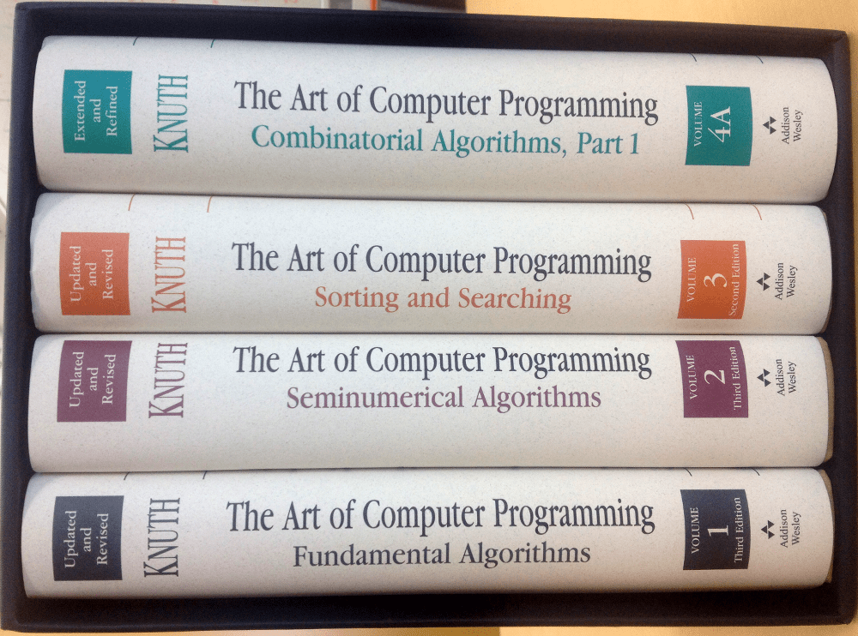
Bit of Fun History
Donald Knuth is considered one of the greatest programmers of all time (many would say the greatest)
He wrote an article all about how to properly write and design code from the ground up to solve a specific problem: Read in a text file and print out the 10 most frequently used words in that file, sorted from most to least frequent
Solution is extremely clever, uses a custom data structure just for this problem, etc. -> 10 book pages of code
The Art of Computer Programming, A Foundational CS Work

Slide 39
Unix Approach to the Same Problem
His explanation:
Put each word on its own line by converting the complement of the alphabet (-c) into newlines, squeezing repeated newlines (-s) into one
Convert uppercase to lowercase
Sort lines to bring identical words together
Replace each run of duplicate words with a single word and include the count (-c)
Sort in reverse (-r) numeric (-n) order
Print out only the first 10 lines
Doug McIlroy’s solution:
1 tr -cs A-Za-z '\n’ |
2 tr A-Z a-z |
3 sort |
4 uniq -c |
5 sort -rn |
6 head -n 10

Slide 40
Some Useful Recipes
Figure out which subdirectories are taking up the most space (e.g., to free up room for your quota): du -d 1 -h . | sort -h -r
Revert all files that have been modified since the last git commit: git status | grep modified | awk ‘{print $2}’ | xargs git checkout
Easier ways to do this last one, but shows power of the command line
grep and awk are two especially useful tools you may want to investigate

