Slide 1
OurApp
App Trader Analysis

Slide 2
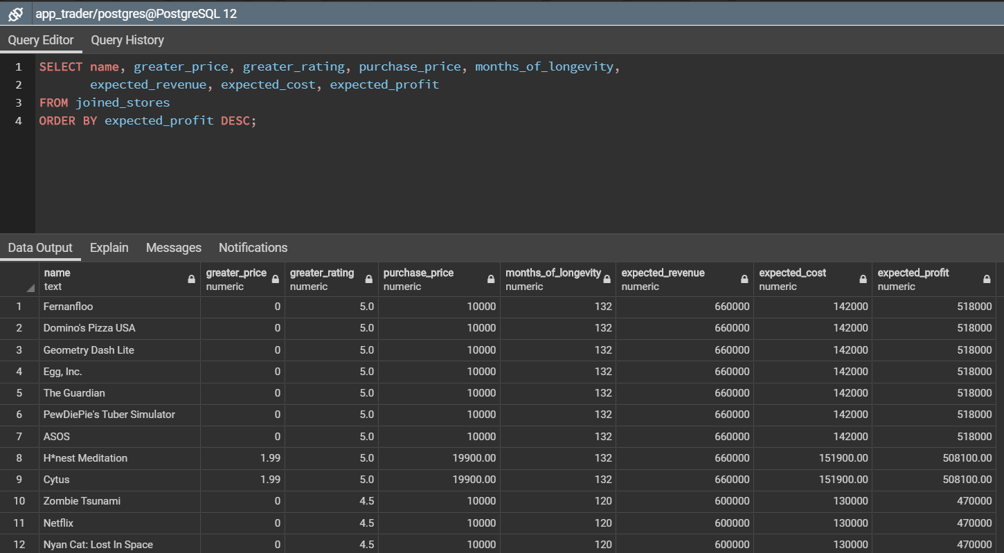
This is the final results of our analysis, in the next slides we’ll show you how we arrived at this list of top 10 (and other strong candidates).

Slide 3
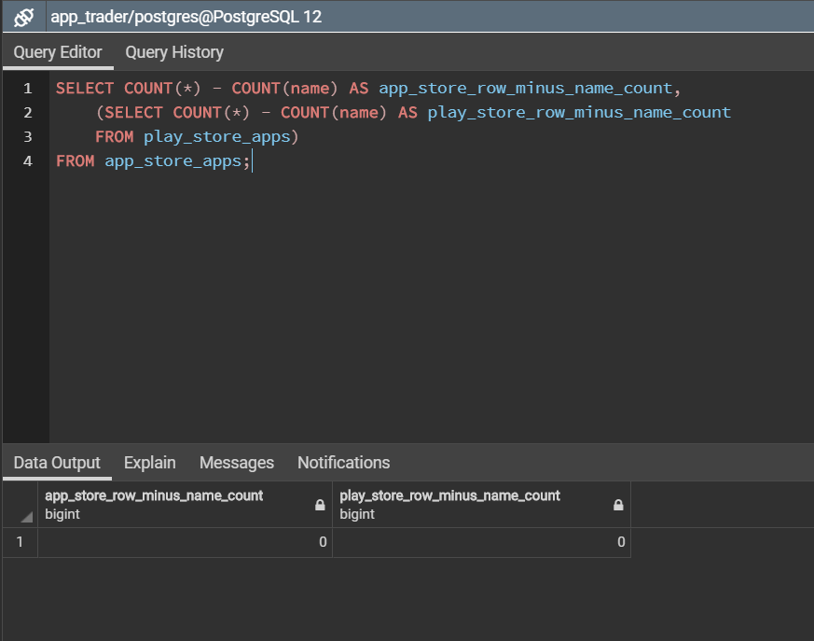
Does every row in each app store have a value for name?
Using a subquery in the SELECT statement and selecting the count of rows minus the count of names shows us that every row in both stores has a value for name.

Slide 4
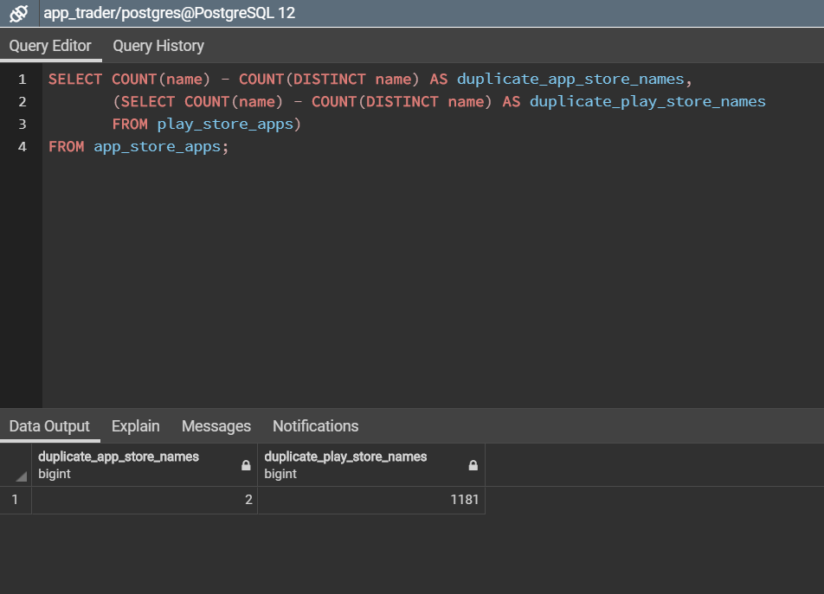
Are there duplicates for name in either app store?
We used a COUNT – DISTINCT COUNT SELECT statement with a subquery in SELECT to find that the app store only had 2 duplicate names while the play store had 1181 duplicate names.

Slide 5
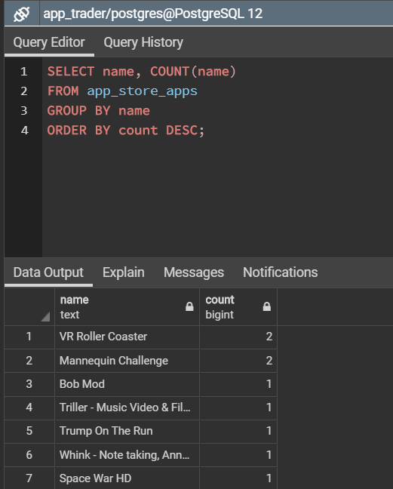
This query (and one like it) were used to show the names of duplicate apps in the app_store_apps table and the play_store_apps table.

Slide 6
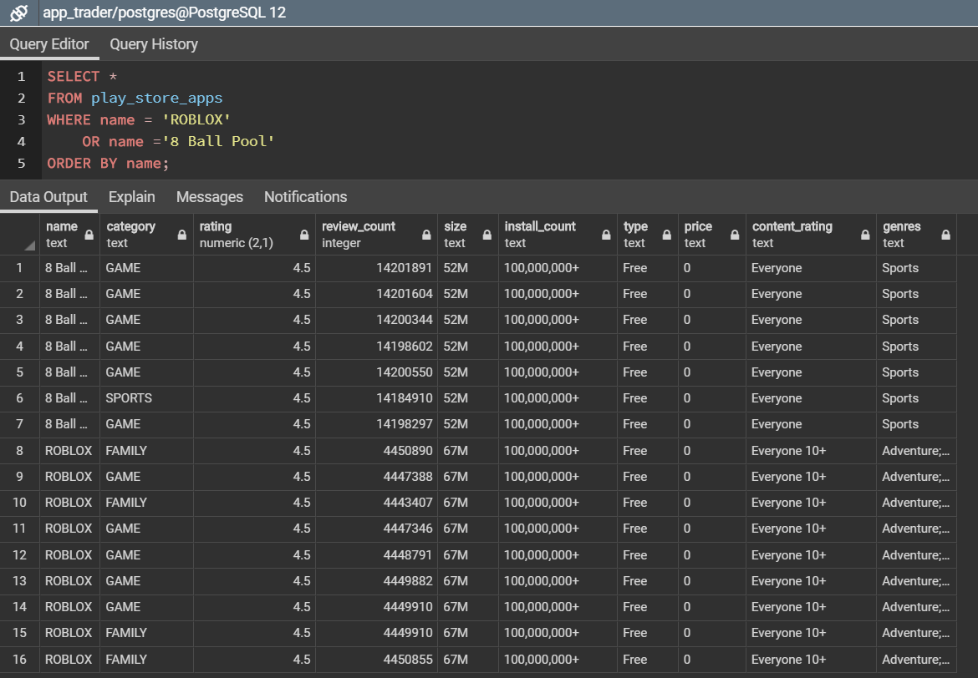
A review of all the rows of a couple of apps identified in the play store as duplicates showed substantial overlap in many categories within an app. This lead our team to decide group these apps as they were likely copies.

Slide 7
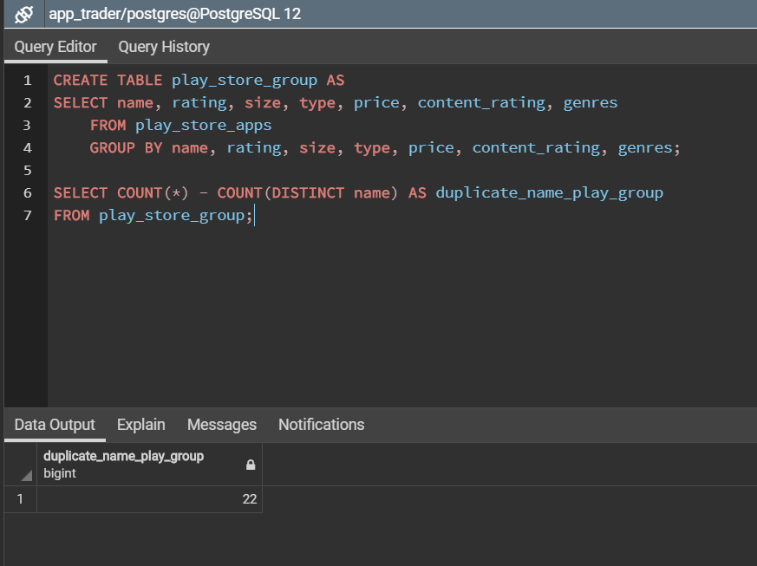
We elected to group the play store apps on name, rating, size, type, price, content_rating, and genres. If these values were the same the records would become one row in our new table.
After running these queries the number of name duplicates in our new play_store_group table was 22, much more manageable.

Slide 8
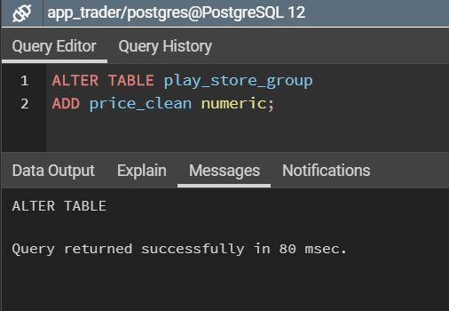
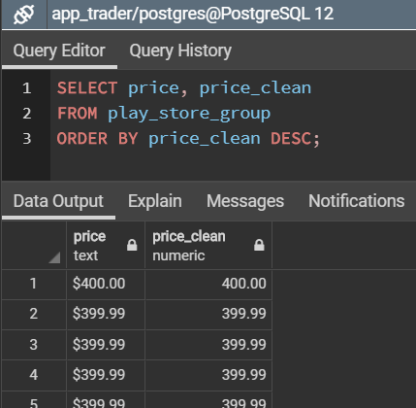
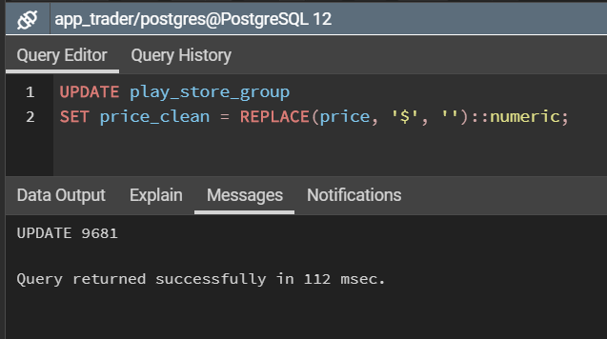
The play_store_apps table (and the new play_store_group table) use a text field with other characters (i.e. $) to store price data. To compare prices across the app_store_apps table and the play_store_group table we created a new column called price_clean and set that field to a value of the price field with the ‘$’ character removed and the field cast as a numeric.

Slide 9
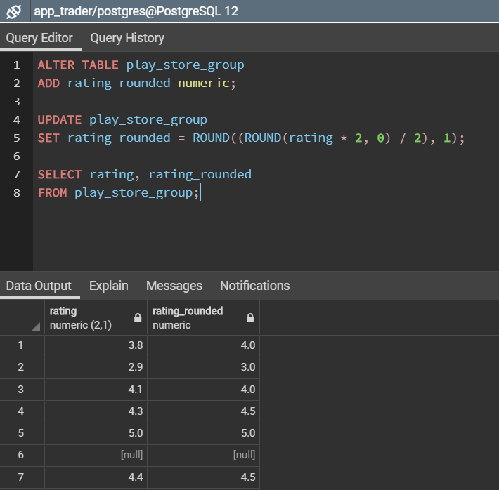
We created a new column with altered values for rating in a similar way as we modified price in the play_store_group table.
These queries were ran sequentially in order to add a column in the play_store_group table, round the rating to the nearest ½ number and set the new column to that value, and display the results.

Slide 10

Because we wanted to keep records that showed up on both tables we used an INNER JOIN.

Slide 11
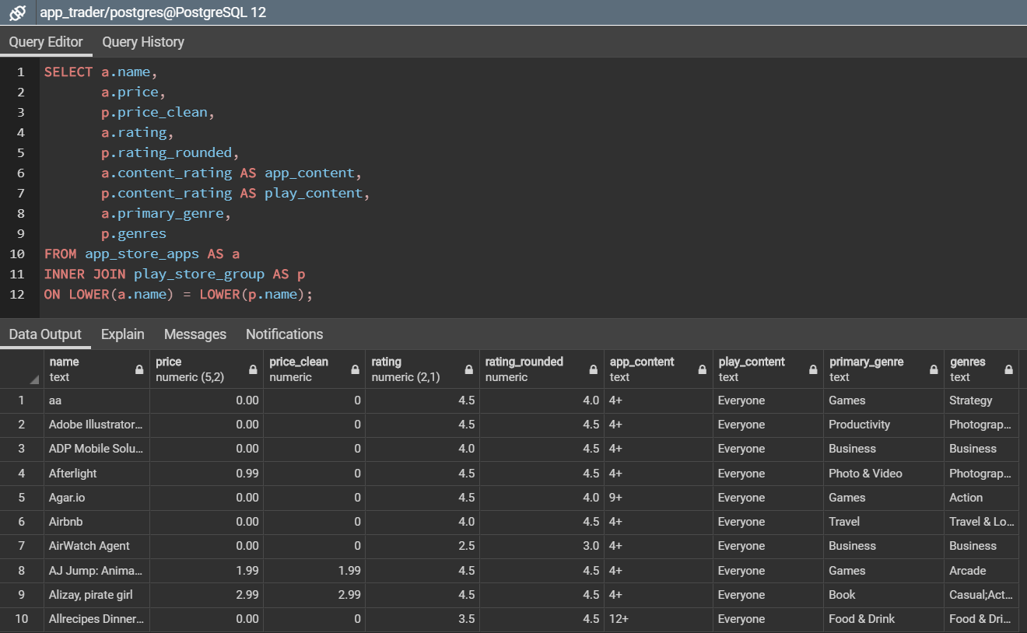
An INNER JOIN was used to retain apps that were found in both the app store and the play store group tables. These were grouped on case insensitive name using the LOWER() function.

Slide 12
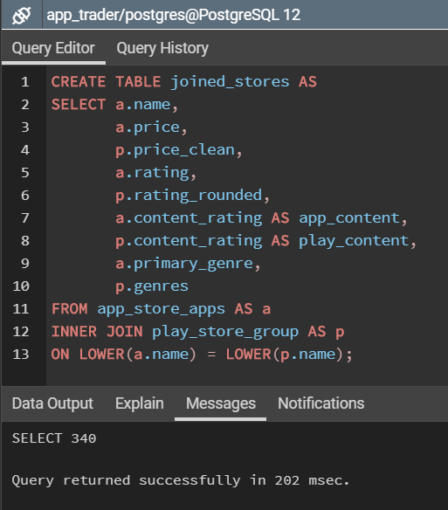
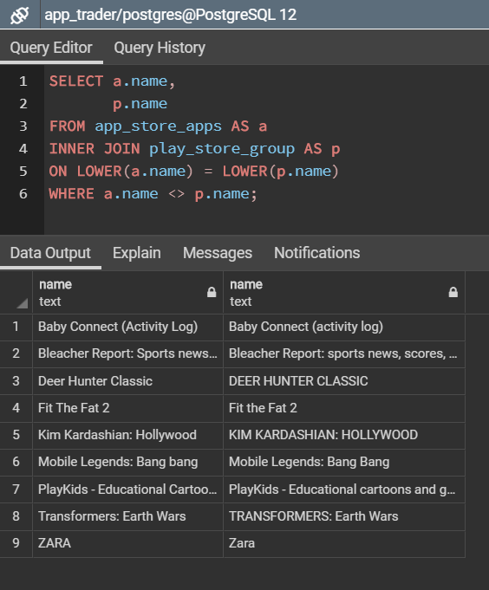
This query shows the substantial overlap in names that were not completely case sensitive matched.
The query shown in the previous slide was used to create a new table called joined_stores

Slide 13
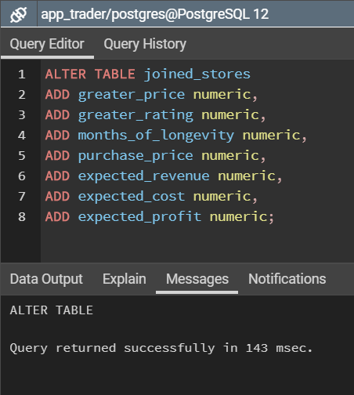
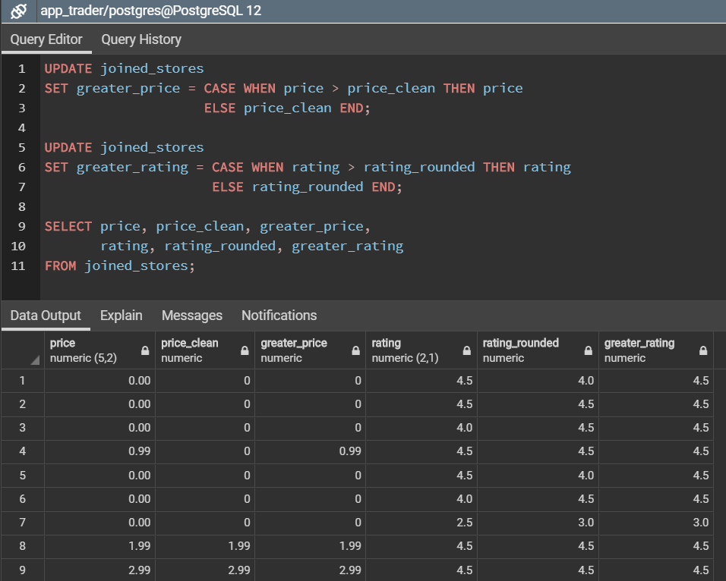
New columns were created in the joined store to hold the greater price and rating between the two stores and the calculated values.
The new greater_price and greater_rating columns were SET with data. We utilized CASE WHEN statements to select the values that filled the fields.

Slide 14
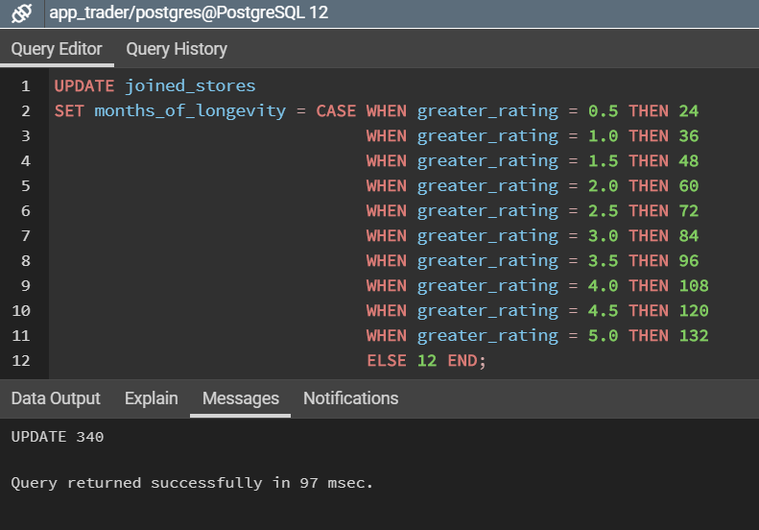
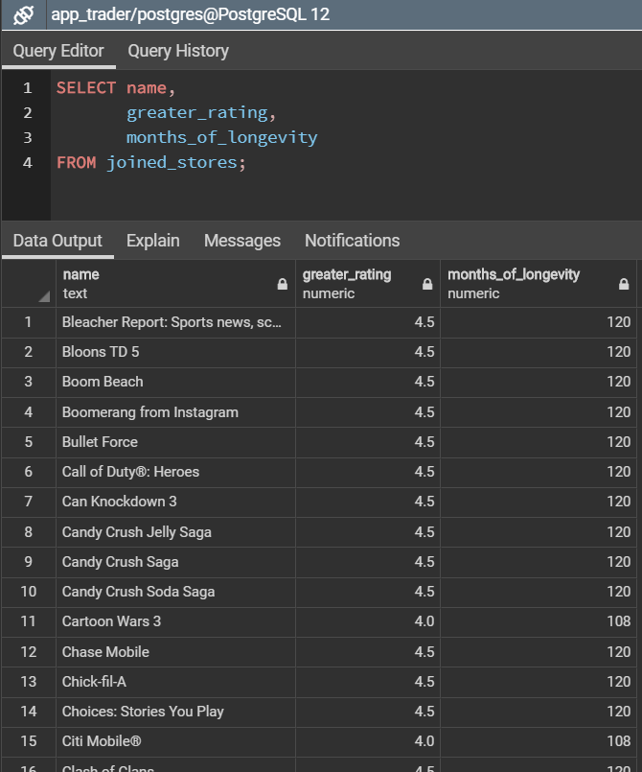
A set of CASE WHENs was used to update the months_of_longevity column.

Slide 15
A set of CASE WHENs was used to update the months_of_longevity column.

Slide 16
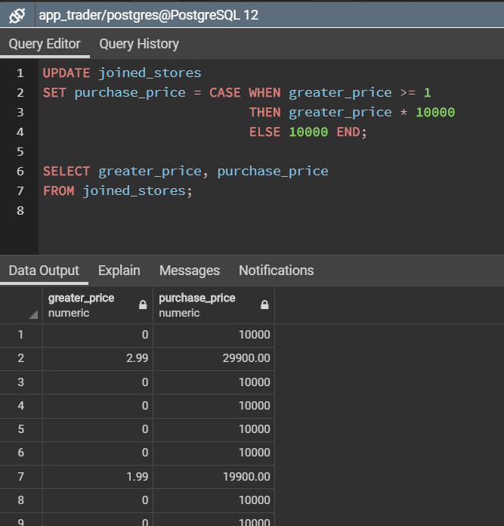
Again, utilizing a CASE WHEN the purchase price of an app was set to 10,000 * the cost of the app with a minimum cost of $10,000.

Slide 17
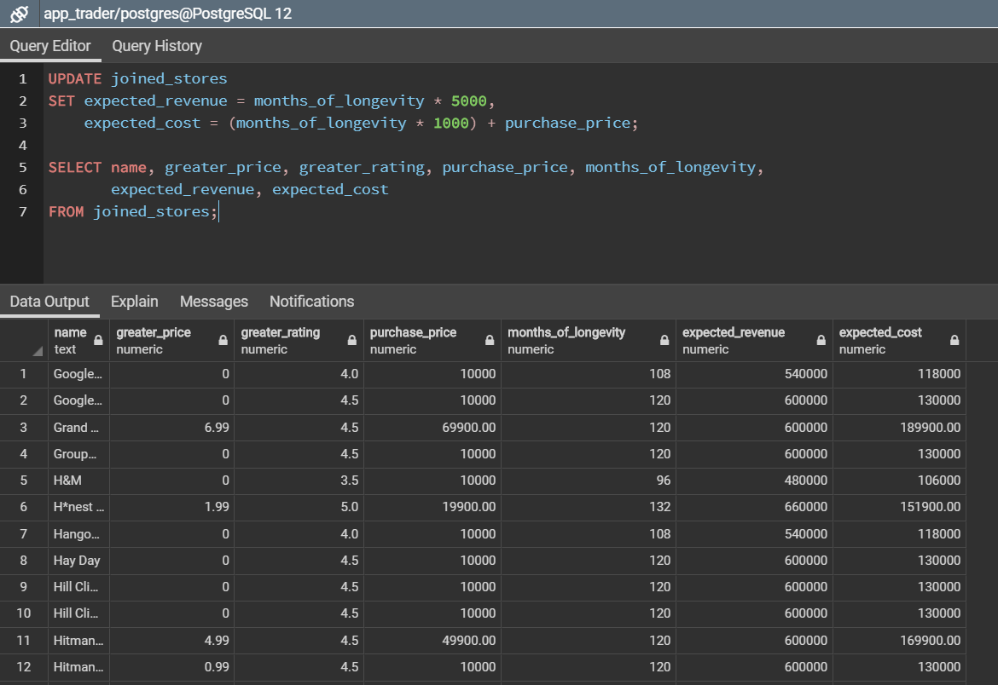
The expected_revenue and the expected_cost fields were updated in the joined_stores table.
Revenue was defined by the assumptions as 5000/month and cost was defined as purchase price plus 1000/month of marketing.

Slide 18
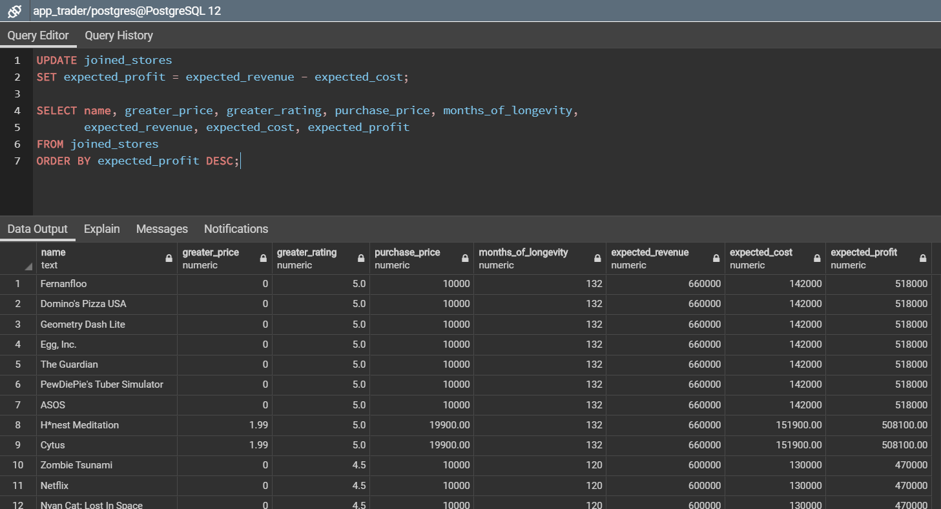
In the last table update step, expected profit column was set as the expected revenue less the expected cost. This new column was used to sort the results from highest expected profit to lowest.

Slide 19
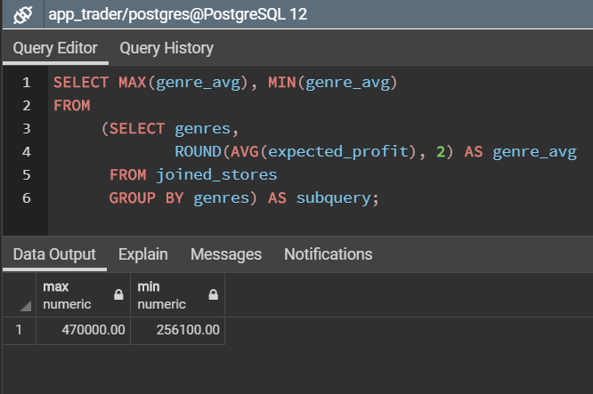
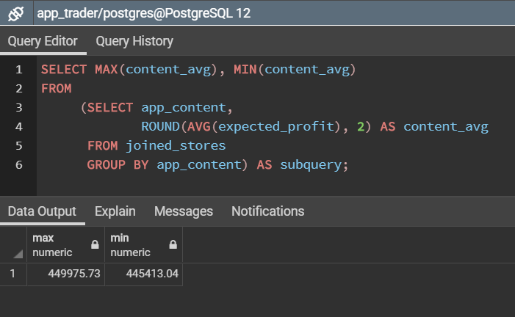
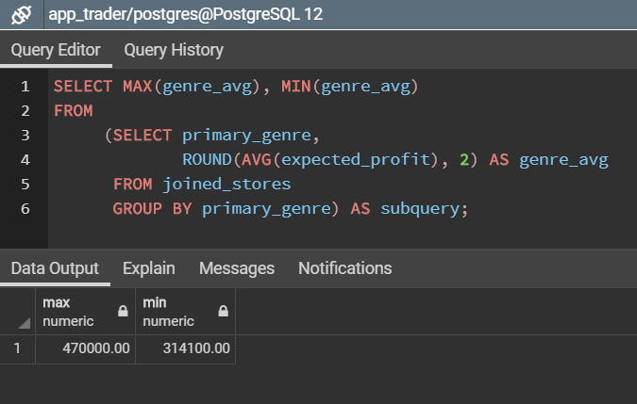
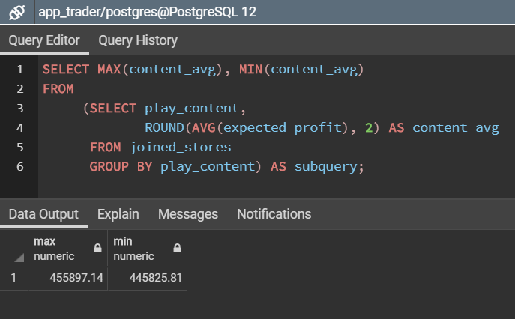
Using grouping and averaging in a subquery in the FROM clause of a query SELECTING the MIN and MAX average values we see there’s not a large difference between the highest earning categories when grouped by genre or content rating, in either store.

Slide 20
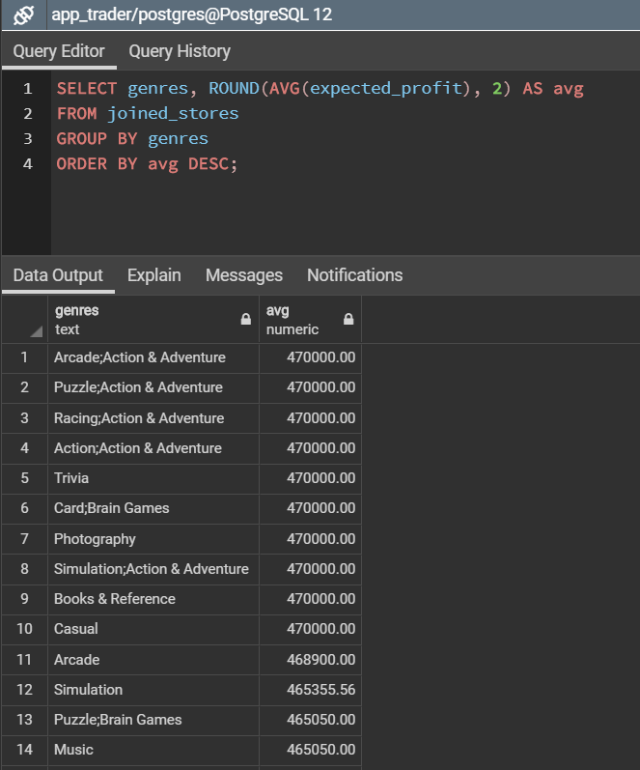
The greatest differences were found in the MAX and MIN values for AVG when grouped by the genres category. A closer look at the values in that subquery show a lot of categories with similar values.
These results seem to suggest that neither category nor content rating are the best criteria when selecting an app to purchase/market.
The top earning apps are all highly rated apps with low cost. Our team suggests focusing on rating and purchase price when selecting apps.

Slide 21
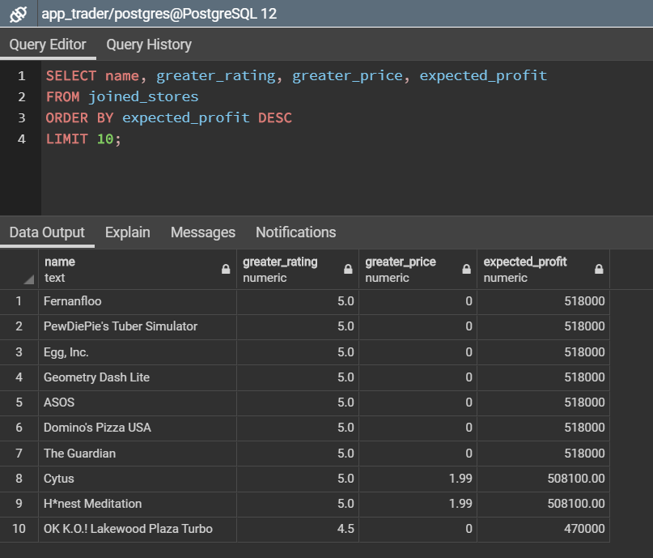
The 10 highest earning Black Friday candidates.
The app in the 10th spot in our analysis has quite a few other apps that had an equal expected profit.

