Slide 2







importSubfolderFiles.m
$$⋮$$
$$⋮$$
Number of
participants
$$⋮$$
Data_GRF_Elderly{15,3}
$$⋮$$
Folders
1 static test file
Multiple dynamic test files
walking repetitions

Slide 3
Start GRF
importSubfolder.m
importFile.m
getEvents.m
segmentCurves.m
prepDataCurves.m
dataFilter.m
dataInterp.m
prepDataCorr.m
repeatCorrFilter.m
corrFilterInter.m
interSubj.m
corrFilterIntra.m
Finish GRF

Slide 4
Main_preProc
plot number of curves
corr_filter
Right and Left
load ‘elderly_metadata.mat’
Keep participants with number of curves >= 4
GRF_proc
elderly_metadata
Starting GRF
interSubj(GRF_proc)
data_path = ‘./elderly_GRF’
Mass_kg
Weight
elderly_subj_final.mat
importSubfolderFiles (data_path)
plot opt_GRF
Right and Left
Finished GRF
Data_GRF
Change signal of GRF data: -AP_R, -AP_L and -ML_L
opt_GRF_R
getEvents(Data_GRF)
Right and Left
plot trials
Right and Left
opt_GRF_L
Legend
repeatCorrFilter(grf_side_corr, corr_n_coef)
Right and Left
Start/End
Data
n_steps
Right and Left
events
Right and Left
Fs
corr_coef=[0.85,0.90,0.95]
plot grf_corr
Right and Left
File
Process
segmentCurves(Data_GRF, n_steps,events, AP, ML, V)
Right and Left
grf_corr_L
prepDataCorr(prep._curves_R, prep._curves_L)
Manual input
Display
Fc=20
grf_corr_R
seg_grf_R
seg_grf_L
prep_curves_R
Function
Internal storage
prepDataCurves(seg_grf_side, n_steps,events, Weight, Fs, Fc)
Right and Left
prep_curves_L

Slide 5
main_preProc
plot number of curves
corr_filter
Right and Left
load ‘elderly_metadata.mat’
Keep participants with number of curves >= 4
GRF_proc
elderly_metadata
Starting GRF
interSubj(GRF_proc)
corrFilterIntra.m
Mass_kg
Weight
elderly_subj_final.mat
data_path = ‘./elderly_GRF’
importSubfolderFiles (data_path)
Data_GRF
Change signal of GRF data: -AP_R, -AP_L and -ML_L
plot opt_GRF
Right and Left
Finished GRF
importFile.m
getEvents(Data_GRF)
Right and Left
plot trials
Right and Left
opt_GRF_R
opt_GRF_L
n_steps
Right and Left
events
Right and Left
repeatCorrFilter(grf_side_corr, corr_n_coef)
Right and Left
corrFilterInter.m
Fs
segmentCurves(Data_GRF, n_steps,events, AP, ML, V)
Right and Left
seg_grf_R
plot grf_corr
Right and Left
corr_coef=[0.85,0.90,0.95]
seg_grf_L
grf_corr_L
grf_corr_R
prepDataCorr(prep._curves_R, prep._curves_L)
prepDataCurves(seg_grf_side, n_steps,events, Weight, Fs, Fc)
Right and Left
prep_curves_R
Fc=20
dataInterp.m
dataFilter.m
prep_curves_L
Legend
Start/End
Data
Manual input
Display
File
Process
Function
Internal storage

Slide 6
main_preProc.m
plot number of curves
corr_filter
load ‘elderly_metadata.mat’
Keep participants with number of curves >= 4
GRF_proc
elderly_metadata
Starting GRF
interSubj.m
corrFilterIntra.m
data_path = ‘./elderly_GRF’
Mass_kg
Weight
elderly_subj_final.mat
importSubfolder.m
Data_GRF
Change signal of
Data_GRF
plot opt_GRF
Finished GRF
importFile.m
getEvents.m
opt_GRF_R
plot trials
concatenated
opt_GRF_L
n_steps
Right and Left
events
Right and Left
repeatCorrFilter.m
corrFilterInter.m
Fs
segmentCurves.m
seg_grf_R
plot grf_corr
Right and Left
corr_coef=[0.85,0.90,0.95]
seg_grf_L
grf_corr_L
grf_corr_R
prepDataCorr.m
prepDataCurves.m
prep_curves_R
Fc=20
dataInterp.m
dataFilter.m
prep_curves_L
Legend
Start/End
Data
Manual input
Display
File
Process
Function
Internal storage

Slide 7
corrFilterIntra.m
data;
limiar;
Calculate cross-correlation matrix
(cm_within)
Mean correlation of each curve relative to its pairs
(cm_mean)
matrix_opt = data
repeat = False;
Find minimum mean correlation value
(min_corr)
Yes
END
min_corr
≥
limiar?
No
matrix_opt = data(ind_2keep)
repeat = True;
Find ind2keep =
(cm_mean > min_corr)
repeatCorrFilter.m
while repeat = True

Slide 8
repeatCorrFilter.m
corrFilterIntra.m
Calculate cross-correlation matrix
(cm_within)
Mean correlation of each curve relative to its pairs
(cm_mean)
data;
limiar;
True
Find minimum mean correlation value
(min_corr)
Legend
While repeat == True
START/END
END
repeat = False;
False
Data
True
matrix_opt = data
min_corr
≥
limiar?
Function
Process
matrix_opt = data(ind2keep)
False
repeat = True;
Decision
ind2keep =
find(cm_mean > min_corr)

Slide 9
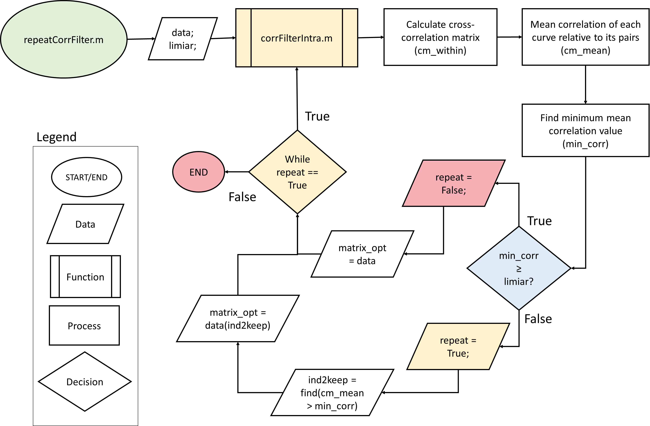

Slide 10
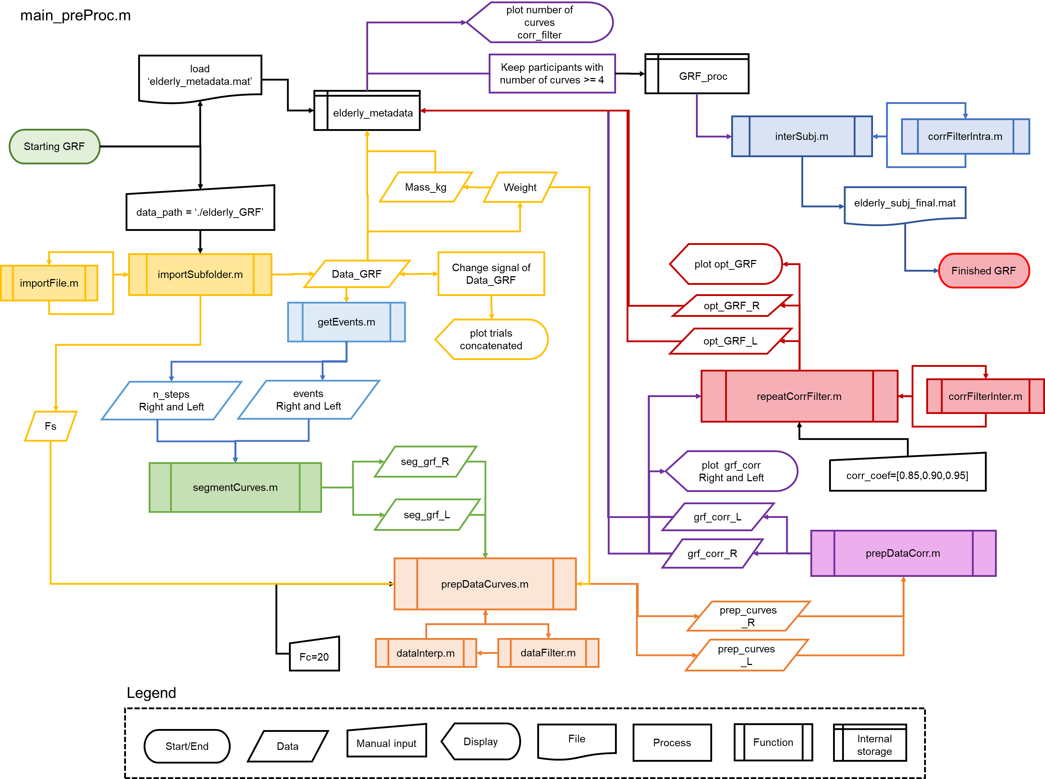

Slide 11
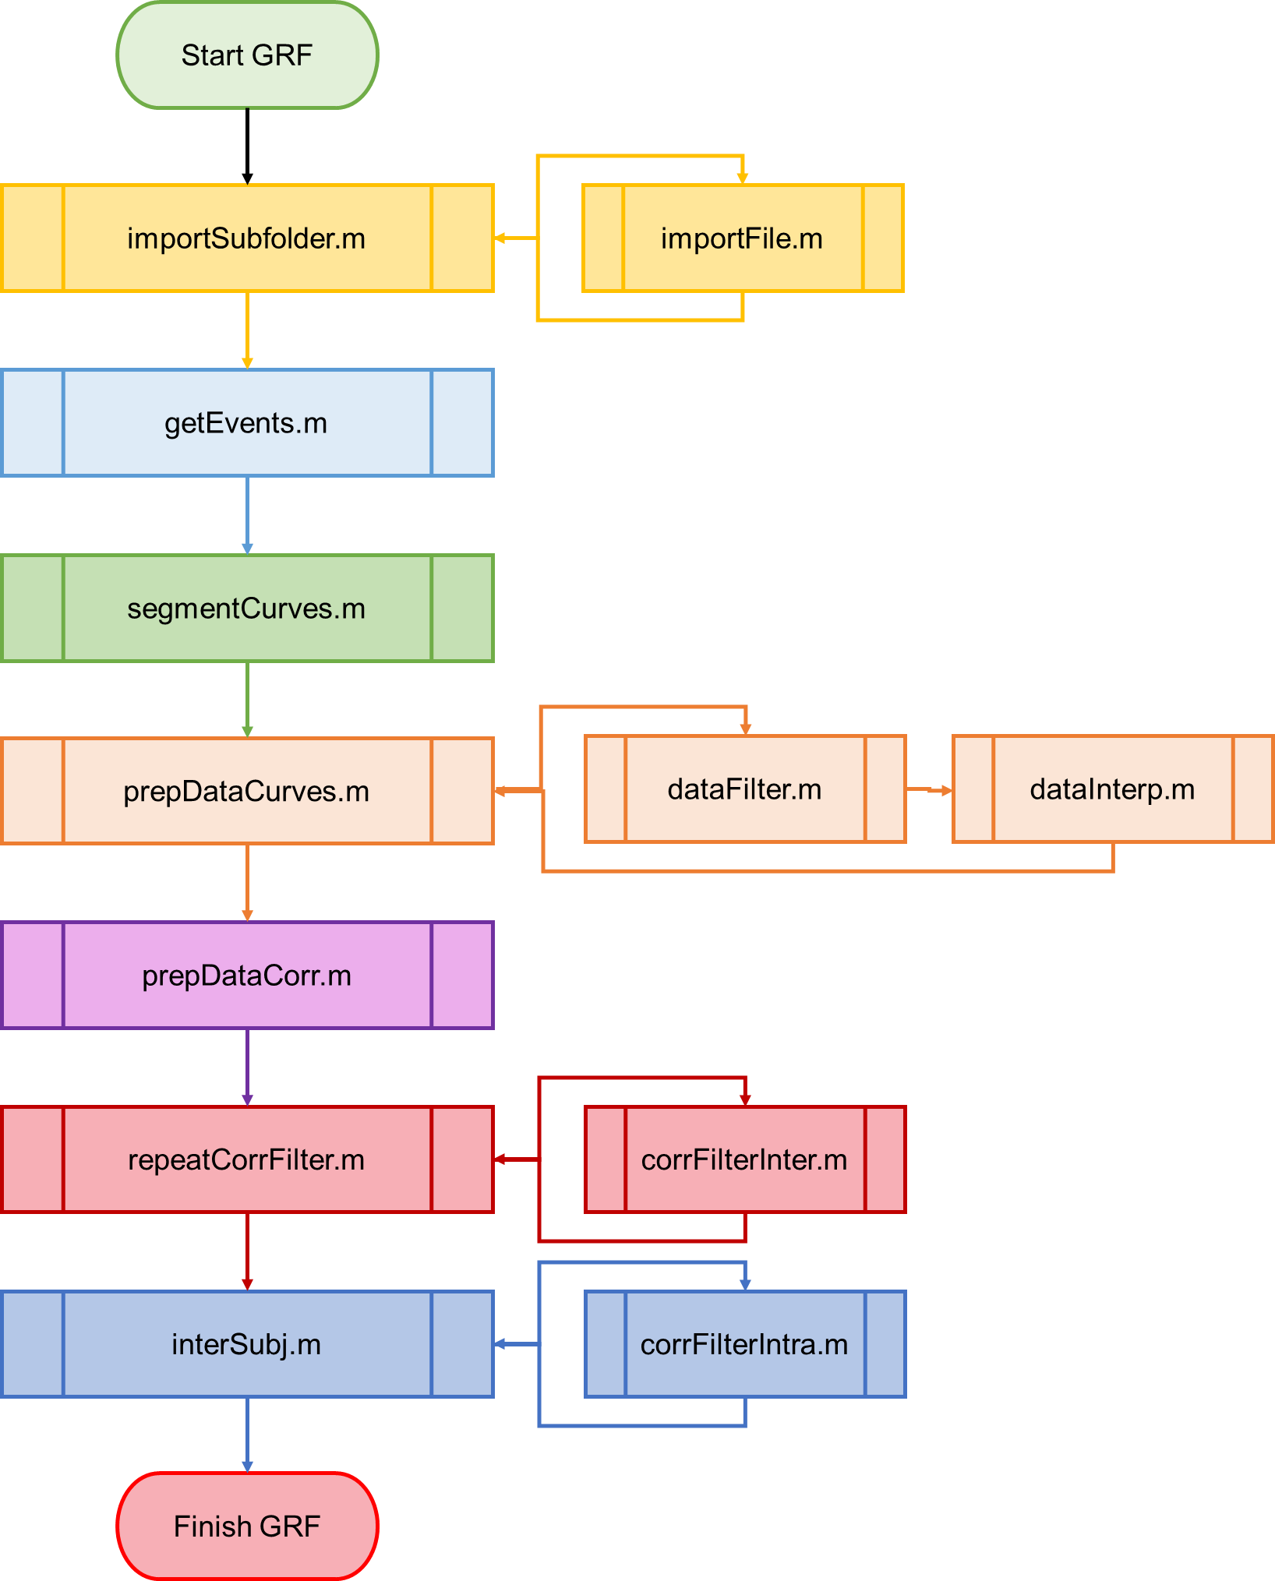

Slide 12
