Slide 1

gun violence usa
By Seidi Mohammad
By Hunter Johnson

Slide 2

(E)TL- Extraction
We use 3 different datasets from the public platform Kaggle. The data contained gun violence broken into 3 categories
Accidental deaths
Mass shootings
Accidental injuries
Each record in the files contained the below data
Incident date
State
City
Number injured and/or number killed
The data is from 8/31/2020 to 9/05/2020

Slide 3
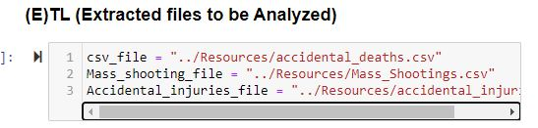
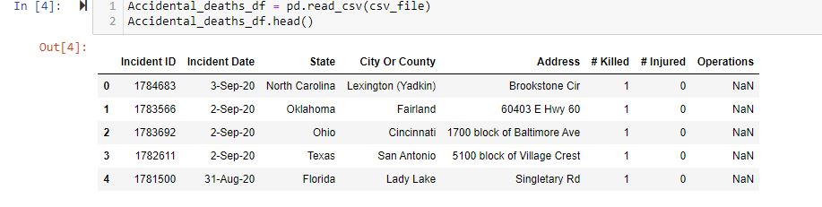
Files CSV

Slide 4

E(T)L - Transformation
Our data transformation process:
Used Pandas functions in Jupyter notebook to load all three CSV files
Used postgrsSQL drop the column operator and create queries
Reviewed the fields into dataFrames
Removed the operator column because did not have nothing
Sorted the data by the state
Merged by state and included number of injured and killed

Slide 5
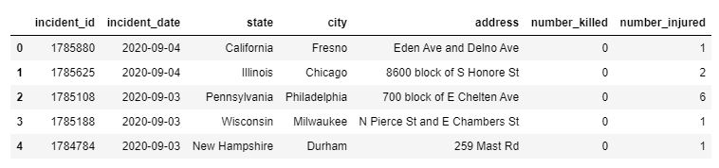
Accidental Injuries

Slide 6
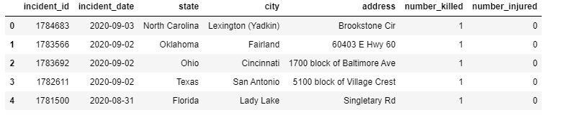
Accidental Deaths

Slide 7
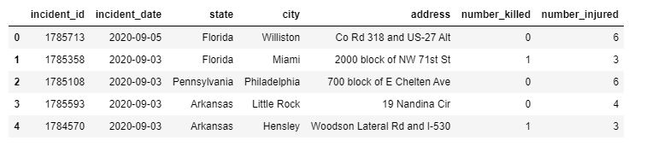
Mass Shootings

Slide 8
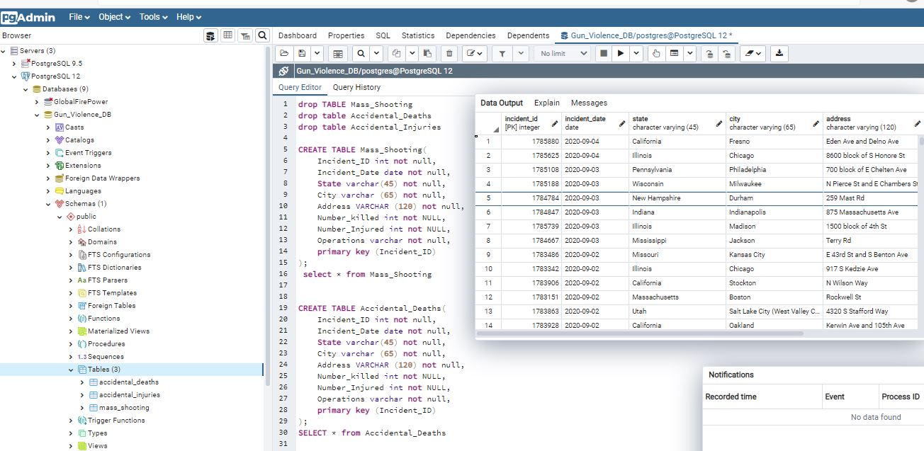
ET(L )- Load Postgres Database

Slide 9

Summary
There is not a significant difference in injuries/deaths from mass shootings compared to accidental shootings.
3 of the top 5 states with the most gun violence are states with strict gun control laws (Illinois, California, and New York)
These states also the highest number accidental Injury

Slide 10
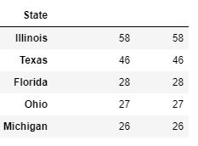
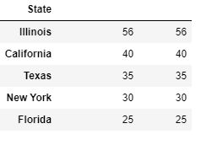
The Top 5 Gun violence in USA State accidental Injury & mass shootings

Slide 11
Our sources data use
https://www.kaggle.com/gunviolencearchive/gun-violence-database
https://www.gunviolencearchive.org/reports
https://www.gunviolencearchive.org/mass-shooting
https://www.gunviolencearchive.org/accidental-deaths

