Slide 1
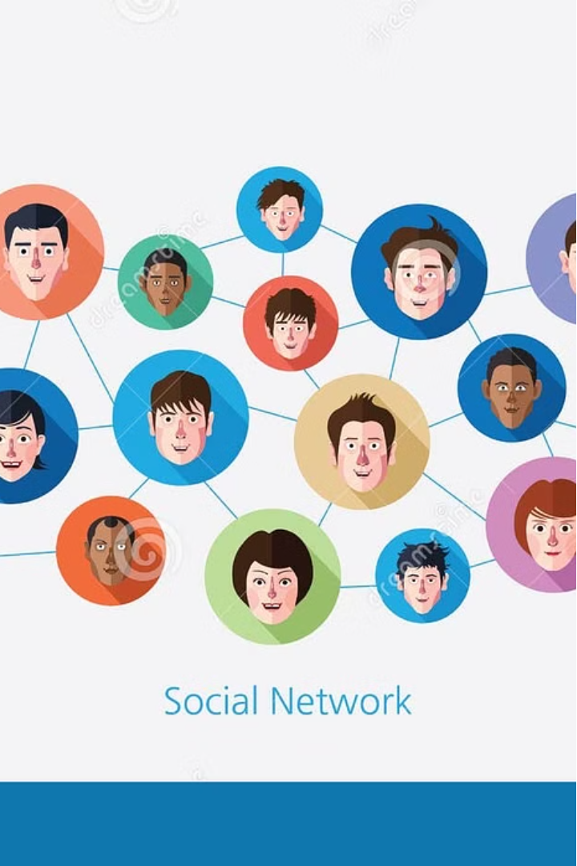
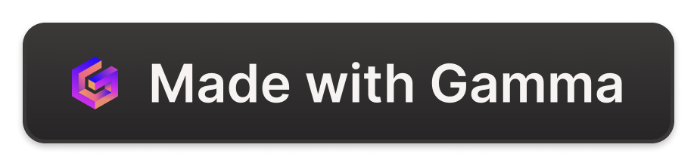
Introducing Our Social Media Platform
Our cutting-edge social media platform connects people , fostering meaningful connections and shared experiences. With a focus on privacy, security, and user-centric design.

Slide 2
Technical Overview
Robust Architecture
Advanced Algorithms
Cutting-Edge Security
Our platform is built on a scalable, local infrastructure, ensuring high availability and seamless performance even during peak usage.
Sophisticated algorithms power our content curation, delivering a personalized and safe experience.
Data protection measures prevents unauthorized access to other accounts.

Slide 3
Key Features and Functionalities
1
Intuitive Newsfeed
2
Seamless Messaging
A personalized newsfeed that surfaces relevant and engaging content
real-time messaging capabilities, enabling users to stay connected with friends, family, and communities.
3
Post Creation
4
Explore Feed
allowing users to express themselves and tell their stories.
A page where user can see trending posts from all users and interact with them

Slide 4
User Interface and Experience

Slide 5
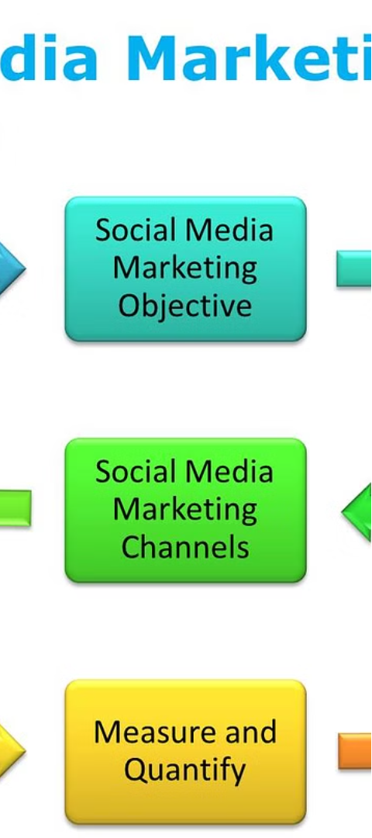
Future Plans and Roadmap
1
Expanded Integrations
Seamless integration with popular third-party apps and platforms to enhance the user experience and unlock new capabilities.
2
Artificial Intelligence
Leveraging advanced AI and machine learning to deliver more personalized recommendations, content curation, and user assistance.
3
Decentralized Architecture
Exploring a decentralized, blockchain-based approach to further strengthen data privacy and user control.

Slide 6



Conclusion and Call to Action
Sign Up Today
Share Your Story
Give Feedback
Join our vibrant community and start connecting with like-minded individuals from around the world.
Showcase your unique experiences, passions, and perspectives, and engage with others who share your interests.
Help us improve and enhance your social media experience by providing valuable feedback and suggestions.

