Slide 1

Lec(6):Valence Shell Electron-Pairs
Repulsion Theory “VSEPR”

Slide 2



Molecular Geometry and Chemical Bonding Theories
Valence Shell Electron-Pairs Repulsion Theory “VSEPR”
It is a method for predicting the shape of a molecule from the knowledge of the groups of electrons around a central atom.
VSEPR is revolves around the principle that electrons repel each other.
One can predict the shape of a molecule by finding a pattern where electron pairs are as far from each other as possible.
1

Slide 3
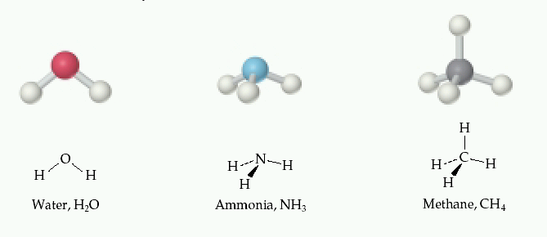
The shape of a molecule has an important bearing on its reactivity and behavior.
The shape of a molecule depends on a number of factors. These include:
Atoms forming the bonds
Bond distance
Bond angles.
2

Slide 4
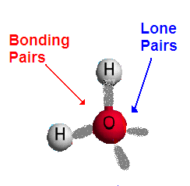
Bonding Electrons and Lone Pairs
In a molecule some of the valence electrons are shared between atoms to form covalent bonds. These are called bonding electrons.
Other valence electrons may not be shared with other atoms. These are called non-bonding electrons or they are often referred to as lone pairs.
3

Slide 5
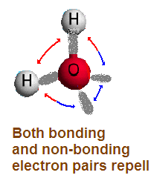
VSEPR
In all covalent molecules, electrons will tend to stay as far away from each other as possible
The shape of a molecule therefore depends on:
the number of regions of electron density it has on its central atom,
whether these are bonding or non-bonding electrons.
4

Slide 6
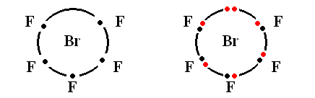
Applying the VSEPR theory
In order to use VSEPR to predict molecular structure:
Draw up Lewis dot diagram for the molecule or ion. The first atom (e.g. Br in BrF₅) is always the central atom. Place the other atoms around the central atom.
place 5 F
atoms around
central Br
red = 7 valence
electrons for Br
5

Slide 7
If these are single bonds, contribute one electron per attached atom. Then add the valence electrons for the central atom = 7 for Br.
2) Work out number of electron domains = valence electron pairs (‘n’) plus attached atoms on central atom. For BrF₅ n = 6.
3) Relate n to the type of structure predicted for that value of n. n = 6 = octahedral.
4) Place lone pairs in expected positions, maximizing separation of lone pairs. For BrF₅, there is one lone pair, so mol. structure = square pyramidal.
6

Slide 8
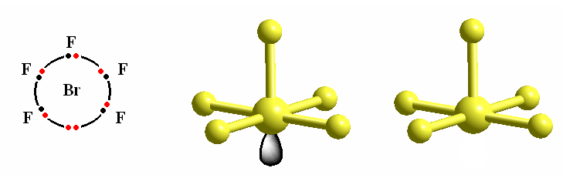
The structure of BrF₅ from VSEPR:
Lewis dot diagram
parent structure
molecular structure =
square pyramidal
lone pair
n = 6 from five
attached atoms
plus one electron
pair
n = 6, parent structure
= octahedral, but one site
occupied by a lone pair
molecular or final
structure – disregard
the lone pair
7

Slide 9
VSEPR: Predicting the shape
Once the dot structure has been established, the shape of the molecule will follow one of basic shapes depending on:
The number of regions of electron density around the central atom.
The number of regions of electron density that are occupied by bonding electrons.
The number of regions of electron density around the central atom determines the electron skeleton
The number of regions of electron density that are occupied by bonding electrons and hence other atoms determines the actual shape.
8

Slide 10
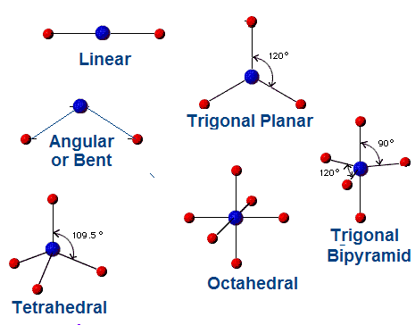
Basic Molecular Shapes
The most common shapes of molecules are shown below:
9

Slide 11
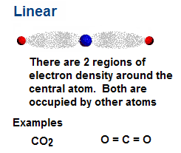
Linear Molecules
Linear molecules have only two regions of electron density.
10

Slide 12
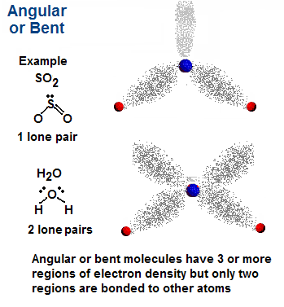
Angular or Bent
Angular or bent molecules have at least 3 regions of electron density, but only two are occupied.
11

Slide 13
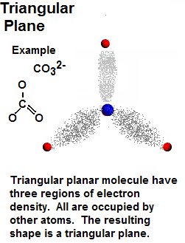
Triangular Planar
Triangular planar molecules have three regions of electron density. All are occupied by other atoms.
12

Slide 14
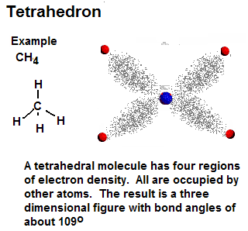
Tetrahedron
Tetrahedral molecules have four regions of electron density. All are occupied by other atoms:
13

Slide 15
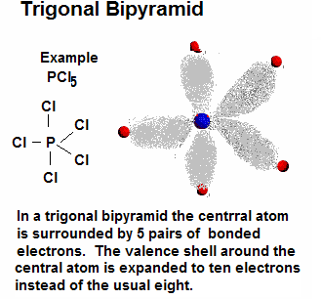
Triagonal Bipyramid
A few molecules have expanded valence shells around the central atom. Hence there are five pairs of valence electrons. The structure of such molecules with five pairs around one is called trigonal bipyramid.
14

Slide 16
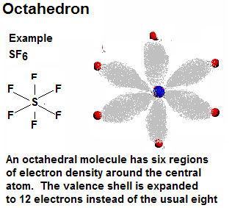
Octahedron
A molecules have valence shells around the central atom that are expanded to as many as six pairs or twelve electrons. These shapes are known as octahedrons.
15

Slide 17
The effect of lone pairs on bond angles
In VSEPR the lone pairs appear to occupy more space than electron pairs in bonds, with the result that bond angles are compressed away from the lone pairs. For example, in structures derived from tetrahedral parent geometry, such as water or ammonia, the H-O-H and H-N-H angles are compressed to be less than the 109.5º expected for a regular tetrahedron:
16

Slide 18
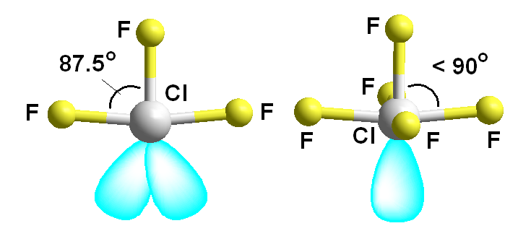
Effects of lone pairs on bond angles in ClF₃ and ClF₅.
chlorine trifuoride chlorine pentafluoride
Lone pairs tend to compress the other bond angles in a molecule, because the repulsion increases in the order;
Two Lone Pairs > Lone Pair and Bond Pair > Two Bond Pairs
17

Slide 19


Question: predict the shape of CO₂ HCN CH₄, NH3 SO₂ PCl₅, SF6 and H₂O by using VSEPR theory.
18

Slide 20
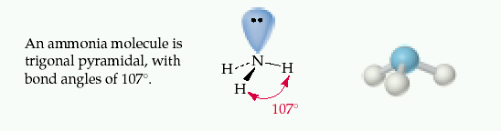
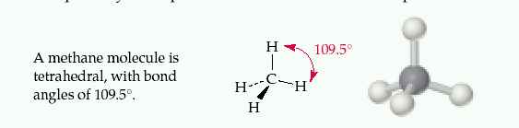
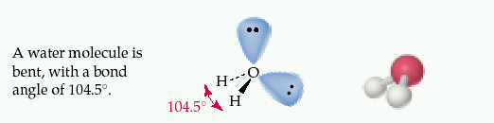
19

Slide 21
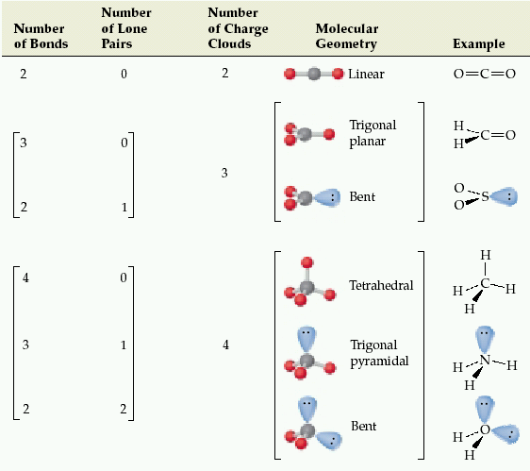
20

Slide 22
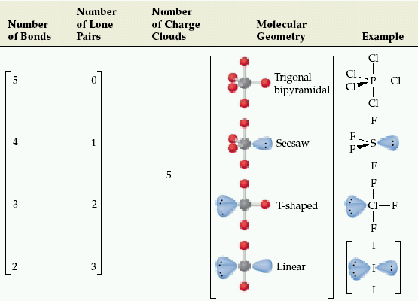
22

Slide 23
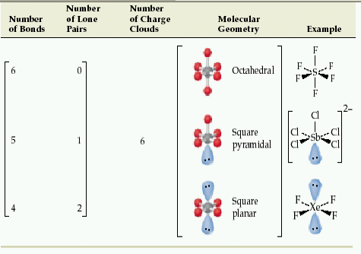
22

