Slide 1

Lec(7):Valence Bond Theory (VBT) and Hybridization

Slide 2



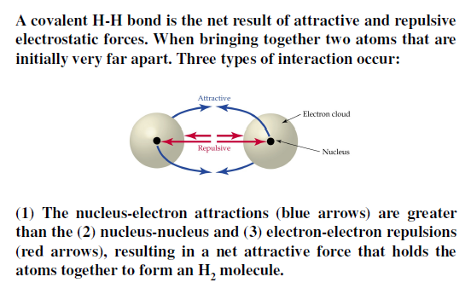
1

Slide 3
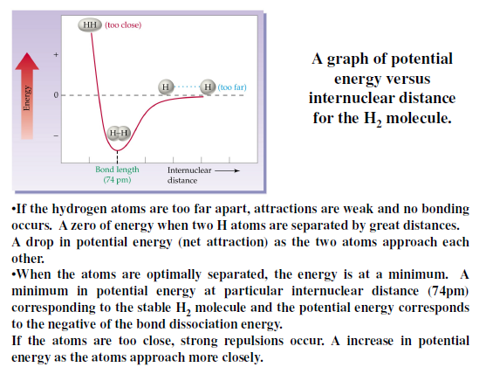
2

Slide 4

Valence Bond Theory (VBT)
* Bond formation by overlapping orbitals: A description of covalent bond formation in terms of atomic orbital overlap is called valence bond theory. It gives a localized electron model of bonding: core electrons and lone-pair valence electrons retain the same orbital locations as in the separated atoms, and the charge density of the bonding electrons is concentrated in the region of orbital overlap. VBT focuses on how the atomic orbitals of the dissociated atoms combine on molecular formation to give individual chemical bonds. The basic postulates of Valence Bond Theory:
3

Slide 5

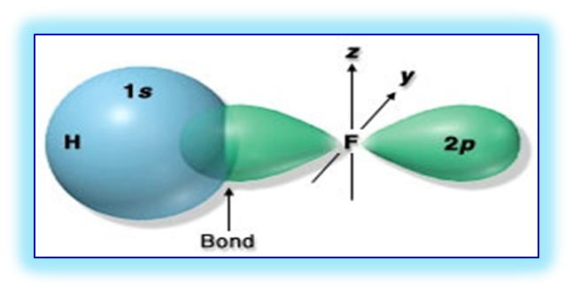




The main postulates of Valence Bond Theory (VBT)
1- When two atoms come together to form a covalent bond, an atomic orbital of one atom overlaps with an atomic orbital of the other. By overlap, the two orbitals share some common region in space, which contain the pairs of electrons.
+
+
+
+
+
1s
1s
2- The strength of the covalent bond is proportional to the degree of overlap.
“ The greater the overlap, the stronger the bond ”
4

Slide 6

Hybridization of Atomic Orbitals
Linus Pauling (in 1931), proposed that the wave function for the s and p atomic orbitals can be mathematically combined to form a new set of equivalent wave function called hybrid orbitals.
The mathematical process of replacing pure atomic orbitals with reformulated atomic orbitals for bonded atoms is called hybridization. It means mixing of the atomic orbitals of an isolated atom (central atom) to generate a new set of equivalent atomic orbitals called “hybrid orbitals”. In hybridization scheme, the number of hybrid orbitals equals to the total number of atomic orbitals that are combined.
The symbols identify:
the numbers and kinds of orbitals involved.
4

Slide 7

Basic concepts of Hybridization process
The number of hybrid orbitals is equal to the number of mixed atomic orbitals.
All orbitals in a set of hybrid orbitals are equivalent “have the same energy and the same shape”.
Hybrid orbitals have shapes and orientations that are completly different from those of the atomic orbitals in isolated atom.
Hybrid orbitals do not exist in isolated atoms. They are found only in covalently bonded atoms.
The shape of the molecule is determined by sigma bond and lone pairs.
Sigma bonds in polyatomic molecules usually involve the overlap of hybrid orbitals. While, pi bond result from the overlap of unhybridized orbitals.
6

Slide 8

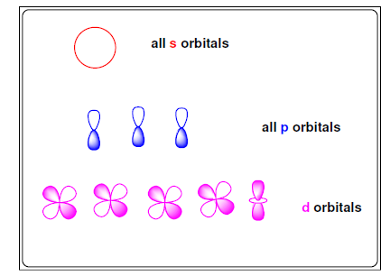
7

Slide 9


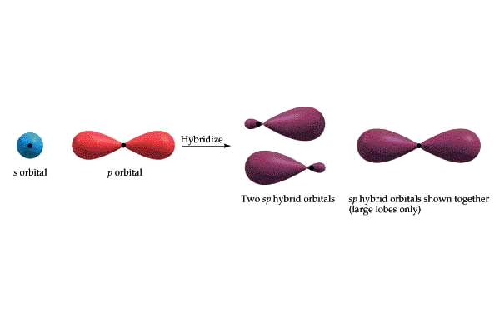
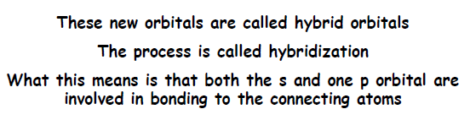
sp Hybridization Linear Arrangement
8

Slide 10


Example of sp Hybridization: BeH₂
⁴Be: 1s², 2s²
⁴Be atom in ground state:
⁴Be atom in excited state:
sp Hybridization:
Hybridized Be atom in
BeH₂
2p
2s
2p
2s
2p
sp
sp
2p
sp
sp

Slide 11

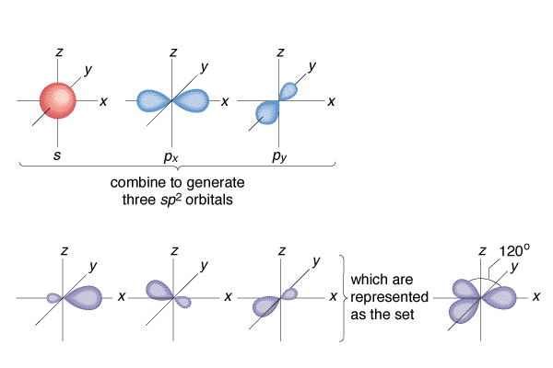
10

Slide 12

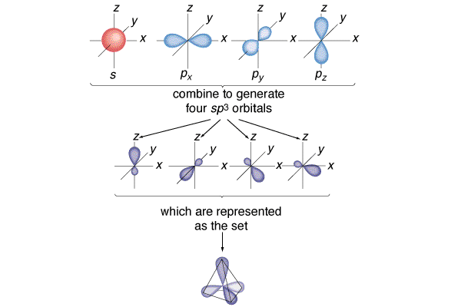
11

Slide 13

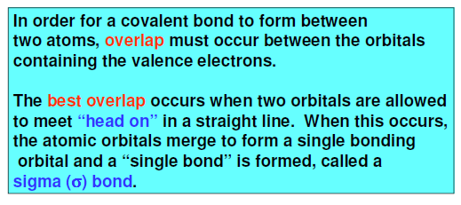
12

Slide 14
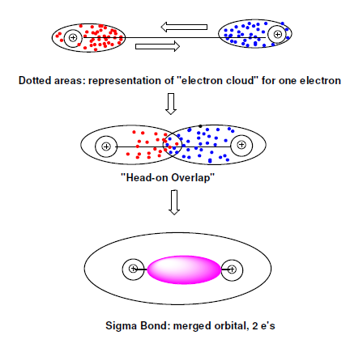
13

Slide 15

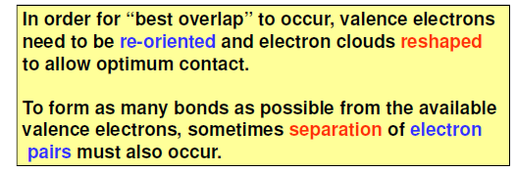

14

Slide 16

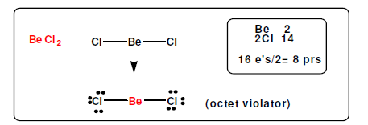
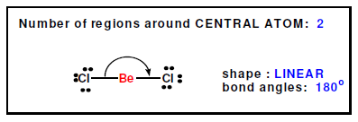
15

Slide 17
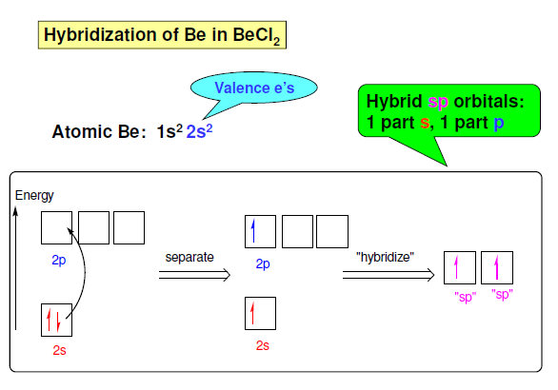
16

Slide 18
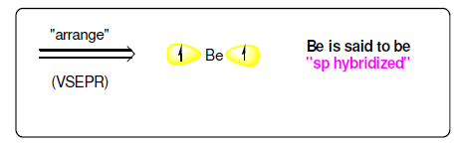

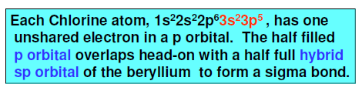
17

Slide 19
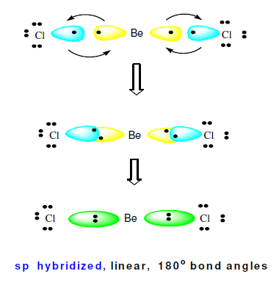
18

Slide 20

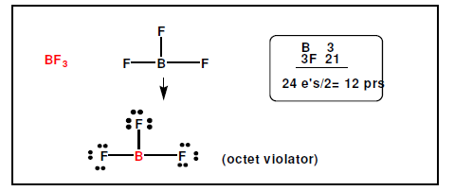
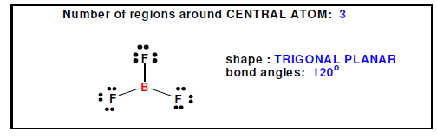
19

Slide 21
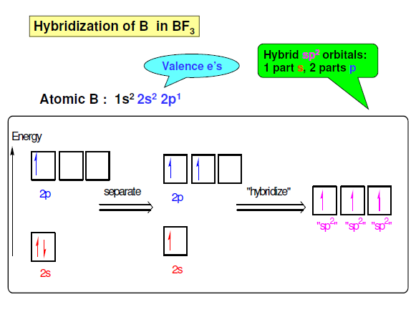
20

Slide 22
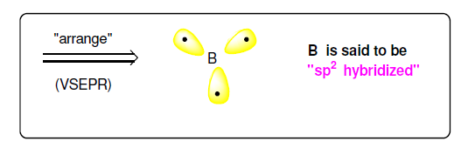

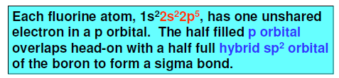
21

Slide 23
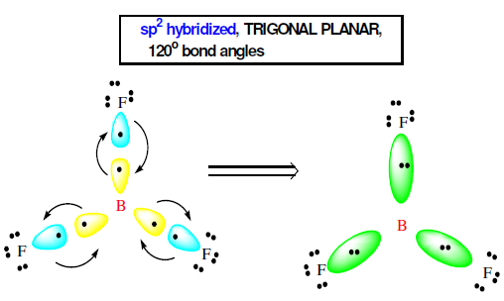
22

Slide 24

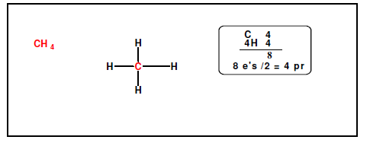
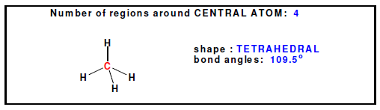
23

Slide 25
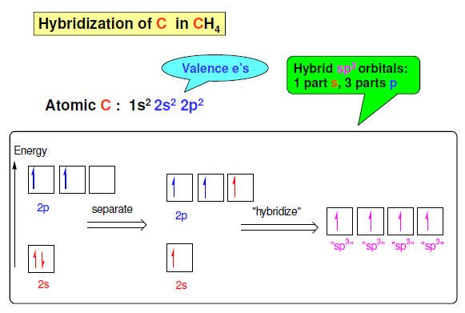
24

Slide 26
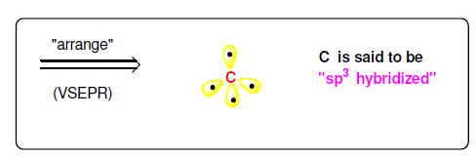

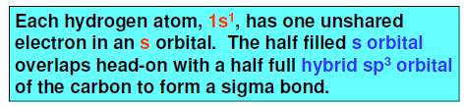
25

Slide 27
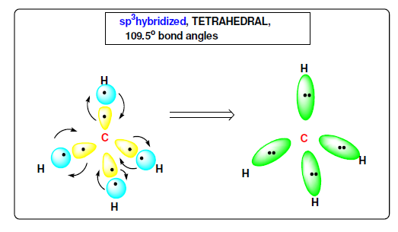
26

Slide 28


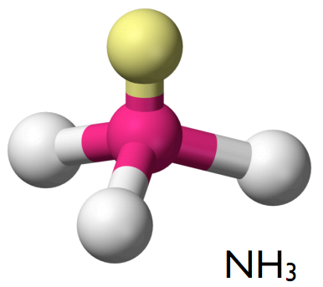
sp³ Hybridization with lone pair of electrons (NH₃)
⁷N: 1s², 2s² ,2p³
⁷N atom in ground state:
sp³ Hybridization:
Hybridized N atom
in NH₃
2p
2s
sp³
sp³
sp³
sp³
sp³
sp³
sp³
sp³
sp³ Hybridization
Tetrahedral Arrangement
27

Slide 29



sp³ Hybridization with twp lone pair of electrons (H₂O)
⁸O: 1s², 2s² ,2p⁴
⁸O atom in ground state:
sp³ Hybridization:
Hybridized O atom
in H₂O
2p
2s
sp³
sp³
sp³
sp³
sp³
sp³
sp³
sp³
sp³ Hybridization
Tetrahedral Arrangement
28

Slide 30


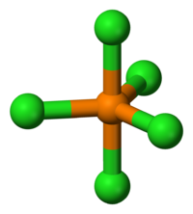
sp³d Hybridization PCl₅
Trigonal bipyramid Arrangement
¹⁵P: [Ne], 3s² ,3p³
¹⁵P in G. S.
¹⁵P in E. S.
sp³d-Hybridization:
Hybridized P atom
in PCl₅
3d
3p
3s
3d
3p
3s
3d
sp³d
sp³d
sp³d
sp³d
sp³d
3d
sp³d
sp³d
sp³d
sp³d
sp³d
29

Slide 31


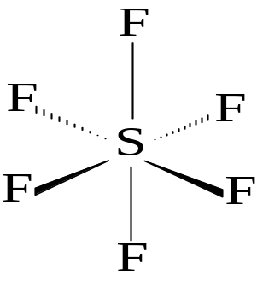
sp³d² Hybridization (SF₆)
Octahedron Arrangement
¹⁶S in G. S.
¹⁶S in E. S.
sp³d²-Hybridization:
Hybridized S atom
in SF₆
3d
3p
3s
3d
3p
3s
3d
Six sp³d² hybridized orbitals
3d
Six sp³d² hybridized orbitals
30

