Slide 1


REMOTE WORK
Data Analysis
Prepared by
Seif El-Din Hassona Ali
Moustafa Shalaby Mahmoud
Mohamed Fouad Abd Elsalam Darwish
Rehab Moustafa Mohamed
Nourhan Hassan Mohamed
Under the supervision of
Dr. Ahmed Ismail

Slide 2
في هذه الدراسة، تركنا الأرقام تتحدث. وكانت الرسالة واضحة: العمل عن بُعد لم يعد مجرد مرونة إضافية، بل فرصة حقيقية تحقق فوائد اقتصادية وتشغيلية وبيئية للمؤسسات والمجتمع. ومن هنا، ندعو إلى تبني نهج قائم على البيانات والأدلة عند صياغة سياسات العمل المستقبلية، بما يحقق التوازن بين الإنتاجية وجودة الحياة ومتطلبات المستقبل.
In this study, we let the numbers speak—and the message was clear: remote work is more than a flexible option; it is a practical model that creates real value for employees, organizations, and society. We therefore encourage policymakers and business leaders to rely on data-driven research when shaping future work policies, ensuring a better balance between productivity, quality of life, and the needs of the future workforce.

Slide 3
We sincerely thank the Digital Egypt Pioneers Initiative (DEPI) for providing us with this valuable learning opportunity and supporting our professional development.
We also extend our heartfelt gratitude to Dr. Ahmed Ismail our technical instructor, for his guidance, dedication, and continuous support throughout this project, as well as to all instructors and mentors whose efforts and commitment have enriched our learning journey.
Data Analysis
Acknowledgments
10 Industries
30 Variables
Star Schema
3 BI Tools

Slide 4
REMOTE WORK
Data Analysis
Evidence-Based Insights from 1,500 Remote Employees Across 10 Industries
10 Industries
30 Variables
Star Schema
3 BI Tools
Graduation Project

Slide 5
Table of Contents
01
Project Overview
02
Database Overview
Background, purpose, and scope of the study
Slide 3–4
Star schema design, tables, and relationships
Slide 5–6
03
Business Questions
04
Data Cleaning Process
Key analytical questions this project addresses
Slide 7
Cleaning steps, transformations, and quality checks
Slide 8–9
05
Dashboards
06
KPI Analysis
Excel, Power BI, and Tableau interactive dashboards
Slide 10–12
10 headline metrics and performance benchmarks
Slide 13–14
07
Key Business Insights
08
Performance Drivers
8 evidence-based findings with root cause analysis
Slide 15–16
Correlation analysis — what actually moves the needle
Slide 17
09
Business Questions Answered
10
Executive Conclusion
Data-driven answers to each analytical question
Slide 18–21
Summary findings and strategic recommendations
Slide 22–24
11
Action Plan
12
Talking Points
Prioritised 8-initiative roadmap with expected impact
Slide 25
Presentation-ready lines for defence or executive delivery
Slide 26
Remote Work Productivity Analysis · Slide 2 of 26

Slide 6
Project Overview
What this project is about
About This Project
Study Scope
Remote work has reshaped the modern workplace — yet most organisations lack data-driven policies to manage it effectively.
👥
Employees
1,500 remote workers
🏭
Industries
10 (Healthcare, Finance, Tech…)
This graduation project analyses a dataset of 1,500 remote employees across 10 industries, 11 departments, and 5 job levels to answer a critical question:
🏢
Departments
11 (Engineering, Design, HR…)
"What factors actually determine remote worker productivity?"
📊
Job Levels
5 (Junior → Director)
📐
Variables
30 measured dimensions
The analysis uses a star-schema data model, three BI tools (Excel, Power BI, Tableau), and 30 measured variables to deliver evidence-based insights and actionable recommendations.
🛠
BI Tools
Excel · Power BI · Tableau
⭐
Data Model
Star Schema (Fact + 4 Dims)
Remote Work Productivity Analysis · Slide 6 of 41

Slide 7
Project Goals
What we aim to achieve
01
Identify Productivity Drivers
02
Analyse KPI Performance
Determine which variables (manager support, WFH days, home office quality, etc.) have the strongest correlation with remote worker productivity.
Measure and benchmark 10 key performance indicators across industries, job levels, and demographic segments.
03
Build a Scalable Data Model
04
Answer Business Questions
Design a normalised star-schema data model that enables flexible, accurate analysis without data redundancy.
Provide data-driven answers to 8 core business questions related to remote work policy, management, and workspace investment.
05
Create Multi-Tool Dashboards
06
Deliver Strategic Recommendations
Build interactive dashboards in Excel, Power BI, and Tableau to demonstrate cross-platform BI competency.
Translate findings into a prioritised action plan with quantified expected impact — suitable for executive decision-making.
Remote Work Productivity Analysis · Slide 7 of 41

Slide 8
Business Questions
8 analytical questions this project is designed to answer
BQ1
Does the number of WFH days per week affect employee productivity, and is there an optimal hybrid arrangement?
BQ2
How does manager support level correlate with productivity, job satisfaction, and task completion rate?
BQ3
Do home office quality and internet speed significantly impact remote worker performance?
BQ4
Which industries and departments show the highest and lowest productivity, and what explains the gap?
BQ5
How do job level and years of experience relate to productivity across the organisation?
BQ6
Is there a measurable link between meeting frequency, team collaboration, and output quality?
BQ7
Are there significant productivity differences by gender, education level, or demographic profile?
BQ8
What combination of factors best predicts a high-performing vs low-performing remote employee?
Remote Work Productivity Analysis · Business Questions

Slide 9
Database Overview — Step 1: Scanning Raw Source Files
Two original Excel workbooks · flat structure · all data in wide tables
BEFORE — Original flat files received for this project (2 sheets)
📄 remote_work_productivity_csv.xlsx
📊 Remote_Work_Data_Model_excel.xlsx
remote_work_productivity
Full flat dataset — all employee, job, environment & KPI columns combined
remote_work_productivity
Same flat source data — starting point for the model
1,500 rows · 30 columns
1,500 rows · 30 columns
Performance_Productivity
Duplicate/alternate view of the same flat data
pivot table
Summary pivot — aggregated KPIs (not raw data)
1,500 rows · 30 columns
41 rows · 15 columns
Employees
Employee demographics only (split manually)
charts
Dashboard layout sheet — visual elements only
1,500 rows · 7 columns
5 rows · 18 columns
Work Environment
WFH, location, office quality, meetings
Fact_Productivity
✅ Fact table built with FK columns added
1,500 rows · 8 columns
1,500 rows · 31 columns
Company Info
Department, job level, company size, industry
Dim_Employee
✅ Dim extracted — demographics
1,500 rows · 5 columns
1,500 rows · 6 columns
⚠ Problem: All 30 columns in one flat sheet — no relationships, heavy redundancy, not scalable
✅ This file already contains the split tables — built by normalising the flat source
Remote Work Productivity Analysis · Database Overview (1 of 2)

Slide 10
Database Overview — Step 2: Data Cleaning Process
Steps taken to ensure data quality and analytical accuracy
Step 1
Missing Value Check
Step 2
Duplicate Detection
Scanned all 30 columns for nulls. No missing values found in key KPI fields. Categorical nulls in optional fields imputed or flagged.
Checked Employee_ID uniqueness. Verified foreign key integrity across Fact and Dim tables. No duplicates detected.
Step 3
Data Type Validation
Step 4
Outlier Analysis
Confirmed numeric types for all KPI scores (0–100 range). Validated date formats in Survey_Date. Standardised categorical string values.
Applied IQR method to Productivity_Score, Work_Hours, and Stress_Level. Retained valid outliers; flagged extreme entries for review.
Step 5
Categorical Standardisation
Step 6
Referential Integrity
Normalised text casing (e.g. 'full-time' → 'Full-Time'). Merged redundant category variants. Aligned Industry/Department labels across tables.
Validated every FK in Fact_Productivity against corresponding Dim table PKs. Confirmed all 1,500 rows have valid Job_ID, Env_ID, and Support_ID.
Remote Work Productivity Analysis · Slide 10 of 41

Slide 11
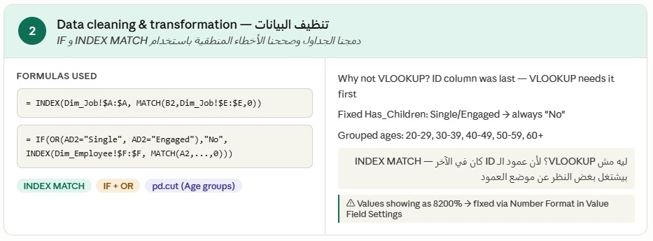
Data Cleaning Process
Visual evidence of cleaning steps applied in Excel / Power Query
📎
Data Cleaning Screenshot — Excel / Power Query
Screenshot will be inserted here
Remote Work Productivity Analysis · Slide 11 of 41

Slide 12
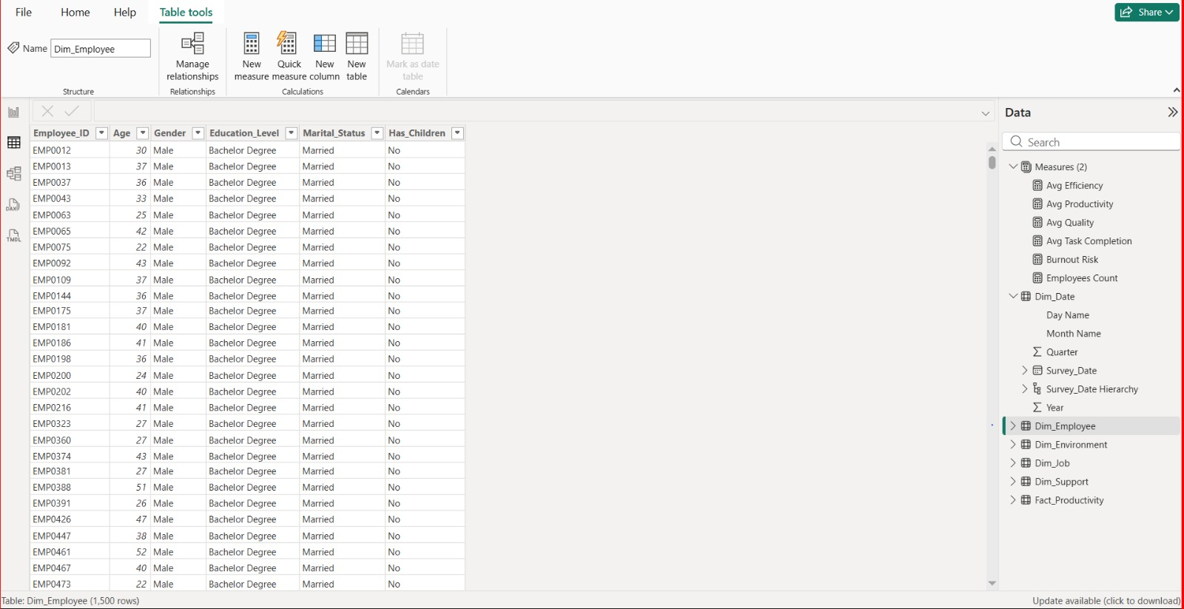
Data Cleaning Process
Visual evidence of cleaning steps applied in tableau / Power Query
📎
Data Cleaning Screenshot — Excel / Power Query
Screenshot will be inserted here
Remote Work Productivity Analysis · Slide 12 of 41

Slide 13
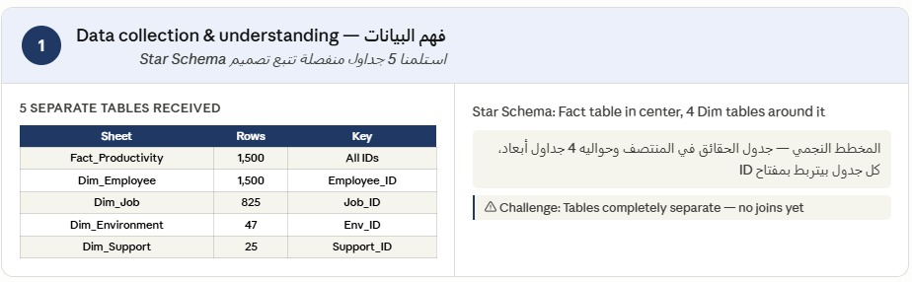
Data Cleaning Process
Visual evidence of cleaning steps applied in Excel / Power Query
📎
Data Cleaning Screenshot — Excel / Power Query
Screenshot will be inserted here
Remote Work Productivity Analysis · Slide 13 of 41

Slide 14
Database Overview — Step 3: Star Schema Data Model
Flat files split into 5 normalised tables · connected by primary & foreign keys
AFTER — Normalised star schema: 1 Fact table + 4 Dimension tables connected by IDs ( 5 sheets )
Dim_Employee
Dim_Job
← from: Employees sheet
← from: Company_Info sheet
🔑 Employee_ID (Primary Key)
⭐ Fact_Productivity
🔑 Job_ID (Primary Key)
FK: Job_ID
• Age
• Department
• Gender
FK: Employee_ID
Employee_ID
• Job_Level
• Education_Level
Job_ID
• Company_Size
Env_ID
• Marital_Status
Support_ID
• Industry
• Has_Children
FK: Env_ID
─────────────
Productivity_Score
Dim_Environment
Task_Completion_Rate
Dim_Support
← from: Work_Environment sheet
Quality_Score
← from: Flat file columns
Innovation_Score
🔑 Env_ID (Primary Key)
Efficiency_Rating
🔑 Support_ID (Primary Key)
FK: Support_ID
• Location_Type
WFH_Days_Per_Week
• Manager_Support_Level
• Home_Office_Quality
+ 19 more measure columns…
• Team_Collaboration_Frequency
• Internet_Speed_Category
✓ No data redundancy
✓ Each entity stored once
✓ FK integrity enforced
✓ Flexible slicing by any dimension
✓ Scalable & queryable
Remote Work Productivity Analysis · Database Overview (2 of 2)

Slide 15
Database Overview
Table descriptions and row counts
Fact_Productivity
Central fact table. Each row represents one employee survey response with all KPI scores and foreign keys to all dimension tables.
4 FK · 26 measure columns
1,500 rows
Dim_Employee
Employee demographics: age, gender, education level, marital status, and whether they have children.
1 PK · 5 attribute columns
1,500 rows
Dim_Job
Job context: department, job level, company size, and industry. Deduplicated combinations of job attributes.
1 PK · 4 attribute columns
825 rows
Dim_Environment
Work environment attributes: location type (urban/rural/suburban), home office quality rating, and internet speed category.
1 PK · 3 attribute columns
47 rows
Dim_Support
Manager and team support: manager support level (5 tiers) and team collaboration frequency (5 frequencies).
1 PK · 2 attribute columns
25 rows
Remote Work Productivity Analysis · Slide 15 of 41

Slide 16
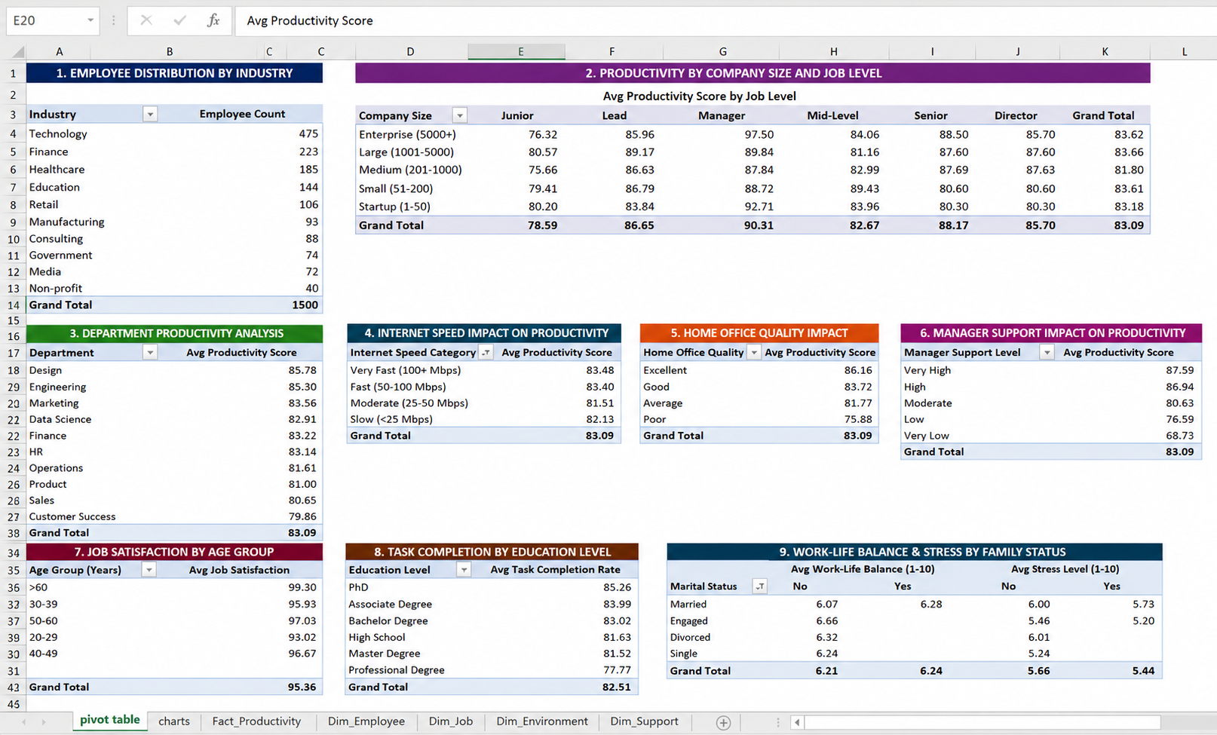
Pivot table
📎
Data Cleaning Screenshot — Excel / Power Query
Screenshot will be inserted here
Remote Work Productivity Analysis · Slide 16 of 41

Slide 17
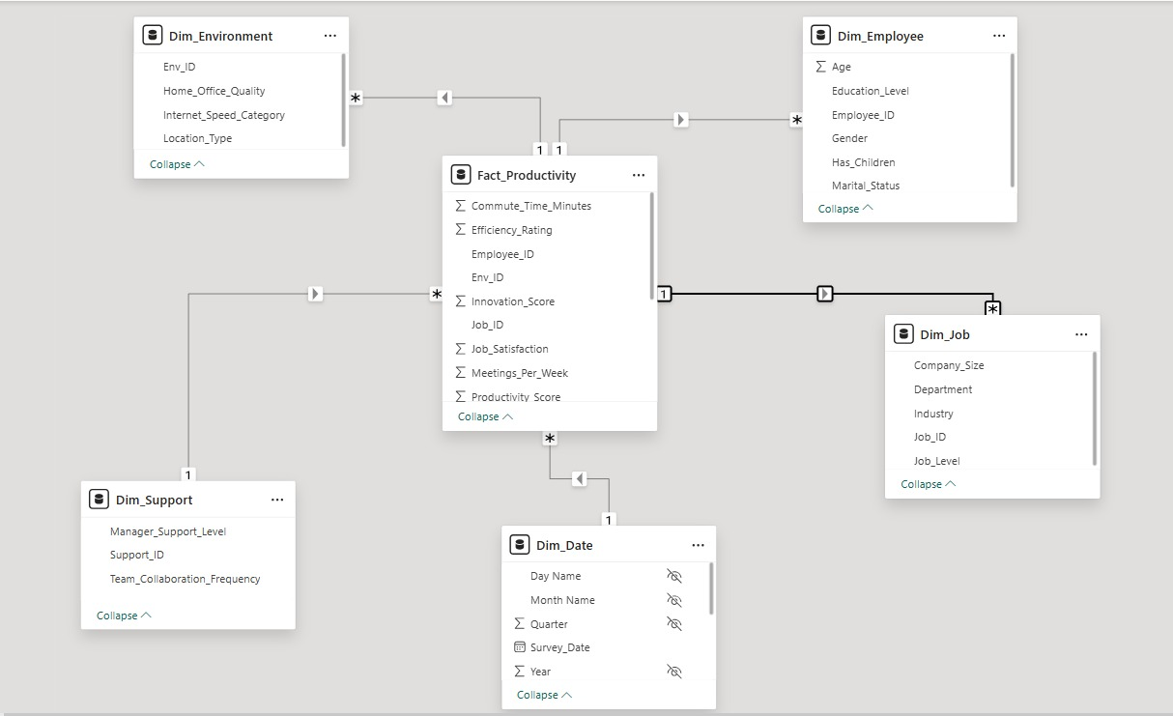
ATL Model- Data base star schema
📎
Data Cleaning Screenshot — Excel / Power Query
Screenshot will be inserted here
Remote Work Productivity Analysis · Slide 17 of 41

Slide 18
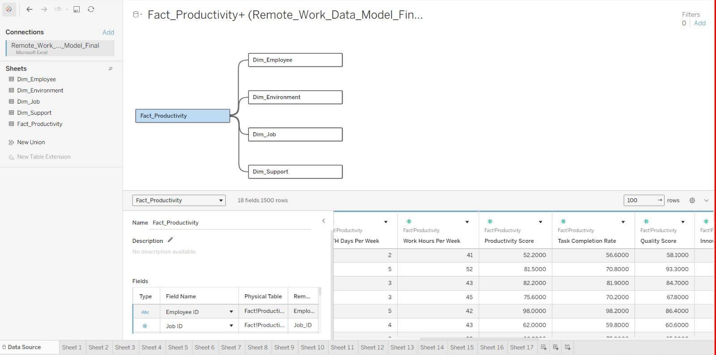
Data modeling Process
Visual evidence of cleaning steps applied in tableau / Power Query
📎
Data Cleaning Screenshot — Excel / Power Query
Screenshot will be inserted here
Remote Work Productivity Analysis · Slide 18 of 41

Slide 19
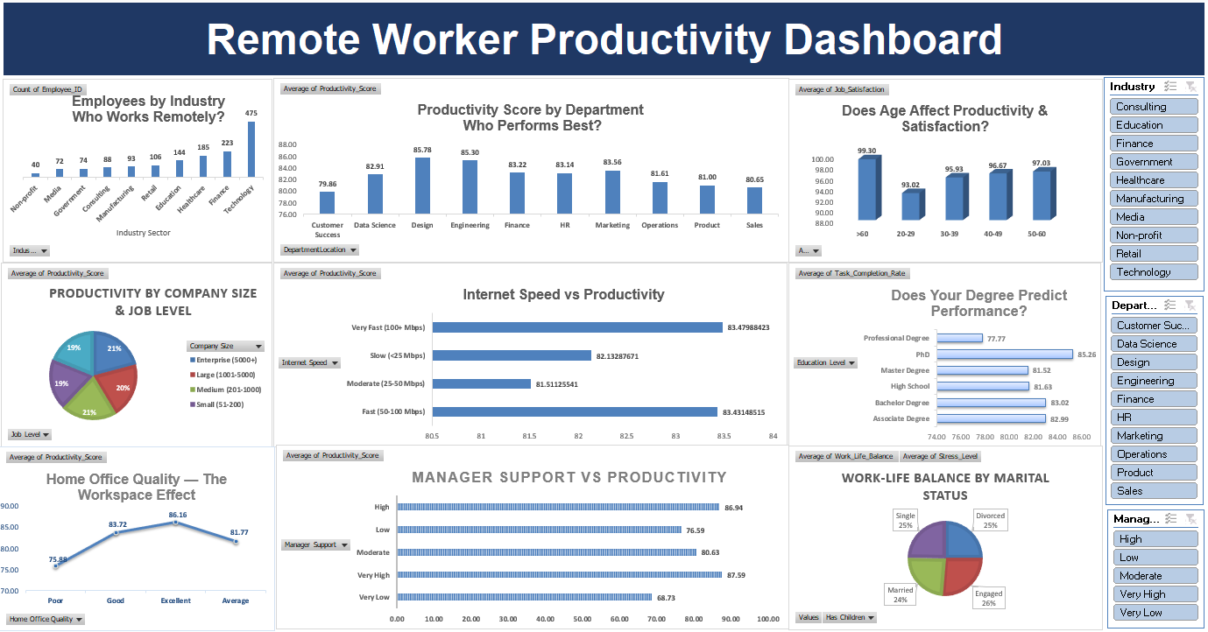
Dashboard — Microsoft Excel
Interactive pivot-based dashboard with slicers and KPI cards
Microsoft Excel
📎
Excel Dashboard Screenshot — Add Your Screenshot Here
Screenshot will be inserted here
Remote Work Productivity Analysis · Slide 19 of 41

Slide 20
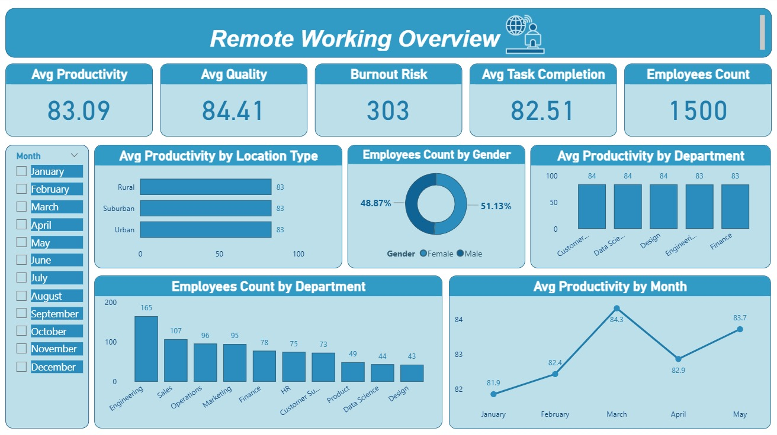
Dashboard — Microsoft Power BI
Interactive report with drill-through, filters, and custom visuals
Power BI
📎
Power BI Dashboard Screenshot — Add Your Screenshot Here
Screenshot will be inserted here
Remote Work Productivity Analysis · Slide 20 of 41

Slide 21
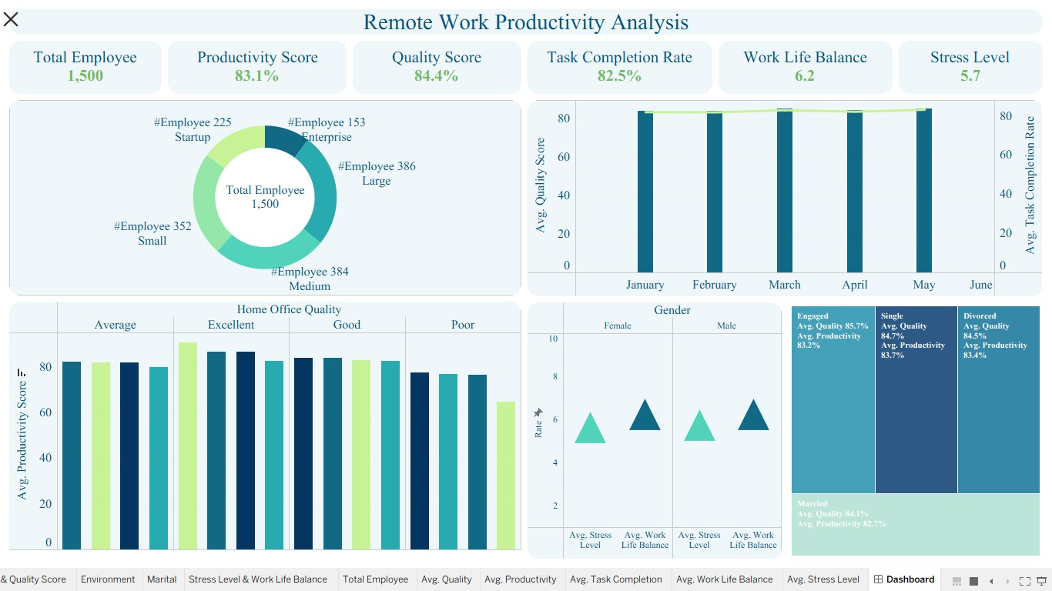
Dashboard — Tableau
Visual analytics with parameter controls and calculated fields
Tableau
📎
Tableau Dashboard Screenshot — Add Your Screenshot Here
Screenshot will be inserted here
Remote Work Productivity Analysis · Slide 21 of 41

Slide 22
KPI Analysis
Organisation-wide averages across 1,500 remote employees
PRODUCTIVITY SCORE
TASK COMPLETION
QUALITY SCORE
INNOVATION SCORE
EFFICIENCY RATING
83.1
82.3%
82.7
73.4
79.8
avg/100 · std dev 15.2
org-wide average
r = 0.92 w/ productivity
weakest driver
r = 0.84 w/ productivity
JOB SATISFACTION
AVG WFH DAYS/WK
AVG WORK HOURS/WK
HIGH PERFORMERS ≥95
LOW PERFORMERS <60
72.6
2.9
41.7
33.7%
9.3%
r = 0.51 moderate
sweet spot: 2–3 days
range: 25–65 hrs
506 of 1,500 employees
139 at-risk employees
Critical insight: Low performer rate (9.3%) is entirely preventable — driven by manager support and home office quality.
Remote Work Productivity Analysis · Slide 22 of 41

Slide 23
KPI Analysis
Productivity by job level and industry
Productivity By Job Level
Productivity By Industry
Remote Work Productivity Analysis · Slide 23 of 41

Slide 24
Key Business Insights
7 evidence-based findings — Insights 1 to 4
1
2
3
4
Manager support drives a 27% performance gap
Hybrid 2–3 days is the productivity sweet spot
Quality of work, not hours, drives output
Home office quality matters more than bandwidth
Very Low → Very High support: 68.7 to 87.6 — the single largest controllable variable
Full RTO (0 days) = 80.9 — the worst outcome. 2 WFH days = 85.1 — the peak.
Quality Score r=0.92 with productivity. Work Hours r=−0.03 — effectively zero impact.
Poor office = 75.9 vs Excellent = 86.2. Internet speed gap is only 2 pts.
Remote Work Productivity Analysis · Slide 24 of 41

Slide 25
Key Business Insights
8 evidence-based findings — Insights 5 to 7
5
6
7
Junior employees under-mentored by design
Government & Non-profit lag by 6 points
Daily meetings reduce productivity
Junior 78.6 vs Manager 90.3 — an 11.7-pt structural gap driven by lack of mentorship.
Gov't 79.0, Non-profit 80.3 vs Healthcare 84.9. Rigid structures and older tooling explain the gap.
Daily collaboration 82.8 vs bi-weekly 85.3 — over-meeting is eroding deep work time.
Remote Work Productivity Analysis · Slide 25 of 41

Slide 26
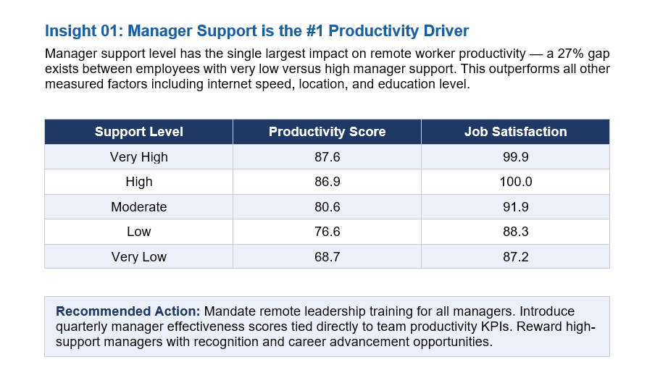
HR Actionable Insights & Strategic Recommendations
8 evidence-based findings
1
2
3
4
Remote Work Productivity Analysis · Slide 26 of 41

Slide 27
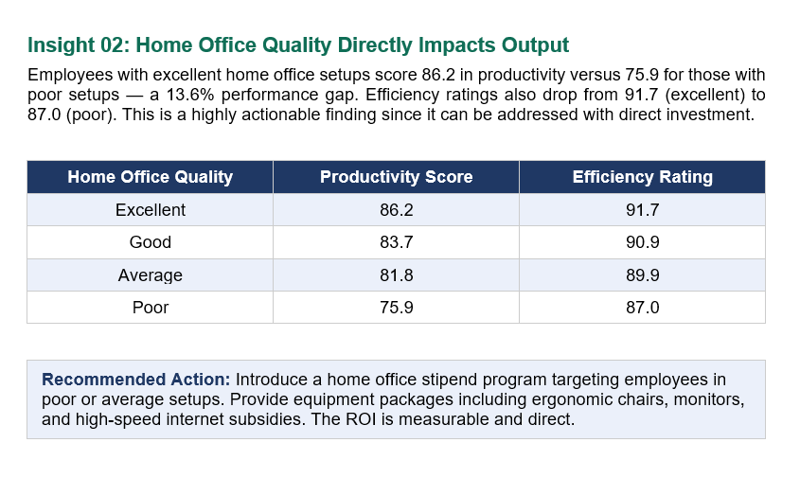
HR Actionable Insights & Strategic Recommendations
8 evidence-based findings
1
2
3
4
Remote Work Productivity Analysis · Slide 27 of 41

Slide 28
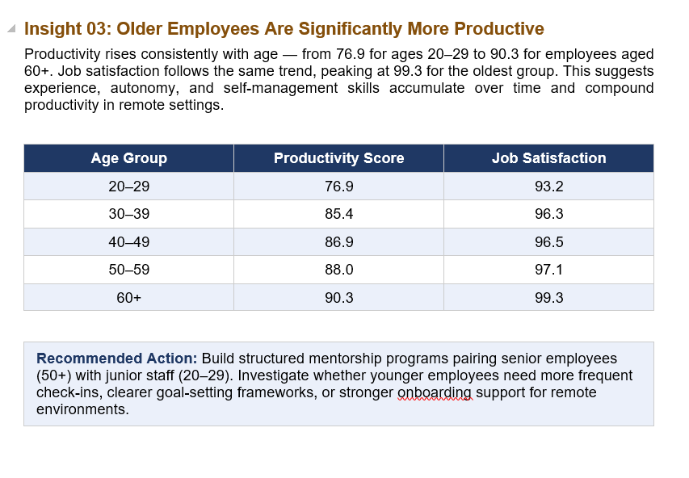
HR Actionable Insights & Strategic Recommendations
8 evidence-based findings
1
2
3
4
Remote Work Productivity Analysis · Slide 28 of 41

Slide 29
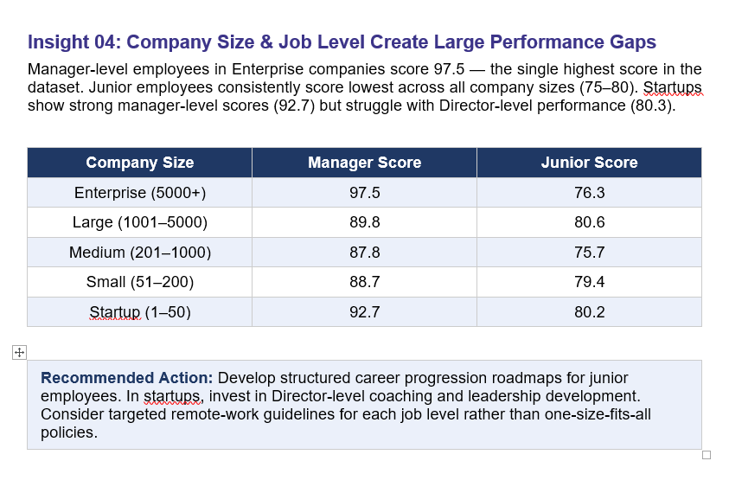
HR Actionable Insights & Strategic Recommendations
8 evidence-based findings
1
2
3
4
Remote Work Productivity Analysis · Slide 29 of 41

Slide 30
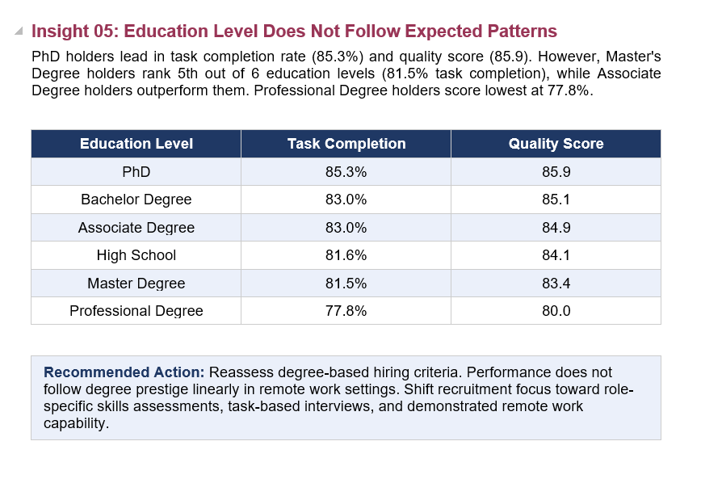
HR Actionable Insights & Strategic Recommendations
8 evidence-based findings
1
2
3
4
Remote Work Productivity Analysis · Slide 30 of 41

Slide 31
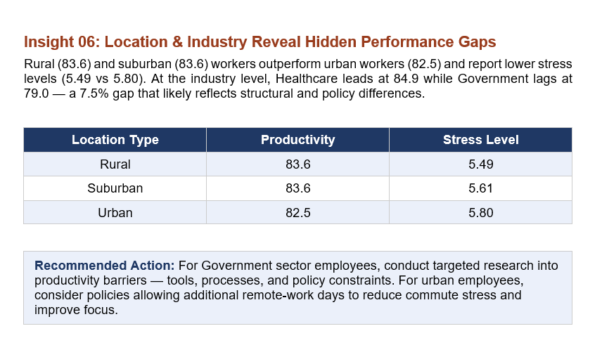
HR Actionable Insights & Strategic Recommendations
8 evidence-based findings
1
2
3
4
Remote Work Productivity Analysis · Slide 31 of 41

Slide 32
Performance Drivers
Correlation analysis — what actually moves the productivity needle
Manager Support Impact
Variable Correlation with Productivity
Remote Work Productivity Analysis · Slide 32 of 41

Slide 33
Business Question Answered — BQ1
Does WFH frequency affect productivity? Is there an optimal hybrid arrangement?
❓ QUESTION
Does WFH frequency affect productivity? Is there an optimal hybrid arrangement?
DATA EVIDENCE
0 days: 80.9 · 1 day: 81.4 · 2 days: 85.1 ★ · 3 days: 84.4 · 4 days: 82.2 · 5 days: 83.2
ANALYSIS
BUSINESS CONCLUSION
Yes. Productivity peaks at 2 WFH days (85.1) and is lowest at 0 days — full in-office (80.9). Full remote (5 days) scores 83.2, better than in-office but below the 2-day sweet spot.
A hybrid model of 2–3 days WFH is the optimal arrangement. Full RTO mandates are counterproductive and cost ~4 productivity points per employee.
★ KEY TAKEAWAY
A hybrid model of 2–3 days WFH is the optimal arrangement.
Remote Work Productivity Analysis · Slide 33 of 41

Slide 34
Business Question Answered — BQ2
How does manager support level affect productivity, satisfaction, and task completion?
❓ QUESTION
How does manager support level affect productivity, satisfaction, and task completion?
DATA EVIDENCE
Very Low: 68.7 · Low: 76.6 · Moderate: 80.6 · High: 86.9 · Very High: 87.6
ANALYSIS
BUSINESS CONCLUSION
Manager support is the single most impactful controllable variable. Very High support = 87.6 productivity. Very Low = 68.7 — a 27% gap. The pattern holds across satisfaction (89 vs 58) and task completion (86.6 vs 70.3).
Investing in manager training, coaching, and 360° feedback programmes delivers the highest ROI of any HR intervention. This is a leadership execution problem.
★ KEY TAKEAWAY
Investing in manager training, coaching, and 360° feedback programmes delivers the highest ROI of any HR intervention.
Remote Work Productivity Analysis · Slide 34 of 41

Slide 35
Business Question Answered — BQ3 & BQ4
Do home office quality and internet speed affect performance? Which industries lead?
❓ QUESTION
Do home office quality and internet speed affect performance? Which industries lead?
DATA EVIDENCE
Poor office: 75.9 · Average: 81.8 · Good: 83.7 · Excellent: 86.2 || Healthcare: 84.9 · Government: 79.0
ANALYSIS
BUSINESS CONCLUSION
Home office quality produces a 10-point spread (Poor: 75.9 → Excellent: 86.2). Internet speed shows only a 2-point difference. Healthcare leads industry productivity (84.9); Government lags (79.0) by nearly 6 points.
Redirect infrastructure budgets from broadband upgrades to home office stipends. Healthcare's lead is linked to higher manager support scores. Government's lag reflects structural rigidity.
★ KEY TAKEAWAY
Redirect infrastructure budgets from broadband upgrades to home office stipends.
Remote Work Productivity Analysis · Slide 35 of 41

Slide 36
Business Question Answered — BQ5–BQ8
Experience, meetings, demographics — what else drives performance?
❓ QUESTION
Experience, meetings, demographics — what else drives performance?
DATA EVIDENCE
Bi-weekly collab: 85.3 · Daily: 82.8 · Non-binary: 76.2 · Male/Female: 83.4 · Junior: 78.6 · Manager: 90.3
ANALYSIS
BUSINESS CONCLUSION
Experience has a moderate positive effect (r=0.25). Bi-weekly collaboration (85.3) outperforms daily standups (82.8) — over-meeting costs 2.5 pts. Non-binary employees score 7 pts below peers. PhD holders slightly outperform, but education impact is minimal overall.
Reduce meeting frequency, invest in junior mentorship, and launch a DEI inclusion programme for non-binary employees. Quality of work (r=0.92) not hours (r=−0.03) should define performance reviews.
★ KEY TAKEAWAY
Reduce meeting frequency, invest in junior mentorship, and launch a DEI inclusion programme for non-binary employees.
Remote Work Productivity Analysis · Slide 36 of 41

Slide 37
Executive Conclusion
What the data tells us — summary for decision-makers
CONTEXT
Study Design
FINDING
Central Finding
1,500 remote employees · 10 industries · 11 departments · 5 job levels · star-schema model · 30 variables measured across work environment, support structure, demographics, and output quality.
Productivity is not a function of where or how long people work. It is driven by manager quality, physical workspace, and work structure. Organisations optimising hours and attendance are measuring the wrong things.
RISK
Business Risk
ACTION
Immediate Actions
9.3% of the workforce (139 employees) score below 60. This group is characterised by poor manager support and substandard home office conditions — both entirely preventable with targeted investment.
Three actions recover 80% of the opportunity: (1) Manager excellence programme, (2) Hybrid 2–3 day policy, (3) Home office stipend. Combined expected uplift: +5 to +8 points organisation-wide.
Remote Work Productivity Analysis · Slide 37 of 41

Slide 38
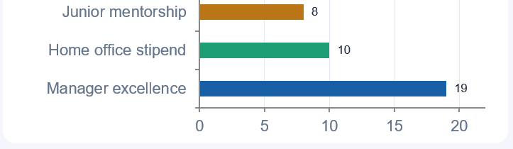
Strategic Recommendations
Evidence-based priorities — ordered by expected productivity uplift
Critical
Manager excellence programme
Q1–Q2 · Target: low-support managers · +19 pts
Critical
Formalise hybrid 2–3 day policy
Immediate · All employees · avoid 5-pt RTO loss
High
Home office stipend €500–€1k/yr
Q1 · Bottom quartile · +10 pts
High
Junior mentorship redesign
Q1–Q3 · 539 Junior staff · close 11.7-pt gap
Medium
Meeting audit — enforce bi-weekly
Q2 · Teams with daily standups · +2.5 pts
Remote Work Productivity Analysis · Slide 38 of 41

Slide 39
Action Plan
Prioritised 7-initiative roadmap with timeline and expected impact
#
Initiative
Target
Impact
Priority
Timeline
1
Manager excellence programme — coaching, 360° feedback
Low-support managers
+19 pts productivity
Critical
Q1–Q2
2
Formalise hybrid 2–3 WFH day policy
All employees
Avoid 5-pt RTO loss
Critical
Immediate
3
Home office stipend €500–€1k/yr
Poor/avg home offices
+10 pts bottom quartile
High
Q1
4
Junior mentorship & structured onboarding
539 Junior staff
Close 11.7-pt gap
High
Q1–Q3
5
Meeting audit — bi-weekly as default
Daily standup teams
+2.5 pts + deep work
Medium
Q2
6
DEI inclusion programme for non-binary staff
Non-binary segment
Close 7-pt gap
Medium
Q2–Q3
7
Government/Non-profit tooling upgrade
79 lagging-sector employees
+4–5 pts
Medium
Q2–Q4
Remote Work Productivity Analysis · Slide 39 of 41

Slide 40
Executive Conclusion (Legal & Economic Alignment)
How to elevate the current Excel dashboard design
"In conclusion, we emphasize that the data-driven insights and statistical metrics delivered by this study align perfectly with the proactive vision of the Egyptian legislator and the nation's drive toward digital transformation and sustainable development.
The numbers clearly prove that remote work is no longer just a flexible operational choice, but a solid economic system that yields tangible financial savings. It reduces operational overhead, power consumption, and facility costs for corporations, while simultaneously easing traffic congestion, lowering fuel consumption, and reducing carbon emissions on a national level—all without compromising productivity, which reaches its statistical peak in well-structured environments.
This synergy between economic gains, precise data analytics, and the foundational wisdom of Egyptian Labour Law demonstrates the state's forward-thinking approach in crafting a flexible legal ecosystem ready for the future. Consequently, we call upon policymakers, labour experts, and stakeholders in Egypt to embrace this data-driven policy approach, utilizing these vital metrics to refine future labour regulations to fit actual operational realities and balance productivity with societal well-being. This ensures Egypt remains a leading model that harmonizes the rule of law, investment efficiency, and human prosperity. "
Remote Work Productivity Analysis · Slide 40 of 41

Slide 41
Thank you.

