Slide 1
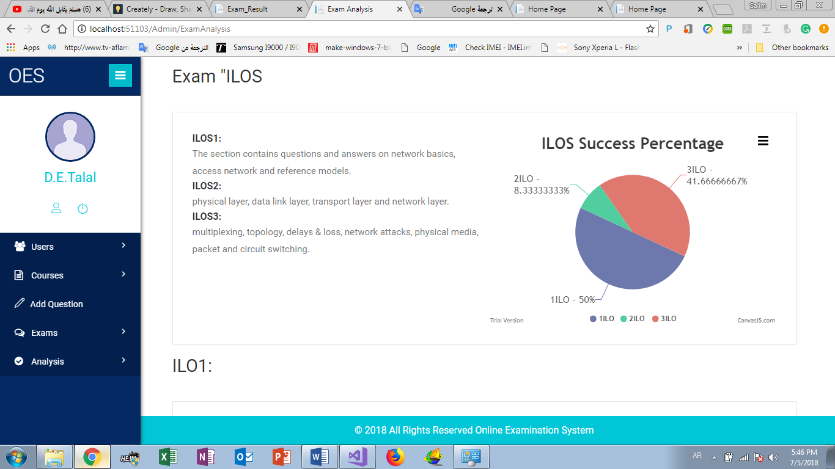
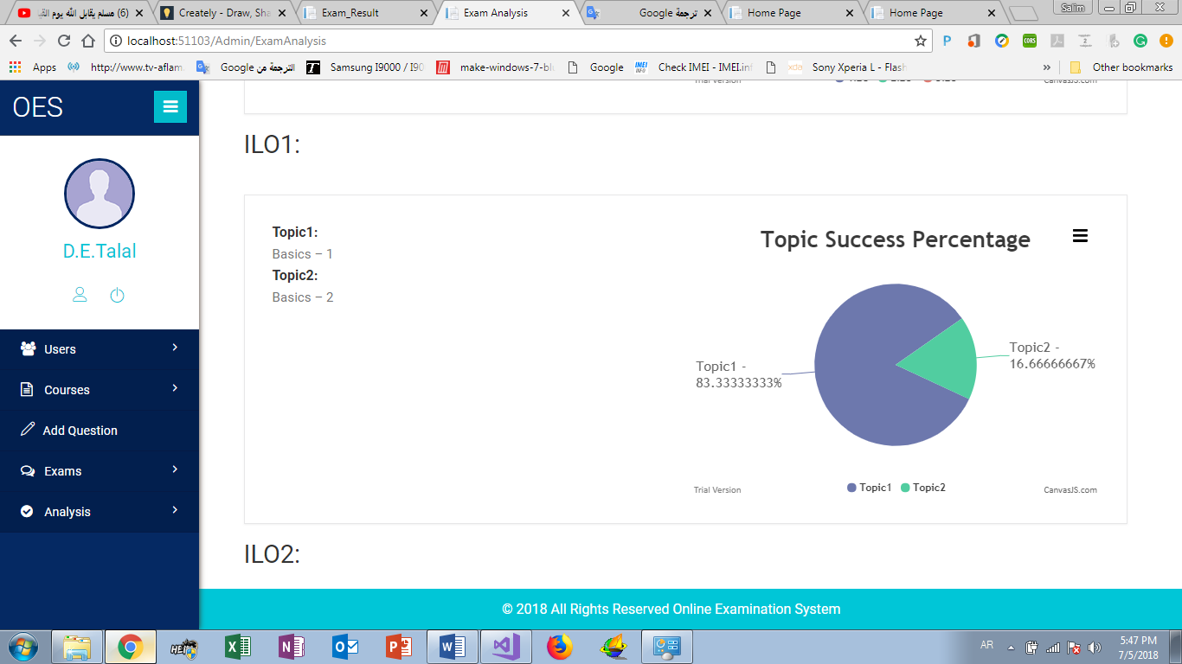

Slide 2
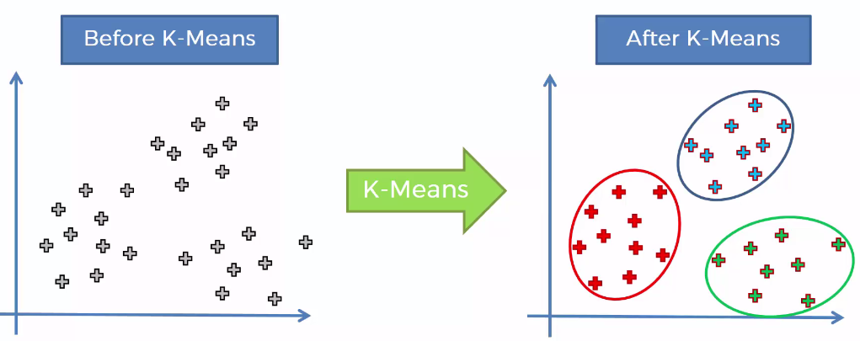

Slide 3
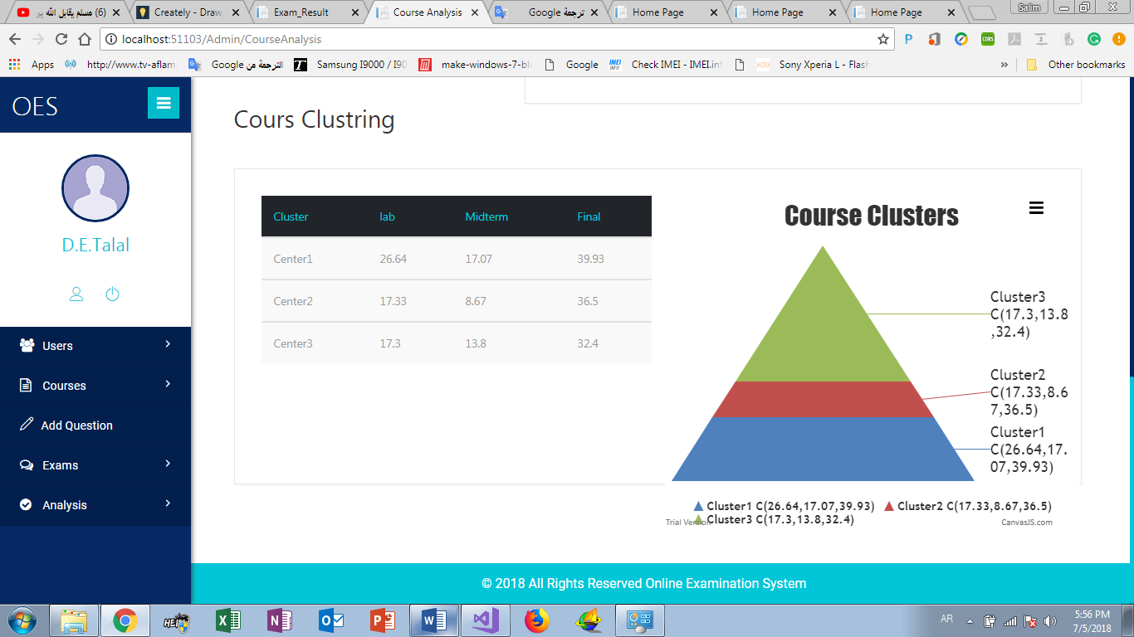

Slide 4

ssl
A protocol developed by Netscape.
It is a whole new layer of protocol which operates above the Internet TCP protocol and below high-level application protocols.
SSL is a standard security protocol for establishing encrypted links between a web server and a browser in an online communication.
The usage of SSL technology ensures that all data transmitted between the web server and browser remains encrypted

