Slide 1
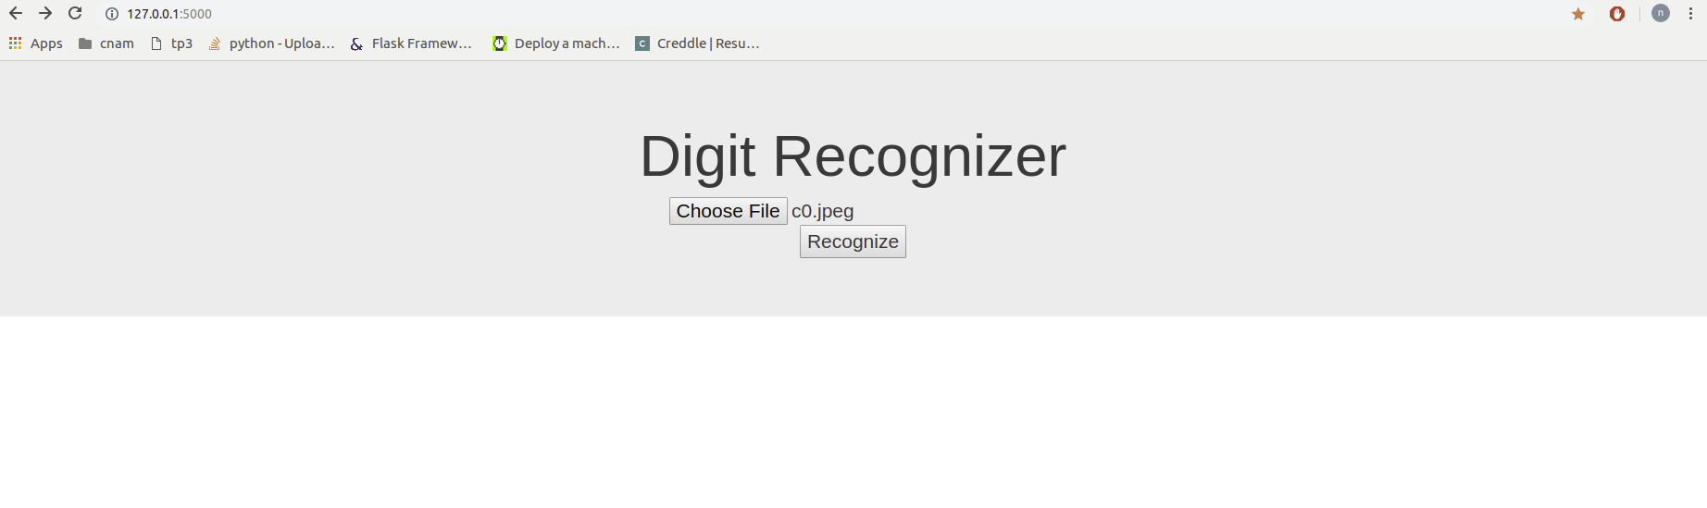
Step 1: upload image

Slide 2
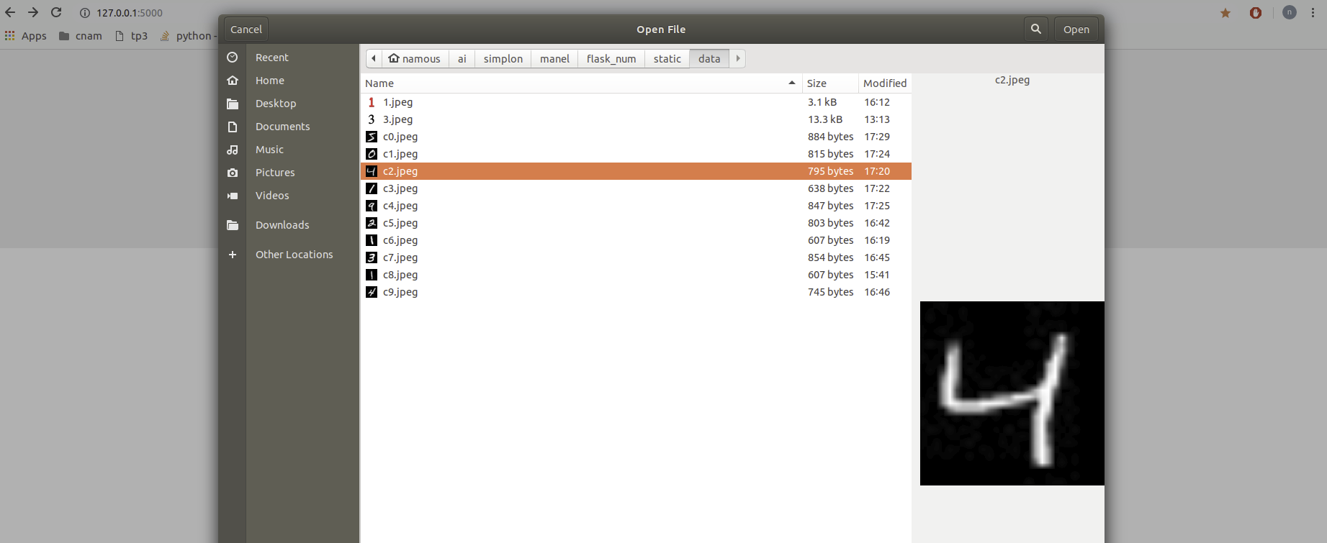
Step 2: Select image

Slide 3
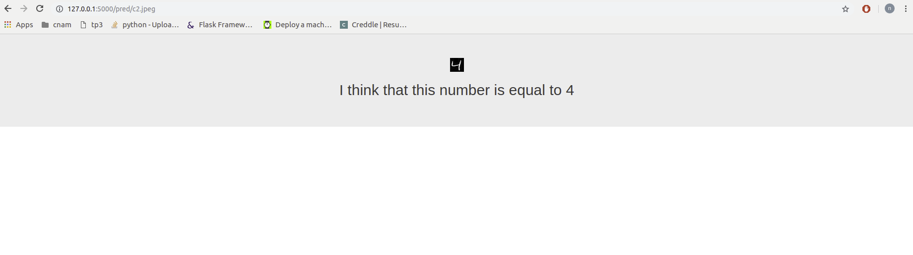
Step 1: Display Prediction

