Slide 1
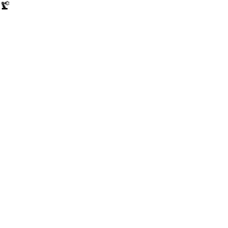

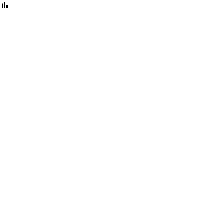
PREDICTIVE MAINTENANCE · MACHINE LEARNING
Machine Downtime
Prediction
Predicting equipment failure from real-time sensor data — torque, pressure, spindle speed, and temperature — so maintenance teams can act before a machine stops.
Sensor Data
ML Model
Insights
Machine Downtime Prediction
1

Slide 2

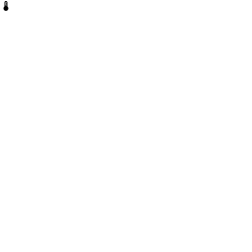
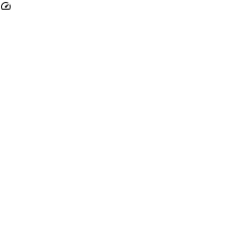
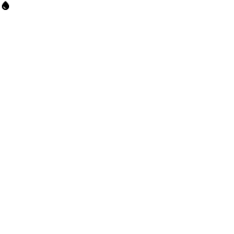
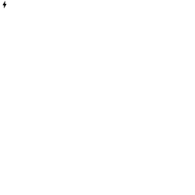
Dataset Overview
Industrial sensor readings used to anticipate machine failure
2500 Row 16 column
What is the dataset about?
2,500
16
Real-world industrial machine operating conditions and sensor readings, in the spirit of predictive-maintenance dataset.
Goal: predict Machine Failure vs. No Machine Failure from sensor signals alone.
Framed as a binary classification problem — target column: Downtime.
Raw Records
column Records
6
2
Six core sensors drive the prediction:
Torque (Nm)
Spindle Speed (RPM)
Hydraulic Pressure (bar)
Cutting Force (kN)
Sensor Features
Target Classes
Coolant Temperature
Coolant Pressure (bar)
Machine Downtime Prediction
2

Slide 3
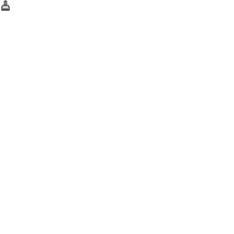
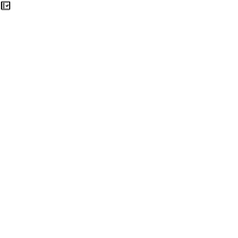
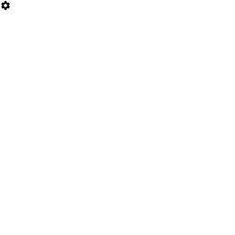
Data Cleaning
Preparing raw sensor logs before modeling
Missing & Invalid Readings
Duplicates
Data Preparation
Several sensor columns contained missing readings.
Affected rows were imputed with median
Dataset size: 2,500 → 2,500 clean records.
Duplicate rows were checked across the full record set.
Result: no duplicate rows found.
No further deduplication was required.
Assembly_Line_No was dropped — it duplicates Machine_ID.
Date is kept only for reference, never used as a model feature.
The target Downtime was encoded as 0 / 1.
Machine Downtime Prediction
3

Slide 4

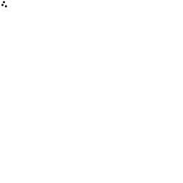
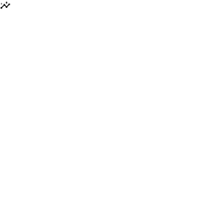
Exploratory Data Analysis
Understanding patterns before training models
Target Distribution
Relationships Explored
Correlation Analysis
The cleaned dataset (2,500 records) splits into Failure and No-Failure cases.
Classes are reasonably balanced — no heavy skew toward either outcome.
A balanced target makes accuracy a meaningful metric alongside precision/recall.
Torque vs. Spindle Speed — mechanical load patterns.
Hydraulic Pressure vs. Downtime — pressure drops preceding failure.
Coolant Temperature vs. Downtime — overheating as a failure signal.
A correlation heatmap was built across all sensor features.
It highlights which readings move together, and which move with the target.
Guided which sensors carry the strongest predictive signal.
Machine Downtime Prediction
4

Slide 5

Feature Engineering & Modeling
From clean sensor data to a trained classifier
Pipeline
Models Compared
1
Clean & Encode
Logistic Regression
85%
Drop Assembly_Line_No (duplicate of Machine_ID), missing values were imputed with the median, encode the target 0/1.
Linear baseline model
val. accuracy
2
Screen & Select Features
A quick Random Forest ranks all 12 candidate columns; the top 6 are kept: Torque, Hydraulic Pressure, Cutting Force, Coolant Pressure, Spindle Speed, Coolant Temperature.
85%
Linear SVM
Train / Validation / Test Split
Margin-based linear classifier
3
val. accuracy
80% train / 20% test, then the train set is split again (80/20) to create a validation set for model selection.
Random Forest
98.9%
4
Train & Compare
Ensemble of decision trees — selected model
Fit Logistic Regression, Linear SVM, and Random Forest on the validation split; pick the best by F1-score, then confirm on the untouched test set.
val. accuracy
Machine Downtime Prediction
5

Slide 6
Model Results
Held-out test-set performance
Best Model: Random Forest
Ensemble of decision trees — chosen for the strongest, most consistent test performance.
98.90%
99.10%
98.79%
99.00%
99.98%
Accuracy
Precision
Recall
F1-Score
ROC-AUC
Tree-based ensemble models consistently outperformed the linear baseline during comparison.
Random Forest generalized best on unseen data, with very high recall — critical for catching real failures early.
Machine Downtime Prediction
6

Slide 7
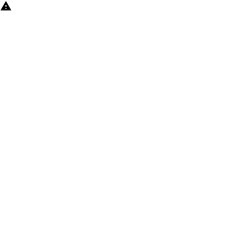
Roadmap: From Notebook to Production
What's already built, and what production deployment still needs
Model Saved
Inference Function
Interactive Demo
Production Deployment
The full pipeline (preprocessing + Random Forest) is persisted to disk with its metadata.
Validates each reading's sensor ranges and flags low-confidence cases for manual review.
A Gradio interface with sliders bounded to real sensor ranges — built and tested in the notebook.
Wrap inference in a FastAPI service, deploy to the cloud and monitor for drift with vercel.
Machine Downtime Prediction
7

Slide 8

Thank you for your time
Machine Downtime Prediction
8

