Slide 1

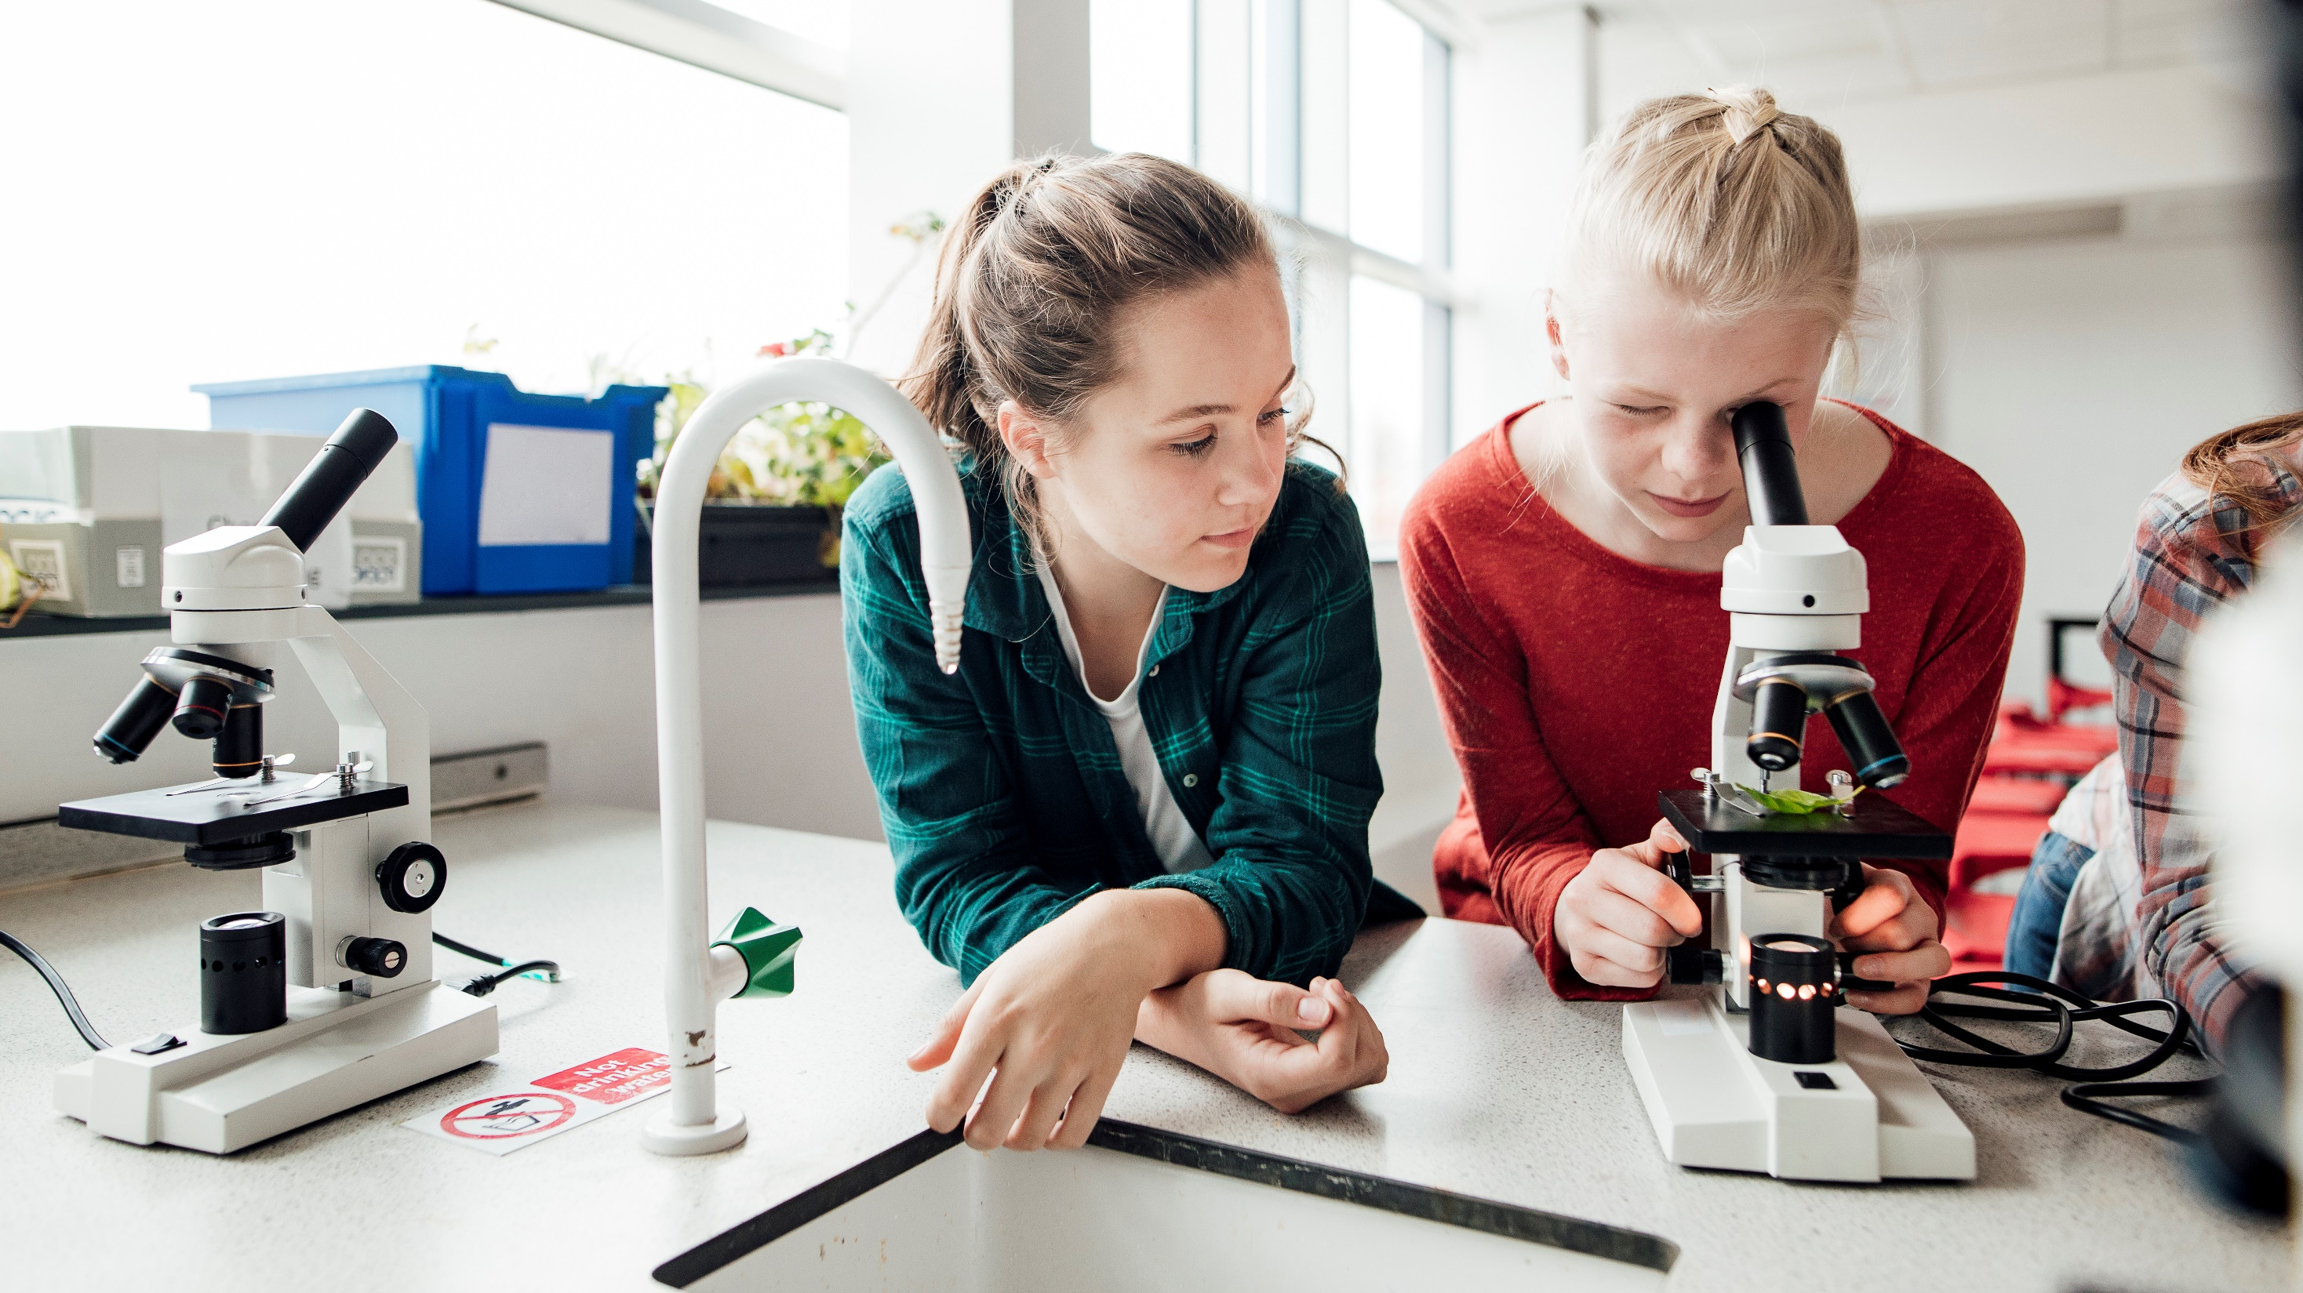
School Design

Slide 2
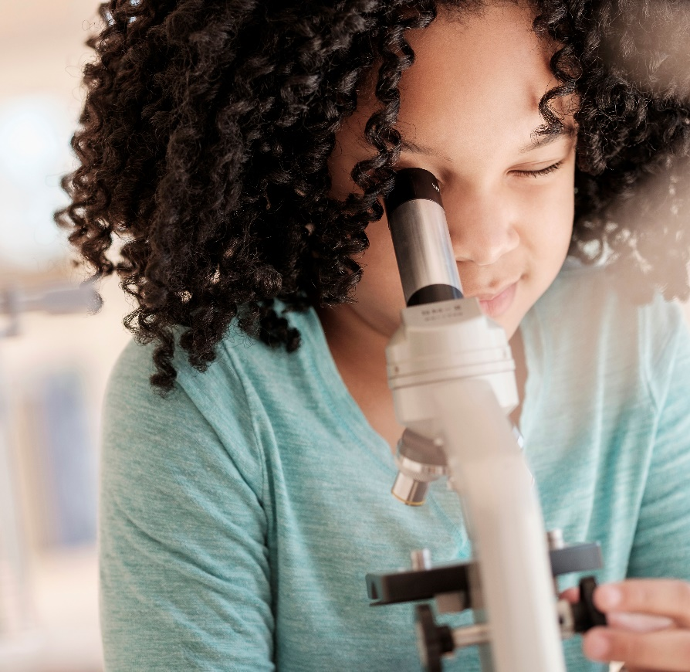



Science in education Promotes
Research
Communication
Curiosity

Slide 3
Student Growth By Grade

Slide 4

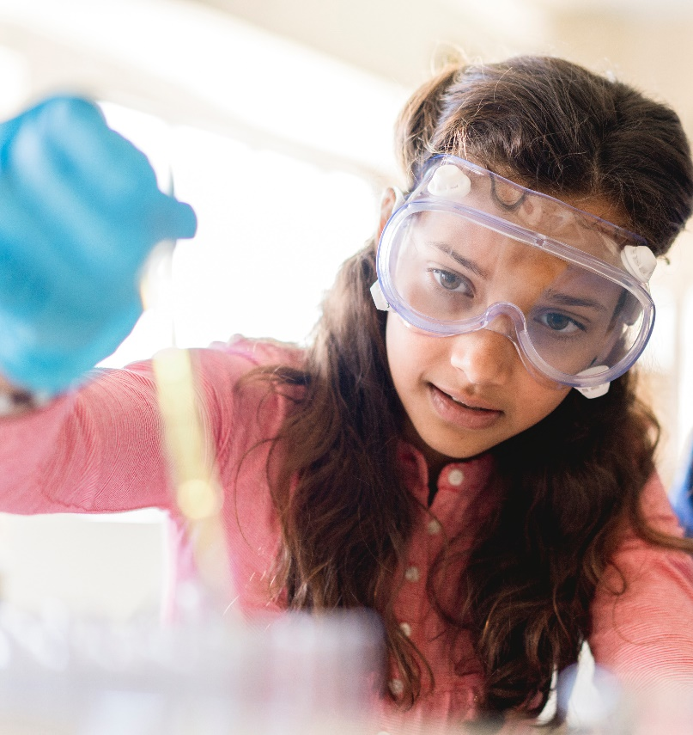
Our Curriculum
6th Grade: Basics
7th Grade: Scientific Method
8^{h} Grade: Research
9th Grade: Final Thesis

Slide 5
Thank You
someone@example.com

