Slide 1

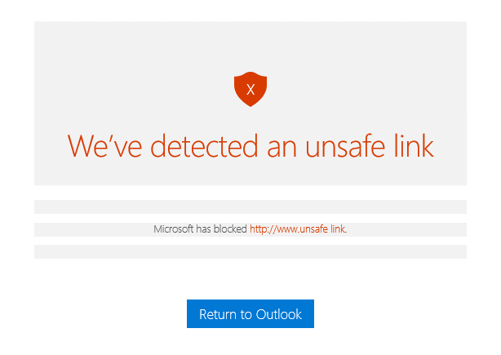
1. Avoid viruses and phishing scams
4 ways to
stay safe online
With the growing presence and sophistication of online threats like viruses, ransomware, and phishing scams, it’s important to have the right protection. Microsoft gives you advanced security tools to help keep your information secure and private.
35%
Malware and viruses attack your computer when you visit malicious websites or download infected files. Thirty-five percent of all computers globally are infected by malware.
23%
Hackers use phishing scams to try to steal your identity or money by sending official-looking email asking for sensitive personal information. 23% of people open phishing email.
To stay safe, use Outlook.com to send and receive email. Outlook.com uses advanced detection techniques to check attachments for viruses, and it warns you if you click on a suspicious link.

Slide 2
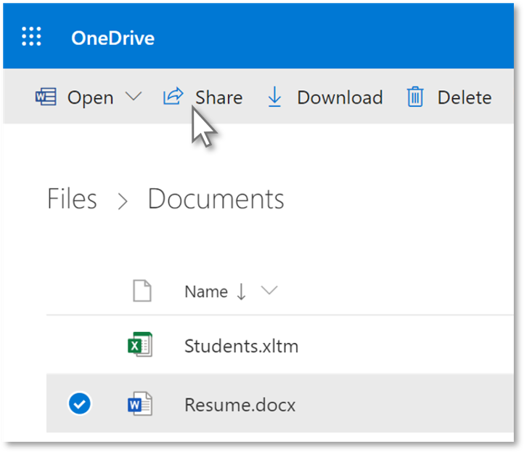
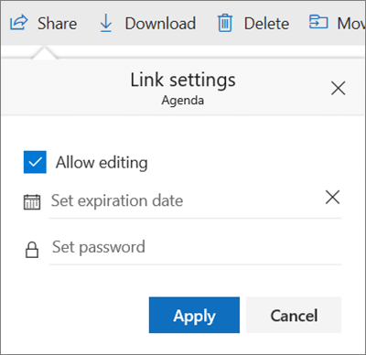
2. Protect your information with passwords
Sending confidential or personal information online can be worrisome. Using OneDrive, you can require a password to access a shared link. This prevents others from accessing your files if the recipient forwards or shares the link.
Go to OneDrive, select the file you want to share, then select Share.
Select Anyone with the link can edit, then select Set password and enter a password.
Select Apply, then enter an email address and select Send.

Slide 3
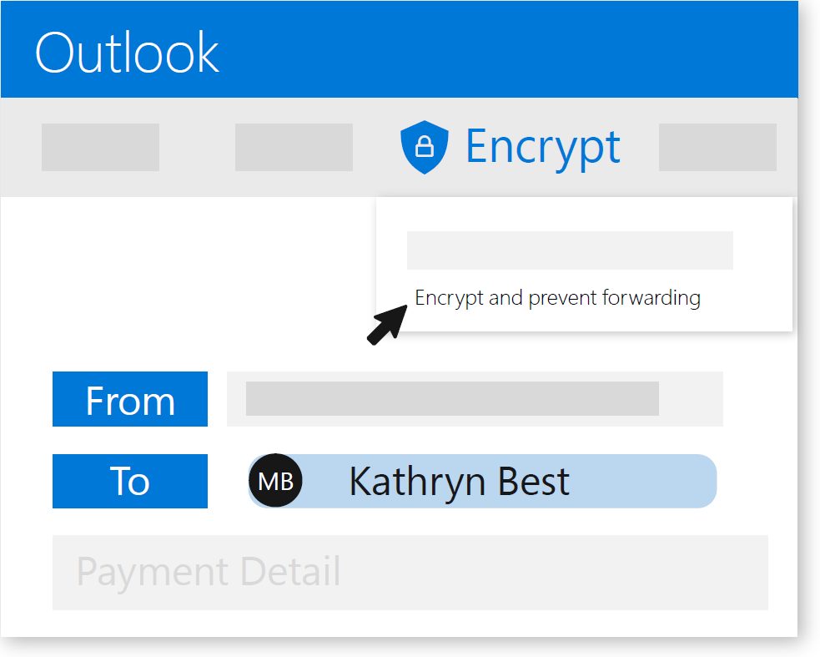
3. Encrypt email to minimize threats
Use email encryption in Outlook.com to share your confidential and personal information and minimize the threat of your email being intercepted or leaked to cybercriminals.
To send an encrypted email,
select Encrypt > Encrypt to encode your message, or Encrypt > Encrypt and prevent forwarding to encode your message and prevent it from being copied or forwarded.

Slide 4
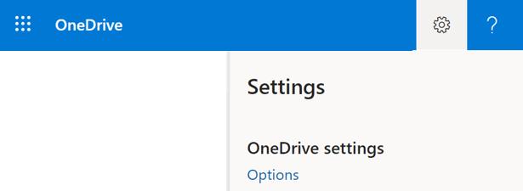
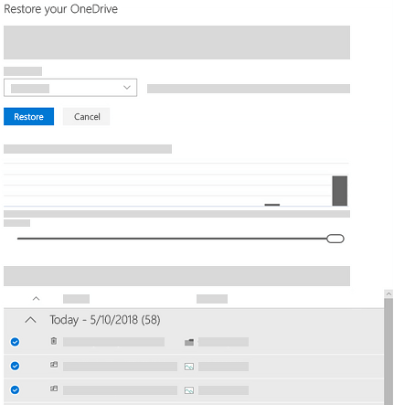
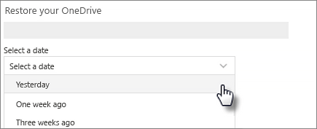
4. Recover files from malicious attacks
If Microsoft detects a ransomware attack, you’ll get an email or notification. To recover from ransomware, file corruption, malicious attacks, or accidental deletions, you can restore your OneDrive to a previous time.
Go to OneDrive, select Settings > Options.
Select Restore your OneDrive, then Select a date from the drop-down list, or choose Custom date and time.
Select the earliest activity that you want to undo, then select Restore to undo all the activities you selected.
For more information, visit aka.ms/staysafeonline
Sources: U.S. Department of Justice, How to Protect your Networks from Ransomware;
Anti-Phishing Working Group, Phising Activity Trends Report, Q4 2015;
Verizon, Data Breach Investigations Report, 2015

