Slide 1

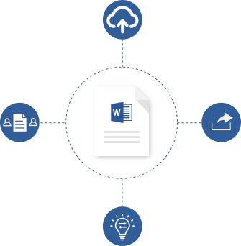

Collaborate with anyone, anywhere
No need to huddle around the same computer or send files back and forth.
You can all edit the same copy of the document—even in real time.
Save to the Cloud
Saving your files to the cloud lets you access
them from anywhere and makes it easy
to share with your team.
Work together in real time
Co-author documents in real time, and see others’ changes as they happen.
Share
With a click of a button,
quickly invite others
to edit or view your document.
Give or receive ideas
Track your changes and share your thoughts
in comments. Everyone can add to the conversation and stay on top of changes.
aka.ms/coauthorinword

Slide 2
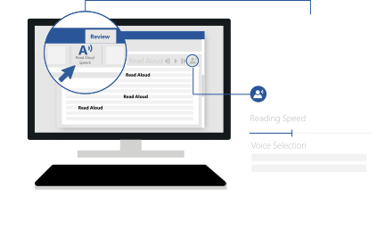
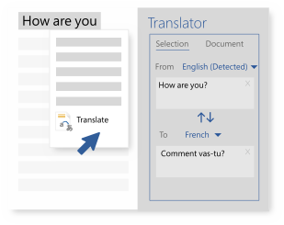
Listen to your content
Too busy to sit down and read? Listen instead.
Read Aloud in Word lets you to hear your document as each word is highlighted.
Change the reading speed and the voice of your narrator.
Read Aloud is one of Word’s Learning Tools, designed to aid people with dyslexia and dysgraphia,
but it can help anyone working on their reading skills.
aka.ms/wordlearningtools
Translate
Break the language barrier. Read a document in your language or translate it to your reader’s language without leaving Word.
Use Translator to look up and learn what words and phrases mean in other languages.
Translate selected text
or full documents across
60 languages.
aka.ms/translateinword

Slide 3
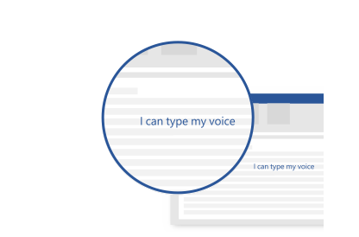
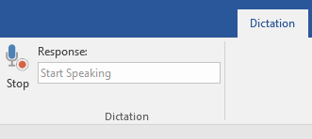
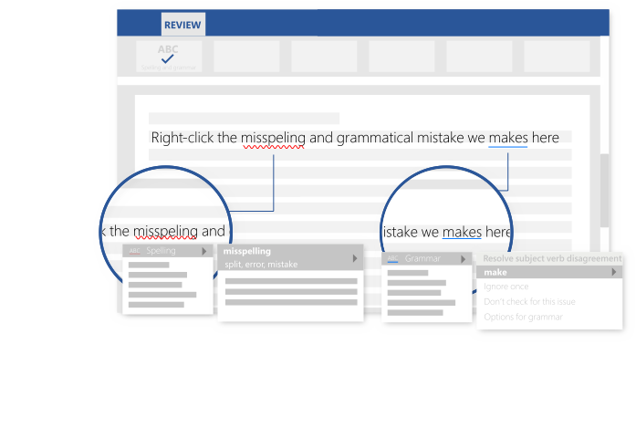
Dictate
Typing can take a lot of time. Writing emails, drafting documents—why not type with your voice and be hands-free? Type, edit, and format documents by speaking in Word. Anything you say turns into text.
I can type my
voice
Dictate is an add-in for Word, Outlook, and PowerPoint. It adds a Dictation tab to the ribbon.
aka.ms/dictate
Proofread as you type
Feel more confident writing in Word – Editor has your back.
Editor checks your spelling and grammar, and also offers style suggestions to help you improve your writing.
aka.ms/editorinword

Slide 4
See more tips, videos, help, and training
Visit aka.ms/WordHelp
These experiences are available in the Word 2016
desktop and Word in Office 365.

