Slide 1
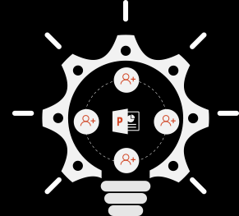
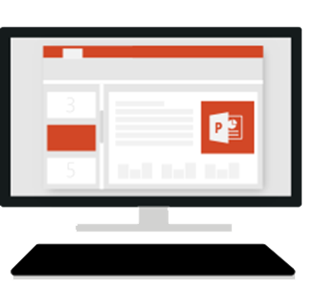

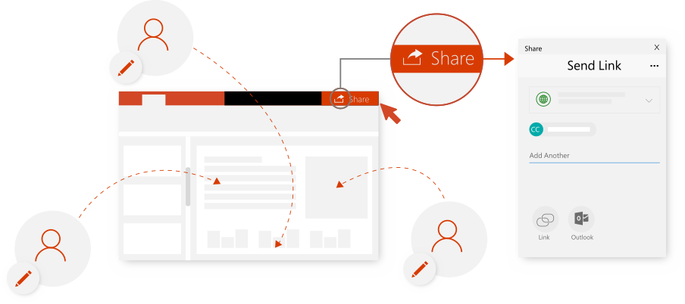

7 Ways to work together
in PowerPoint
Edit with other people
Share a presentation with others
so you can work on it together.
How-to steps and video: aka.ms/powerpointsharehelp
See who's working
Presence indicators show
who’s working in the file.
How-to steps and video: aka.ms/powerpointpresencehelp

Slide 2
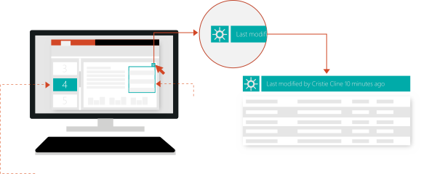
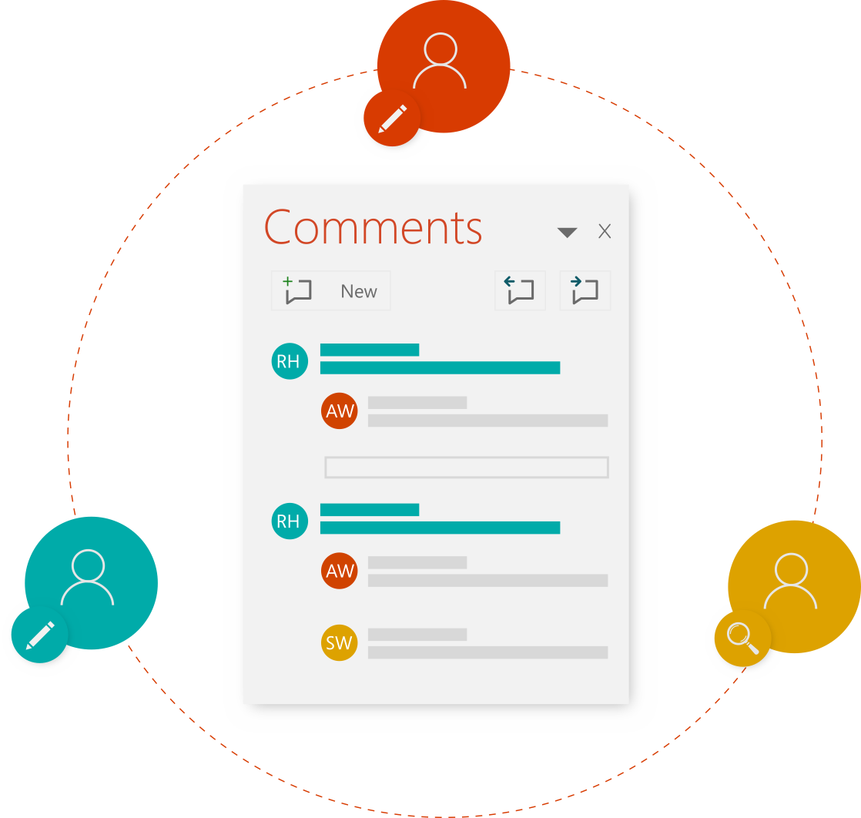
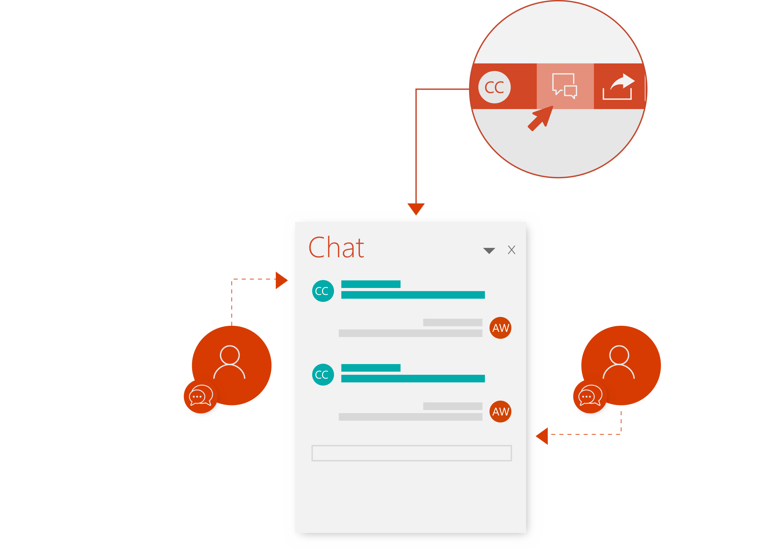
See what's changed
Coloring in the thumbnail pane and on slides indicates
what’s been updated since you last looked.
Outlined item
Shading in the thumbnail pane
How-to steps and video: aka.ms/powerpointrevisionshelp
Give and receive ideas
Chat instantly with others
Add notes for others,
or see what they've written.
Want to discuss it right now?
Start a chat that’s seen by everyone currently editing the file.
How-to steps and video: aka.ms/officechathelp
How-to steps and video: aka.ms/powerpointcommentshelp

Slide 3


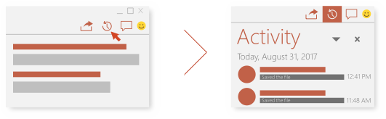
Give vivid feedback
Ink for emphasis! Some things are just easier to draw or scribble.
How-to steps and video: aka.ms/officeinkhelp
EDIT
SCRIBBLE
DRAW
See previous versions
When you’re collaborating with others, sometimes you want to see what the file looked like before someone changed it.
How-to steps and video: aka.ms/powerpointhistoryhelp
YESTERDAY
2 HOURS AGO
NOW
You can restore a prior version, save it separately, or copy content from it

Slide 4
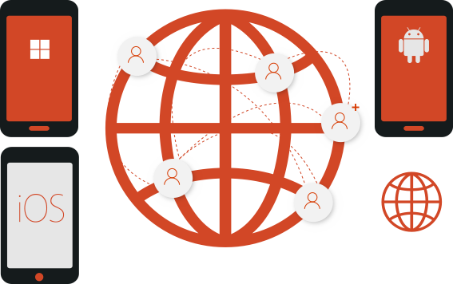
Work from anywhere, on any device
Away from your desk? Make quick changes on your phone or tablet.
PowerPoint
for Windows Phone
PowerPoint
for Android
PowerPoint
for iOS
PowerPoint
Online
How-to steps and video: aka.ms/officeappsmobilehelp
See more tips, videos, help, and training
Visit aka.ms/PowerPointHelp
These experiences are available in PowerPoint in Office 365.

