Slide 1

Presentation Title
Presenter Name

Slide 2

Agenda
Topic one
Topic two
Topic three
Topic four
Topic five

Slide 3



Introduction
With PowerPoint, you can create presentations and share your work with others, wherever they are. Type the text you want here to get started. You can also add images, art, and videos on this template. Save to OneDrive and access your presentations from your computer, tablet, or phone.

Slide 4


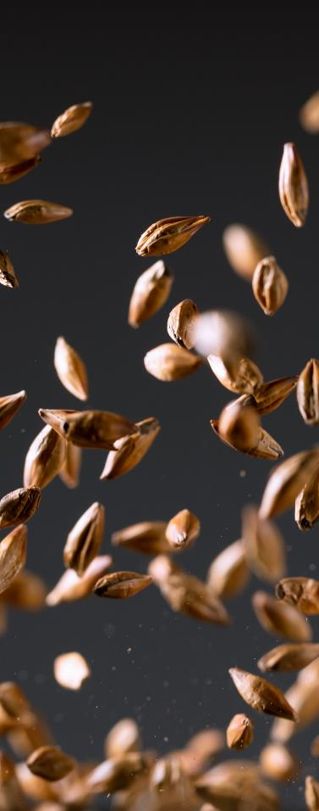

Topic one
Subtitle

Slide 5
Chart

Slide 6
Table
 | Category 1 | Category 2 | Category 3 | Category 4
Item 1 | 4.5 | 2.3 | 1.7 | 5
Item 2 | 3.2 | 5.1 | 4.4 | 3
Item 3 | 2.1 | 1.7 | 2.5 | 2.8
Item 4 | 4.5 | 2.2 | 1.7 | 7

Slide 7


The way to get started is to quit talking and begin doing.
Walt Disney

Slide 8




Team
Name
Name
Name
Name
Title
Title
Title
Title

Slide 9
Timeline
Title
To start a presentation, go to the Slide Show tab, and select From Beginning.
Title
To display Presenter view, in Slide Show view, on the control bar at the bottom left select the three dots, and then Show Presenter View.
Title
If you don’t see the Notes pane or it is completely minimized, click Notes on the task bar across the bottom of the PowerPoint window.
Title
During your presentation, the speaker notes are visible on your monitor, but aren't visible to the audience.
Title
The Notes pane is a box that appears below each slide. Tap it to add notes.

Slide 10
Content
Subtitle
Subtitle
Add text, images, art, and videos.
Add transitions, animations, and motion.
Save to One Drive, to get to your presentations from your computer, tablet, or phone.
Add text, images, art, and videos.
Add transitions, animations, and motion.
Add text, images, art, and videos.
Add transitions, animations, and motion.
Save to One Drive, to get to your presentations from your computer, tablet, or phone.
Add text, images, art, and videos.
Add transitions, animations, and motion.

Slide 11

Content 2
Subtitle
Subtitle
Subtitle
Add text, images, art, and videos.
Add transitions, animations, and motion.
Save to One Drive, to get to your presentations from your computer, tablet, or phone.
Add text, images, art, and videos.
Add transitions, animations, and motion.
Add text, images, art, and videos.
Add transitions, animations, and motion.
Save to One Drive, to get to your presentations from your computer, tablet, or phone.
Add text, images, art, and videos.
Add transitions, animations, and motion.
Add text, images, art, and videos.
Add transitions, animations, and motion.
Save to One Drive, to get to your presentations from your computer, tablet, or phone.
Add text, images, art, and videos.
Add transitions, animations, and motion.

Slide 12


Summary
With PowerPoint, you can create presentations and share your work with others, wherever they are. Type the text you want here to get started. You can also add images, art, and videos on this template. Save to OneDrive and access your presentations from your computer, tablet, or phone.

Slide 13

Thank You
Presenter Name
Email Address
Website Address

