Slide 2
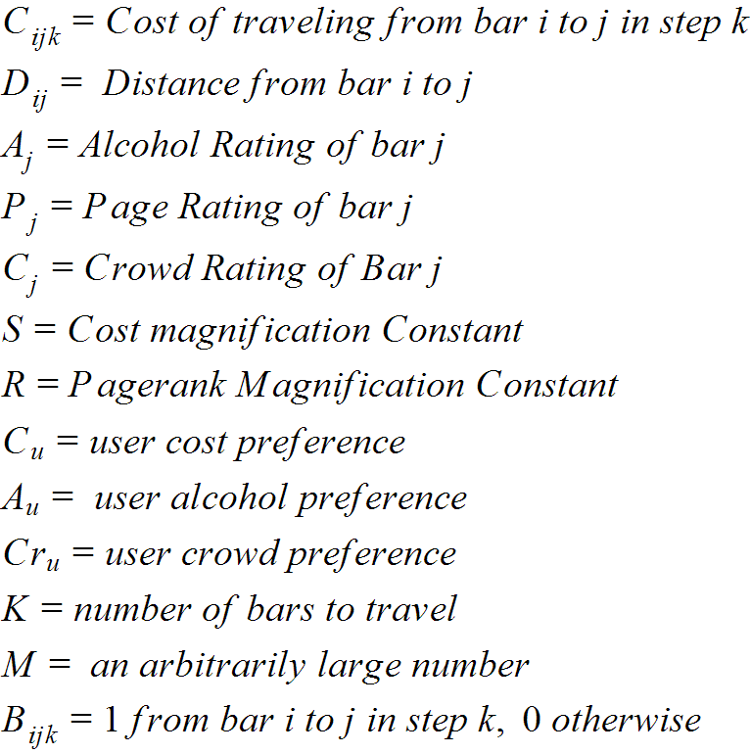
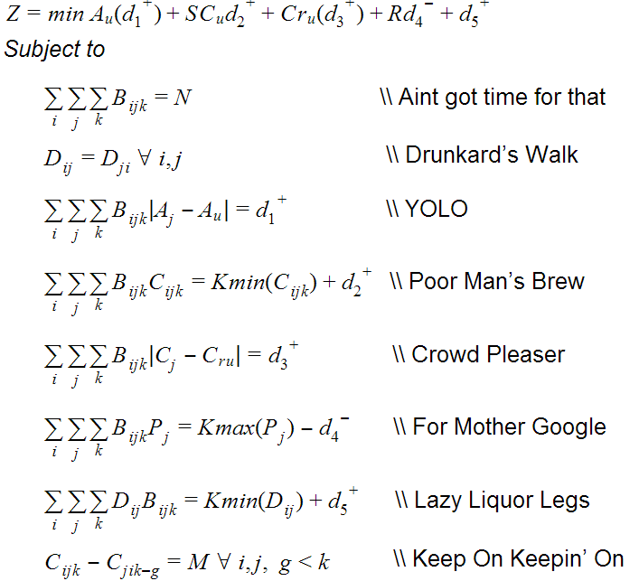
THE CrawlR Algorithm
Variables (Things we can CHANGE) Optimization (What do we really want?)
\\ Aint got time for that
\\ Drunkard’s Walk
\\ YOLO
\\ Poor Man’s Brew
\\ Crowd Pleaser
\\ For Mother Google
\\ Lazy Liquor Legs
\\ Keep On Keepin’ On

Slide 3
The CrawlR Pitch
Users (Beer Money) Optimization (What do we really want?)
\\ Aint got time for that
\\ Drunkard’s Walk
\\ YOLO
\\ Poor Man’s Brew
\\ Crowd Pleaser
\\ For Mother Google
\\ Lazy Liquor Legs
\\ Keep On Keepin’ On

