Slide 1
Babo :: BTetris
presentation : Hyun Gyu Jang
seirion@mensakorea.org
September 8 2010

Slide 2
history
version | contents | editor | date
0.1.0 | Document created. | babo | 2010.Sep.08

Slide 3
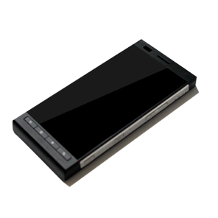




1. icon
72pixel

Slide 4

1. layout
BTetris EXIT
Are you sure you want to exit ?
?
Yes
No
Setting
or
Score board
main

Slide 5
1. 1 main
* Control By Touch
Fling right : move to right
Fling left : move to left
Fling down : move to down
Display Next block
Display score
Main game board
Rotation buttons
Control buttons (left, right)
Down Button

Slide 6
1. 2 setting
Rotation direction
CW, CCW
See the ranking
Apply
Cancel

Slide 7
1. 3 ranking board
1st. babo 2010.08.23
37,900 Points
2nd. babo 2010.08.19
27,100 Points
3rd. babo 2010.08.23
19,990 Points
4th. babo 2010.08.20
17,200 Points
5th. babo 2010.08.20
14900 Points

Slide 8
1. 4 popup
Your Score
15,000 points

