Slide 1
WPF by Ashirwad S.
Windows Presentation Form

Slide 2
Windows Presentation Foundation (WPF) provides developers with a unified programming model for building rich Windows smart client user experiences that incorporate UI, media, and documents. -- MSDN

Slide 3
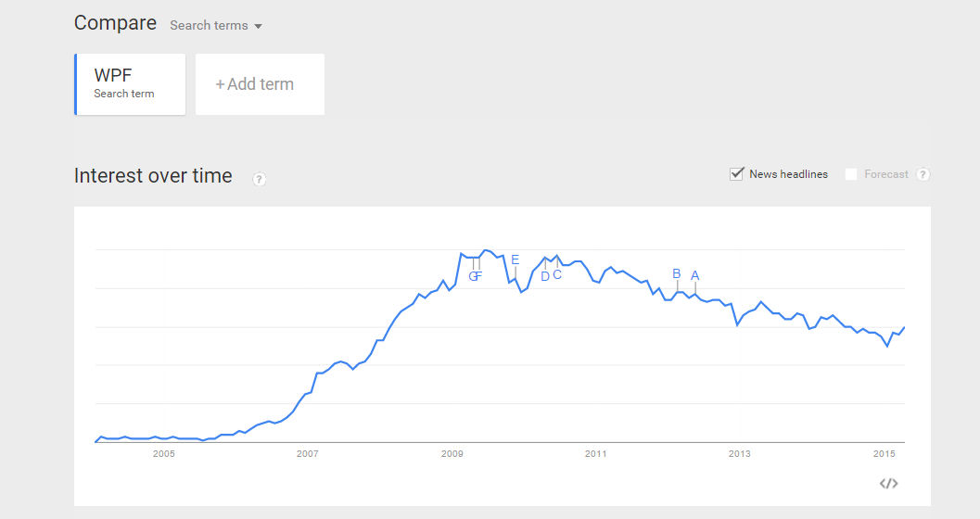

Slide 4
Advantage over the Predecessor
Winforms requiring developers to append separate api.
For instance:
2D Graphics -> GI_ (System.Drawing.dll)
3D Graphics -> DirectX APIs
Streaming video -> Windows media Player Apis
WPF (3.0) purposely created to merge the diverse use of API into one.

Slide 5
Adv Continue
Optimized rendering Model
Flexibility, Scalability
Data binding
Vector & style engine
Support for pages - level/segments
Ability to run in the browser
So basically making interfaces for both Windows applications and web applications (Silverlight/XBAP)
Easier animation and graphics
Separation of UI and code , XAML
New Learning Curve

Slide 6
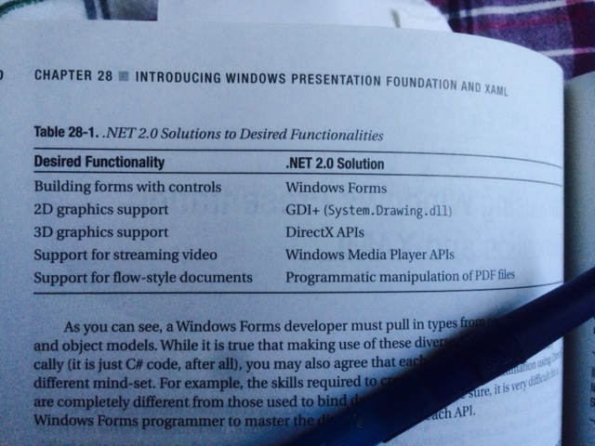
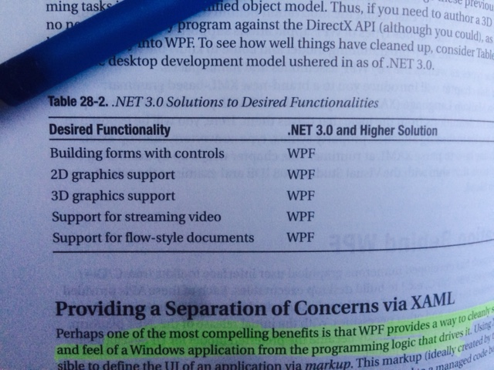
Winform vs WPF

Slide 7
XAML & Design View
Extensive Application Markup Language. Self-describing as XML
One top level Element.
Type Converter engine.
GRID & using Attributes || Using Property Element
Create Events and listener
Control box

Slide 8
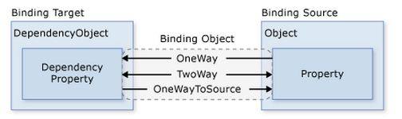
Data Binding

Slide 9
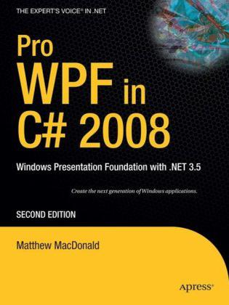
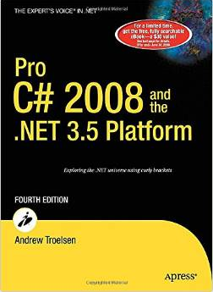
Reference
ISBN-10: 1590599551
ISBN-10: 1590598849

Slide 10
Some Example
Text editor
Music player
Photo viewer
SMTP Client
File Cloner
Alarm (mp3)
Script Generator

Slide 11
Questions
OEO!

