Slide 1
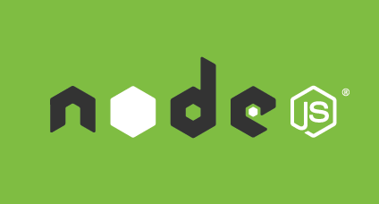
Jed Brundidge

Slide 2
Overview
What is Node.js?
History of Node.js
Pros and Cons of using Node.js
When to use Node.js
Examples
Summary
Questions

Slide 3
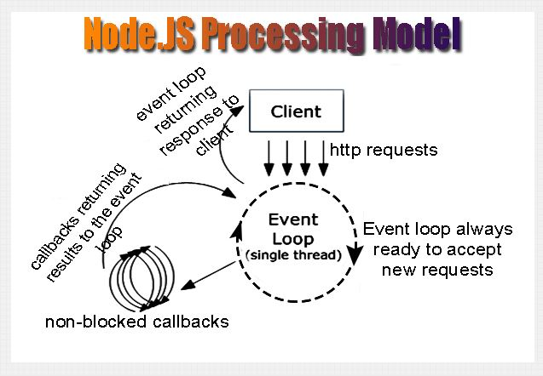
What is Node.js?
Node.js is a platform built on Chrome's JavaScript runtime for easily building fast, scalable network applications. Node.js uses an event-driven, non-blocking I/O model that makes it lightweight and efficient, perfect for data-intensive real-time applications that run across distributed devices.

Slide 4
History of Node.js
In 2008 the V8 JavaScript engine is release by Google for the Chrome web browser.
In 2009 Ryan Dahl attempts to solve the upload progress bar problem. Inspired by Mongrel web server for Ruby, Dahl decides to give JavaScript a try.
Convinced this was "a thing", Dahl quits his job and spends the next 6 months working on developing Node.
After 6 months of developing Node, Dahl begs for and is given a spot at the JS Conference in Berlin. He blew people away with an IRC chat server written in 400 lines of JS.

Slide 5
Node.js Pros
Asynchronous event driven IO helps concurrent request handling.
Uses JavaScript, which is easy to learn.
Well architected Node applications are enabling Enterprises to handle 5x-10x the number of connections on a single server than previously
Active and vibrant community, with lots of code shared via github, etc.

Slide 6
Node.js Cons
Asynch programming has a learning curve. Can be difficult at first to grasp the concepts.
Node.js is not suited for CPU-intensive tasks. It is suited for I/O stuff only.
There isn't a solid webserver option to pair it with.
Not a lot of mature frameworks out there. Things tend to be raw or move quickly.

Slide 7
When To Use Node.js
Multiple File Uploading - Node makes it possible to upload multiple files at the same time, increasing upload speeds.
Real-Time Applications - Stock exchange applications are a good example. Anything that needs to be done in real-time is great for node.js.
Web Socket Server - The non-blocking architecture of node makes it the best suited solution for socket server applications or broadcasting like applications. Chat servers can become more efficient and real time using Node.js as their base.

Slide 8
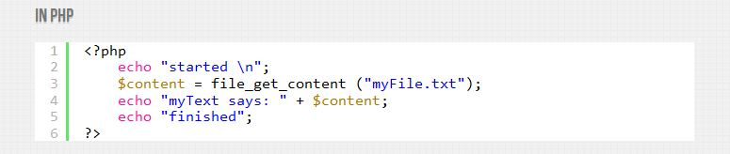
Examples

Slide 9
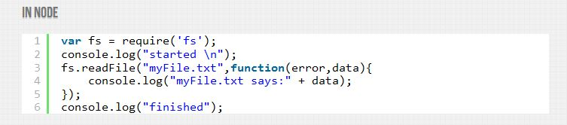
Examples

Slide 10
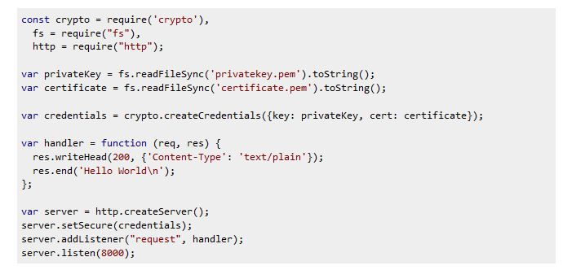
Examples

Slide 11
Summary
What is Node.js?
History of Node.js
Pros and Cons of using Node.js
When to use Node.js

Slide 12
Sources
Nodejs.org
http://elegantcode.com/2012/02/06/solving-the-upload-progress-bar-problemthe-history-of-node-js/
http://voidcanvas.com/describing-node-js/
https://blog.engineyard.com/2013/when-to-use-nodejs

Slide 13
Questions?

