Slide 1
React: A Sneak Peak
Warsame Bashir
Notes:
No fb

Slide 2
Outline
What is ReactJS ?
Why ReactJS?
JSX & Virtual DOM
Components / Render pattern
DEMO
Questions

Slide 3
React is a UI library developed at Facebook to facilitate the creation of interactive, stateful & reusable UI components. It is used at Facebook in production, and Instagram.com is written entirely in React.
What is React?

Slide 4
Meet React.
Not yet another JS framework!

Slide 5
Meet React.
But just a library for creating user interfaces.

Slide 6
Meet React.
Renders your UI and responds to events.

Slide 7
Meet React.
a.k.a. The “V” in M V C

Slide 8
Build components,
not templates
Notes:
Or: mixing markup and display logic

Slide 9
Build components,
not templates
Re-render, don’t mutate
Notes:
Or: mixing markup and display logic

Slide 10
Build components,
not templates
Re-render, don’t mutate
Fast Virtual DOM
Notes:
Or: mixing markup and display logic

Slide 11
Build components, not templates
Combine DOM generation and display logic.

Slide 12
Build components, not templates
Combine DOM generation and display logic.
Transform data into interface components.

Slide 13
Build components, not templates
Combine DOM generation and display logic.
Transform data into interface components.
Data can come from anywhere.

Slide 14
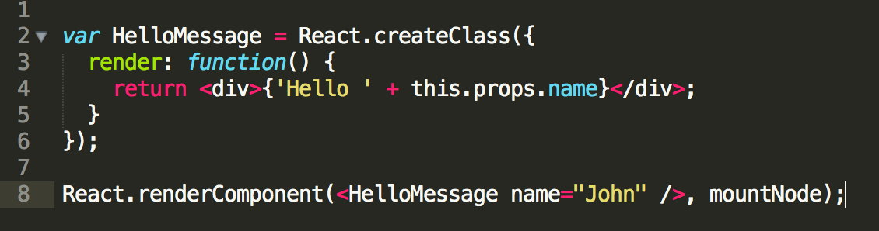
Build components, not templates

Slide 15
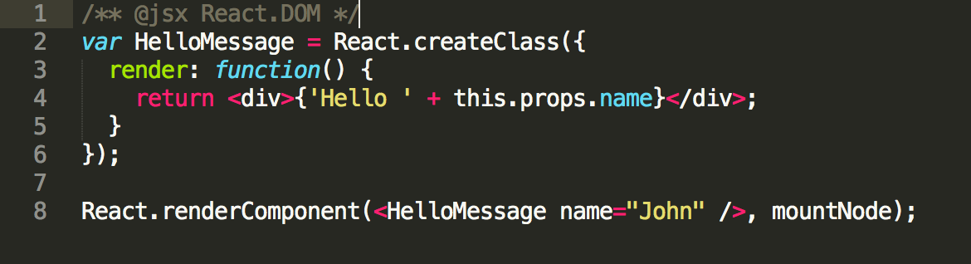
Build components, not templates
/** @jsx .. **/ tells React to use JSX syntax

Slide 16
JSX
Allows you to write JS & XML

Slide 17
JSX
Allows you to write JS & XML
Together!

Slide 18
JSX
Don’t need to use it as such

Slide 19
JSX
React.DOM.div({}, 'Hello ' + this.props.name)

Slide 20
Re-render, don’t mutate!
Every component has “state” and “props”.

Slide 21
Re-render, don’t mutate!
Every component has “state” and “props”.
Acts as an “Immutable DOM”.

Slide 22
Re-render, don’t mutate!
Every component has “state” and “props”.
Acts as an “Immutable DOM”.
Re-render the whole app once the state changes.

Slide 23
Re-render, don’t mutate!
Data is guaranteed
to update!

Slide 24
Re-render, don’t mutate!
Just like the 90’s
Full-page refresh!!

Slide 25
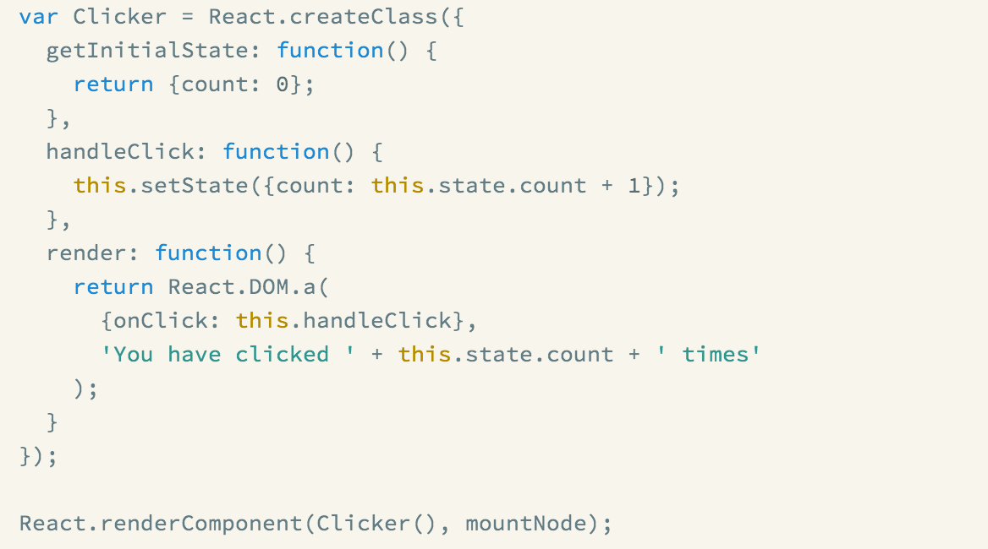
Notes:
----- Meeting Notes (9/9/13 12:00) -----
nowhere in this example is the dom node for count explicitly updated

Slide 26
Fast Virtual DOM
Virtual DOM
Makes re-rendering on every change fast.

Slide 27
Fast Virtual DOM
On every update…
React builds a new virtual DOM subtree

Slide 28
Fast Virtual DOM
On every update…
React builds a new virtual DOM subtree
…diffs it with the old one

Slide 29
Fast Virtual DOM
On every update…
React builds a new virtual DOM subtree
…diffs it with the old one
…computes the minimal set of DOM mutations and puts them in a queue

Slide 30
Fast Virtual DOM
On every update…
React builds a new virtual DOM subtree
…diffs it with the old one
…computes the minimal set of DOM mutations and puts them in a queue
…and batch exexutes all updates

Slide 31
Fast Virtual DOM
none to first
Create Node: <div className="first"><span>A Span</span></div>
first to second
Replace attribute: className=“first" by className=“second"
Replace node: <span>A Span</span> by <p>A Paragraph</p>
second to none
Remove Node: <div className="second"><p>A Paragraph</p></div>

Slide 32
Fast Virtual DOM
Virtual DOM is simple and fast

Slide 33
http://reactjs.org/
#reactjs on Freenode IRC
reactjs on Google Groups

Slide 34
Other helpful links:
http://swannodette.github.io/2013/12/17/the-future-of-javascript-mvcs/
https://news.ycombinator.com/item?id=6936975
https://news.ycombinator.com/item?id=6937921
http://calendar.perfplanet.com/2013/diff/

Slide 35
Thank You!!
Sources:
http://www.slideshare.net/
https://facebook.github.io/react/index.html

