Slide 1
Object # equals(object)
Object a = new Object();
Object b = new Object();
a == b ?
Object a = new Object();
Object b = a;
a == b ?

Slide 2
Object # equals(object)
Object a = new Object();
Object b = new Object();
a == b false
Object a = new Object();
Object b = a;
a == b true
Not overridden equals compares memory addresses

Slide 3
Define Business key
public class User {
private Long id;
private String email;
private String nickname;
private String passwordHash;
private String passwordSalt;
private LocalDateTime createdAt;
private LocalDateTime activatedAt;
private LocalDateTime updatedAt;
}
User a ( id : 2 ,
nickname : “a”,
email : “a@gmail.com”,
passwordHash : “AsD39FfL” )
User b ( id : null ,
nickname : “a”,
email : “a@gmail.com”,
passwordHash : “DfHh2Kel” )
Is User a equals User b ?
Business key is a set of properties that uniquely identify the object, but are not its auto-generated ID.

Slide 4
Object # equals(object)
Uses in collections to find object (e.g. Collection#contains)
The only way to correctly check objects equality
General Contract :
  It is reflexive: For any reference value x, x.equals(x) must return true.
  It is symmetric: For any reference values x and y, x.equals(y) must return true if and only if y.equals(x) return true.
  It is transitive. For any reference values x, y, and z, if x.equals(y) returns true and y.equals(z) returns true, then x.equals(z) must return true.
  It is consistent. For any reference values x and y, multiple invocations of x.equals(y) consistently return true or consistently return false, provided no information used in equals comparisons on the object is modified.

Slide 5
Object # equals(object)
Do NOT use database identifier property (surrogate primary key).
Do NOT include collections.
Identify a business key in your classes. A business key is a property, or some combination of properties, that is unique for each instance with the same database identity.
Use getter methods instead of direct access. This is because the object instance passed as other may be a proxy object, not the actual instance. To initialize this proxy, you need to access it with a getter method.

Slide 6
Object # hashCode
OVERRIDE hashCode EVERY TIME WHEN YOU OVERRIDE equals
Uses in hash collections (HashMap, HashSet ...)
If not implemented you will loose object in hash collection
Not overridden hashCode converts memory address to int
hashCode implementation should use the same Business Key as equals
    - if objects are equal then hashCode should be the same
    - if hashCode is the same objects may not be equal

Slide 7
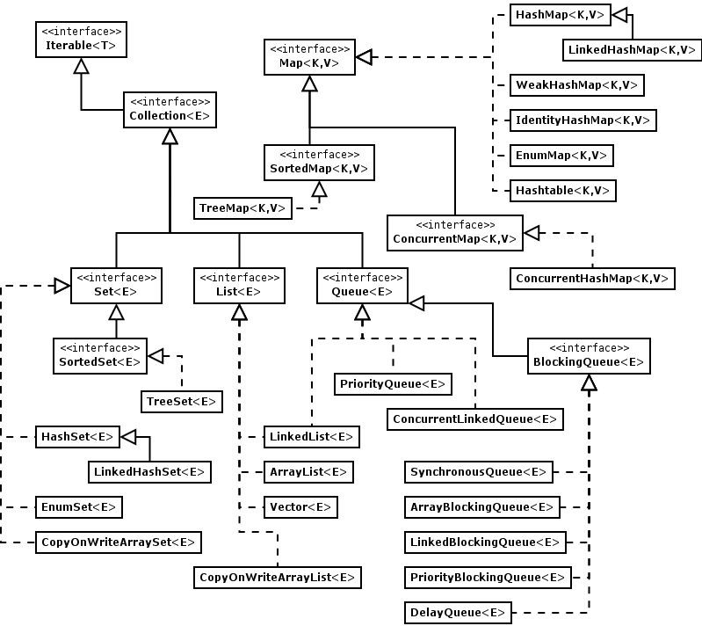

Slide 8
List<E>
Vector<E>
  Based on array
ArrayList<E>
  Based on array
LinkedList<E>
  Doubly-linked list

Slide 9
ArrayList<E>
List<Integer> integers = new ArrayList<>()
...
Creates array of 10 elements
...
integers.add(i) – 10 times, array is full
integers.add(i) - 11th operation, space not enough
...
Creates new array and copy all elements
...
...
New size = oldSize + (oldSize >> 1)
( x1.5)
Growth = 10 , 15 , 22, 33, 49 ....

Slide 10
Vector<E>
The same logic as ArrayList<E>
Growth = x2
  ArrayList x1.5
All methods are synchronized
Prefer ArrayList instead of Vector
  If you need synchronized collection use Collections.synchronizedList(new ArraysList<>())

Slide 11
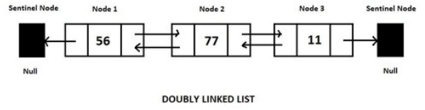
LinkedList<E>
Is
  List<E>
  Queue<E>
  Deque<E>
adding/removing a node at the head is very fast
getting an element from the middle is very slow

Slide 12
Lists
Prefer ArrayList in common
Choose LinkedList if :
  A lot of inserts/removes from the head of list
  You need Queue or Deque
If List is method argument write method using interface instead of implementation
public void doSomething(List<User> users) – Do this
public void doSomething(ArrayList<User> users) – Bad practice

Slide 13
Map<K, V>
HashMap
  Based on hash codes
LinkedHashMap
  HashMap with insert order
WeakHashMap
  HashMap with WeakReferences
ConcurrentHashMap
  HashMap with read/write locks per bucket
TreeMap
  Based on red-black tree

Slide 14
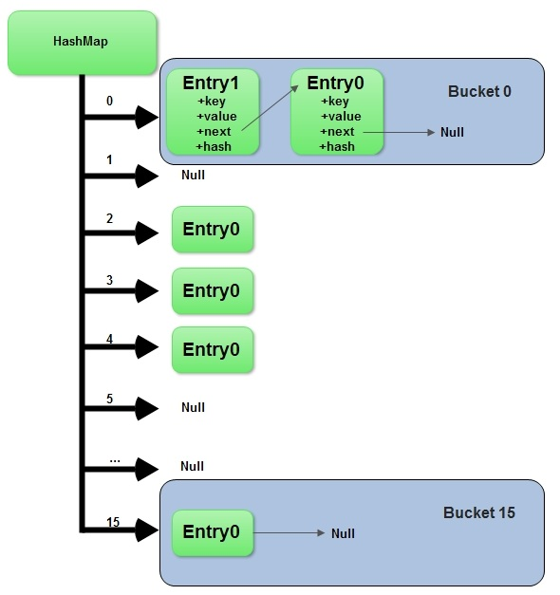
HashMap<K, V>
Contains ArrayList of buckets
Bucket is one-way linked list
Entry is pair <key, value>
Key is unique by equals
Uses key.hashCode() to find bucket for pair
No indexes

