Slide 1
Generics and wildcards as type parameter
Invariant
  List<T>
Covariant
  List<? extends T>
  List<R extends T> (with access to type R)
Contravariant
  List<? super T>

Slide 2
PECS
Producer Extends Consumer Super
Producer emits data
Consumer reads data

Slide 3
Vehicle
Interface Storage<T>
    void addAll(Storage<T> storage)
    Storage<T> getAll(Predicate<T> predicate)
      storage = producer
      predicate = consumer
Car
Truck
Storage<Car> cars = ....
Predicate<Vehicle> pr = ...
Storage result = cars.getAll(pr) – compile error
Storage<Car> cars = ...
Storage<Truck> trucks = ...
cars.addAll(trucks) – compile error
void addAll(Storage<? extends T> storage
Storage<T> getAll(Predicate<? super T> predicate)

Slide 4
Enums
Can be used in switch statement
Can be compared with operator ==
Serializable
Comparable
subclasses of class Enum<E>
Are constants
Static methods :
  values()
  valueOf(String)
Instance methods :
  name()
  ordinal()

Slide 5
Exception handling
Exception handling consists of 3 blocks
  Try - mandatory
  Catch – 1 or more, optional
  Finally – optional

Slide 6
Try
Simple
  try {
  ...
  }
Try-with-resources
  try (objects with AutoClosable interface){
  }
  try (Connection con = dataSource.getConnection()){
  }

Slide 7
Catch
Catch block is optional
Can be present more than 1 catch blocks
try{
...
} catch (IllegalArgumentException e){
...
} catch (RuntimeException e){
...
} catch (Exception e){
...
}
Exception
RuntimeException
IllegalArgumentException
Can catch different exception in single block
try{
...
} catch (IllegalArgumentException | ArrayIndexOutOfBoundsException e){
...
}

Slide 8
Finally
The finally block always executes when the try block exits
Never return value from this block!!!
try {
// do something
return 1;
} catch (Exception e){
return 2;
} finally {
return 3;
}
Result = 3

Slide 9
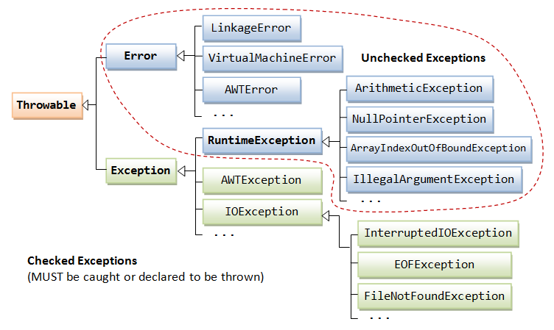
Exceptions

Slide 10
Best practices
Never use finalize method. Clean resources in finally block or use try-with-resources
Use more specific Exceptions
  public void doNotDoThis() throws Exception { ... }
  public void doThis() throws NumberFormatException { ... }
Catch Throwable only in Global Exception Handler
Don't ignore exceptions
Don't log and re-throw

