Slide 1
Array allocation
Array allocation
int [ ] array = new int[3]
array[0] = 5
heap
stack
5
0
0
int[]array

Slide 2
Array allocation
Object [ ] array = new Object[3]
array[0] = new Object()
heap
stack
ref
null
null
Object[]array
Object

Slide 3
Equality
int [ ] array = new int[3]
Int [ ] array2 = array
Int [ ] array3 = new int[3]
heap
stack
0
0
0
0
0
0
int[]array3
int[]array2
int[]array
array == array2 true
array == array3 false

Slide 4
Hotspot JVM memory management
Memory is organized into three generations:
  young generation
  old generation
  permanent generation
Most objects are initially allocated in the young generation
Large objects may be allocated directly in the old generation
The old generation contains objects that have survived some number of young generation collections
Permanent generation holds objects describing classes and methods, as well as the classes and methods themselves.

Slide 5
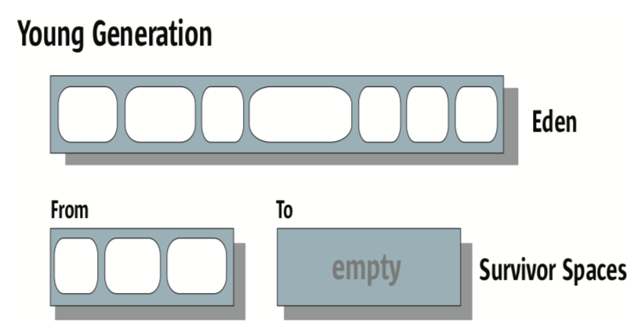
Most objects are initially allocated in Eden
The survivor spaces hold objects that have survived at least one young generation collection and have thus been given additional chances to die before being considered “old enough” to be promoted to the old generation
At any given time, one of the survivor spaces (labeled From in the figure) holds such objects, while the other is empty and remains unused until the next collection.

Slide 6
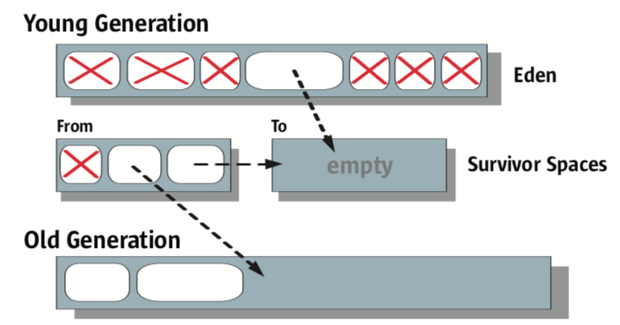
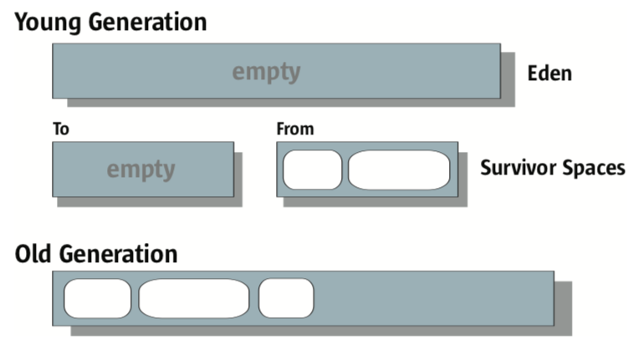
Serial Garbage Collection
Before
After

Slide 7
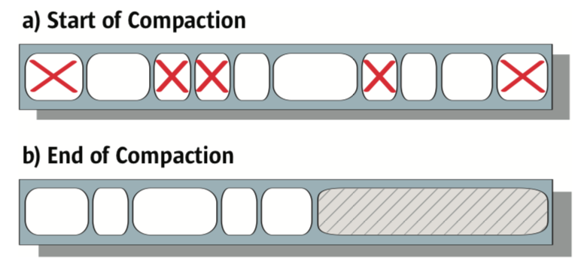
Old generation compaction

Slide 8
When to Use the Serial Collector
Single CPU
No requirements for low pause times
Nontrivial applications with 64MB heaps
automatically chosen as the default garbage collector on machines that are not server-class machines
server-class machine is :
  2 or more physical processors and
  2 or more gigabytes of physical memory
-XX:+UseSerialGC command line option

Slide 9
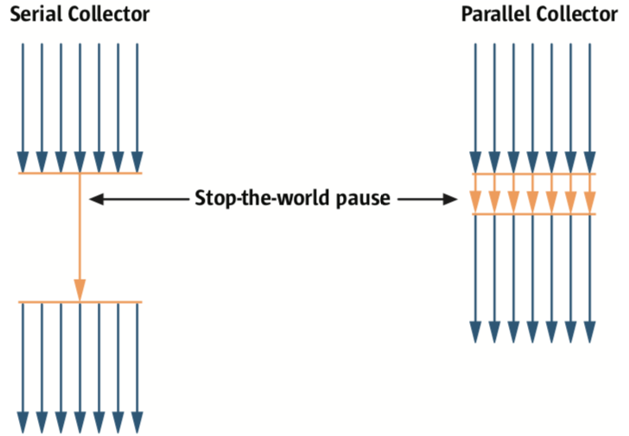
Parallel Collector
Uses the algorithms utilized by the serial collector.
Works in parallel, using many CPUs
Smaller pauses
It is still a stop-the-world collector.

Slide 10
When to Use the Parallel Collector
More than one CPU
Do not have pause time constraints (old generation collections will still occur)
automatically chosen as the default garbage collector on server-class machines
server-class machine is :
  2 or more physical processors and
  2 or more gigabytes of physical memory
-XX:+UseParallelGC command line option

Slide 11
2 more collectors
Parallel Compacting Collector
  -XX:+UseParallelOldGC
Concurrent Mark-Sweep (CMS) Collector
  -XX:+UseConcMarkSweepGC
http://www.oracle.com/technetwork/java/javase/tech/memorymanagement-whitepaper-1-150020.pdf

Slide 12
Inheritance
Single
Multilevel
Hierarchical
class A
class A
class A
is-a
is-a
is-a
is-a
class B
is-a
class B
class B
class C
is-a
B is-a C
class C
class A
class B
class C

Slide 13
Implementation
interface Serializable
interface Comparable
interface Printer
class A
class B
class B is Serializable
class B is A
class B is Comparable
class B is Printer

Slide 14
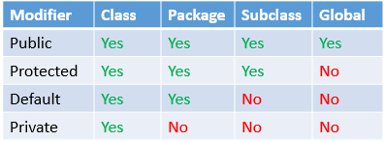
Access modifiers

