Slide 1
Java Basics
https://github.com/javaguruoleg/ingenico

Slide 2
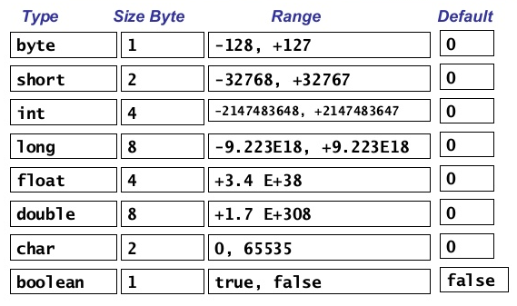
Primitive types

Slide 3
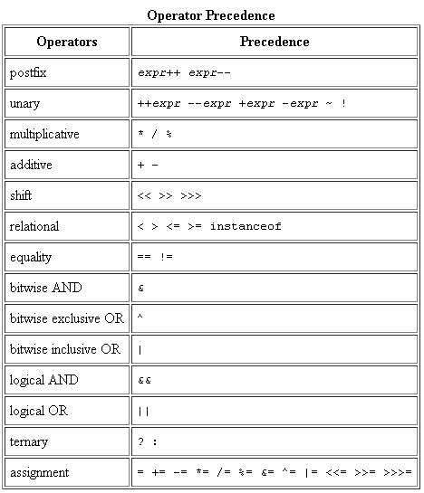
Operators

Slide 4
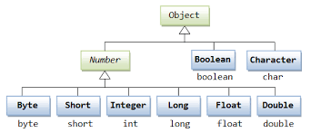
Wrappers

Slide 5
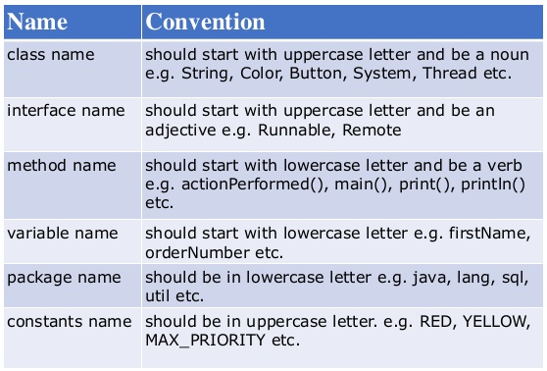
Naming Conventions

