Slide 1
Lambda
Is syntactic sugar for anonymous class
Every method can be replaced by lambda
Are anonymous classes of functional interfaces
Functional interface is interface with only one abstract method

Slide 2
Functional interfaces
Functional interface is interface with only one abstract method
Most usable interfaces :
  Predicate – search/filtering
  Comparator – sorting
  Supplier – get / generate / create value
  Consumer – replace any void method with one argument
  Function – replace method with one argument and return
  BiFunction – replace method with 2 arguments and return

Slide 3
Predicate<T>
boolean test(T t)
private boolean isJose (User user) {
return user.getNickname().equals(“Jose”);
}
Predicate<User> isJose = (user) -> user.getNickname().equals(“Jose”);
or
Predicate<User> isJose = this::isJose

Slide 4
Comparator<T>
int compare(T o1, T o2);
private int compareByNickname (User user1, User user2) {
return user1.getNickname().compareTo(user2.getNickname());
}
Comparator<User> nicknameComparator =
(user1, user2) ->
user1.getNickname().compareTo(user2.getNickname())
or
Comparator<User> nicknameComparator = this::compareByNickname

Slide 5
Consumer<T>
void accept(T t);
public void logMessage(String message){
System.out.println(message);
}
Consumer<String> messageLogger = (message) -> System.out.println(message)
or
Consumer<String> messageLogger = System.out::println

Slide 6
Function<T, R>
R apply(T t);
R = return type
T = argument type
public boolean isEven(int number){
return number % 2 == 0;
}
Function<Integer, Boolean> isEven = (number) -> number % 2 == 0;
or
Function<Integer, Boolean> isEven = this::isEven

Slide 7
Java Streams
Stream is sequence of objects
Getting rid of boilerplate code
  Filtering
  Mapping
  Reducing
  Collecting
  Consuming
Declarative style increase readability
Follow functional principles

Slide 8
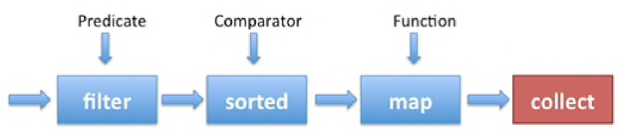
Pipeline with Stream API
[..objects..]

Slide 9
We have List of users and we want to get List of all active users nicknames, nicknames should be sorted
Pipeline :
List<User> users
(source)
filter
Filter by user.isActive
map
user.getNickname()
sorted
If objects don't have interface Comparable then use Comparator
collect
List<String> nicknames
(result)

Slide 10
Java Stream operations
Terminal - return result
  findFirst : Optional
  collect : Collection
  reduce : T
  forEach : void
  ...
Non-terminal - return new Stream<T>
  filter
  map
  flatMap
  limit
  peek
  ...

Slide 11
Collect
  .collect(collector)
[ 1, 1, 2, 4, 5, 5]
Most usable collectors:
  toList()
  toSet()
  Joining() - collects to string
  GroupingBy() - collects to map
.collect(Collectors.toSet())
Set of [ 1, 2, 4, 5]

Slide 12
Filter
  .filter(predicate)
“!”
“world”
“hello”
.filter(string -> string.length() > 2)
= Predicate<String>
“world”
“hello”

Slide 13
Peek (use for debugging or logging)
  .peek(consumer)
3
2
1
.peek(integer -> System.out.println(integer)
= Consumer<Integer>
3
2
1

Slide 14
For Each (terminal operation)
  .forEach(consumer)
3
2
1
.forEach(integer -> System.out.println(integer)
= Consumer<Integer>

Slide 15
Limit
  .limit(int maxCount)
“strings”
“some”
“here”
.limit(2)
“some”
“here”

Slide 16
Map
  .map(function)
“strings”
“some”
“here”
.map(string -> string.length())
7
4
4

Slide 17
Flat map
  .flatMap(function from object to Stream)
“next,text”
“first,sentence”
Split by comma
.flatMap(string -> Stream.of(string.split(“,”))
“text”
“next”
“sentence”
“first”

