Slide 1
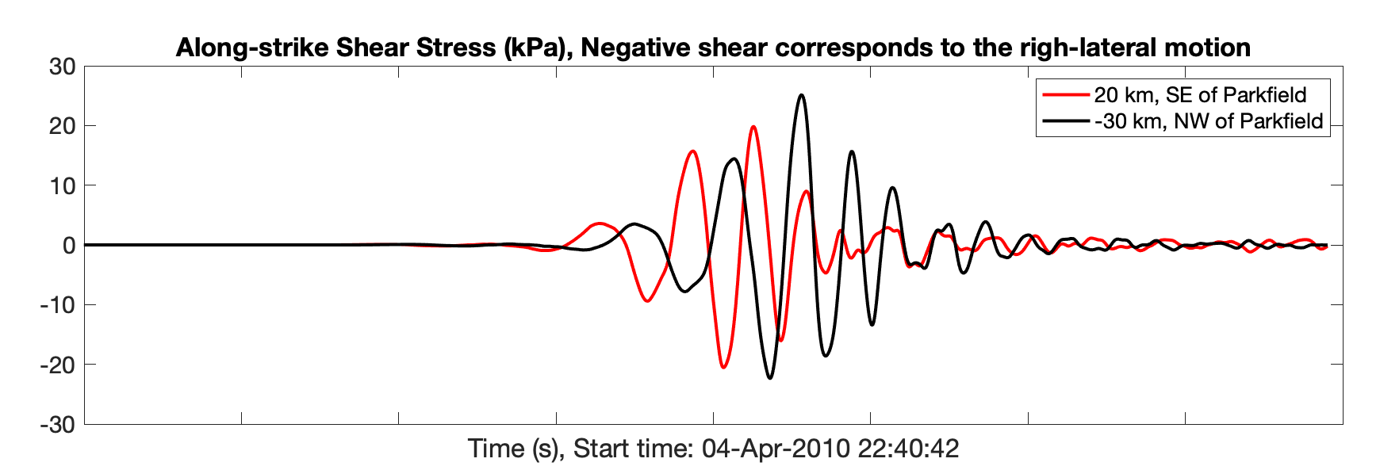
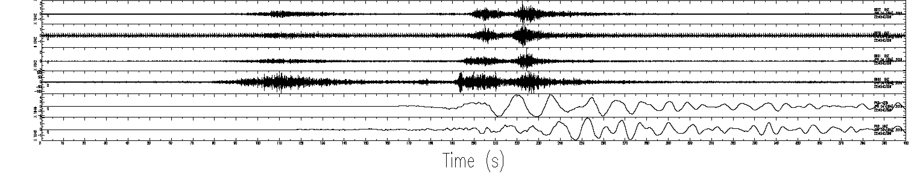
Stress at Parkfield generated by the 2010 Mw 7.1 Baja Earthquake
Filter: 10-50 s
Negative corresponds to right-lateral motion
BK.PKD

Slide 2
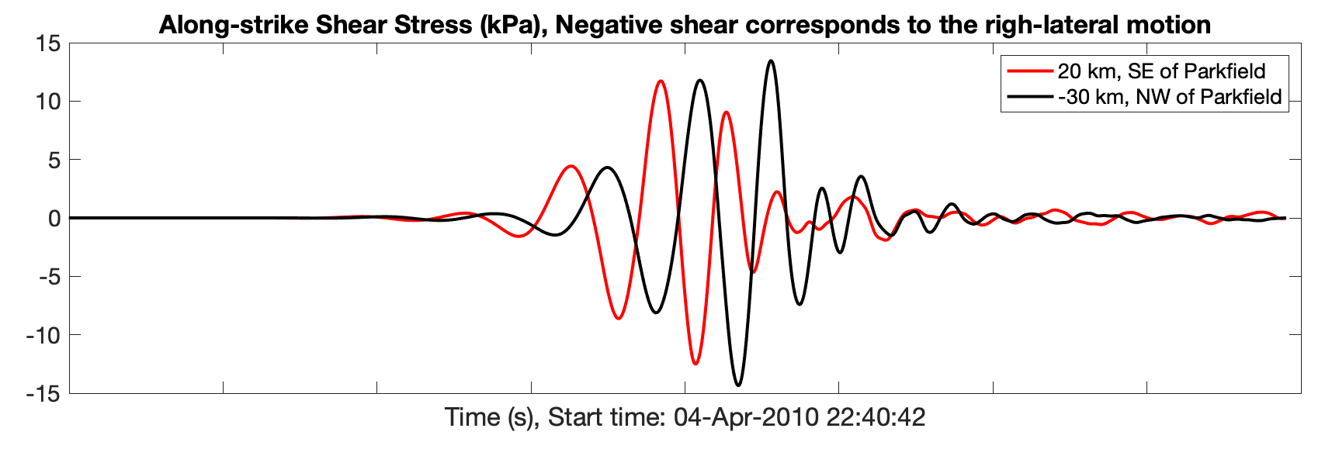
Stress at Parkfield generated by the 2010 Mw 7.1 Baja Earthquake
Filter: 20-50 s
Negative corresponds to right-lateral motion
BK.PKD

