Slide 1
Social Distancing Detector
CV Project
-Rasagya Shokeen (2019088)
Vasu Jain (2019125)
Sejal (2019102)

Slide 2
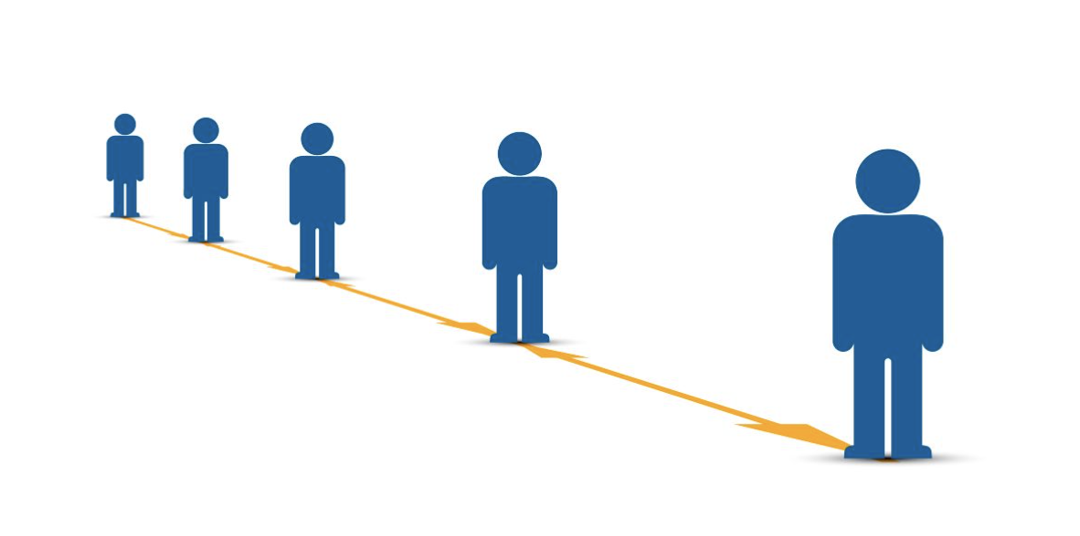
Problem Statement
Covid19 has changed a lot of things for us. We’ve learnt that the virus is spreading at a rapid pace and monitoring physical human interaction is of paramount importance and the need of the hour.
It is important to maintain social distance in public places. To oversee these actions, social distancing detector will come into play.
We will use a pre-recorded video, say, a video from a CCTV to take the input from a public space.
An output video will be such that each individual will be marked with a rectangular boundary.
The decision would be made on the basis of the social distancing threshold. We initiate a system to automate the process and monitor social distancing at a public space remotely.

Slide 3
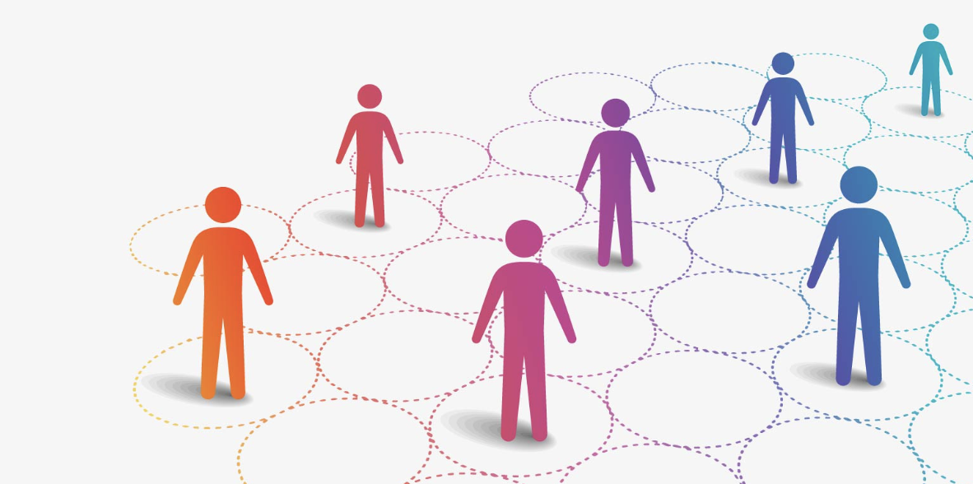
Methodology
We have used YOLO library for object (a person in a public space) detection. This is a faster way of detecting objects than other methods.
The image is divided into regions and this way this predicts bounding boxes and probabilities for each region.
The image that is basically the input should come from a higher angle camera so as to overcome the problem of 3D distance. But if the camera angle is too high it could create problems in detecting the social distance. So therefore, there should be a balance between both.

Slide 4
Methodology
The system generates an output which consists of bounding boxes which are weighted by the predicted probabilities also known as probability weights.
The output video highlights people violating covid protocols by marking a Red and Green rectangle around them. This is done by calculating the social distance between two individuals and the social distance is actually the threshold.
Green rectangles represent people being at safe distance from the public while red ones represent covid protocol violators.
Our approach also focused on mask detection. But there are few challenges with mask detection : beard on one's face could confused the machine. Also this is majorly effective when the face detection is accurate (done through opencv).

Slide 5
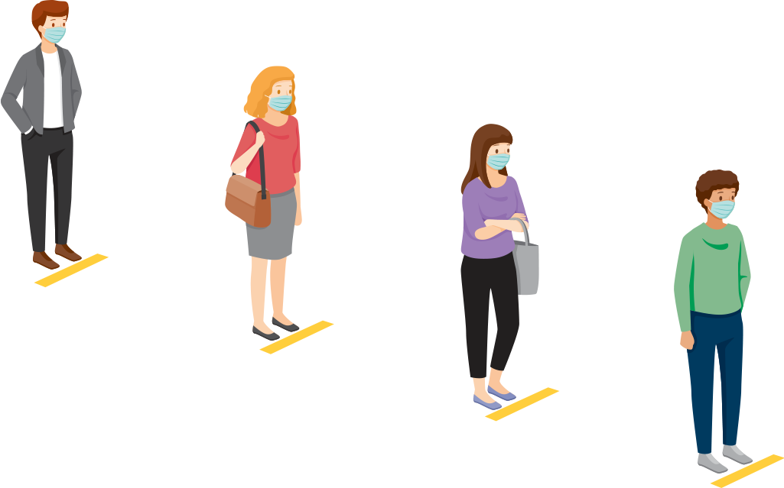
Demo
The videos have to be in a way so that the issue of 3d distance is solved, that is, cameras need to take the overhead view of the surroundings. Below is the link for the video we used in our model to monitor social distancing :
https://vimeo.com/530909999?embedded=true&source=vimeo_logo&owner=136871050

Slide 6
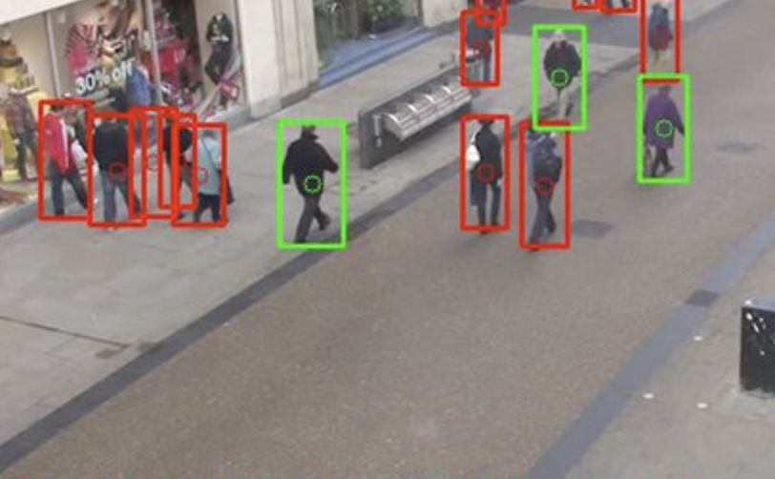
Experimental results
The pre-trained model delivers near perfect results and detects various sized persons bounding boxes as shown with red and green rectangles.
If people are too close to each other the model effectively detects the breach of social distancing between them and appropriately marks the bounding boxes as red or green rectangles.
People at distances lesser than the social distance threshold appear in red rectangles and others appear in green rectangles.

Slide 7
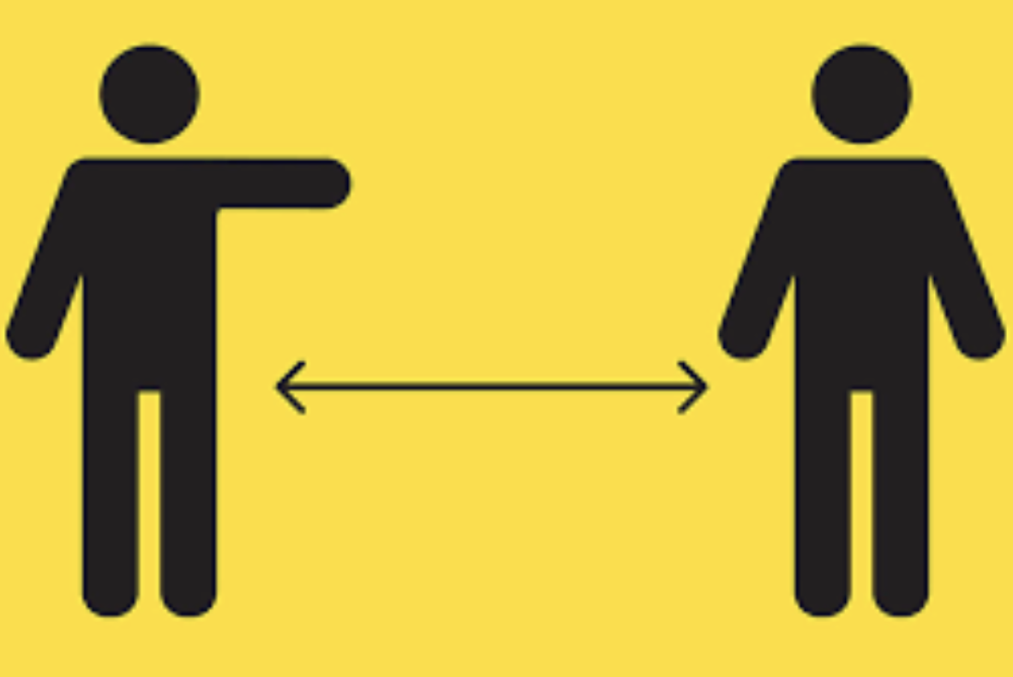
Thank you!

