Slide 1
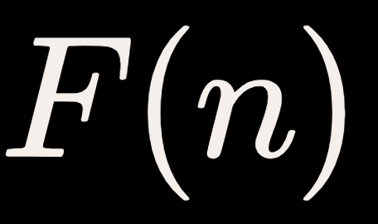

DAA · DYNAMIC PROGRAMMING FOUNDATIONS
Compute without
repeating work
RECURRENCE RELATION
SEQUENCE VALUE STRIP
n = 0..2
n = 3..5
n = 6..8
0, 1, 1
2, 3, 5
8, 13, 21
Objective: evaluate the -th term in linear rather than exponential time.
Identical subproblems overlap repeatedly across recursive branches, making Fibonacci the canonical entry point for dynamic programming.
DAA Lecture Notes · Optimal Substructure & Overlapping Subproblems
Notes:
Introduce the lecture problem: evaluating the standard Fibonacci recurrence. Highlight the base cases and write out the first nine terms. Point out that because subproblems overlap, naive division leads to redundant recalculations.

Slide 2
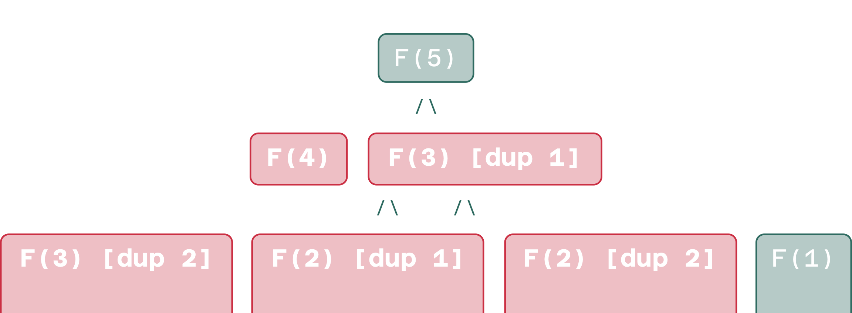
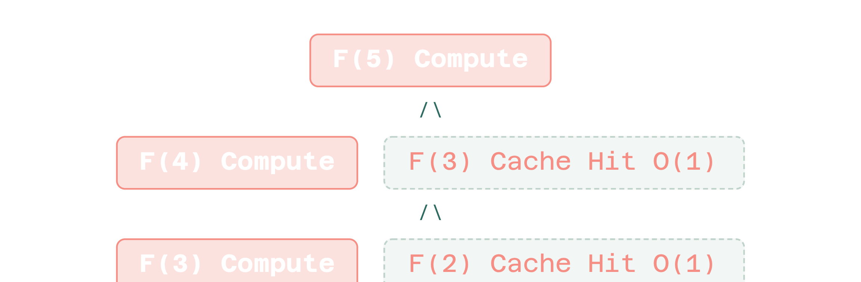





SUBPROBLEM EVALUATION
Naive recursion recomputes; memoization remembers
NAIVE TREE · F(5) RECOMPUTATION
MEMOIZED TREE · PRUNED LOOKUPS
Compute each state exactly once and persist it in a table. Subsequent calls bypass recursion via an memory lookup.
is evaluated 2 times; is evaluated 3 times. Total invocations grow exponentially as .
Comparison: red nodes denote repeated recomputations; dashed border denotes instant table returns.
Notes:
Contrast the two recursion graphs. On the left, emphasize how calls proliferate exponentially because the right subtree repeats subproblems already solved on the left. On the right, show how caching turns deep subtrees into instant O(1) returns.

Slide 3
ALGORITHM SPECIFICATION
Pseudocode: Top-down memoized Fibonacci
Table initialization: memo[0..n] = -1; -1 marks unvisited states.
Base case: For n ≤ 1, return n.
Cache hit: If memo[n] ≠ -1, return the cached scalar in O(1) time.
Compute and cache: Evaluate the recursive sum once; store in memo[n], then return.
01 memo=[-1]*(n+1)
02 FIB(n)
03 def FIB(n):
04 if n<=1: return n
05 if memo[n]!=-1: return memo[n]
06 memo[n]=FIB(n-1)+FIB(n-2)
07 return memo[n]
Top-down memoization maintains standard recursive structure while avoiding redundant calls.
Notes:
Walk line-by-line through the algorithm. Explain why a sentinel value like -1 is used, how the base case triggers, and how the memo check prunes duplicate subtrees before the recursive step executes.

Slide 4
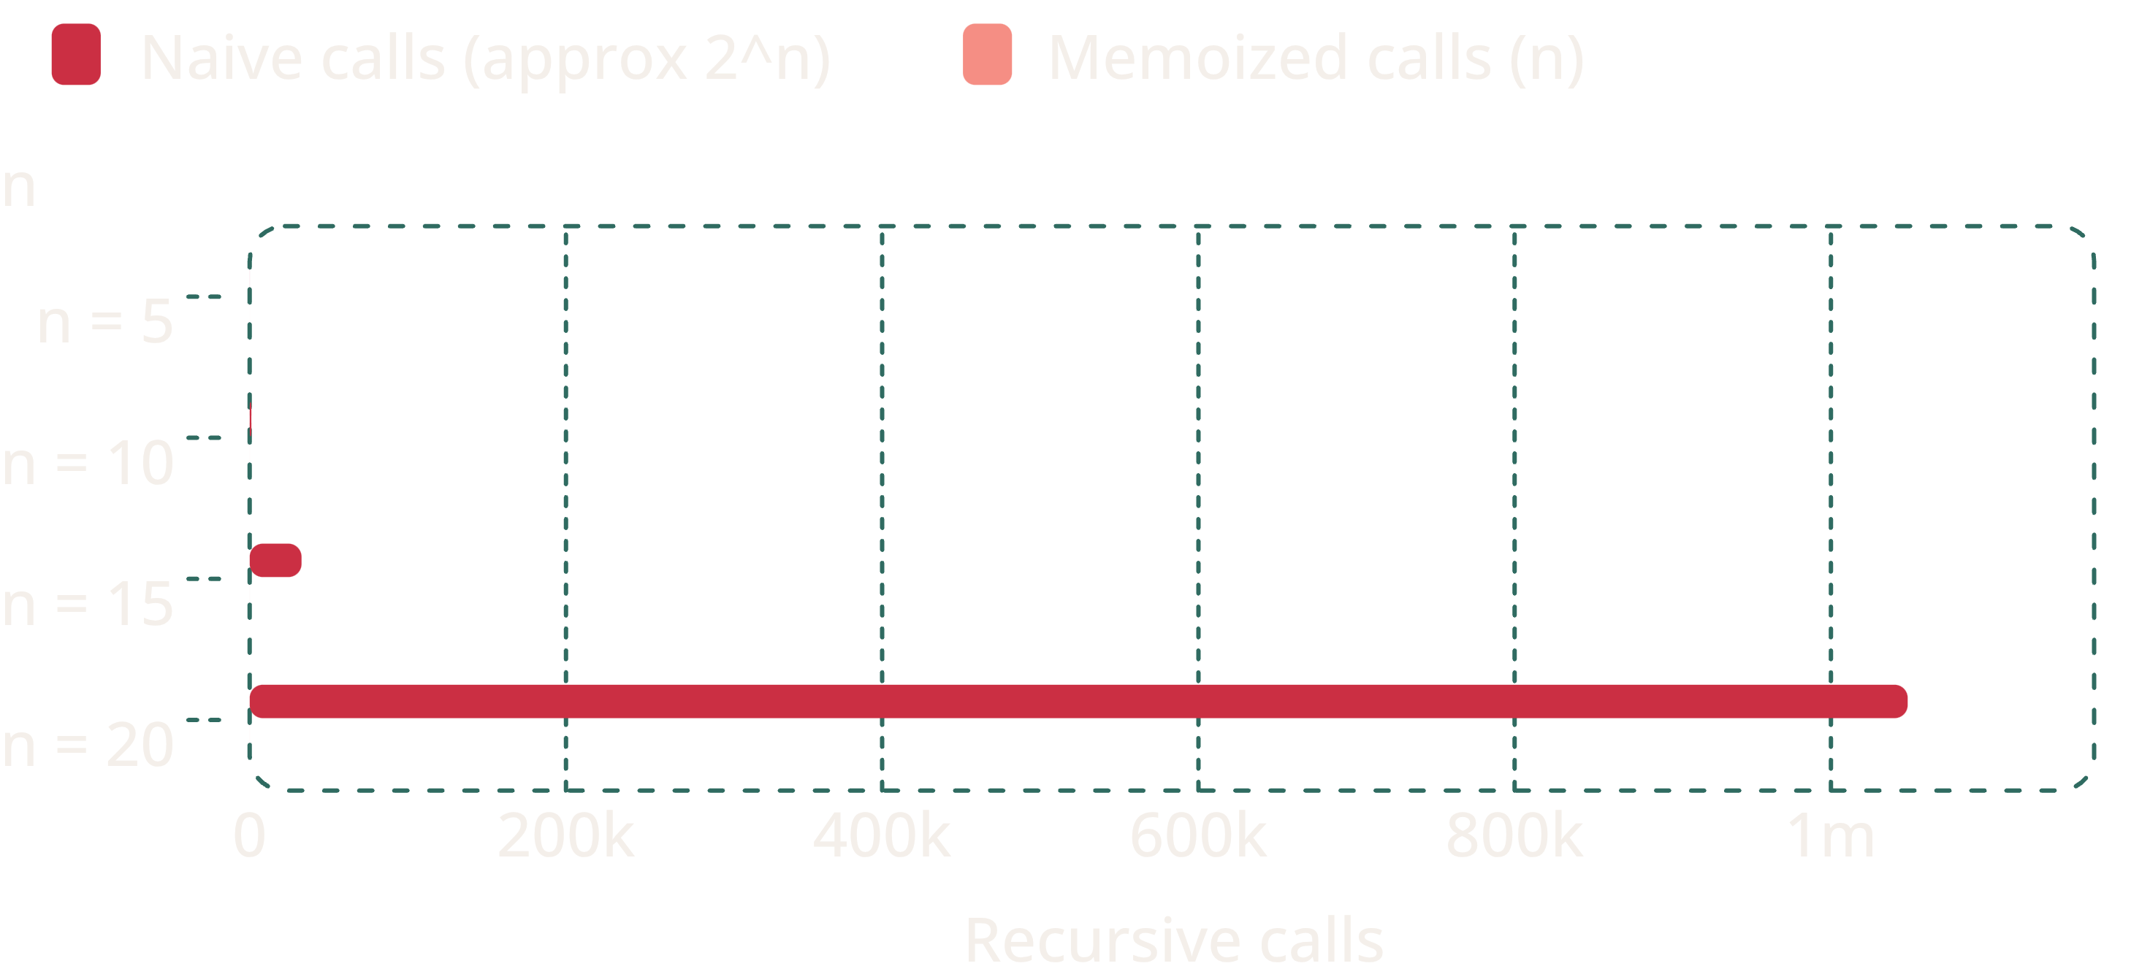
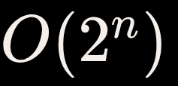
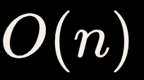
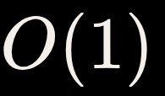
ASYMPTOTIC ANALYSIS
Time complexity drops from
O(2^n) to O(n)
Operations growth: naive vs memoized
Naive recursion
Time: (exponential explosion)
Space: call stack depth
Memoized approach
Time: (each state computed once)
Space: memo array + stack depth
Bottom-up tabulation: runtime; space with two variables.
Values based on theoretical upper bound counts for naive execution trees versus linear state transitions.
Notes:
Direct the audience to the horizontal bar chart showing the astronomical divergence at n=20: over 1,000,000 operations for naive recursion versus 20 calls with memoization. Conclude with the space complexity trade-off and preview bottom-up tabulation.

