Slide 1


STUDENT’S PERFORMANCE PREDICATION IN EXAMS

Slide 2
NAME:
SEJAL SANTOSH BHEKARE
PROJECT NAME:
STUDENT’S PERFORMANCE PREDICATION IN EXAMS
INTRODUCTION
The Students Performance dataset offers complete insights into academic achievements across subjects like Math, Reading, and Writing, Including additional attributes that enable analysis of the factors such as gender and catagories on student performance.

Slide 3
Description:
In this notebook, we are going to predict whether a student pass or fail in academic using various features like gender, parent's education, subject's score etc
The dataset we are going to use is the student's academic info dataset from Kaggle which contains about 1000 rows and 17 features.
The dataset contains the labels which we have to predict and the labels are discrete and binary. So the problem we have is a Supervised Classification type.

Slide 4
Motivation
The main objective of analyzing the Students Performance dataset is to identify how predefined factors impact student performance and provide recommendations for improving overall academic achievement.
Building such predictive models can help us better understand the academic progress of students as well as the various factors affecting the student's academic growth so educatioanl system and Governments can understand such factors and improve upon them leading to the growth of the educatioanl system

Slide 5
Column DESCRIPTION
SR.NO | COLUMN NAME | DESCRIPTION
1 | GENDER | GENDER OF STUDENTS
2 | CATEGORIES | CATEGORIES OF STUDENTS
3 | PARENT_EDUCATION | EDUCATION OF PARENTS
4 | LUNCH | LUNCH TYPE OF STUDENTS
5 | TEST PREPARATION COURSE | COURSE IS COMPLETED OR NOT
6 | MATH SCORE | MATH SCORE OF STUDENTS
7 | READING SCORE | READING SCORE OF STUDENTS
8 | WRITING SCORE | WRITING SCORE OF STUDENTS

Slide 6
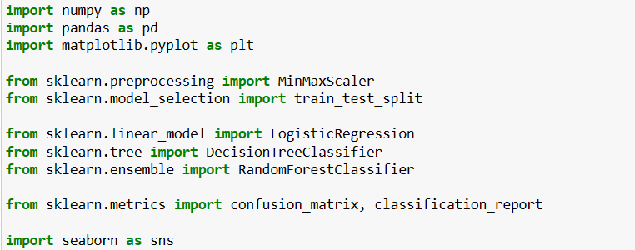
Load Libraries And Dataset

Slide 7
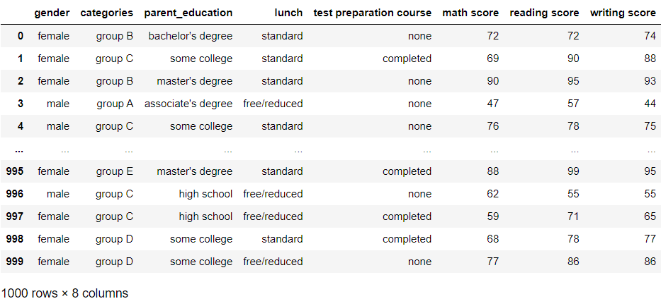
Importing Dataset
df=pd.read_csv(r"C:\Users\HP\Downloads\ds for project.csv")
df

Slide 8
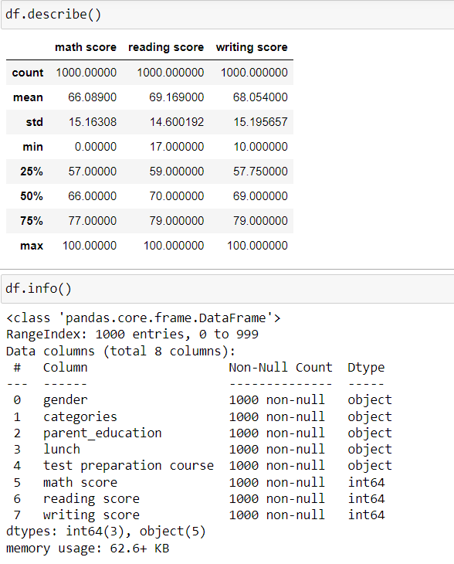
Describe() function give us descriptive statistics values about columns whereas
info() displays various information about our data such as the column names, no. of non-null values in each column, type of each column, memory usage, etc.

Slide 9
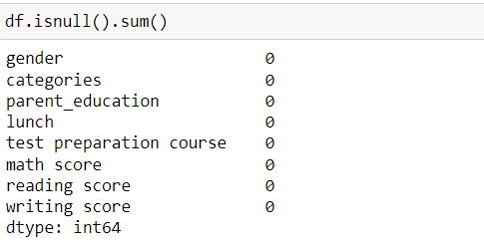
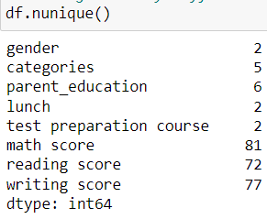
Get the null values df.isnull().sum()
checking how many different values there are per column
df.nunique()

Slide 10
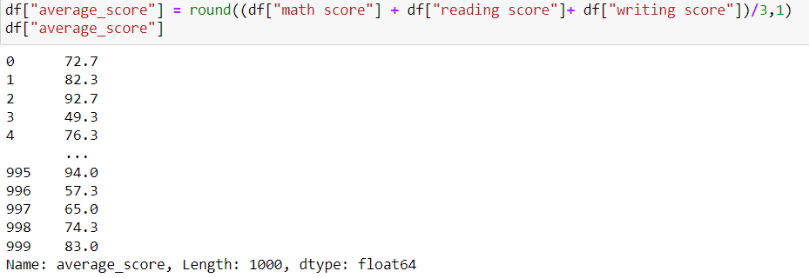
Creating New Average Score Column

Slide 11
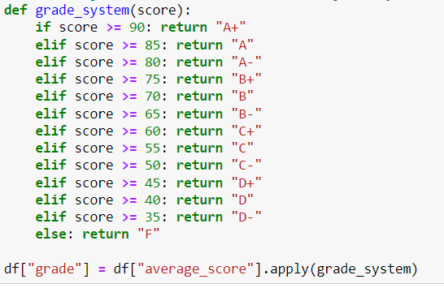
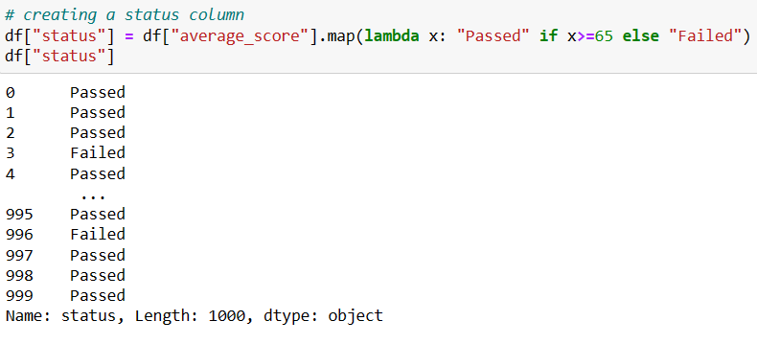
Creating A Grade Column And Status Coulmn

Slide 12
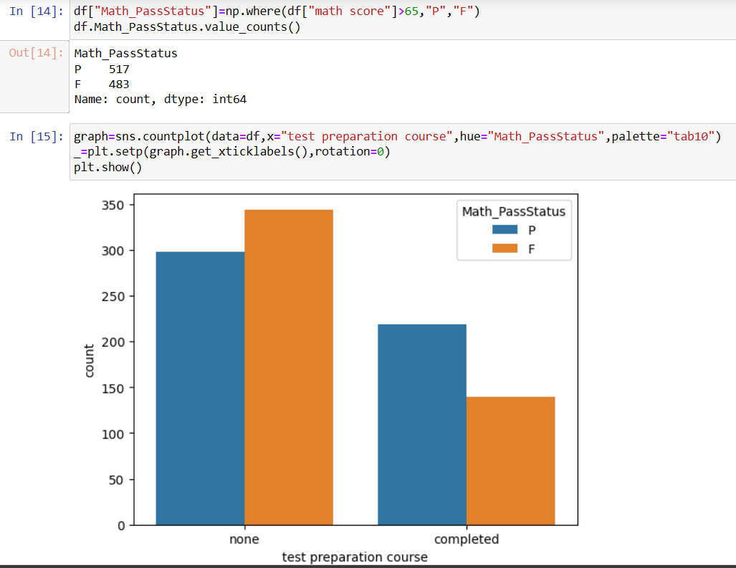
VISUALIZATION Student Pass In Maths Exam

Slide 13
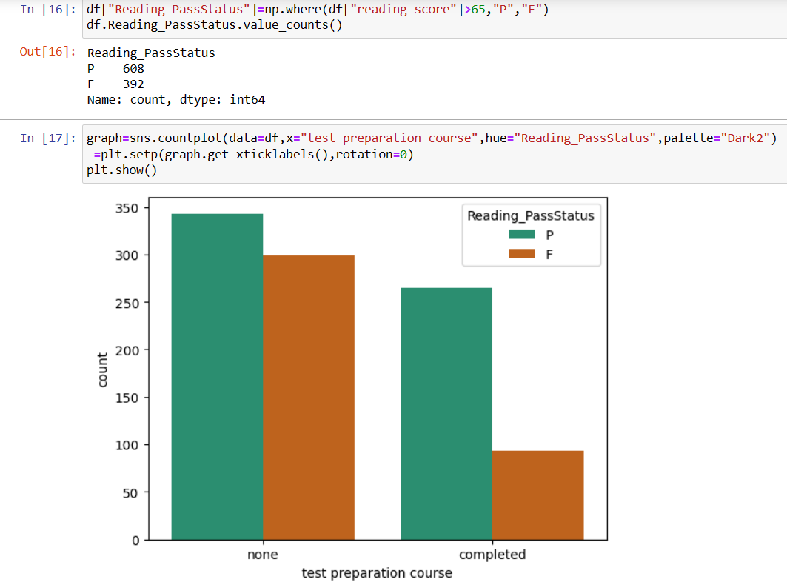
Student Pass In Reading Exam

Slide 14
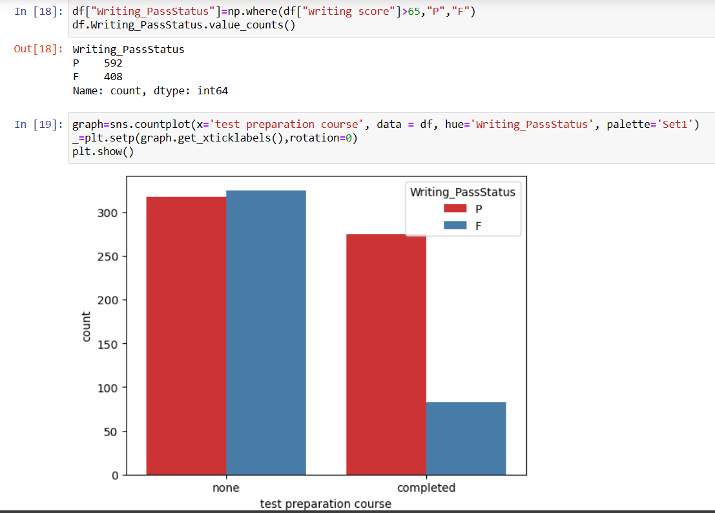
Student Pass In Writing Exam

Slide 15
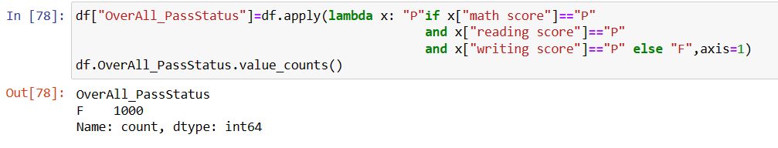
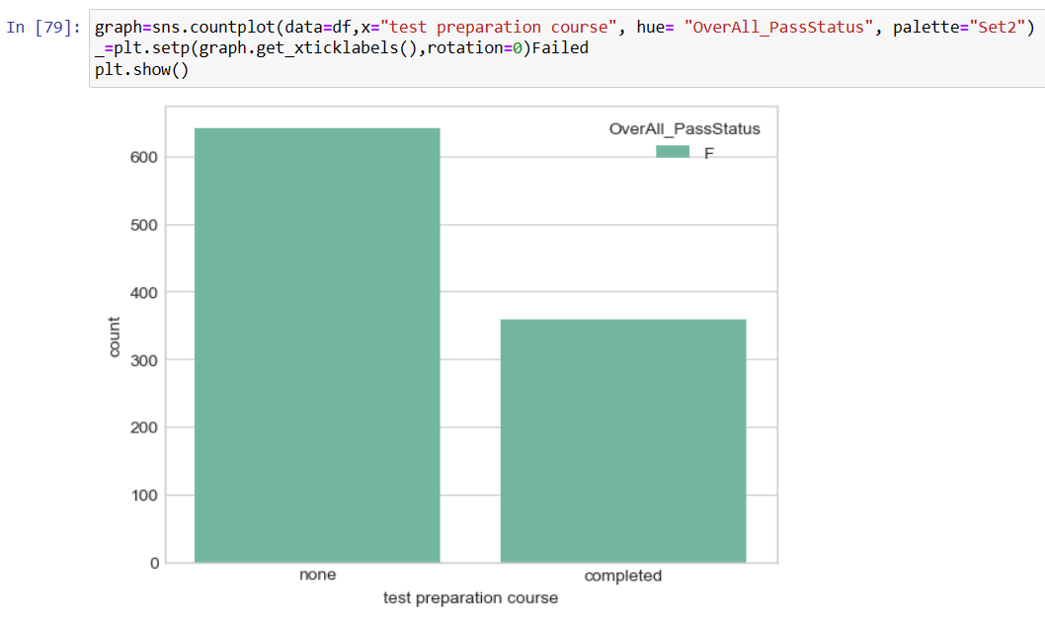
Student Failed in all sub.
Graph the student Failed in overall sub.

Slide 16
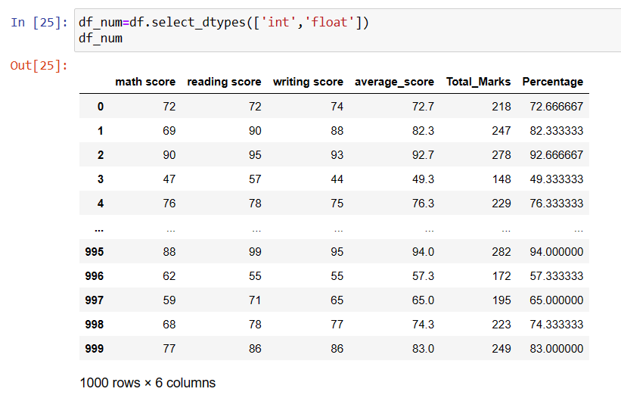
Separting Numeric and category Data Numerical Data

Slide 17
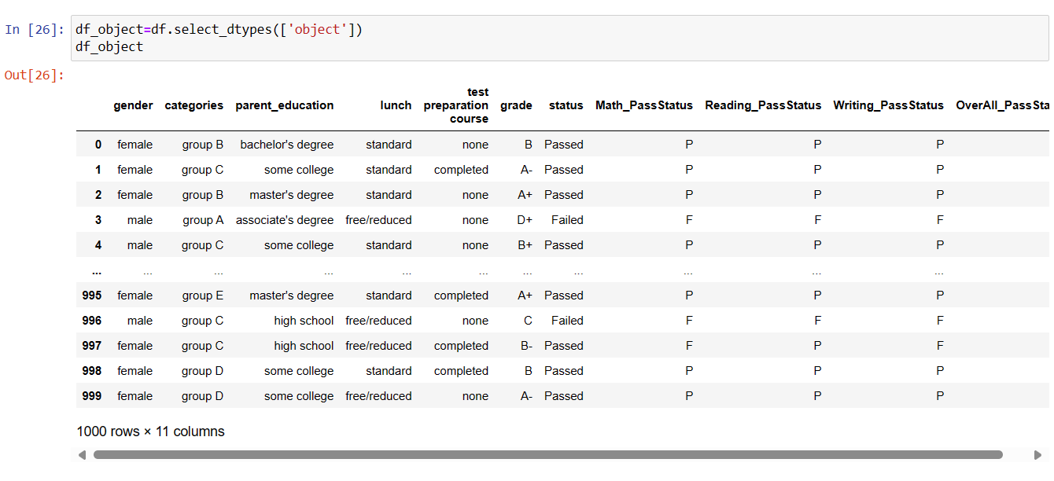
Categorical Data

Slide 18
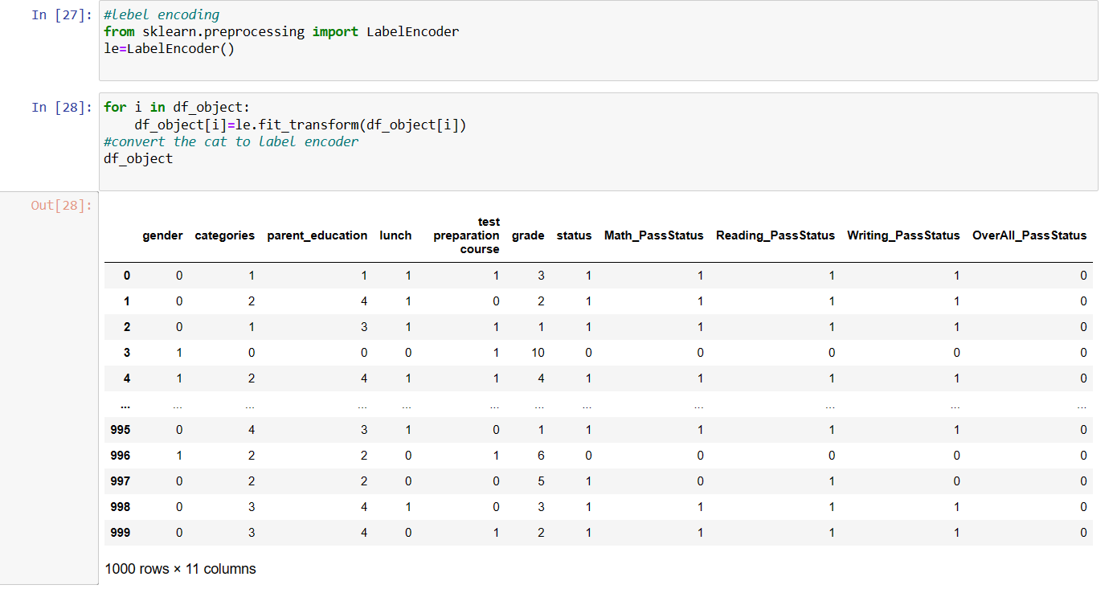
Using Label Encoder for converting category data into numeric

Slide 19
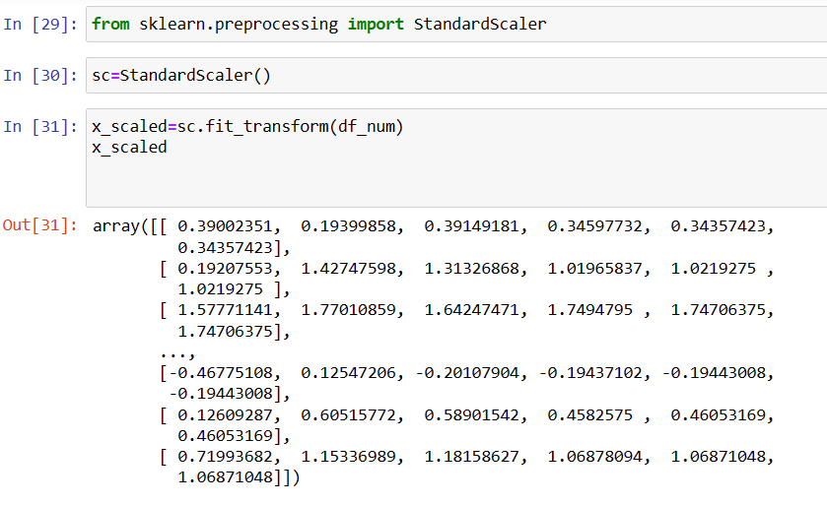
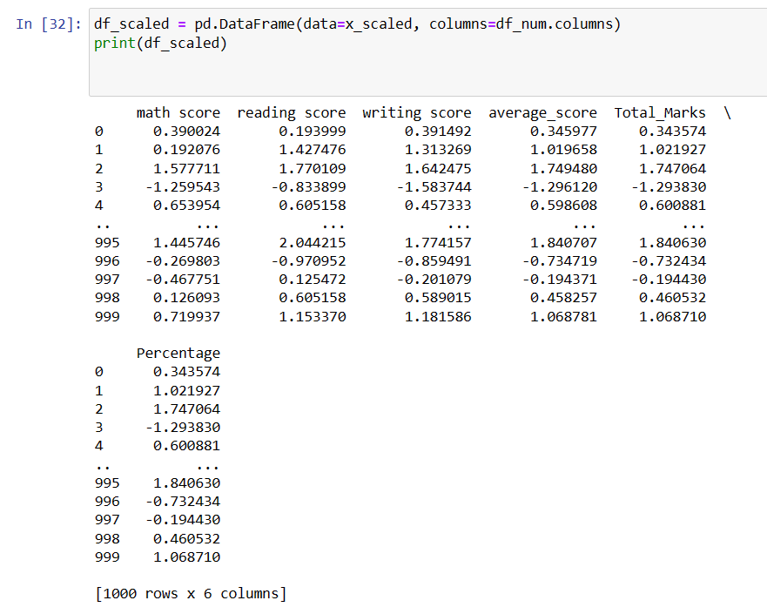
Feacture Scalling

Slide 20
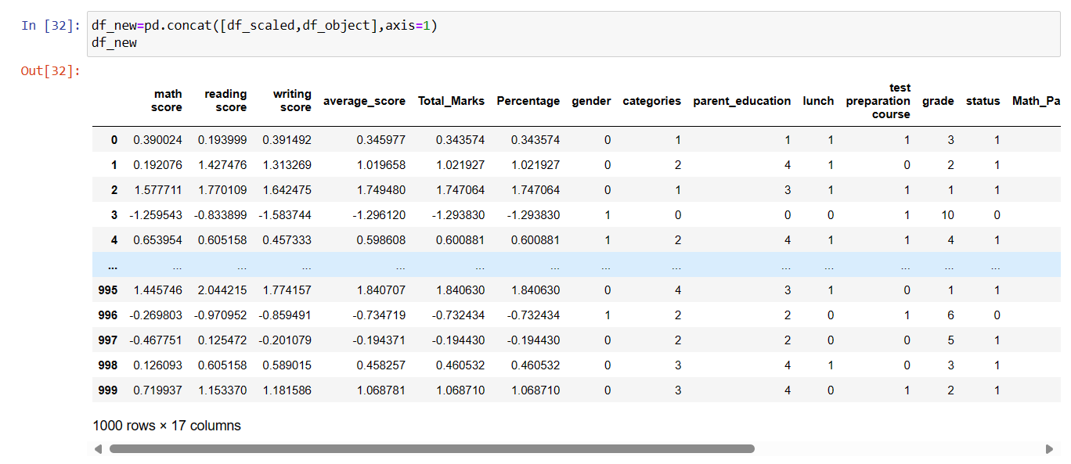
Concatenate Numerical and Categorical Columns

Slide 21
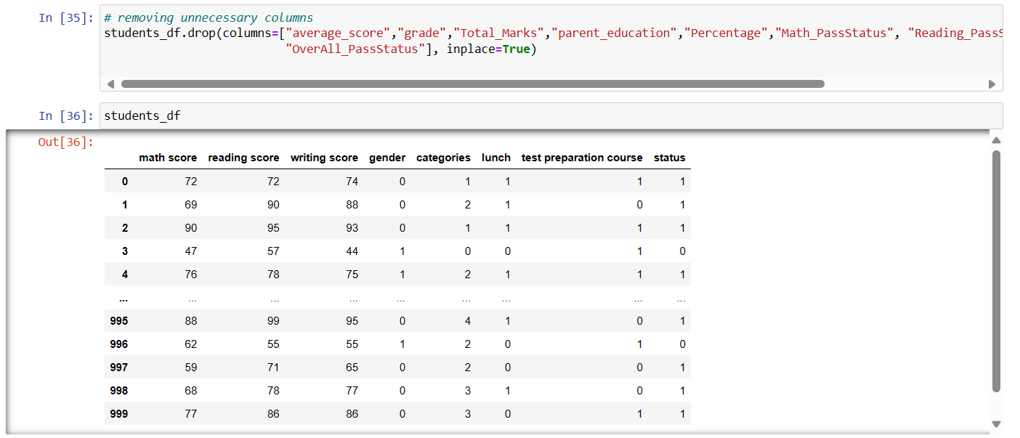
Removing Unnecessary Columns

Slide 22
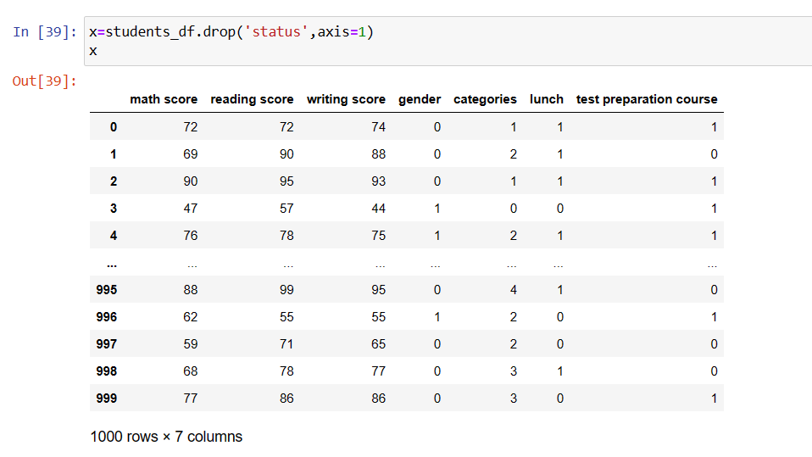
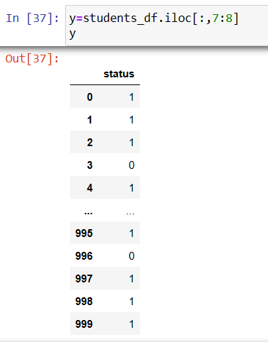
Split The Data

Slide 23
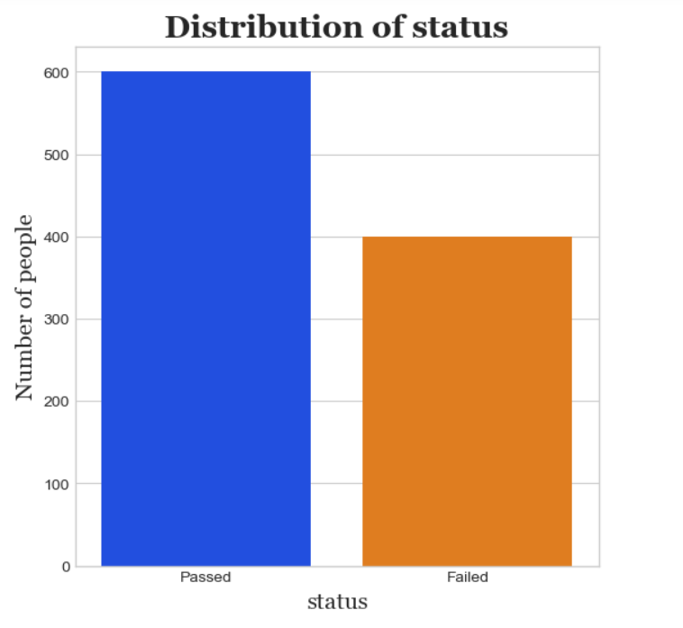
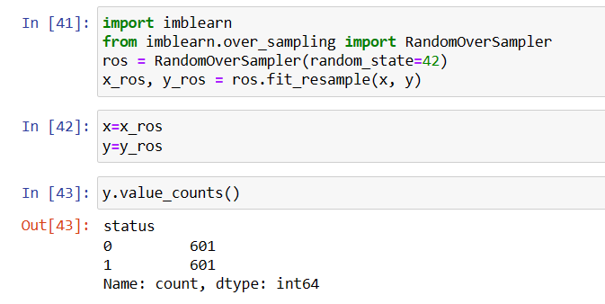
Since The Data Is Imbalanced , Need To Do Sampling (Either Oversampling Or Undersampling)

Slide 24
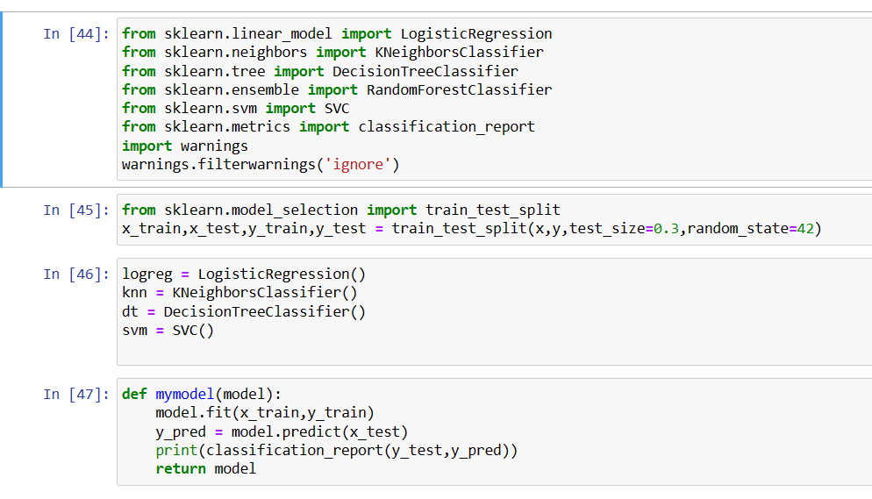
Importing The Models And Train Them

Slide 25
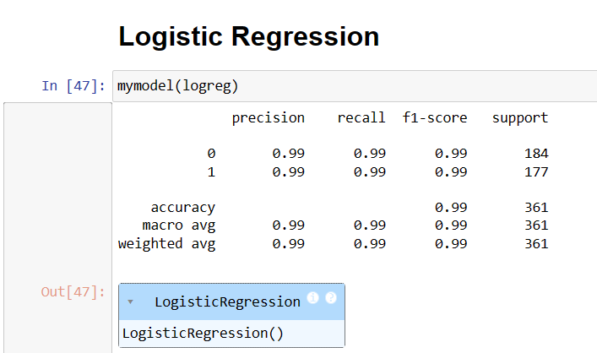
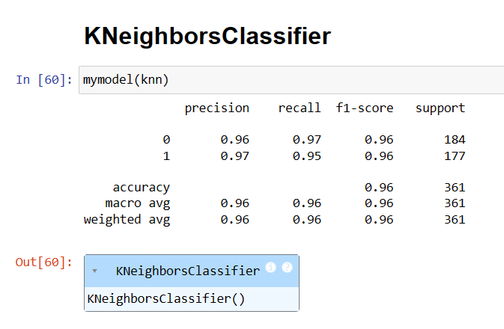
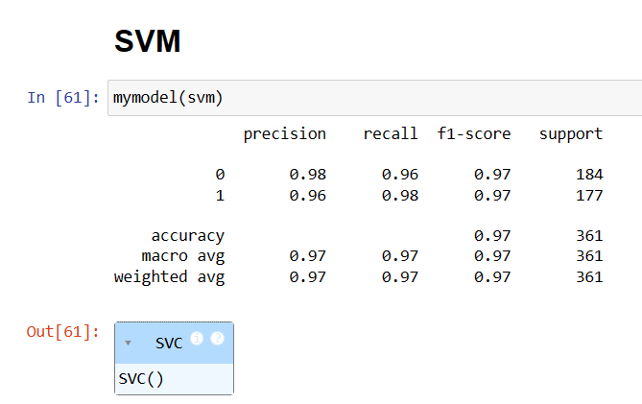
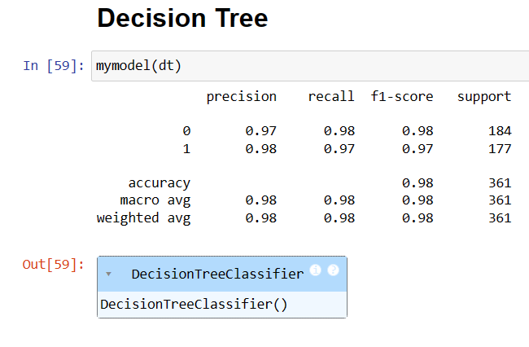

Slide 26
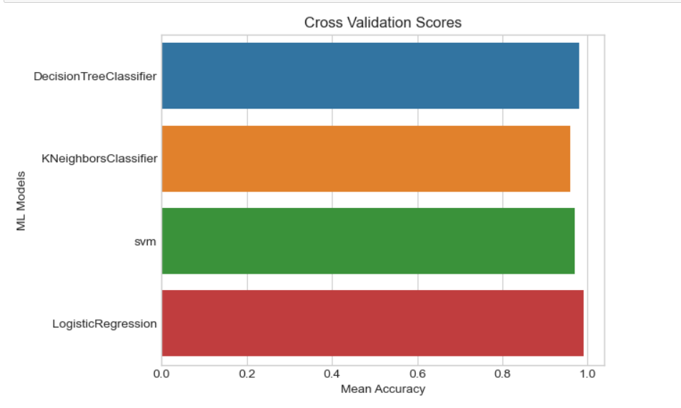
CONCLUSION
In this project, we build various models like logistic regression, knn classifier,decision tree classifier & svm
A logistic regression gives the highest accuracy score of 99.00 percent among all the ML Models.
So for the Airline passenger Satisfaction prediction logistic regression is best model

Slide 27
Thank You
someone@example.com

