Slide 1
S3
Static Website Hosting on Amazon S3
Question 1 · Hosting HTML, CSS and JavaScript from an S3 bucket
Region: Asia Pacific (Mumbai) ap-south-1

Slide 2
Project overview
1
2
3
Objective
Services used
Outcome
Host a static website on Amazon S3 and make it reachable from any browser.
Amazon S3 for storage, static website hosting and a bucket policy for public read.
A live site with a page, styling and a button that shows the current time.

Slide 3
How it works
Website files
Amazon S3 bucket
Visitor's browser
index.html
style.css
script.js
Upload
q1-project-buckket
Static website hosting
Public-read policy
Serve
Opens the bucket
website endpoint
over HTTP
S3 stores the files and serves them directly as a website, with no web server to manage.

Slide 4
The website files
Page structure: heading, message text and a "Show current time" button.
index.html
Styling: Arial font, centred layout, light background and an orange button.
style.css
Behaviour: showTime() writes the current date and time into the page.
script.js

Slide 5
Create the S3 bucket
1
Screenshot placeholder
Bucket overview showing name, region and creation date
Open the S3 service in the AWS Console and click Create bucket
Bucket name: q1-project-buckket
Region: Asia Pacific (Mumbai) ap-south-1
Untick Block all public access and acknowledge

Slide 6
Upload the website files
2
Screenshot placeholder
Objects tab listing the uploaded files
Open the bucket and click Upload
Add index.html, style.css and script.js
Keep all files in the bucket root
Click Upload to finish

Slide 7
Enable static website hosting
3
Screenshot placeholder
Static website hosting settings
Bucket, then Properties tab, then Static website hosting
Choose Enable and Host a static website
Index document: index.html
Save changes to get the website endpoint

Slide 8
Add the public-read bucket policy
4
Screenshot placeholder
Bucket policy editor with the policy JSON
Bucket, then Permissions tab, then Bucket policy
Allow s3:GetObject for everyone (Principal *)
Resource: arn:aws:s3:::q1-project-buckket/*
Save changes

Slide 9
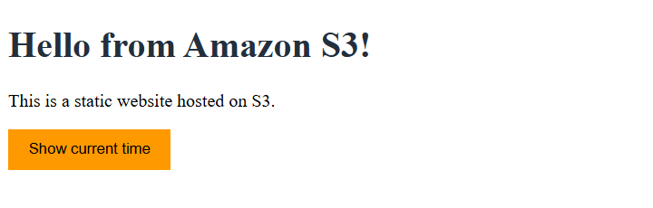
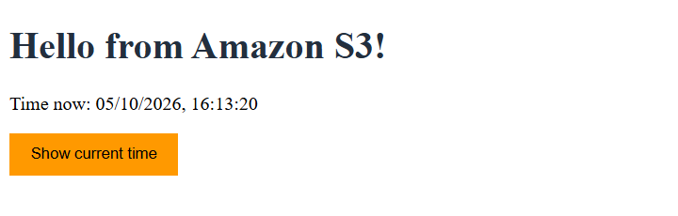
The live website
http://q1-project-buckket.s3-website.ap-south-1.amazonaws.com
Before clicking the button
After clicking Show current time

Slide 10
Conclusion
A static website was hosted on Amazon S3 using only a bucket, three files and a policy.
Static website hosting serves the files at a public website endpoint.
The bucket policy grants read-only access, so visitors can view but not change files.
S3 hosting is low cost, scalable and needs no server to maintain.
Thank you

