Slide 1
Student Registration Application
on Amazon EC2 and Amazon RDS (MySQL)
AWS Project Assignment, Set 1 (AWS Only) | Question 3

Slide 2
Objective and AWS services
Deploy a student registration app, connect the web server to a private MySQL database securely, store records and show insertion and retrieval.
Amazon EC2
Amazon RDS
VPC and security groups
Ubuntu 24.04 web server in the public subnet running a Flask app on port 80
MySQL database student-db in private subnets, Public access: No
my-web-vpc, web-sg and db-sg: MySQL 3306 allowed only from web-sg

Slide 3
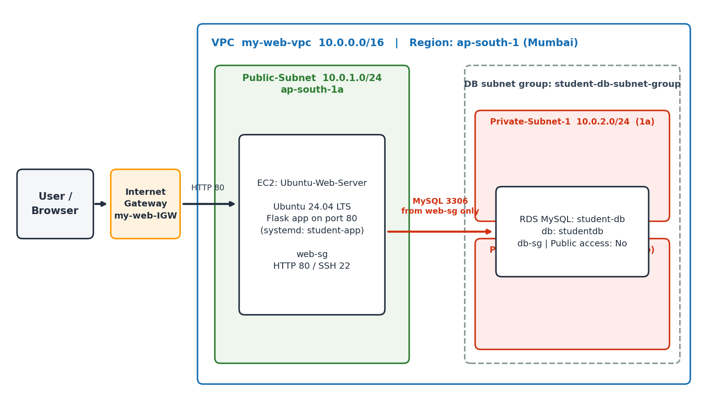
Architecture

Slide 4
Implementation summary
Private subnets | 10.0.2.0/24 (1a) and 10.0.3.0/24 (1b), no route to the Internet Gateway
db-sg | MySQL/Aurora, TCP 3306, source = web-sg
DB subnet group | student-db-subnet-group in my-web-vpc
RDS | student-db, MySQL 8.4, database studentdb, Public access: No
Credentials | /etc/student-app.env, permission 600
Application | Flask + PyMySQL, systemd service student-app, port 80

Slide 5
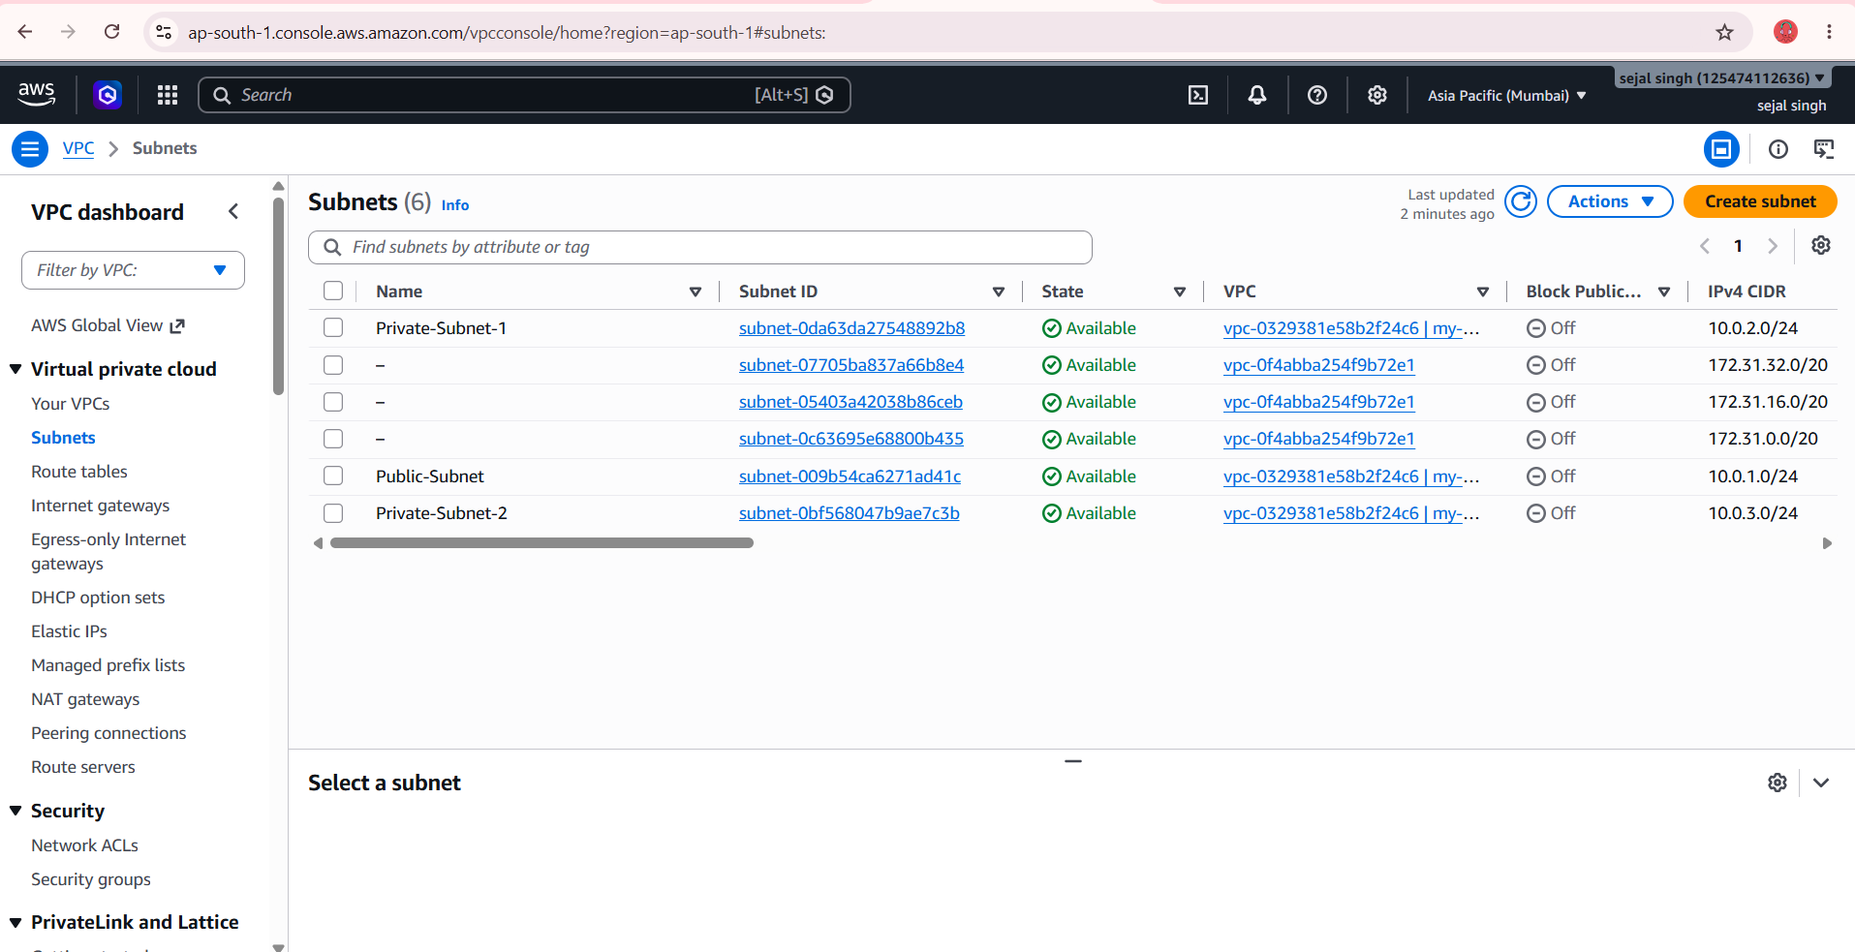
Subnets: public and two private

Slide 6
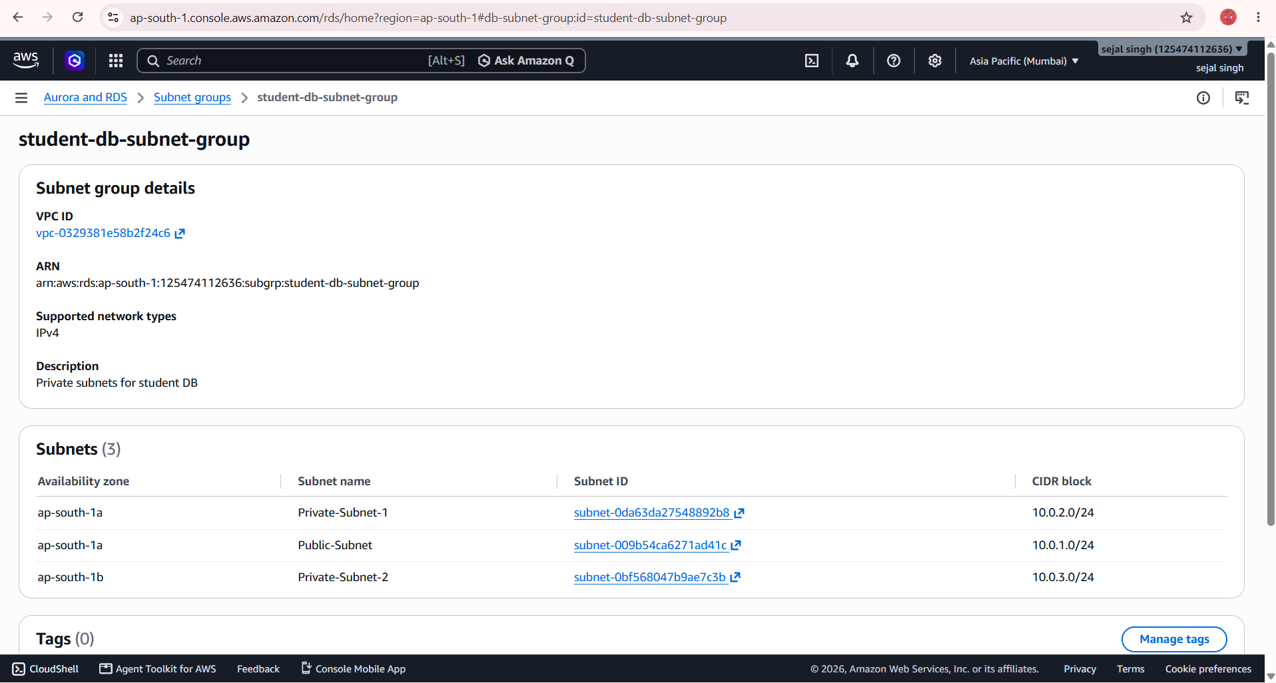
DB subnet group

Slide 7
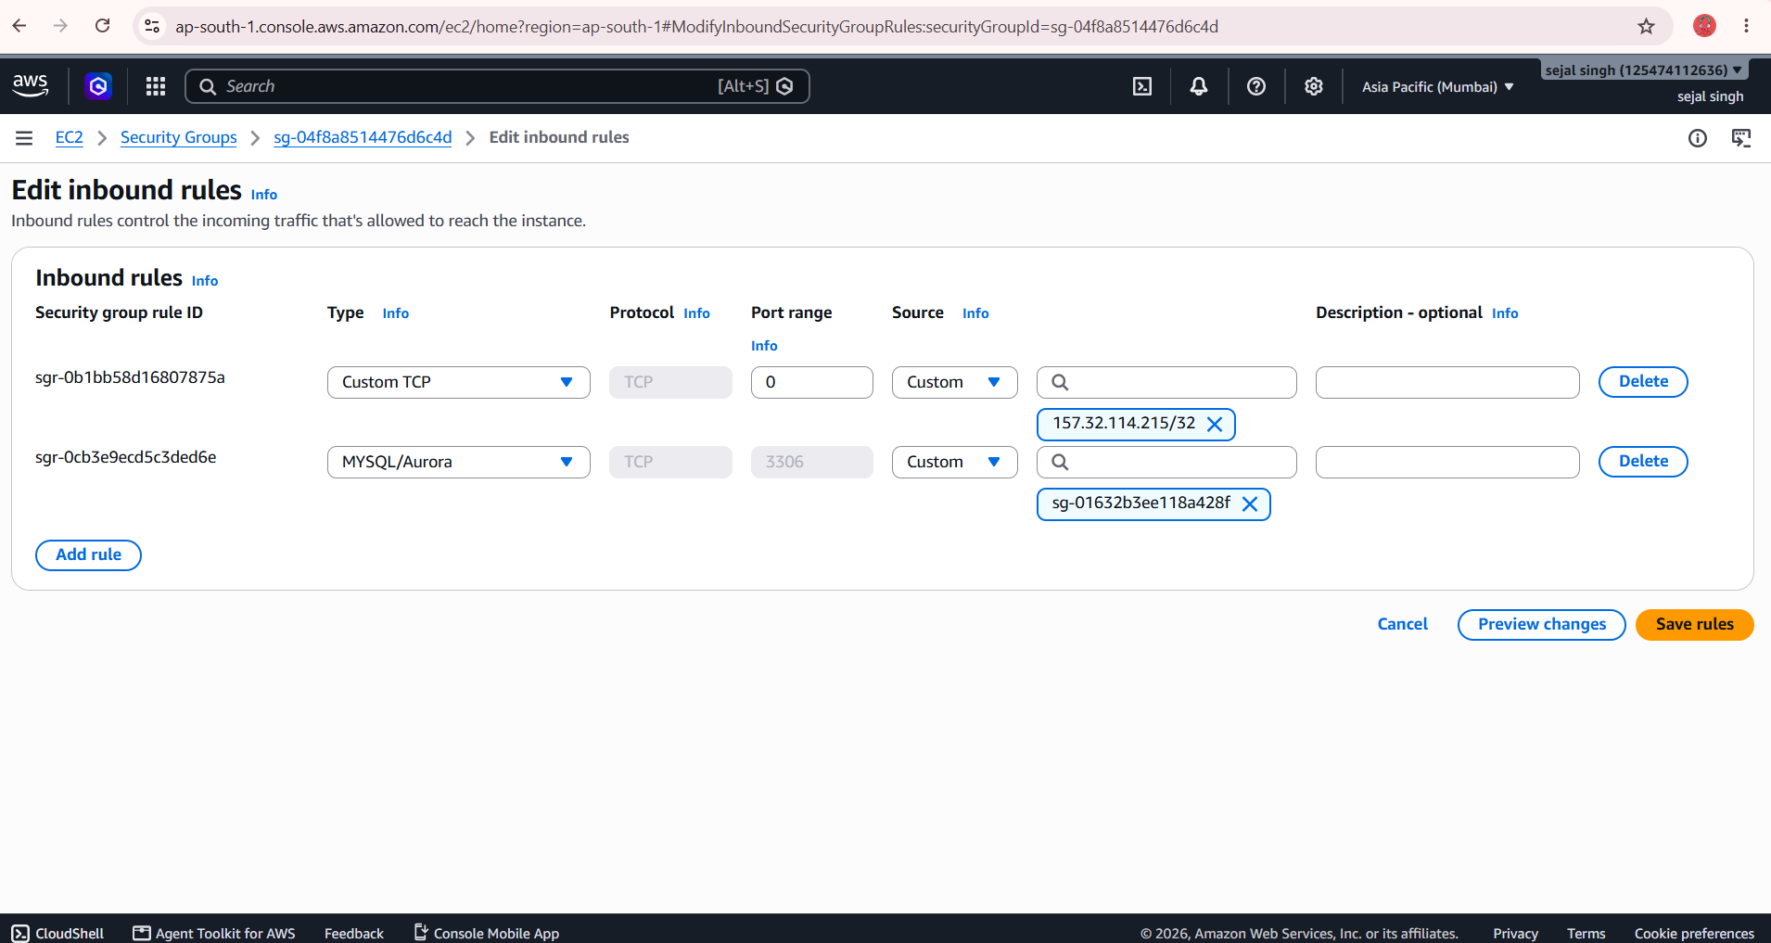
db-sg: MySQL 3306 from web-sg

Slide 8
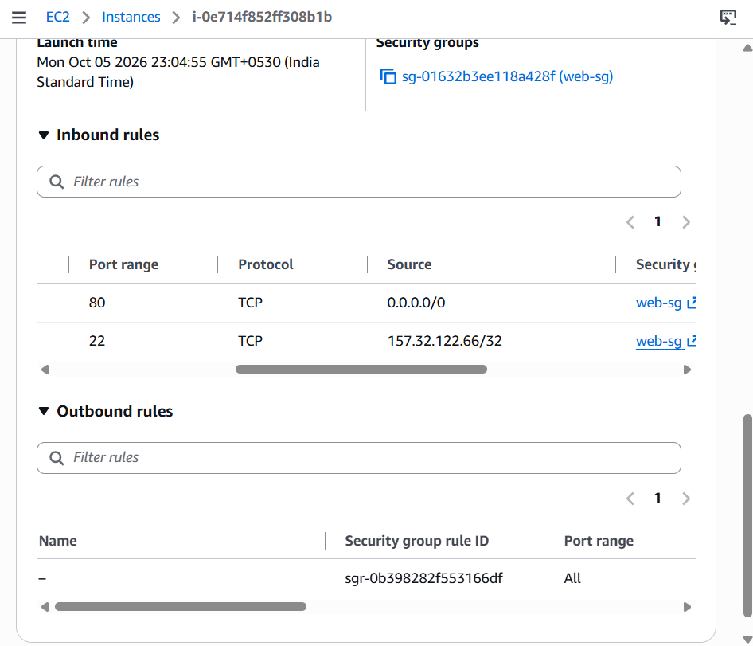
web-sg inbound rules

Slide 9
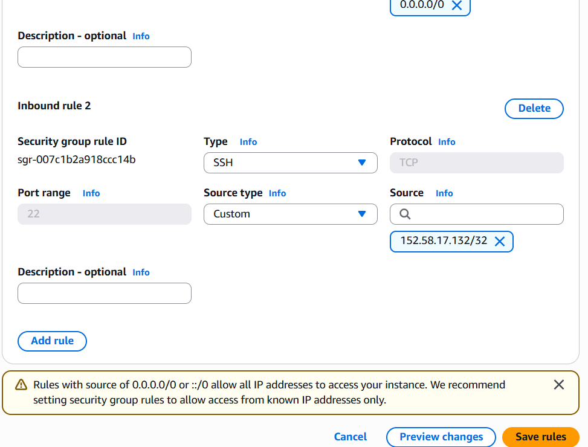
web-sg SSH rule

Slide 10
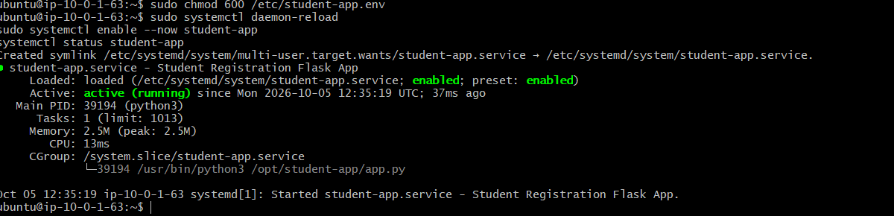
student-app service running

Slide 11
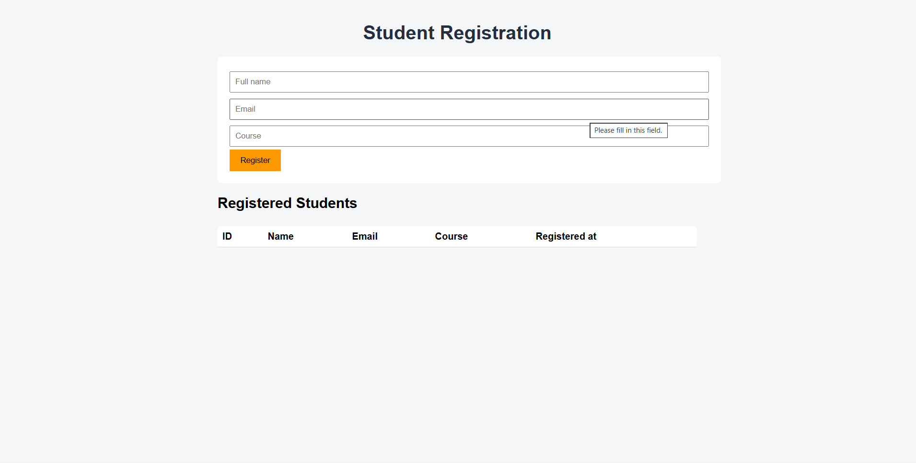
Registration form

Slide 12
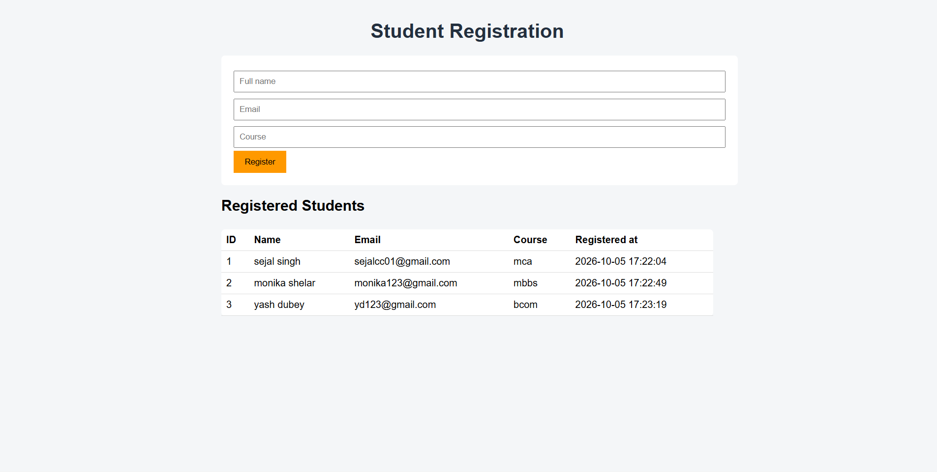
Insertion and retrieval in the web page

Slide 13
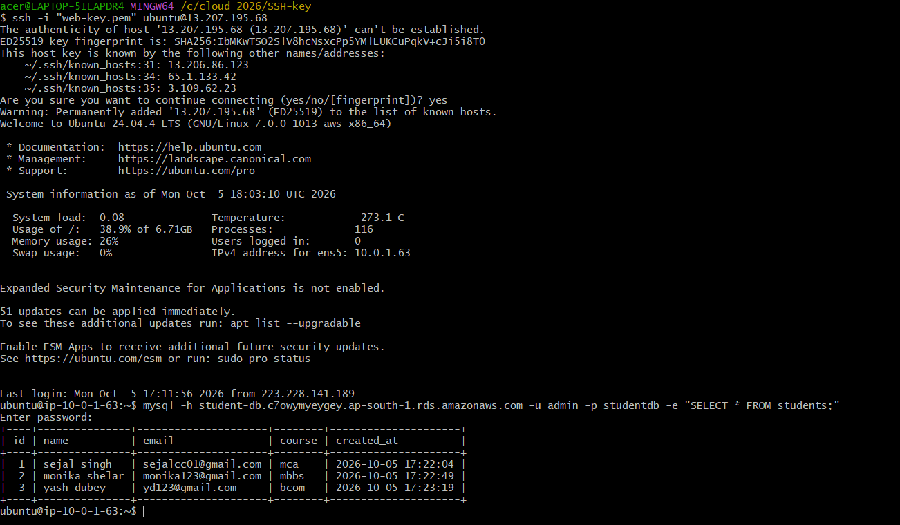
Data read from RDS on the EC2 prompt

Slide 14
Testing results
Test | Result
Open EC2 public IP over HTTP | Form and empty table loaded
Register 3 students | Each record saved and listed in the table
Reload the page | All 3 records returned from RDS
SELECT * FROM students on EC2 | Same 3 rows read directly from the database
The app on EC2 stores and retrieves student records in a private RDS MySQL database that only web-sg can reach.

