Slide 1
Q1
Q2
Q3
AWS PROJECT ASSIGNMENT · SET 1 (AWS ONLY)
Building on AWS: Static Site, Custom VPC and a Database-Backed App
Amazon S3 · VPC · EC2 · RDS MySQL | Region: Mumbai (ap-south-1)

Slide 2
Three questions, three projects
Q1
Q2
Q3
Static website on S3
Custom VPC + Ubuntu EC2
Student app on EC2 + RDS
Host HTML, CSS and JavaScript files from an S3 bucket with the right permissions and a working website URL.
Build a VPC with a public subnet, Internet Gateway, route table and Security Group, then serve a page with Nginx.
Deploy a registration app on EC2 with an RDS MySQL database, then show data insertion and retrieval.

Slide 3
Q1
Static Website Hosting on Amazon S3
Hosting HTML, CSS and JavaScript from an S3 bucket
QUESTION
Design and deploy a static website on AWS using Amazon S3. Configure the S3 bucket for static website hosting, upload HTML/CSS/JavaScript files, configure the required permissions, and demonstrate the working website URL.

Slide 4
How it works
Q1 · Amazon S3
Website files
Amazon S3 bucket
Visitor's browser
→
→
index.html · style.css · script.js
q1-project-buckket
Static hosting + public-read policy
Opens the bucket website endpoint over HTTP
index.html
style.css
script.js
Heading, message text and a "Show current time" button
Arial font, centred layout, light background, orange button
showTime() writes the current date and time into the page

Slide 5
Setup steps, console flow
Q1 · Amazon S3
1
Create the bucket
2
Upload the files
Name q1-project-buckket, region Mumbai. Untick Block all public access.
Add index.html, style.css and script.js to the bucket root.
3
Enable static hosting
4
Add public-read policy
Properties tab, Static website hosting, index document index.html.
Allow s3:GetObject for Principal * on arn:aws:s3:::q1-project-buckket/*

Slide 6
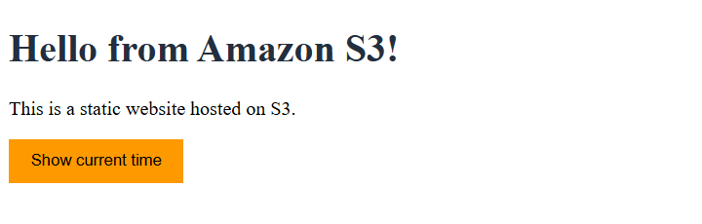
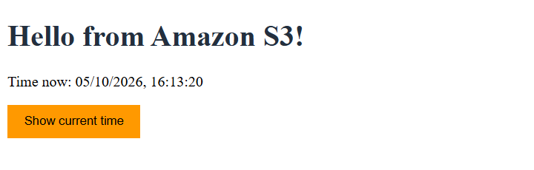
The live website
Q1 · Amazon S3
http://q1-project-buckket.s3-website.ap-south-1.amazonaws.com
Before clicking
The page loads with the heading and the "Show current time" button.
After clicking
script.js writes the current date and time on the page.

Slide 7
Q2
Custom VPC with an Ubuntu Web Server
VPC, public subnet, Internet Gateway, EC2 and Nginx
QUESTION
Create a custom AWS VPC with one public subnet and deploy an Ubuntu EC2 instance. Configure an Internet Gateway, route table, and Security Group, install Apache or Nginx on the instance, and host a basic HTML webpage accessible through the public IP.

Slide 8
Components
Q2 · VPC + EC2
Component | Role
VPC | Isolated private network (10.0.0.0/16)
Public subnet | Address range for the server (10.0.1.0/24)
Internet Gateway | Door between the VPC and the internet
Route table | Sends 0.0.0.0/0 traffic to the gateway
Security group | Firewall allowing SSH (22) and HTTP (80)
EC2 and Nginx | Ubuntu server that serves the HTML page

Slide 9
Network and server setup
Q2 · VPC + EC2
1
VPC
2
Public subnet
3
Internet Gateway
my-web-vpc, CIDR 10.0.0.0/16, VPC only.
Public-Subnet 10.0.1.0/24, auto-assign public IPv4 on.
my-web-IGW created and attached to my-web-vpc.
4
Route table
5
Security group
6
EC2 instance
Public-Route-Table: 0.0.0.0/0 to the gateway, linked to the subnet.
web-sg: SSH 22 from My IP, HTTP 80 from 0.0.0.0/0.
Ubuntu 24.04 LTS, t3.micro, public IP, web-sg, .pem key pair.

Slide 10
Install Nginx
ssh -i "web-key.pem" ubuntu@13.206.86.123
sudo apt update
sudo apt install -y nginx
sudo systemctl enable --now nginx
systemctl status nginx
Status shows active (running), then the HTML page is written to /var/www/html/index.html.

Slide 11
Result: page live on the public IP
Q2 · VPC + EC2
http://13.206.86.123
shows "Hello from my custom AWS VPC!"
Request path
Browser
›
Internet Gateway
›
Route table
›
Public subnet
›
Security group :80
›
EC2
›
Nginx
Cleanup: terminate the instance, then delete the security group, gateway, subnet and VPC to avoid charges.

Slide 12
Troubleshooting checklist
Q2 · VPC + EC2
Problem | What to check
SSH times out | SSH source in web-sg, public IP, route to the gateway, network blocking port 22
Page does not load | Port 80 rule, http not https, Nginx running
Permission denied | User ubuntu and the correct .pem file

Slide 13
Q3
Student Registration on EC2 and RDS
Flask app on EC2 with a private MySQL database
QUESTION
Deploy a student registration application using Amazon EC2 and Amazon RDS. Configure the EC2 web server and an RDS MySQL database, establish secure connectivity between them, store student records in the database, and demonstrate successful data insertion and retrieval.

Slide 14
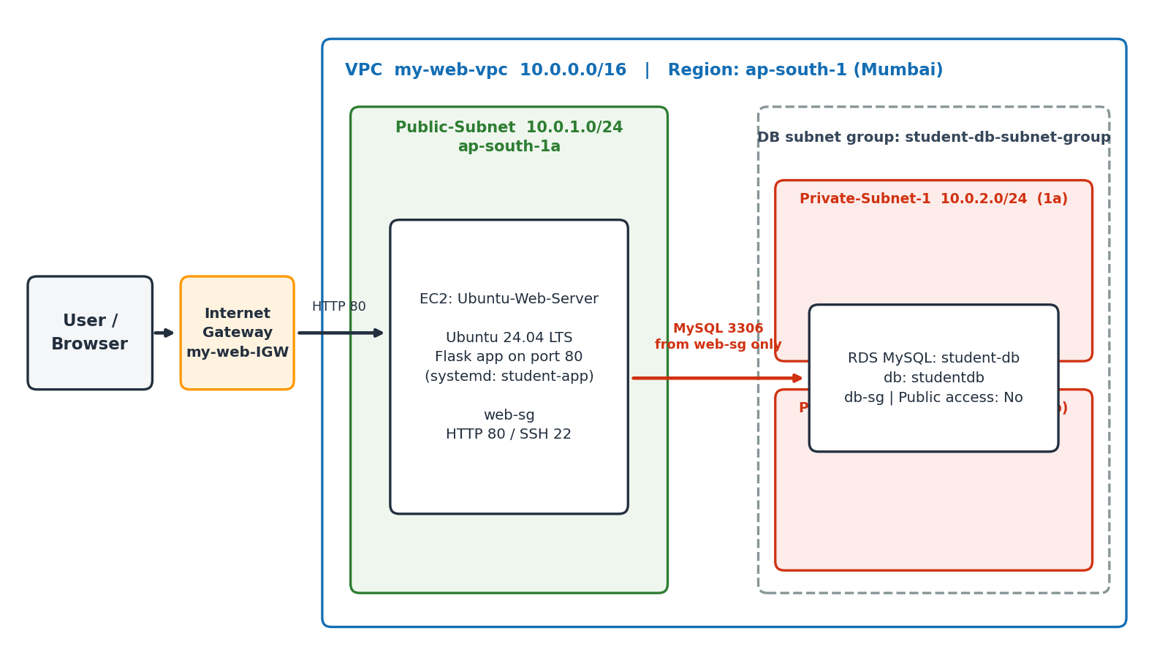
Architecture
Q3 · EC2 + RDS
Amazon EC2
Ubuntu 24.04 web server, Flask app on port 80
Amazon RDS
MySQL student-db in private subnets, Public access: No
VPC + groups
db-sg allows 3306 only from web-sg

Slide 15
Implementation summary
Q3 · EC2 + RDS
Item | Configuration
Private subnets | 10.0.2.0/24 (1a), 10.0.3.0/24 (1b), no route to the IGW
db-sg | MySQL/Aurora, TCP 3306, source = web-sg
DB subnet group | student-db-subnet-group in my-web-vpc
RDS | student-db, MySQL 8.4, database studentdb, Public access: No
Credentials | /etc/student-app.env, permission 600
Application | Flask + PyMySQL, systemd service student-app, port 80

Slide 16
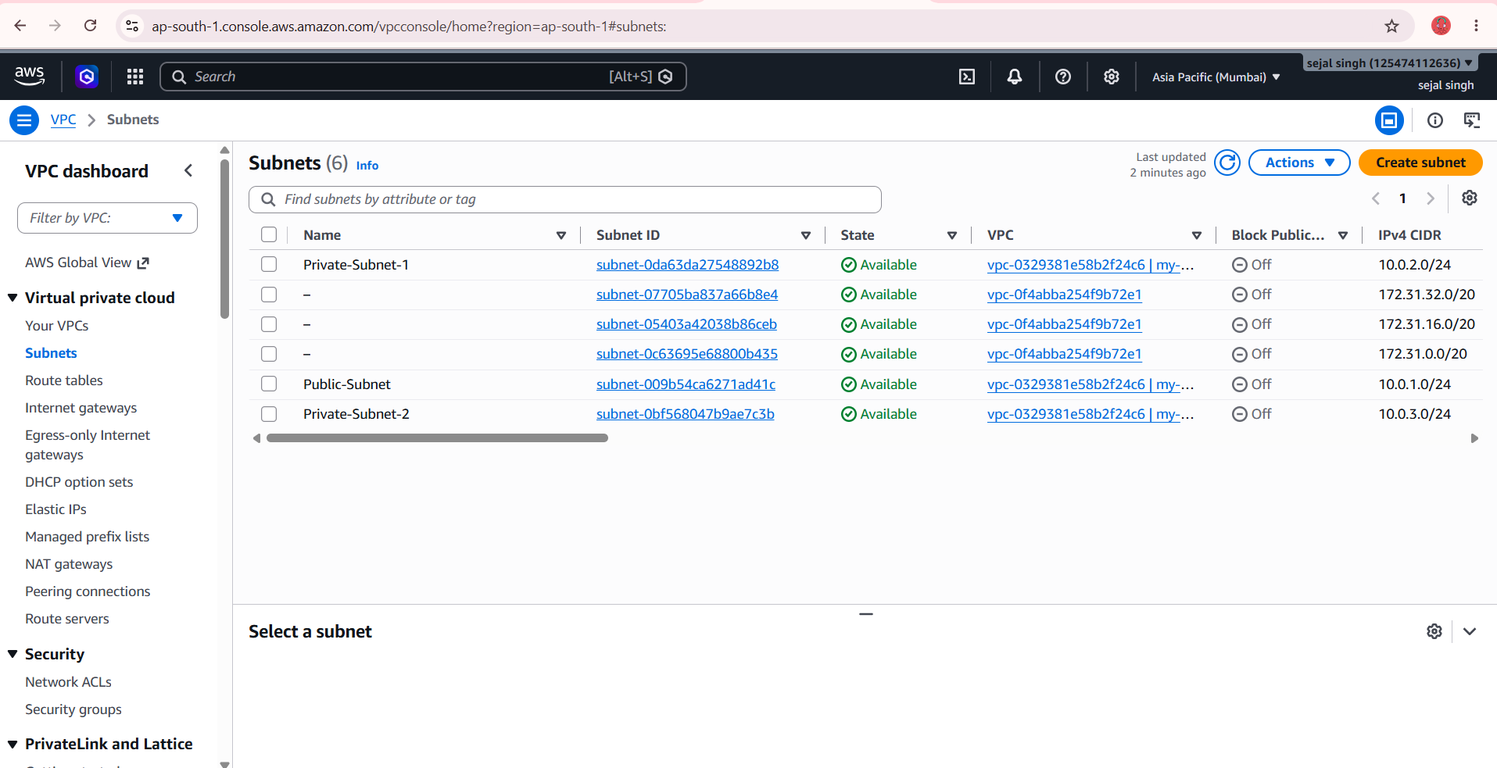
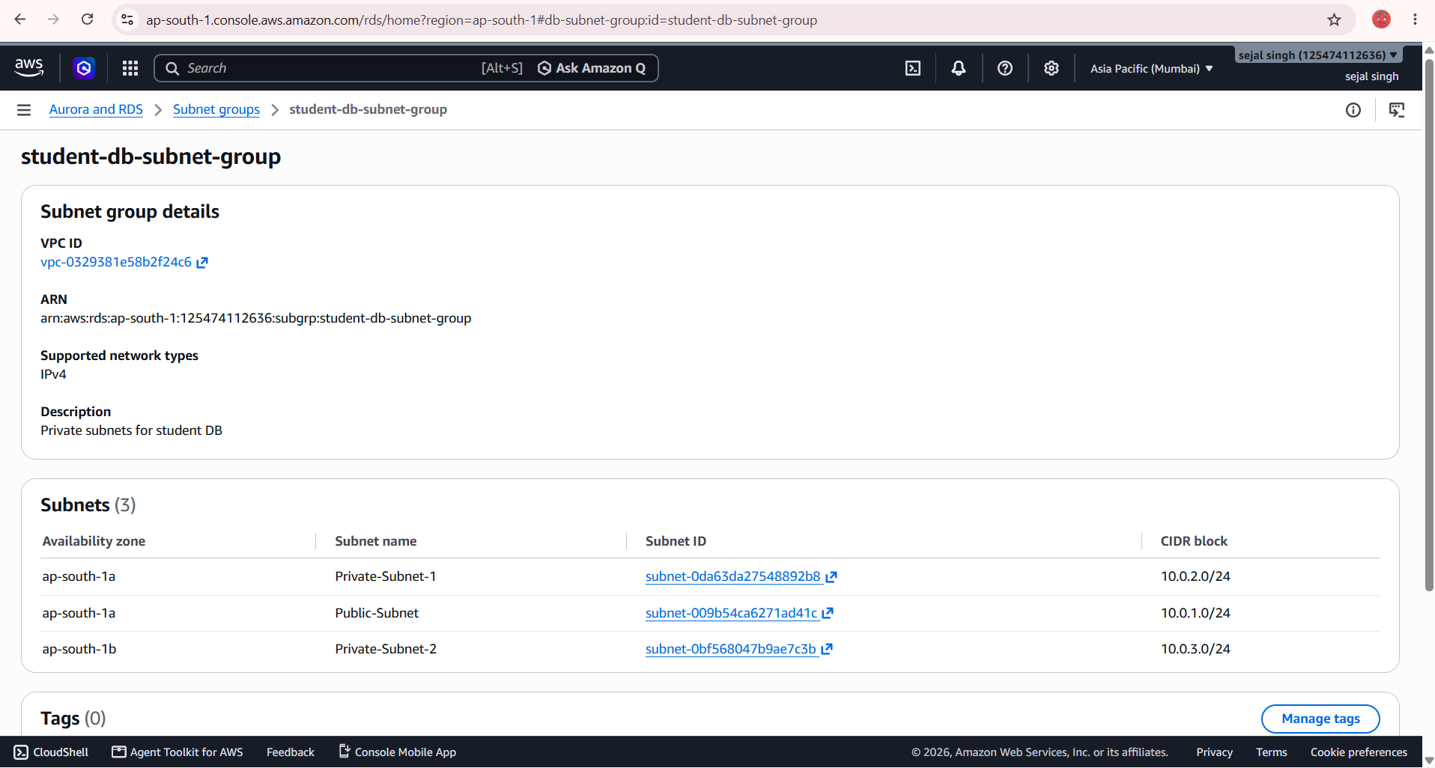
Subnets and DB subnet group
Q3 · EC2 + RDS
Public + two private subnets
DB subnet group
The database lives in two private subnets across two zones, with no route to the Internet Gateway.

Slide 17
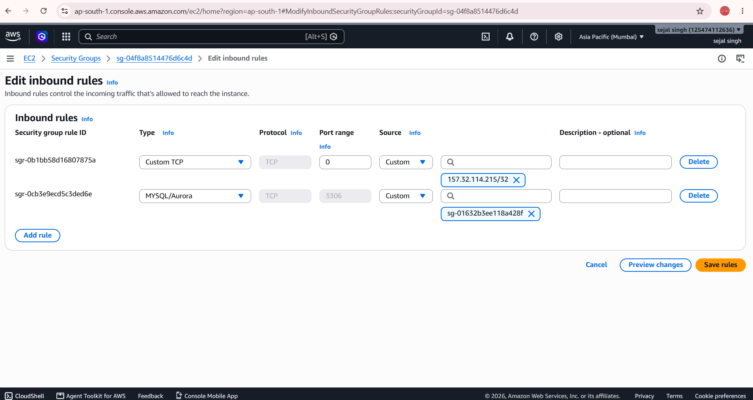
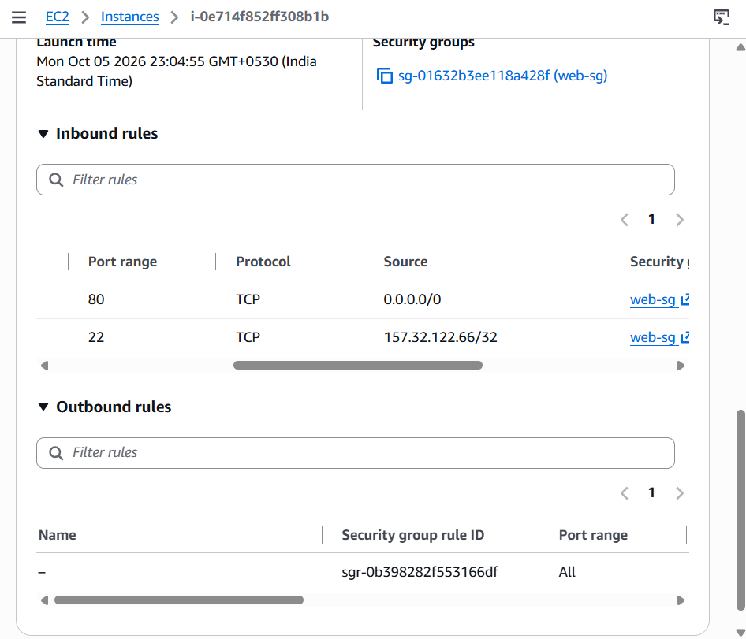
Security group rules
Q3 · EC2 + RDS
db-sg: MySQL 3306 from web-sg
web-sg inbound rules
Only the web server security group can reach the database on port 3306.

Slide 18
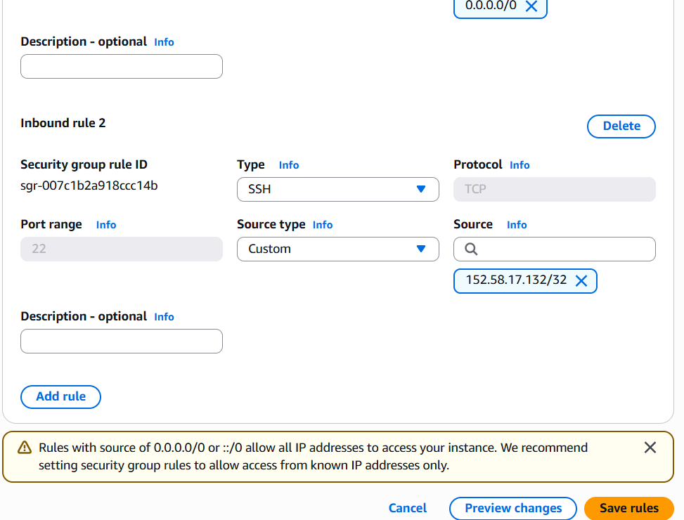
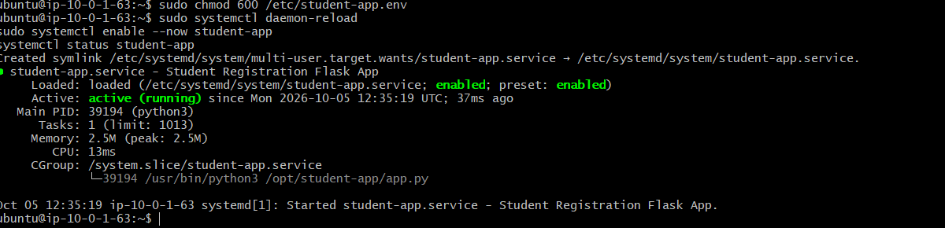
SSH rule and app service
Q3 · EC2 + RDS
student-app service running
web-sg SSH rule
SSH is limited to one IP, and the Flask app runs as a systemd service.

Slide 19
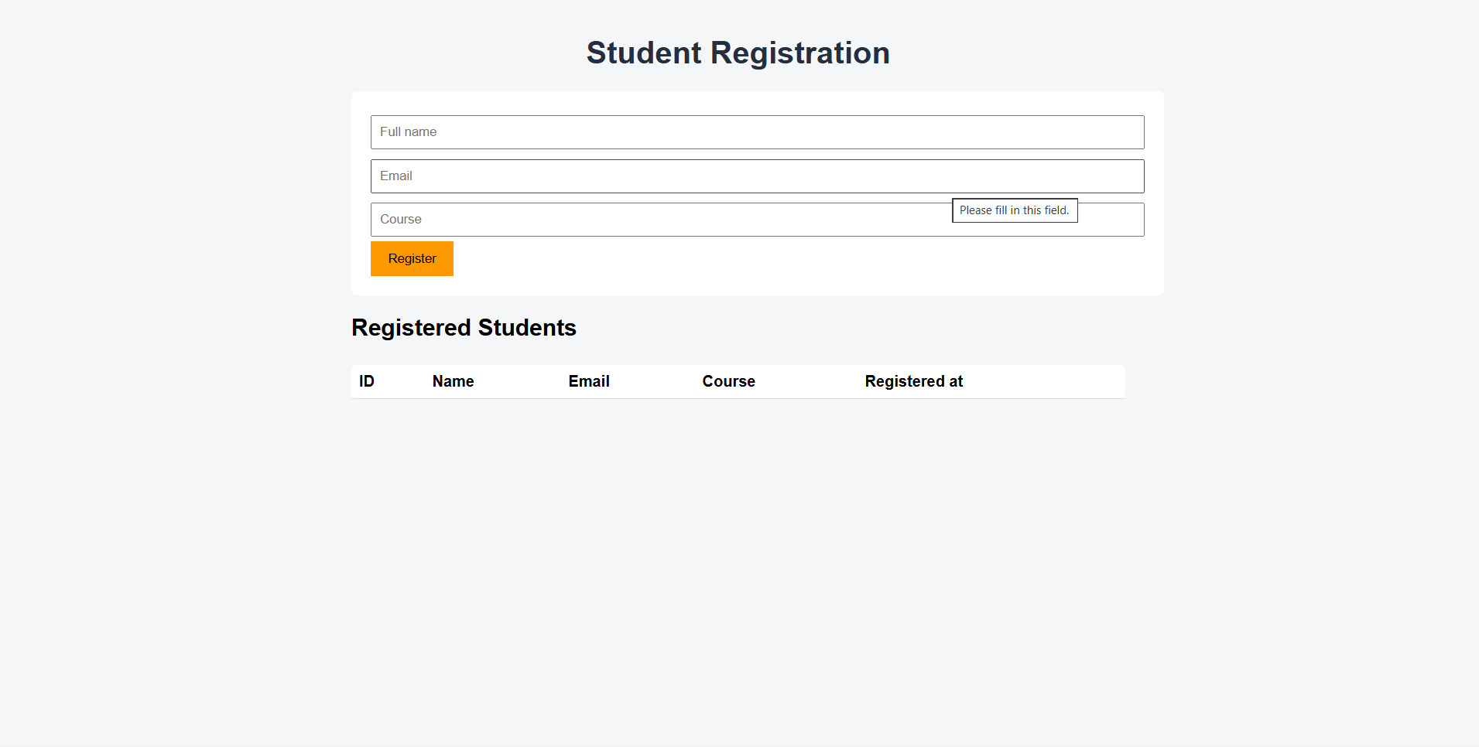
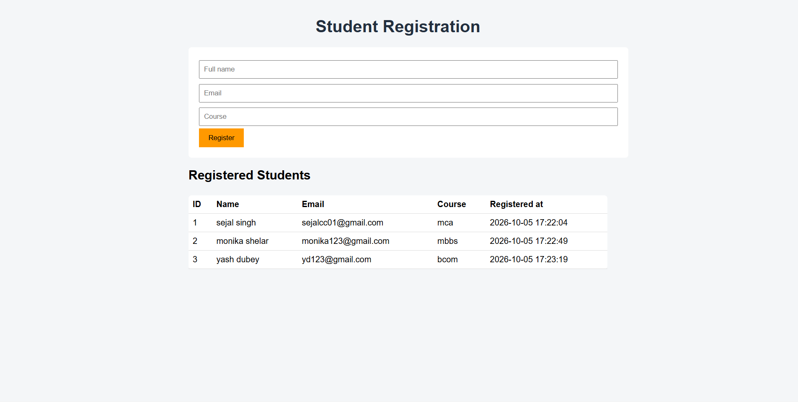
Insertion and retrieval in the web page
Q3 · EC2 + RDS
Registration form
Registered students table
Submitted records are saved to RDS and listed back in the table.

Slide 20
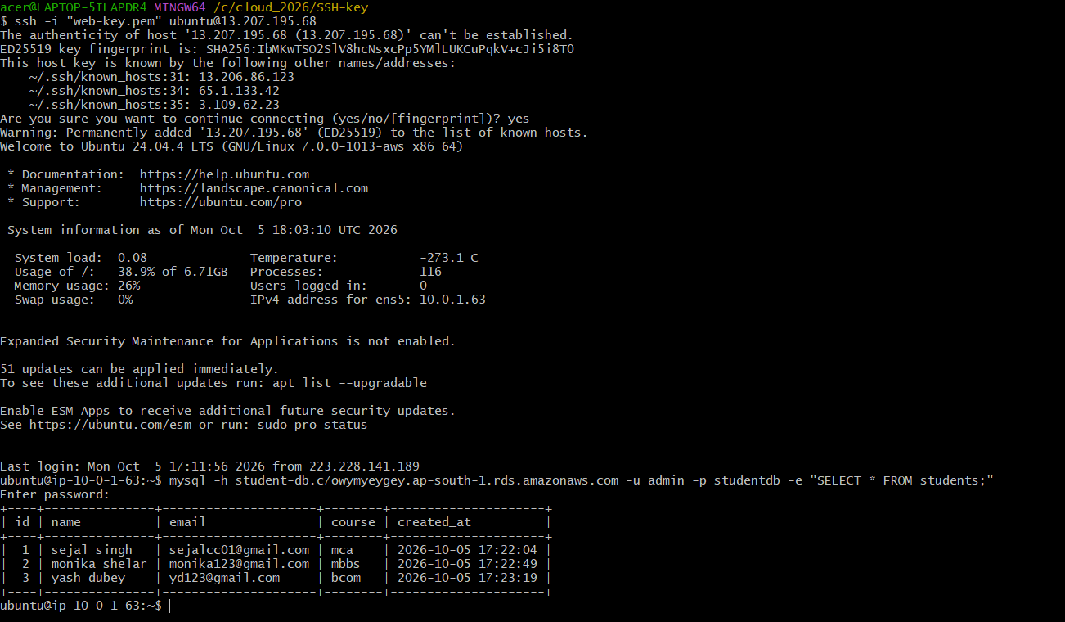
Data read from RDS on EC2
Q3 · EC2 + RDS
SELECT * FROM students
Run from the EC2 prompt, it returns the same 3 rows the web page shows, proving the data is stored in RDS.

Slide 21
Testing results
Q3 · EC2 + RDS
Test | Result
Open EC2 public IP over HTTP | Form and empty table loaded
Register 3 students | Each record saved and listed in the table
Reload the page | All 3 records returned from RDS
SELECT * FROM students on EC2 | Same 3 rows read from the database

Slide 22
Conclusion
Q1
S3 hosts a full website with just a bucket, three files and a public-read policy.
Q2
A custom VPC with an IGW, route table and security group serves a page from EC2.
Q3
EC2 stores and retrieves records in a private RDS MySQL database reachable only via web-sg.
Thank you

