Slide 1
Magnetic resonance imaging biomarkers for the early diagnosis of Alzheimer’s disease: a machine learning approach
Sejal Dua
May 10th, 2018
Abstract:

Slide 2
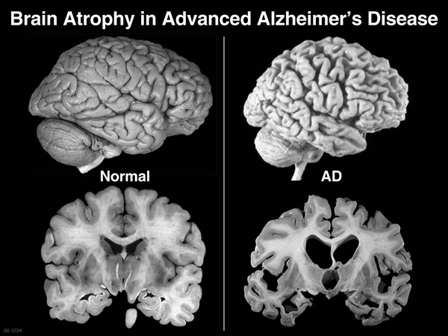
Background
Alzheimer’s disease (AD) is a neurodegenerative disorder of unknown pathogenesis
Primarily affects elderly adults (60+ years of age)
Most common cause of dementia
Neuroimaging via magnetic resonance imaging (MRI) includes both local and generalized shrinkage of brain tissue
MRI features could potentially be used to predict early Alzheimer’s, predict the rate of decline of AD, and guide therapy in the future.

Slide 3
Technical Approach - 1
Some details
More details
total number of (approach slides + results slides) should not exceed 4
font size should be 24 or bigger, except for figure and table labels, which should be readable (18 or 20 is reasonable)

Slide 4
Technical Approach – 2 (if needed)
extension of previous slide – same comments on font size, etc apply

Slide 5
Results- 1
Some results – show at least two figures and/or tables
More stuff
The notes on fonts, # pages from above apply here too

Slide 6
Results- 2 (if needed)
Some results – figures and/or tables
More stuff

Slide 7
Conclusions and Next Steps
what would you do next?
one slide only
same font size rules as above

Slide 8
References
Image on first page https://alzheimersdiseasebiol2095.wordpress.com/alzheimers-effect-on-the-brain/
2nd ref (maybe some code you used)

