Slide 1
Automated brain tumor detection and segmentation using threshold density algorithm with logistic regression and ROC error analysis
Sejal Dua
May 10th, 2018
Abstract:
Almost 80% of malignant brain tumors are gliomas, and patients with malignant gliomas have a mean survival rate of just six months. Since gliomas are easily distinguishable by way of magnetic resonance imaging (MRI), a MATLAB algorithm can be used in tandem with a physician’s visual inspection to automatically detect the presence of a glioma and report some statistical information about the glioma prior to surgery. The technical approach for the algorithm relies on a set threshold density level to distinguish the tumor, followed by edge segmentation techniques to outline the tumor on the MRI scan. This project is a first step for what could be a programming breakthrough in the medical field. The logistical regression and receiver operating characteristic analyses yielded by this project will indicate what standard of accuracy the algorithm meets and illuminate what needs to be improved upon in the future to achieve the most accurate glioma detection algorithm.

Slide 2
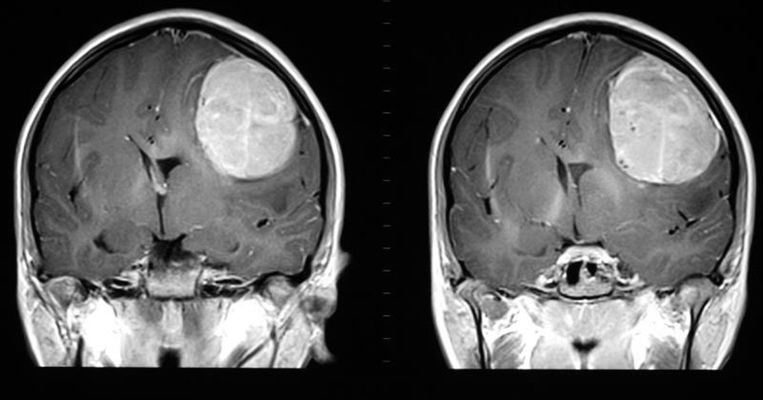
Background
Gliomas are the most common brain tumors all over the world, according to the World Health Organization (WHO).
Brain tumors are differentiated by shape, size, intensity, and density.
Figure 1. An MRI scan of a glioblastoma multiforme (GBM), a malignant glioma and one of the deadliest cancers in the world.
Tumor detection and segmentation by a physician is time consuming and error prone.
Especially problematic for large population countries
If a benign tumor (PBT) is missed, it may become a life-threatening malignant tumor (SBT).
An automated tumor detection algorithm can be used in tandem with a physician’s manual inspection to improve glioma detection accuracy and expedite the process of analyzing MRI data.

Slide 3
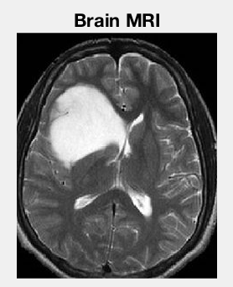
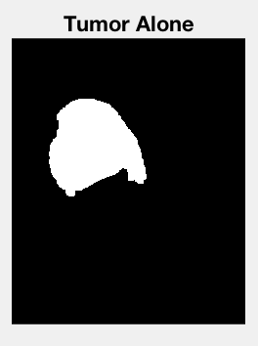
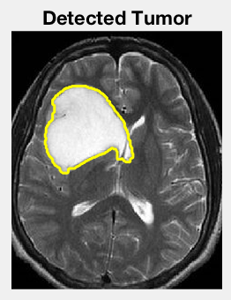
Technical Approach (1) – Neuroimage Processing
Edge Segmentation and Tumor Detection
Takes in an image matrix (imread)
Uses im2bw to apply a simple filter
Finds connected regions using bwlabel
Calls Matlab’s regionprops function to obtain a structure from which it can extract the density and area of the non-black pixels
Defines highDensityArea as all the area where the density > some threshold
Finds the maximum of highDensityArea and labels this region tumorLabel
Uses the ismember function to identify the tumor region
Applies morphological dilation on the tumor region (strel and imdilate functions)

Slide 4
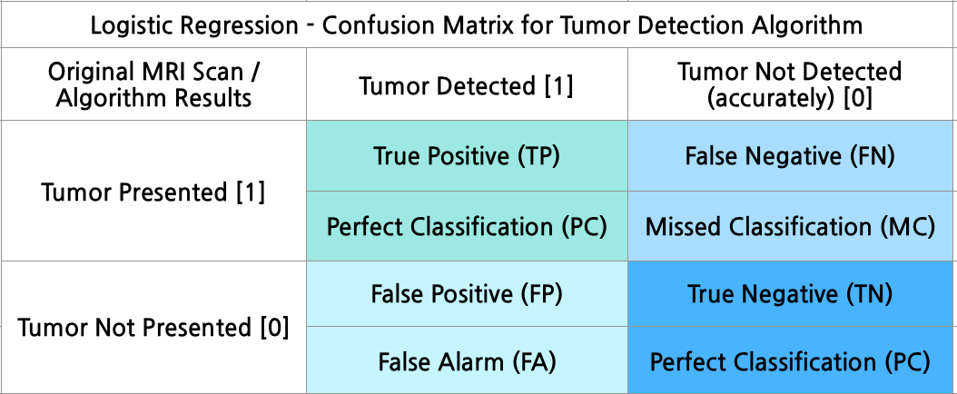
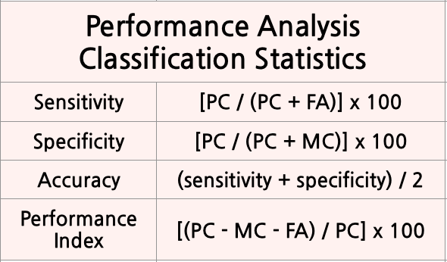
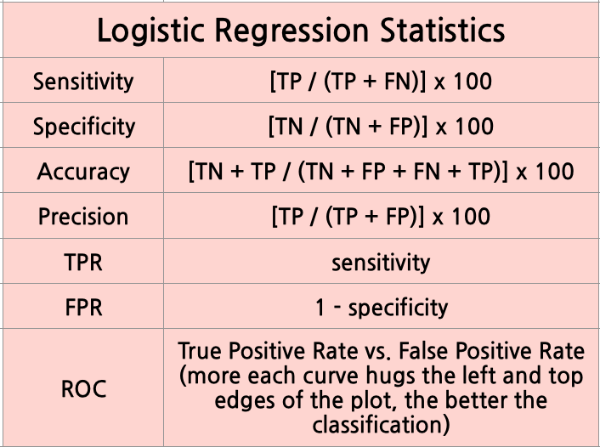
Technical Approach (2) – Error Analysis

Slide 5
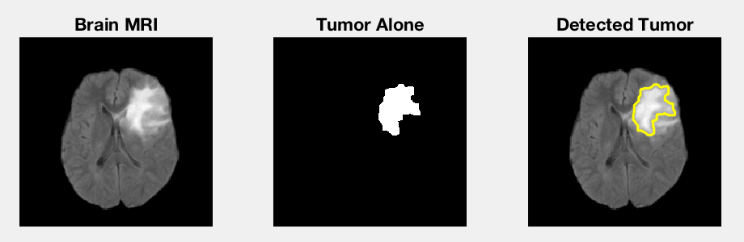
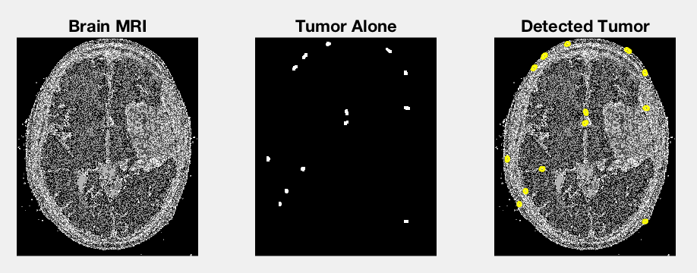
Results (1) – Successful and Unsuccessful Examples
Image 5 / Threshold 0.7 ➔ an example of an exceptionally good tumor detection
Image 4 / Threshold 0.9 ➔ an example of a poor tumor detection

Slide 6
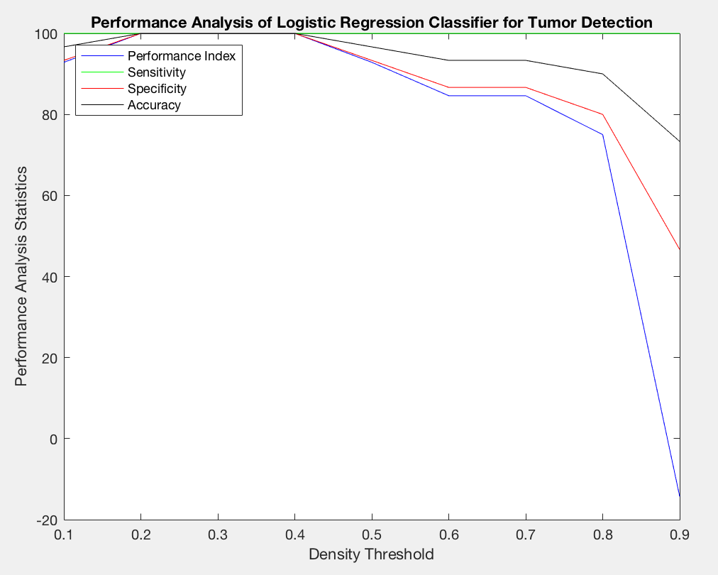
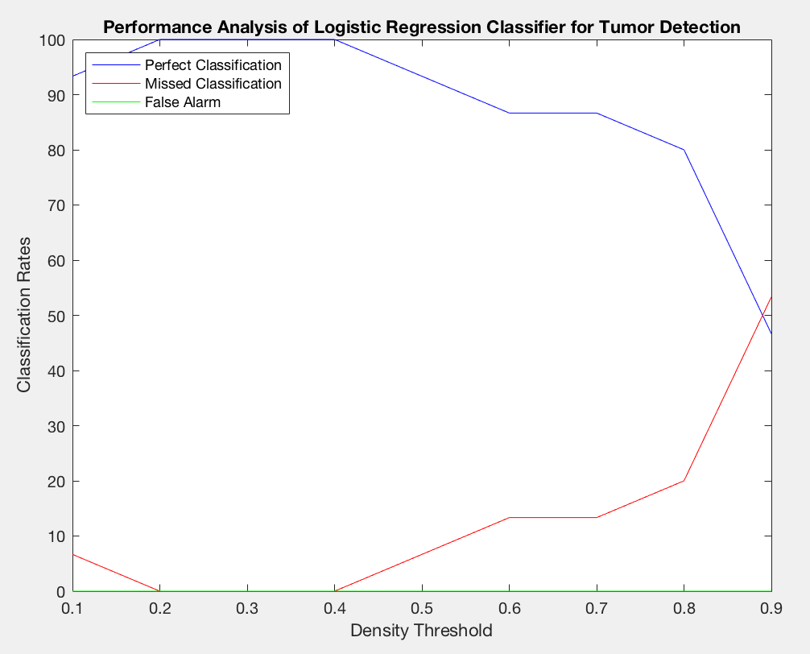
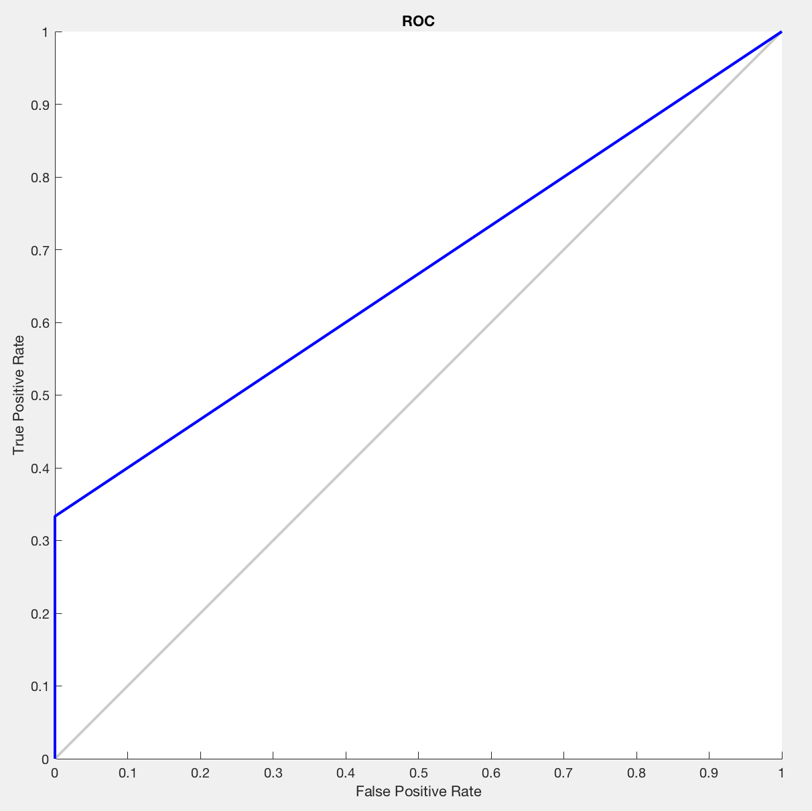
Results (2) – Error Analysis
The figures show that the 0.2 and 0.3 density thresholds were 100% accurate at detecting gliomas from MRI scans. 0.1-0.7 were decently accurate, but 0.8 and 0.9 were not able to detect the presence of tumors very well. The ROC curve indicates that, overall, the program did fairly well. Modifications could definitely be made to obtain a higher area under the curve (AUC).

Slide 7
Conclusion and Next Steps
Conclusion: Density thresholds 0.2-0.7 yielded the most accurate detection of gliomas from MRI scans. If more aspects of these data were factored into the program to make it more robust, it would be able to process diverse scans of unique gliomas. Perhaps this neuroimage processing tool could be used in the medical field to aid surgeons in craniotomy and laser ablation procedures.
Next Steps:
outer edges of brain on MRI scans are typically bright and dense
have an if statement to detect if the edges are influencing the detection algorithm and apply a filter to get rid of them
learn more about the grade classification scale of gliomas (1-4)
→ have the program automatically classify the glioma

Slide 8
See Videos
TUMOR DETECTION (optional – feel free to skip this one if you are short on time)
https://www.youtube.com/watch?v=u6mCYWGO8yE
ERROR ANALYSIS (shows that the GUI window works)
https://youtu.be/pbht9LwJWOc

Slide 9
References
https://www.youtube.com/watch?v=UeFRo7uALhM
https://www.ncbi.nlm.nih.gov/pmc/articles/PMC5564607/#!po=28.6585
http://clincancerres.aacrjournals.org/content/23/20/6078.figures-only
https://www.ncbi.nlm.nih.gov/pmc/articles/PMC5263212/#CR47
https://onlinelibrary.wiley.com/doi/pdf/10.1002/ima.22238
https://medium.com/randy-s-club/brain-cancer-breakthroughs-890a74bf3c4f
http://www.iaeme.com/MasterAdmin/uploadfolder/IJCIET_08_12_007/IJCIET_08_12_007.pdf
https://link.springer.com/chapter/10.1007%2F978-3-642-04962-0_53
https://radiopaedia.org/articles/epithelioid-glioblastoma
http://www.medicalbiostatistics.com/roccurve.pdf
https://www.youtube.com/watch?v=hnRBl9-BzjQ
http://gim.unmc.edu/dxtests/roc3.htm
http://www.ijecscse.org/papers/apr2012/Brain-Tumour-Extraction-from-MRI-Images-Using-MATLAB.pdf
http://www.dana-farber.org/brain-tumors/diagnosis/
https://www.graphpad.com/guides/prism/7/statistics/sensitivity_and_specificity.htm?toc=0&printWindow
https://www.hopkinsmedicine.org/healthlibrary/test_procedures/neurological/craniotomy_92,P08767

