Slide 1
API Consume

Slide 2
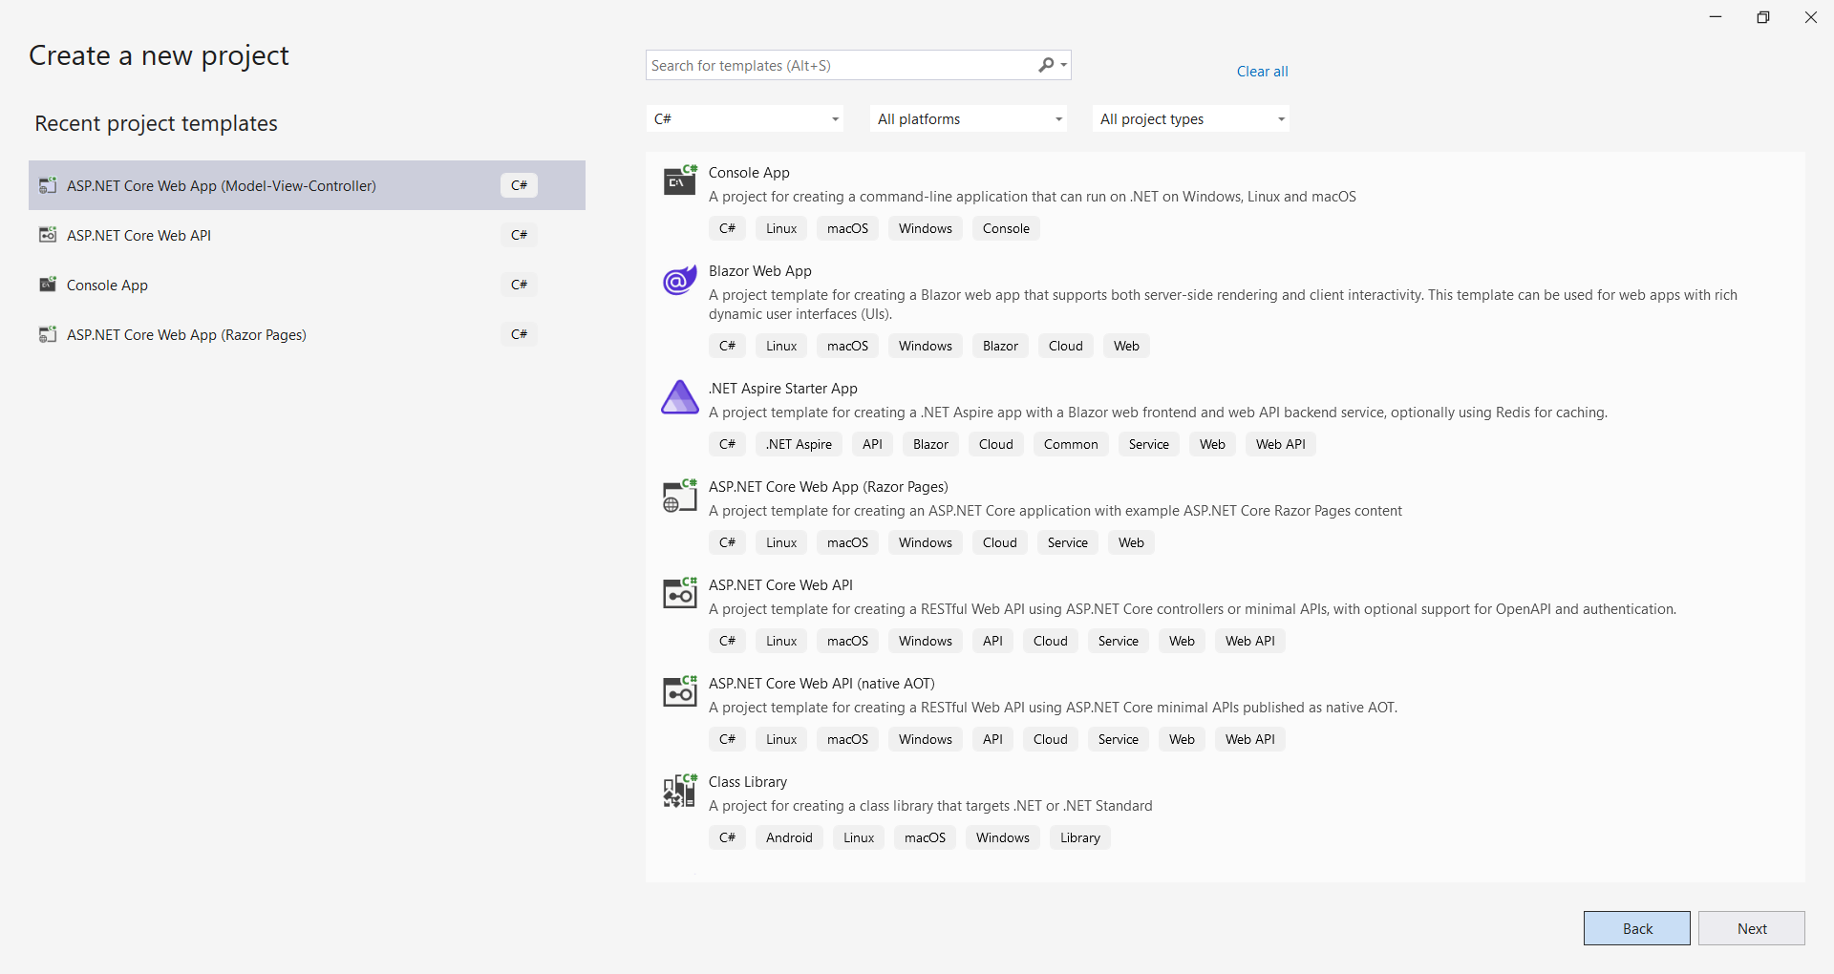
Create MVC project

Slide 3
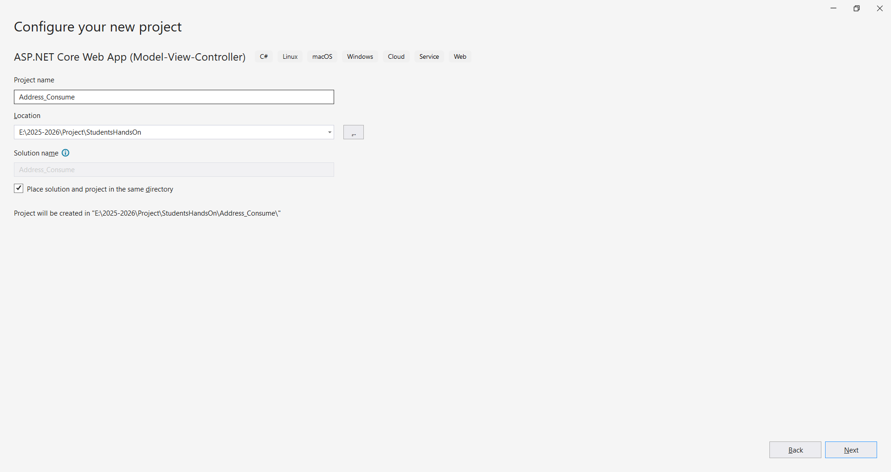
Create MVC project

Slide 4
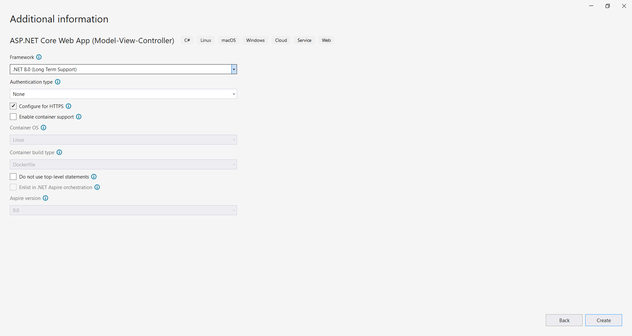
Create MVC project

Slide 5
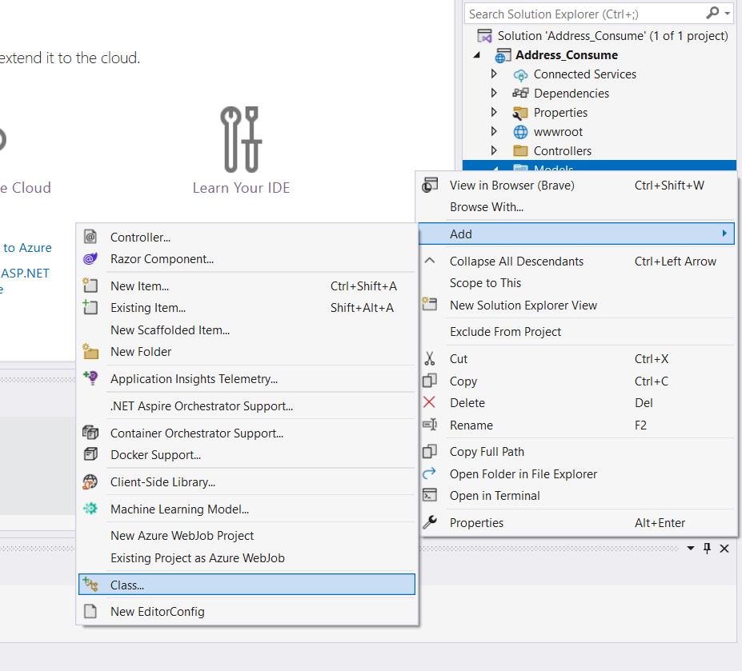
Add StateModel in models folder

Slide 6
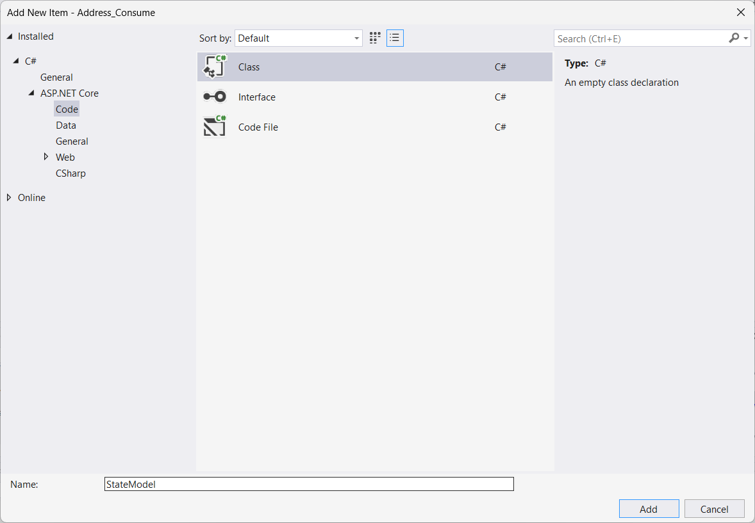
Add StateModel in models folder

Slide 7
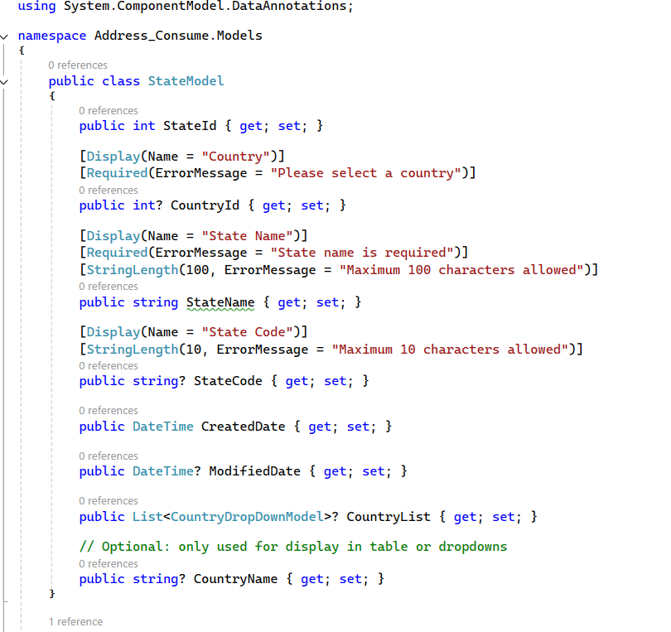
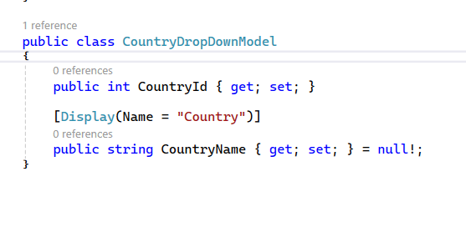
Add Properties and dropdown class in state model

Slide 8
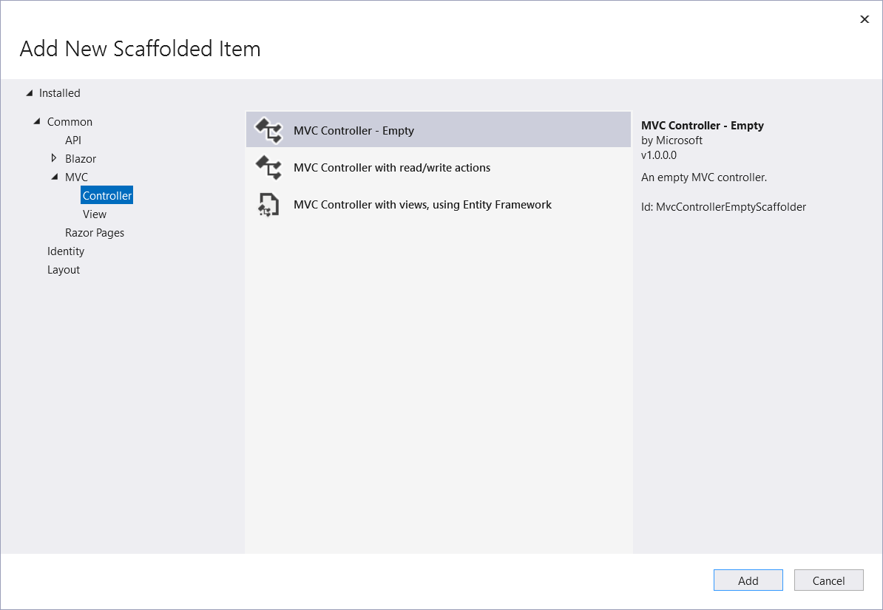
Add State controller

Slide 9
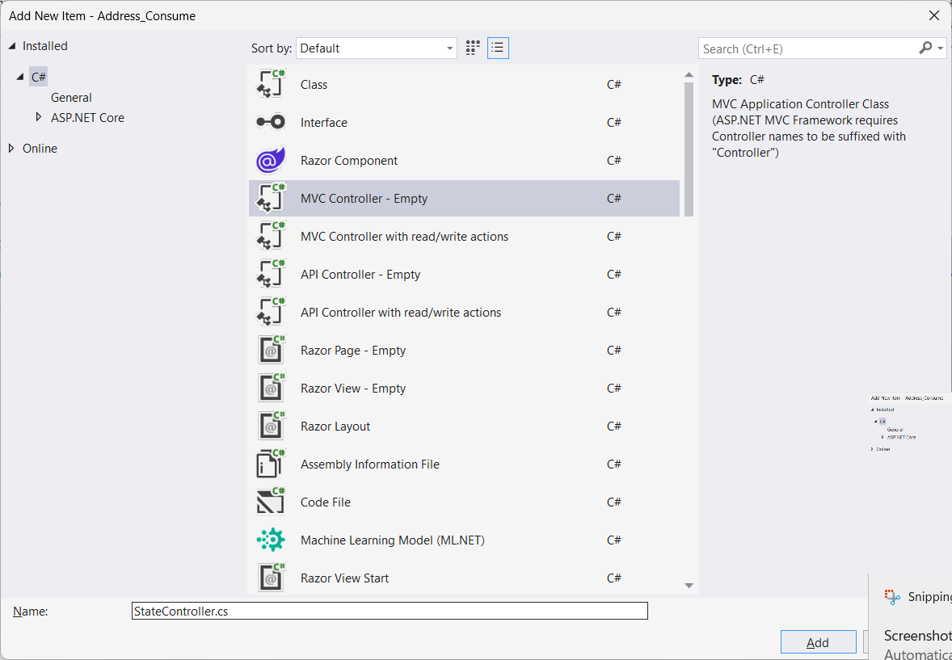
Add State controller

Slide 10
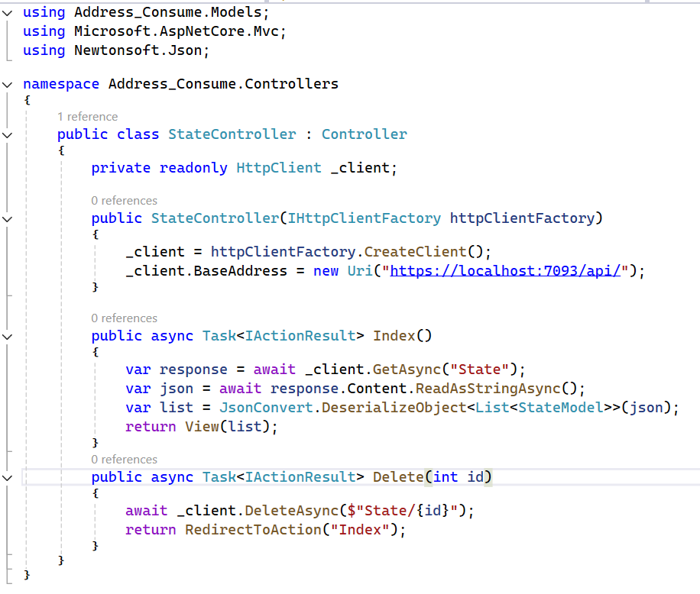
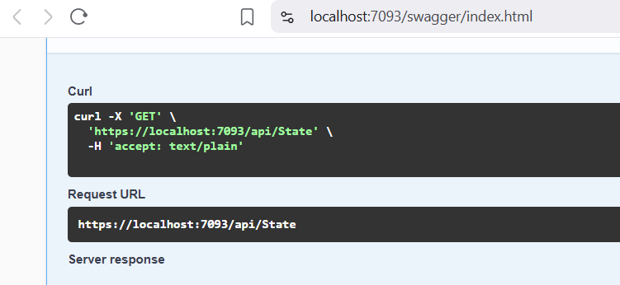
Add code in State Controller
Install package Newtonsoft.Json and add below code in controller
Change port no. (API project is running on)

Slide 11
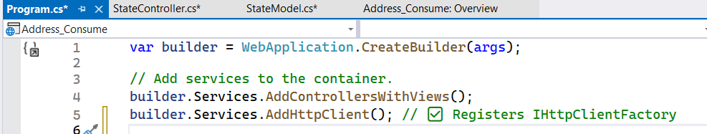
Configure IHttpClientFactory in Program.cs

Slide 12
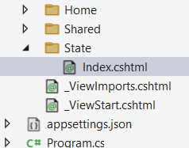
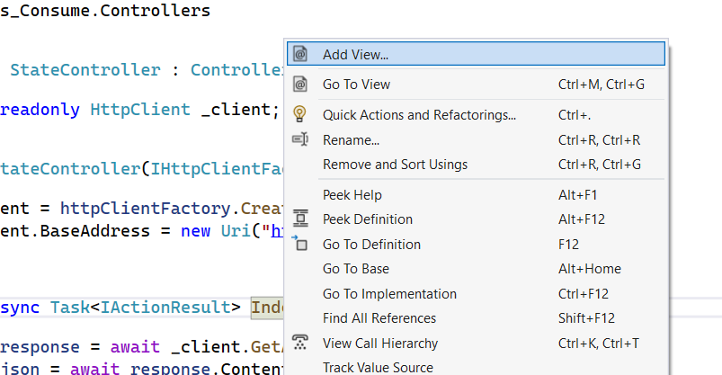
Add Index view
Right click on index method and add view -> select razor view empty -> add file name it index.cshtml
Automatic folder will be created

Slide 13
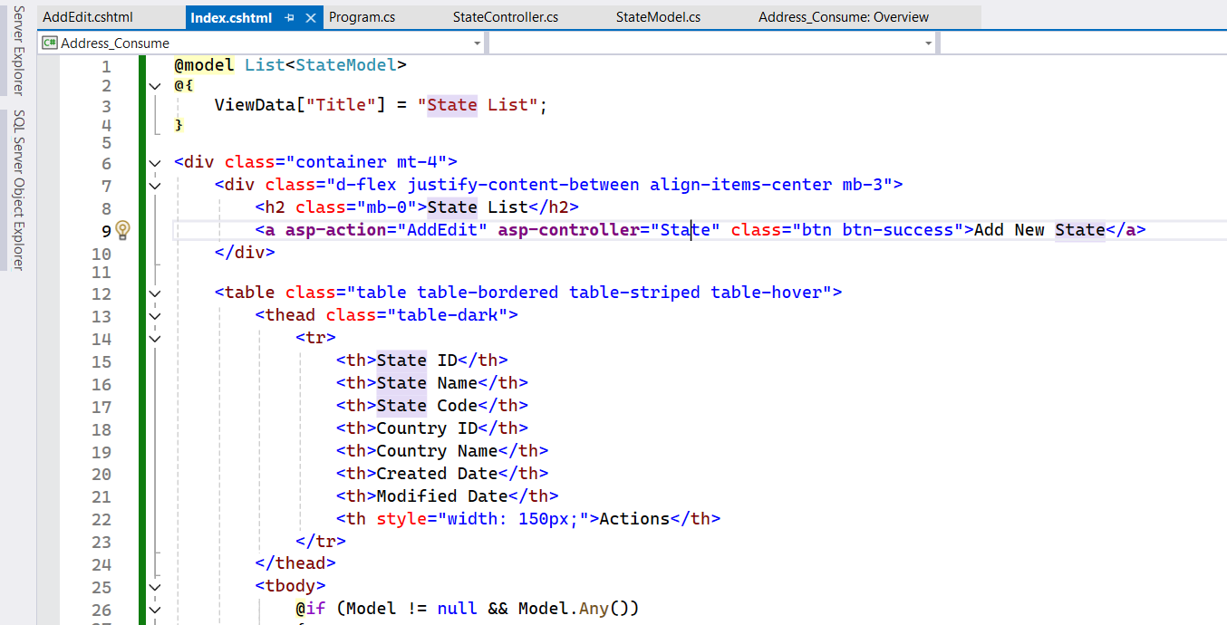
Add code in index.cshtml file

Slide 14
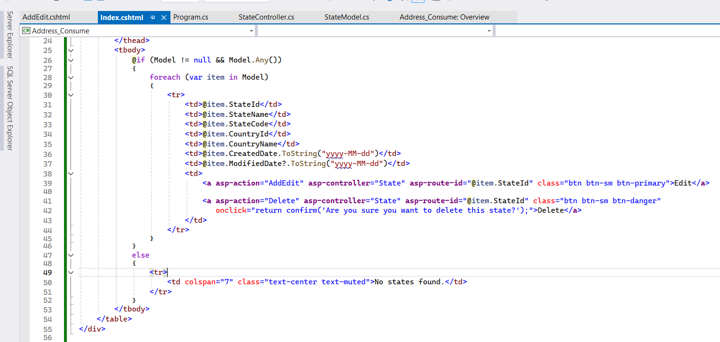
Add code in index.cshtml file

Slide 15
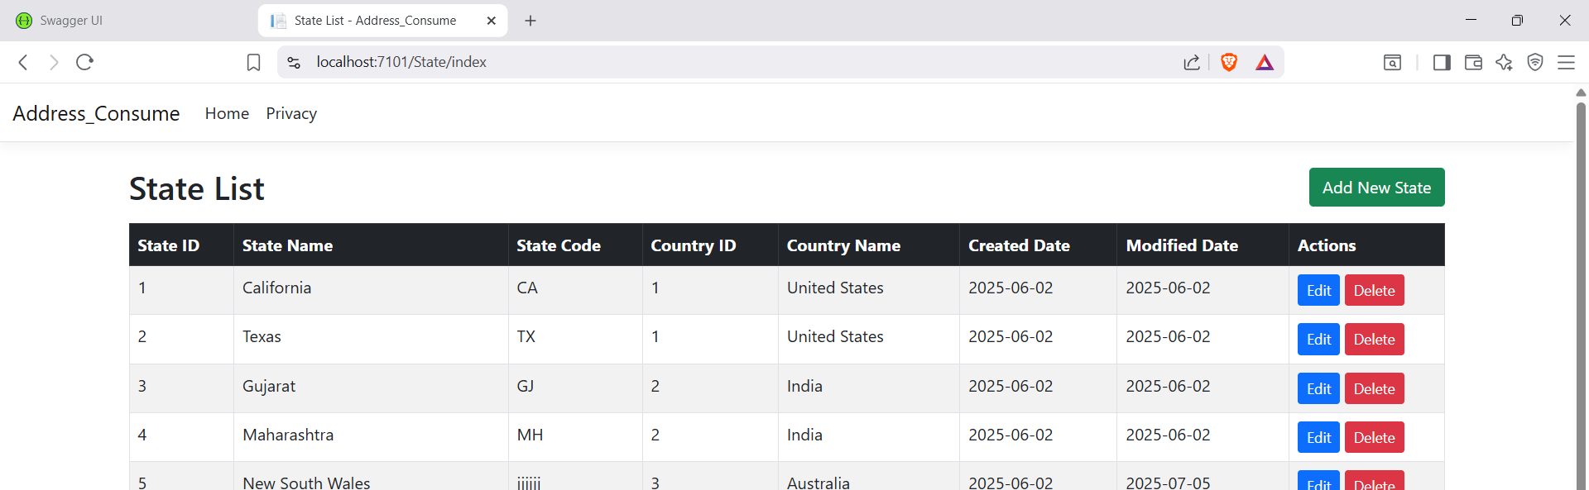
Run the project
First run API project
Then run MVC project
Check functionality Select all and delete

Slide 16
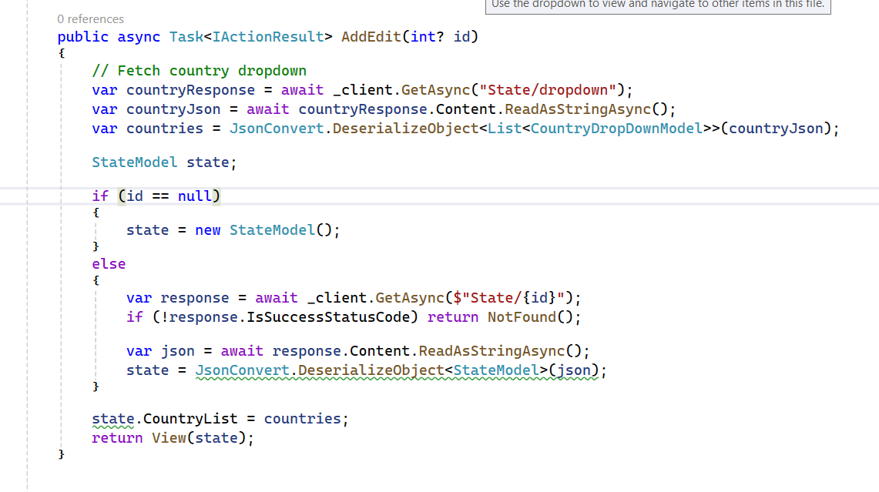
Add AddEdit action method in state controller

Slide 17
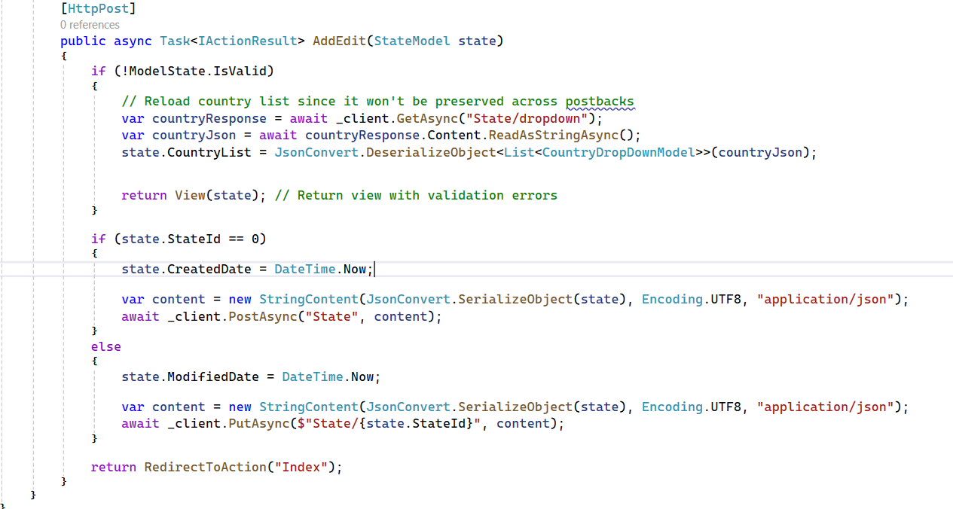
Add AddEdit action method in state controller

Slide 18
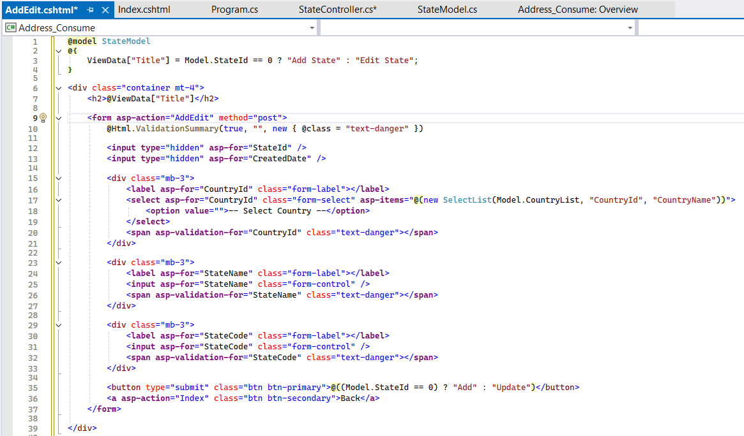
Add AddEdit View page
Right click in AddEdit action method add view
Name it AddEdit.cshtml

Slide 19
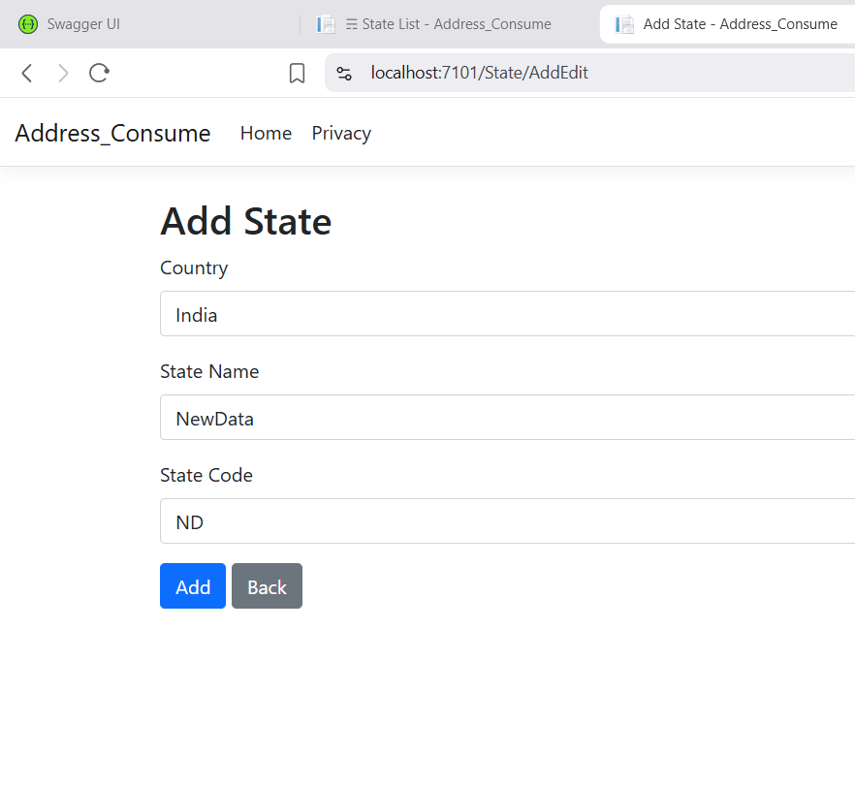
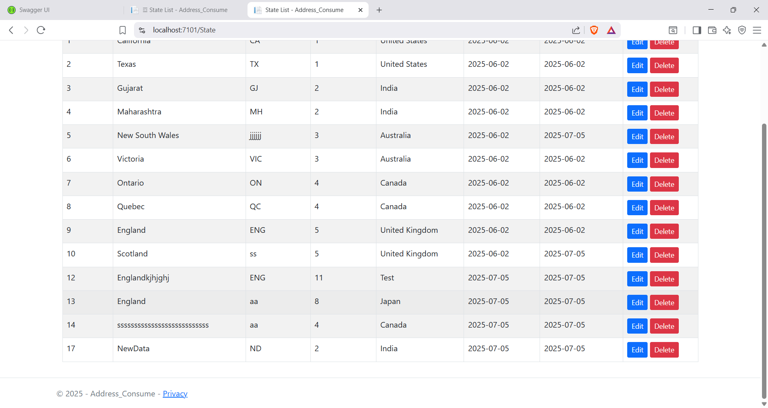
Run both API and MVC project Again
Data added successfully

Slide 20
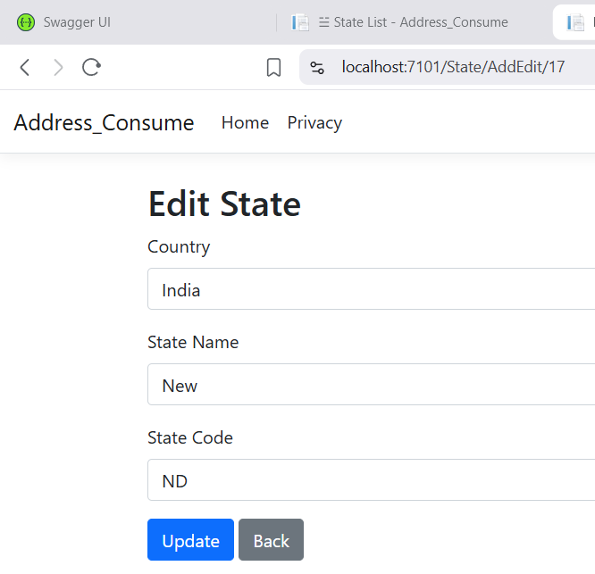
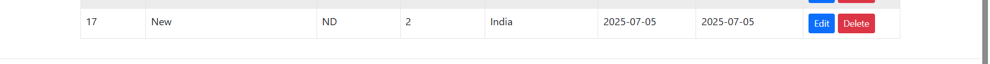
Run both API and MVC project Again
Update Data
Updated data successfully

