Slide 1

Data Analysis Project On Covid-19
Presented by-
Sejal Kankariya

Slide 2
Introduction Of Topic –
We are creating a Data Analysis (Data Science) project on spread of corona virus India.
The raw data of this project are .csv and .xls files and transform it into a Data Analysis.
This project is actually an attempt of analyzing the coronavirus spread in India with the help of data science and data analytics with python language .
This analysis helps us to find the major Covid-19 affected states of India and all that.

Slide 3
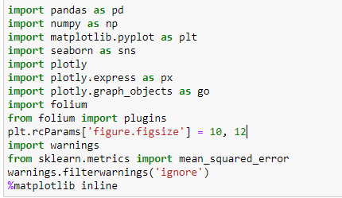

Libraries used in the Project
List of used libraries –
pandas
numpy
matplotlib
seaborn
plotly
folium

Slide 4

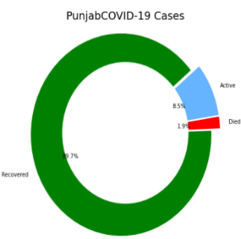
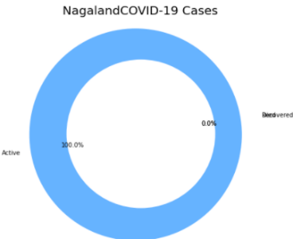
This are some graphs which shows statewise status of Covid-19

Slide 5
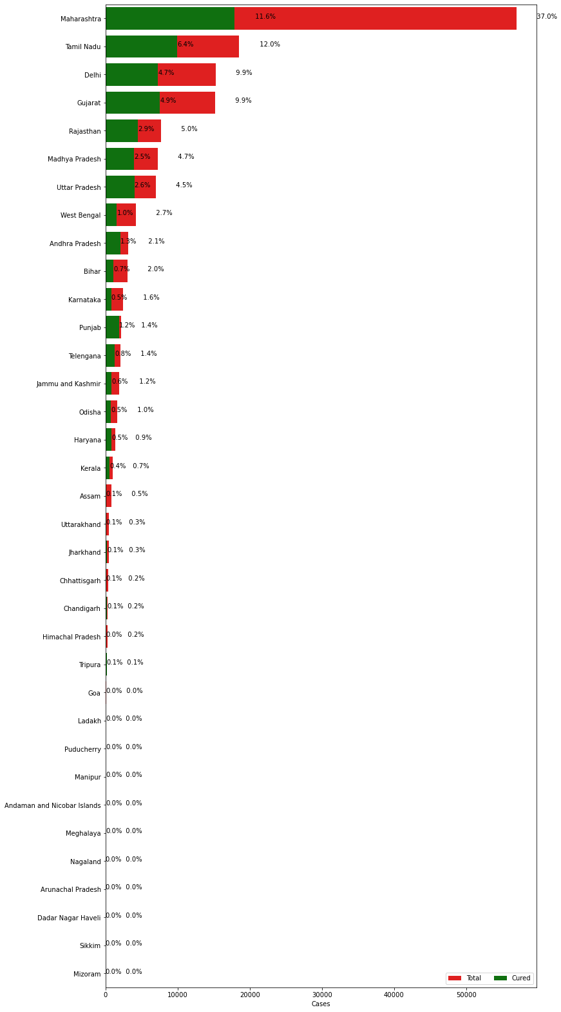
This graph shows statewise percentage of Covid cases.
Highest Maharashtra
Lowest Mizoram

Slide 6
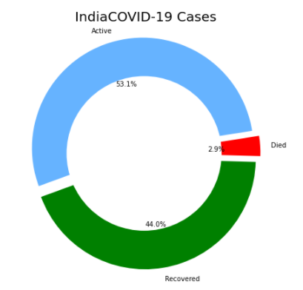
The overall status Of Covid-19 in India

Slide 7
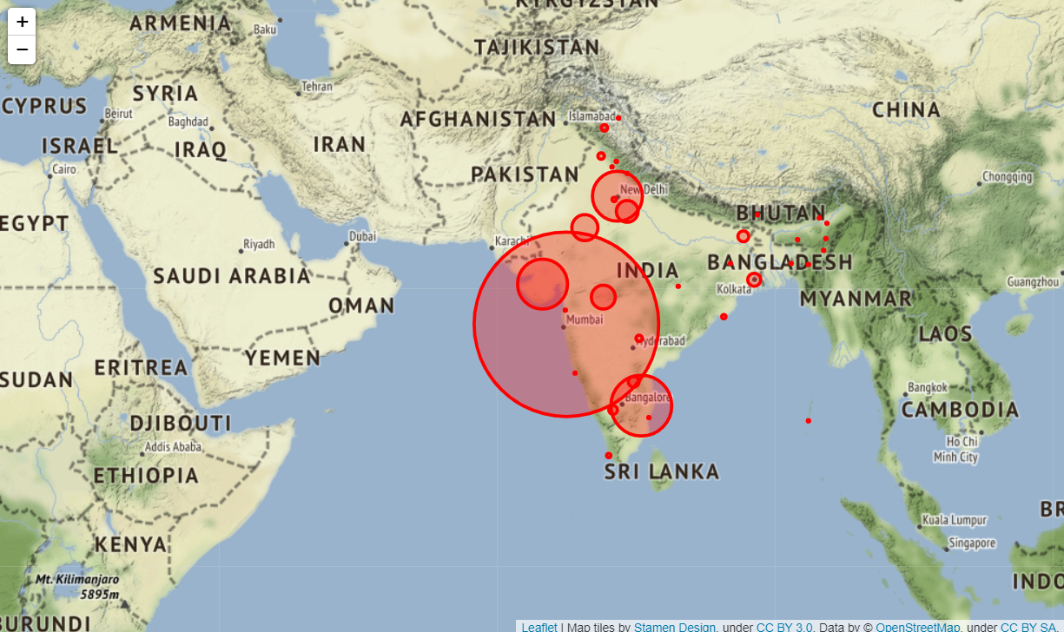
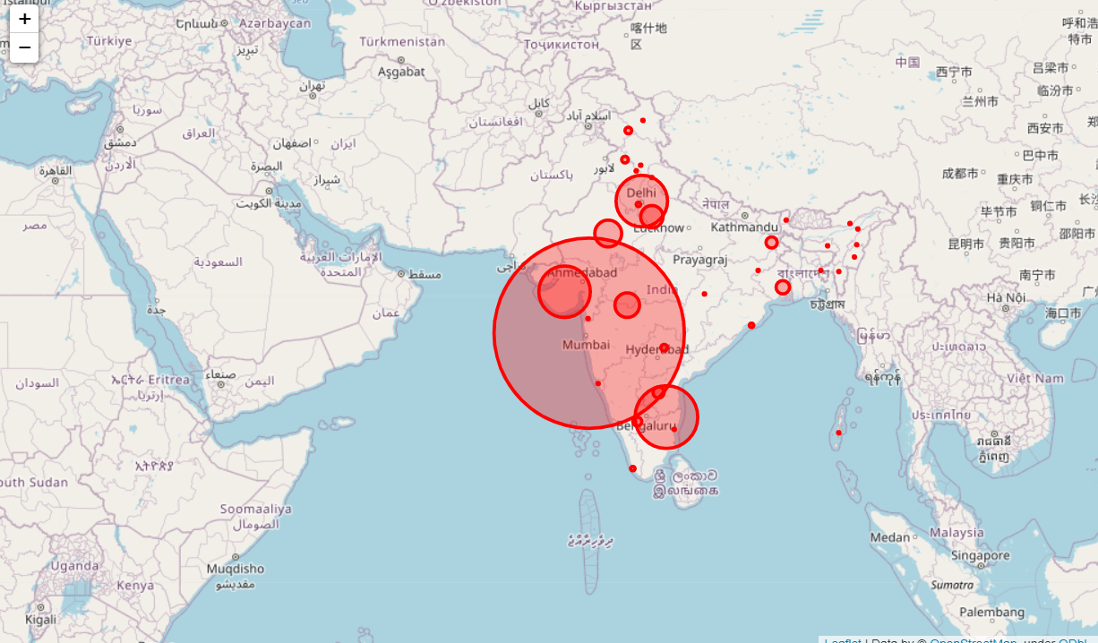
Stamen terrain map
Open Street map

Slide 8
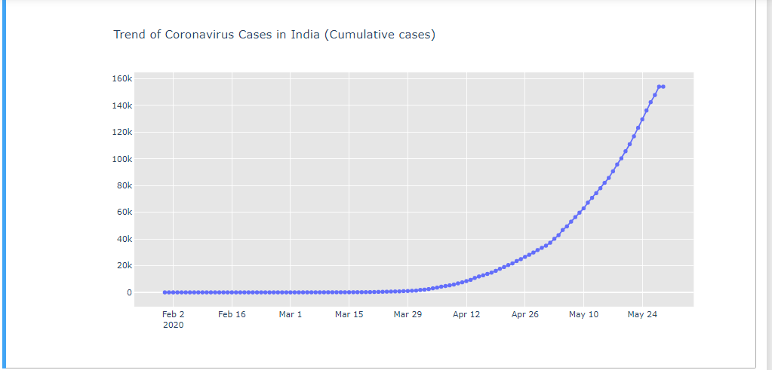
This graph shows Trend of Corona virus in India. Graph show from feb to may Covid
cases of Virus increasing.

Slide 9
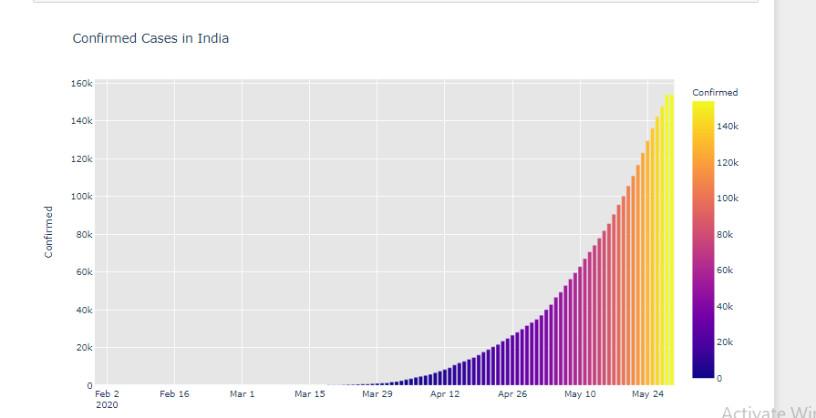
Graph of Confirmed cases in India

Slide 10
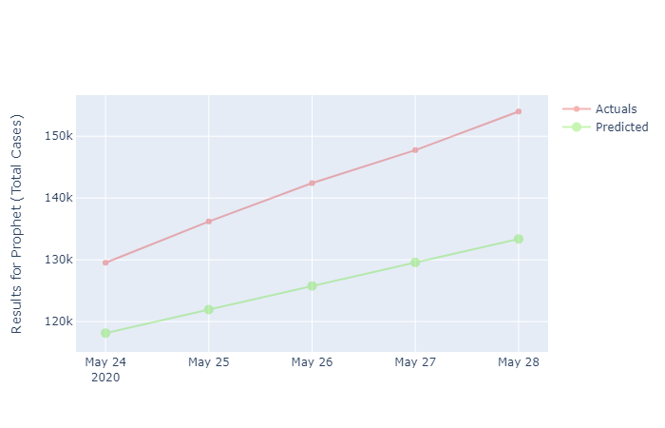
Graph Total cases of Actual and Predicted

Slide 11
Findings –
Covid-19 cases in overall India are increasing rapidly.
Following states of India having highest percentage of Covid-19 cases-
Maharashtra (65.2%)
Tamilnadu (45.9%)
Delhi (50.4%)
Following states of India not having any covid-19 case-
Mizoram
Andman & Nikobar Island
Recovery rate of Covid cases is also increasing .

Slide 12
Thank You

