Slide 1
Seoul Bike Rental Demand Analysis
Group 13

Slide 2
Goal of the Analysis
Understand patterns in bike rentals
Identifying seasonal trends and peak hours
How weather affects the rental system

Slide 3
Data Source
UCI Machine Learning Repository

Slide 4
Dataset Overview
Bike Rented - Main Variable
There are multiple variables such as temperature, humidity, solar radiation etc.
Hour, in 24 hour format, indicating the hour of the day
Branched by seasons
Working days and holidays mentioned

Slide 5
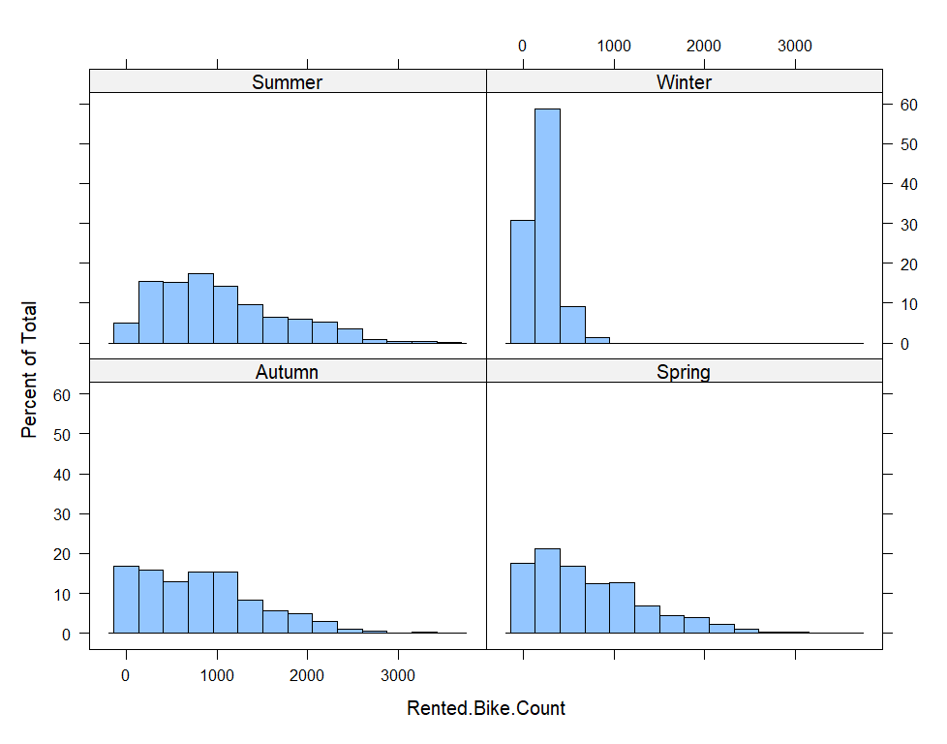
Seasonal Trends
Bike rentals are highest in Summer and Autumn
Winter shows the lowest demand with limited high values
Spring shows moderate demand with gradual increase
Distribution in Summer is wider which indicates more variability and peak usage

Slide 6
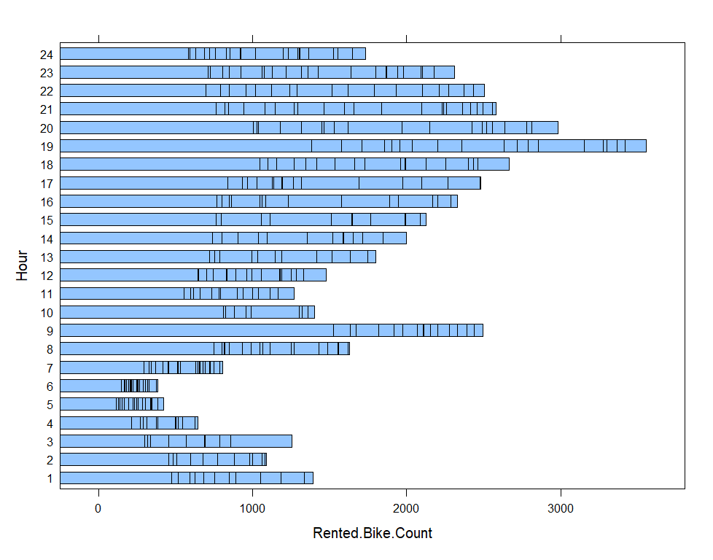
Peak Hour Analysis
Top Demand Hours
7PM (18:00): ~3600 rentals (highest)
8PM (19:00): ~2900rentals
6PM (17:00): ~2600 rentals
9AM (20:00): ~2500 rentals
Interpretation:
Strong correlation with commuting hours. Bikes are widely used for returning home from work and Short-distance evening travel

Slide 7
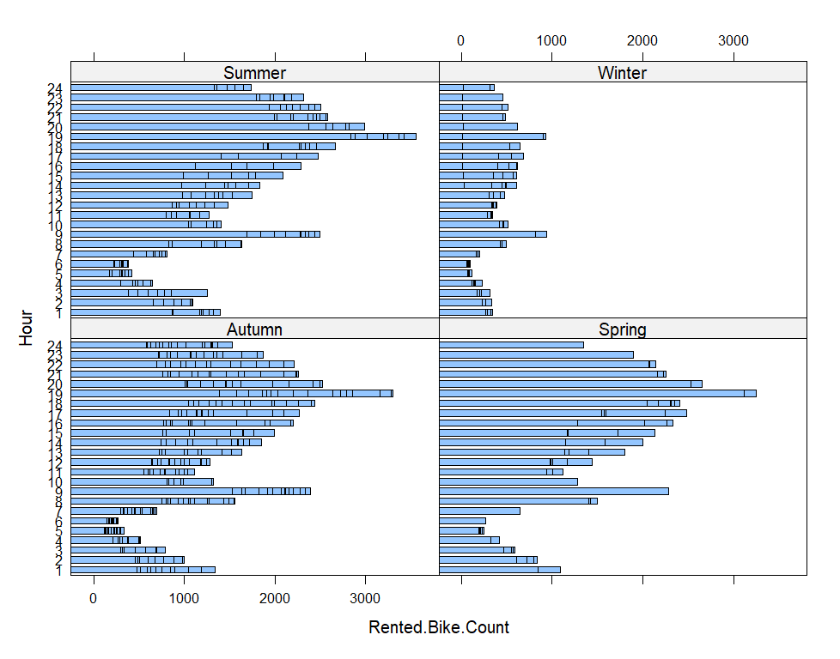
Peak Hour Analysis by Season
Key Observations
Summer: 7PM ~3600
Winter: 7PM ~1000
Autumn: 7PM ~3500
Spring: 7PM ~3400
We interpret that user behavior is consistent (evening peak), but demand intensity is strongly influenced by season.
There is also a spike in rentals at 9AM, which would be the morning commuting time.

Slide 8
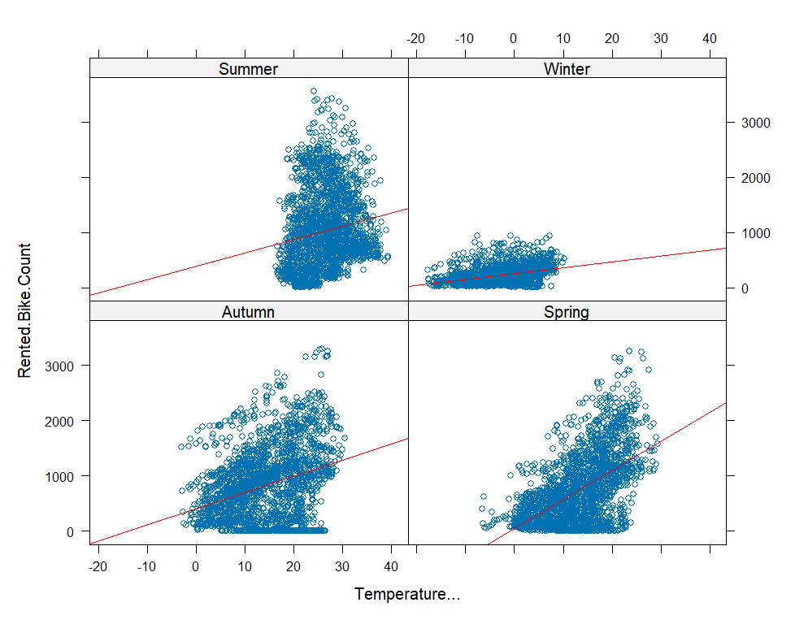
Temperature vs Bike Rentals by Season
Key Observations
Positive relationship between temperature and bike rentals in all seasons
Rentals increase as temperature rises
Spring and Autumn show the strongest increase (steeper trend lines)
Winter has low rentals even as temperature increases
Summer shows high demand but with more variability
We infer that temperature positively influences bike demand, but seasonal context affects its impact

Slide 9
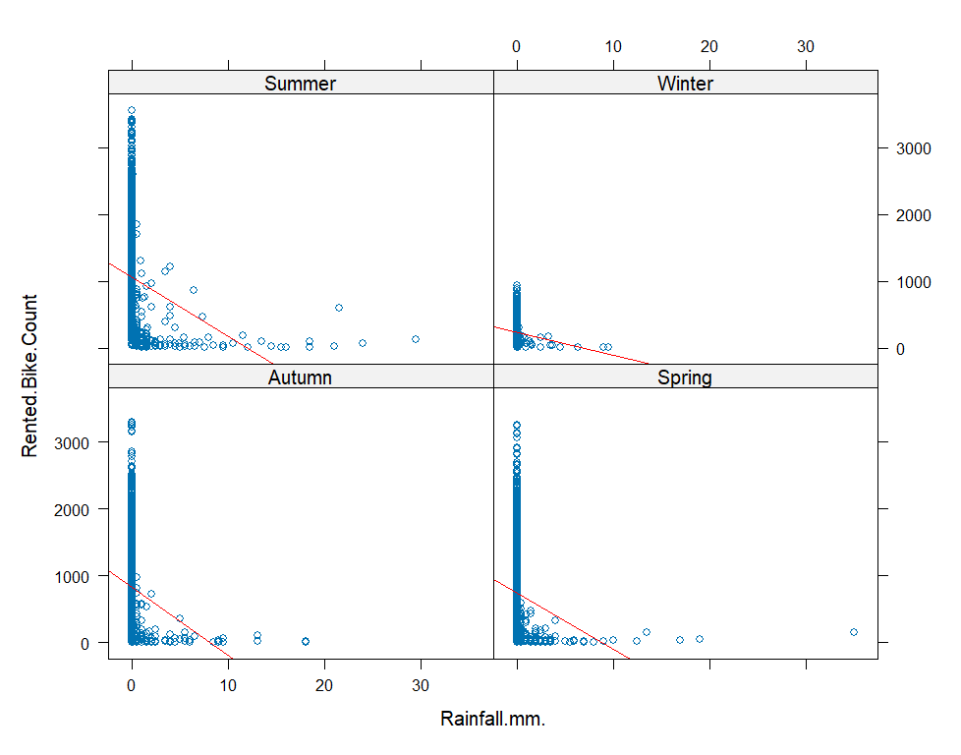
Impact of Rainfall on Bike Rentals by Season
Key Observations
Strong negative relationship between rainfall and bike rentals
Rentals are highest when rainfall is near 0 mm
Even small increases in rainfall lead to a sharp drop in demand
At higher rainfall levels, rentals remain consistently low across all seasons
Rainfall is a major limiting factor for bike usage

Slide 10
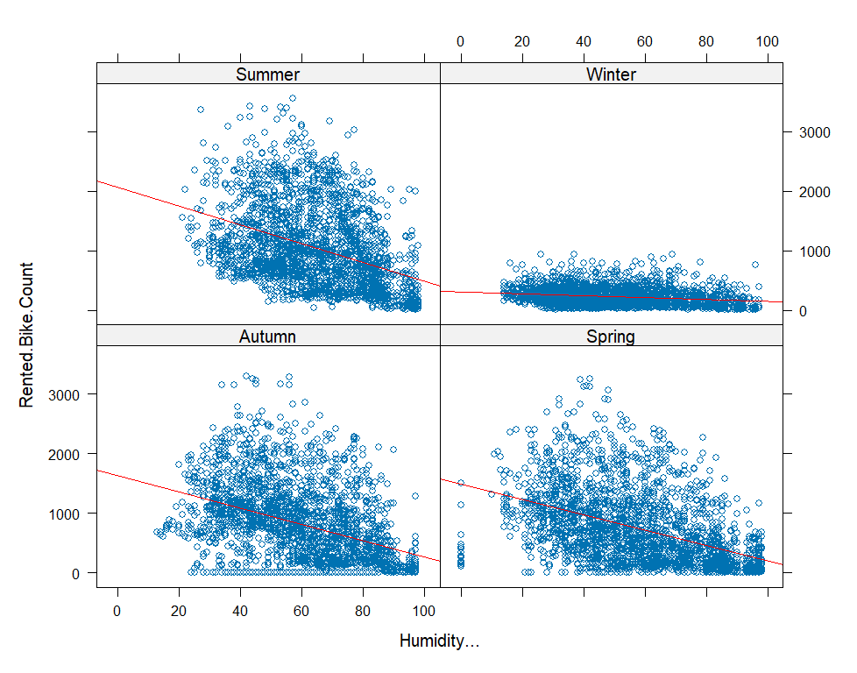
Impact of Humidity on Bike Rentals by Season
Key Observations
Negative relationship between humidity and bike rentals
Rentals tend to decrease as humidity increases
High rental activity is concentrated at moderate humidity levels (≈30–60%)
Very high humidity (>70–80%) is associated with lower demand
Higher humidity reduces comfort, leading to lower bike usage

Slide 11
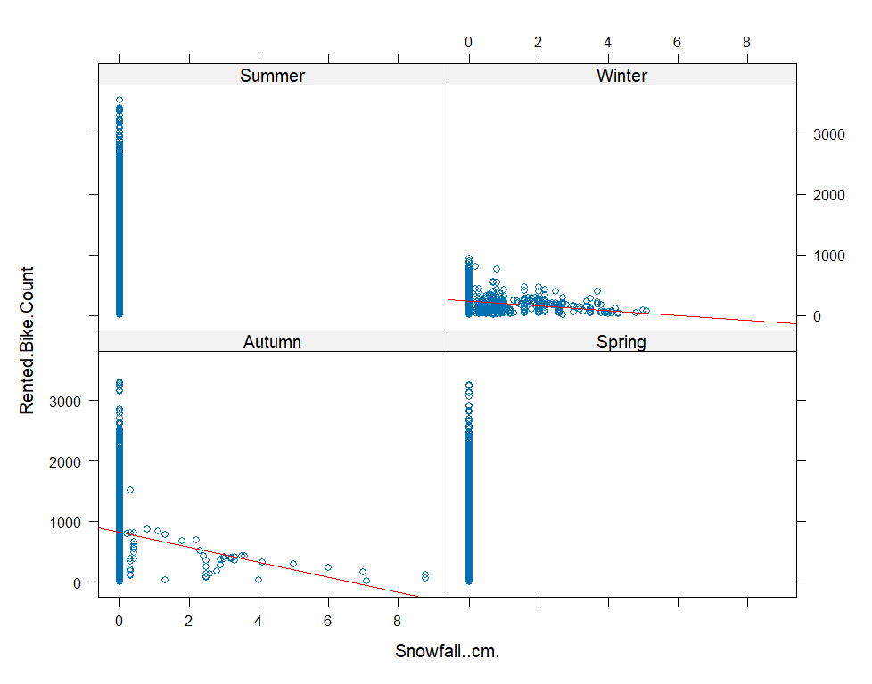
Impact of Snowfall on Bike Rentals by Season
Key Observations
Snowfall occurs primarily in Winter
Other seasons show little to no snowfall
Bike rentals are highest when snowfall = 0 cm
Even small snowfall leads to a sharp drop in demand
Snowfall is a strong limiting factor and mainly affects Winter demand
(Since there was no snowfall during summer and Spring, There is no regression line to follow.)

Slide 12
Conclusion
Key Findings
Bike demand is seasonal, with highest usage in Summer and Autumn.
Peak usage occurs during evening hours (around 6–8 PM)
Temperature positively influences demand, with optimal usage in moderate warm conditions
Rainfall and snowfall significantly reduce rentals
Humidity has a moderate negative effect on usage
Bike rental demand is primarily driven by a combination of time, seasonal patterns, and weather conditions.

Slide 13
Implications
Operational Recommendations
Increase bike availability during peak evening hours (6–7 PM)
Allocate more bikes during high-demand seasons (Summer & Autumn)
Reduce or optimize fleet during low-demand periods (Winter)
Weather-Based Planning
Use weather forecasts to anticipate demand changes
Reduce deployment during rainfall and snowfall
Maintain flexibility during high humidity conditions

Slide 14
Thank You
Any Questions?

