Slide 1
Pizza Sales Dashboard
A Power BI Project by Sejal

Slide 2
Project Objective
The objective of this project is to analyze pizza sales data to derive meaningful business insights.
This dashboard focuses on revenue, orders, customer behavior, and product performance.
It helps businesses:
Identify best and worst selling pizzas 📈
Understand sales trends by day, month, category, and size
Support data-driven decision-making 🚀

Slide 3
Tools & Techniques
Power BI Desktop – dashboard creation and report design
Power Query Editor – data cleaning and transformation
DAX – calculated measures and KPIs
Data Modeling – table relationships and performance optimization
Interactive visuals, slicers, and navigation buttons

Slide 4
Raw Data
Pizza_id
Order_id
pizza name_id
Pizza_name
Pizza_category
Pizza_size
Pizza_ingredients
quantity
Unit_price
Total_price
Order_date
Order_time

Slide 5
Problem Statement
Before creating this dashboard, it was difficult to analyze pizza sales performance effectively.
The business lacked clarity on:
Which pizza categories and sizes generate maximum revenue
Peak order days and seasonal demand patterns
Best and worst performing pizzas
Overall business performance through KPIs

Slide 6
Project Requirements
What is the total revenue, total orders, and pizzas sold? 💰
Which pizza category and size contribute the most to sales? 📊
Which days and months have the highest number of orders? 📆
Who are the top 5 and bottom 5 pizzas by revenue, quantity, and orders?
How does customer demand vary over time?

Slide 7
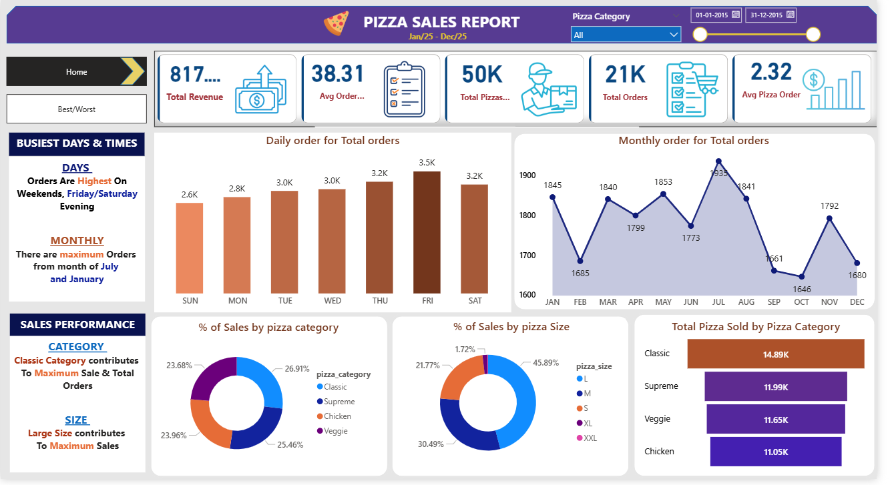
Dashboard (Home Page)

Slide 8
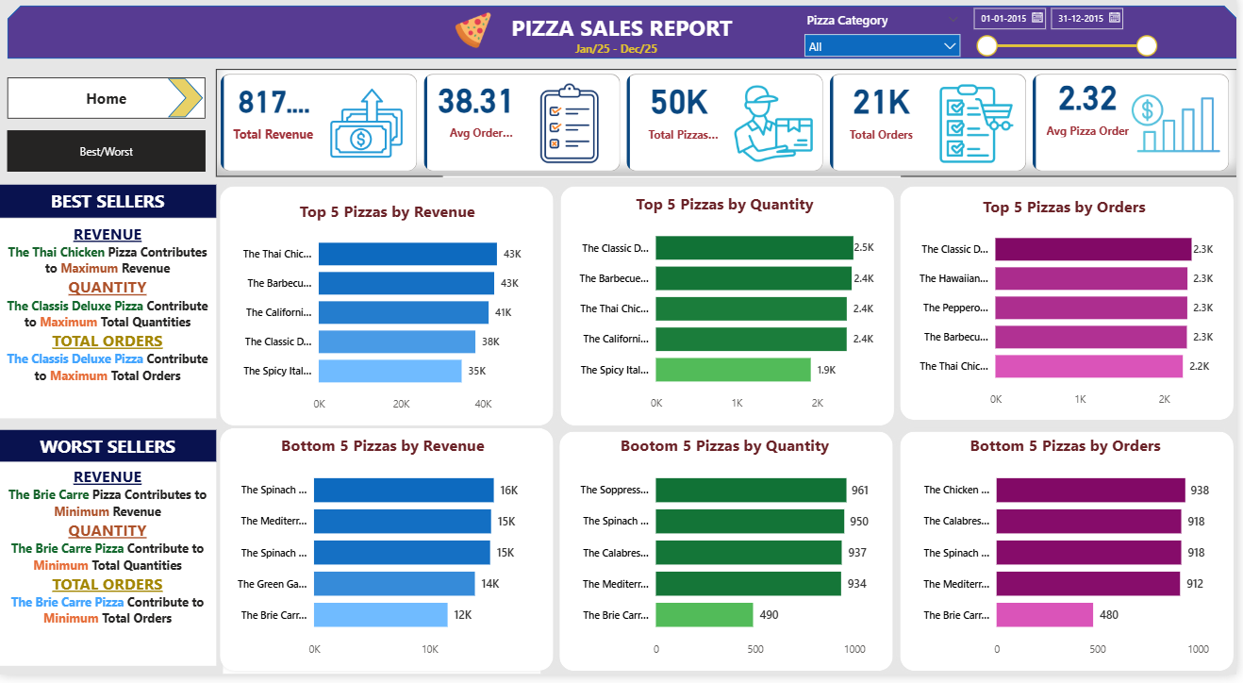
Best and Worst Sale

Slide 9
Conclusion
This Power BI dashboard converts raw pizza sales data into actionable insights.
It helps identify high-performing and low-performing products.
Improves business decision-making through data storytelling.
Strengthened skills in Power BI, DAX, Power Query, and data modeling.
Enhanced ability to present business insights visually 📊✨

Slide 10
Thank You
Open to Data Analyst Opportunities

