Slide 1
MINI PROJECT PRESENTATION
BY – SEJAL MAHESHWARI
2020B0101175
CSE-C

Slide 2
THEME : WORKSPACE – MY UNIVERSE

Slide 3
WORKSPACE – MY UNIVERSE
" A single solution to your problems , It is an interactive workspace that will help you accomplish all of your tasks and manage your work efficiently with ease. ”

Slide 4
MOTIVATION BEHIND THE PROJECT
Ever since the pandemic started work and studies have shifted to online platforms. Doing Tasks is simple but requires multiple apps to do so and navigating through all of them is tough plus the user misses out things that needs to be done in all this.

Slide 5
PROBLEMS FACED BY MANY
With the pandemic creating havoc , all the professional and personal life have been shifted to online medium .
It is difficult for most to keep track of their day to day activity.
It is a tedios task to remember what is to be done and what is left.
Managing day to day activity can be a difficult task for everyone.
Sometimes people forget the deadline.

Slide 6
WHY WORKSPACE – MY UNIVERSE ?
My universe will help the user track his progress like a assistant and remind him which tasks remains to be done.
It will help users to keep track of their day to day activities .

Slide 7
FEATURES IN WORKSPACE : MY UNIVERSE
- Proper Authentication System to ensure security ( Login & Signup Page )
- A ToDo List to keep track of day to day tasks
- Where we can add our projects
- We can add tasks to our projects
- We can schedule the tasks
- We can edit them
- Once completed , we can mark it as complete

Slide 8
TECHNOLOGies USED in website
FRONTEND :
HTML
CSS
JAVASCRIPT
UI/UX:
BOOTSTRAP
BACKEND/DATABASE:
FIREBASE

Slide 9
WEBSITE LINK & GITHUB LINK OF PROJECT
WEBSITE LINK :
https://determined-perlman-360e66.netlify.app/
GITHUB LINK : https://github.com/sejalmah/todoist

Slide 10
SNAPSHOTS FROM THE WEBSITE

Slide 11
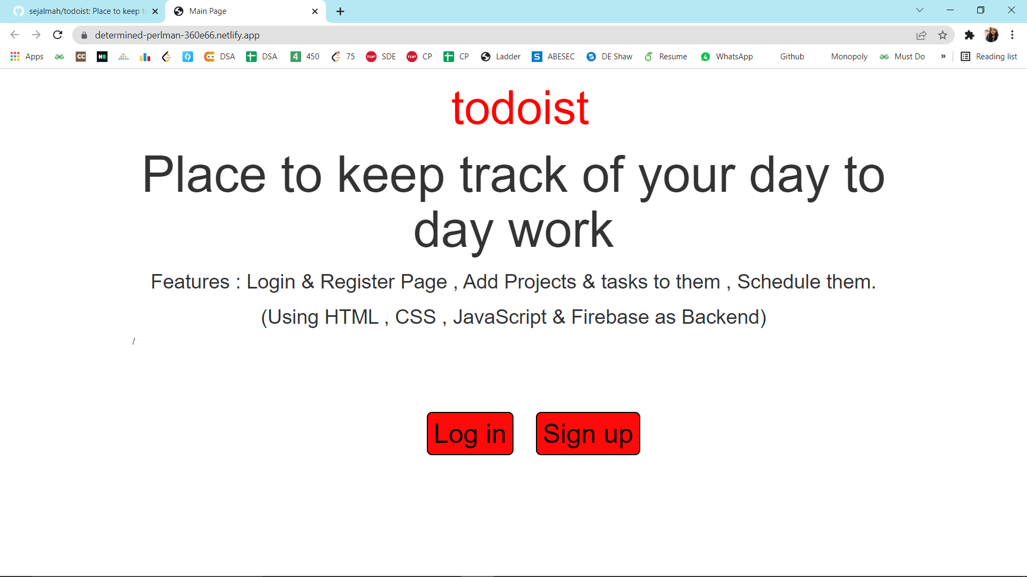
HOME PAGE OF THE WEBSITE

Slide 12
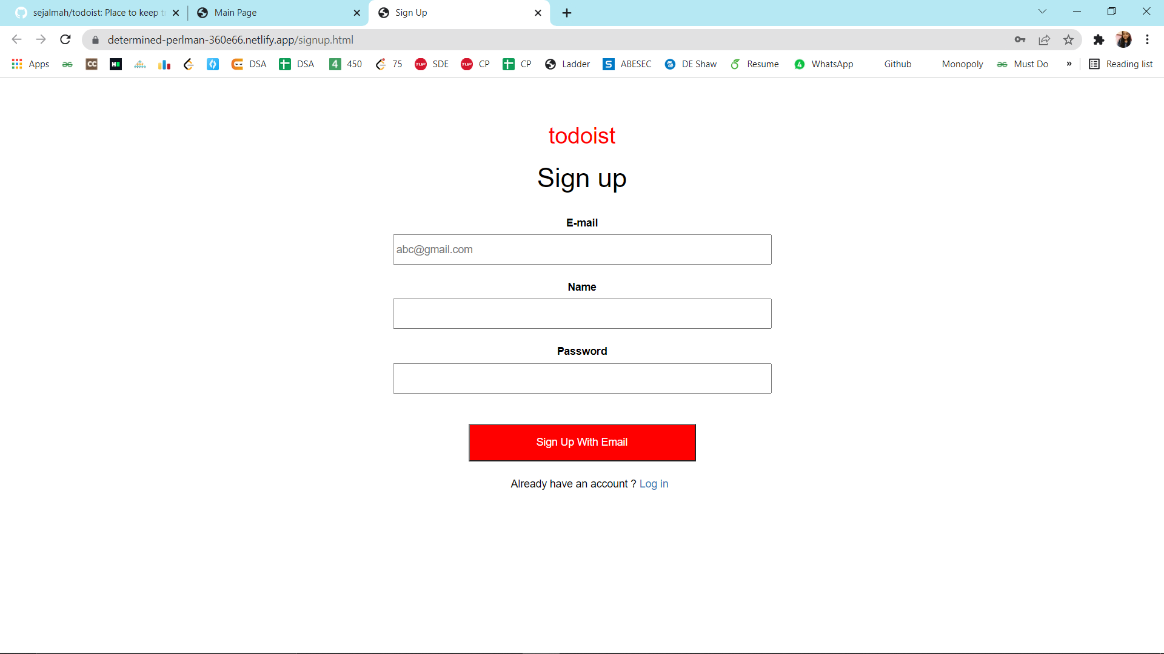
SIGN UP PAGE OF THE WEBSITE

Slide 13
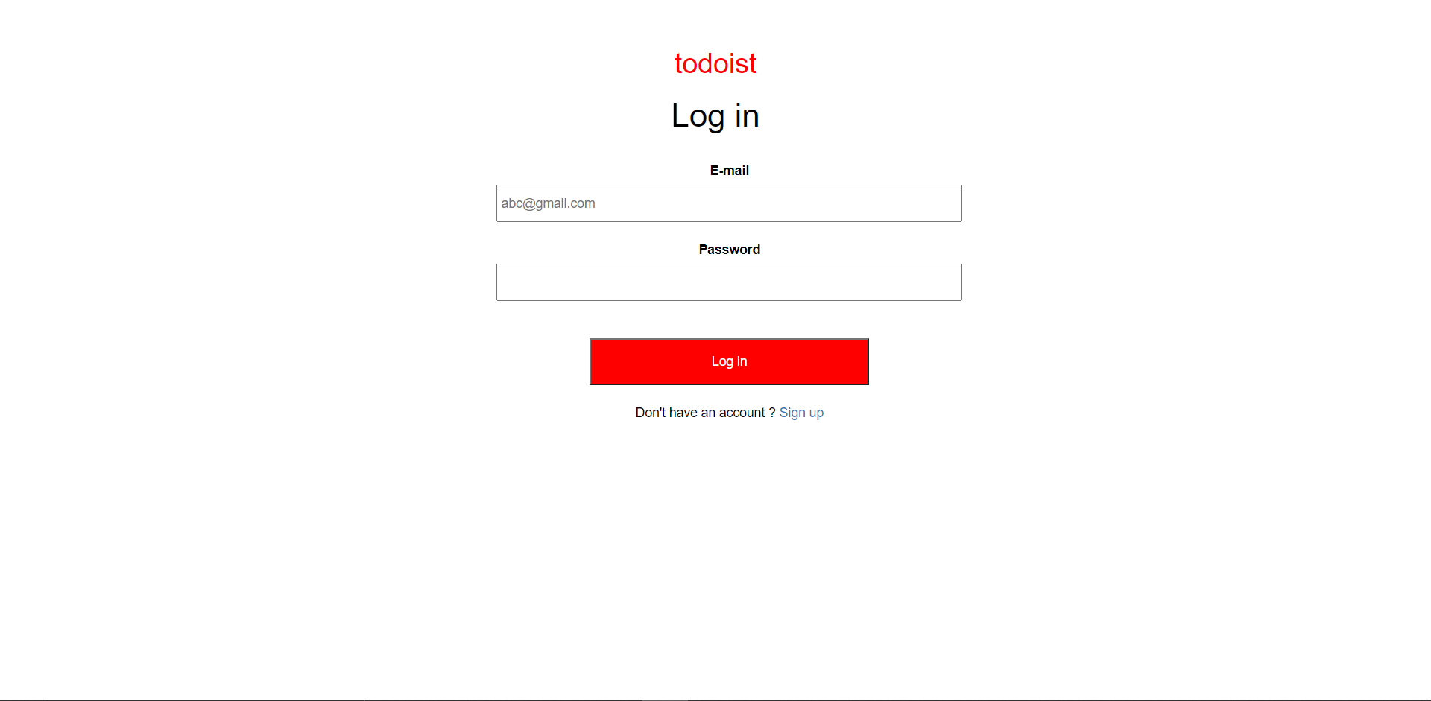
LOGIN PAGE OF THE WEBSITE

Slide 14
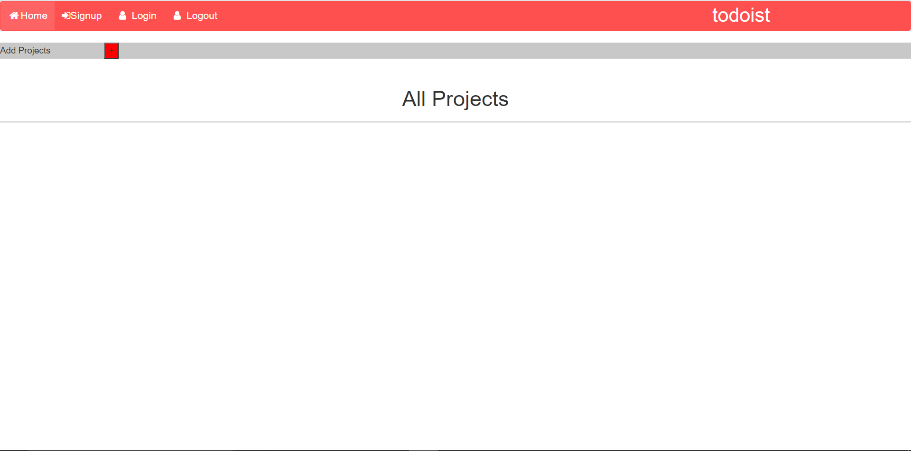
MAIN PAGE OF THE WEBSITE

Slide 15
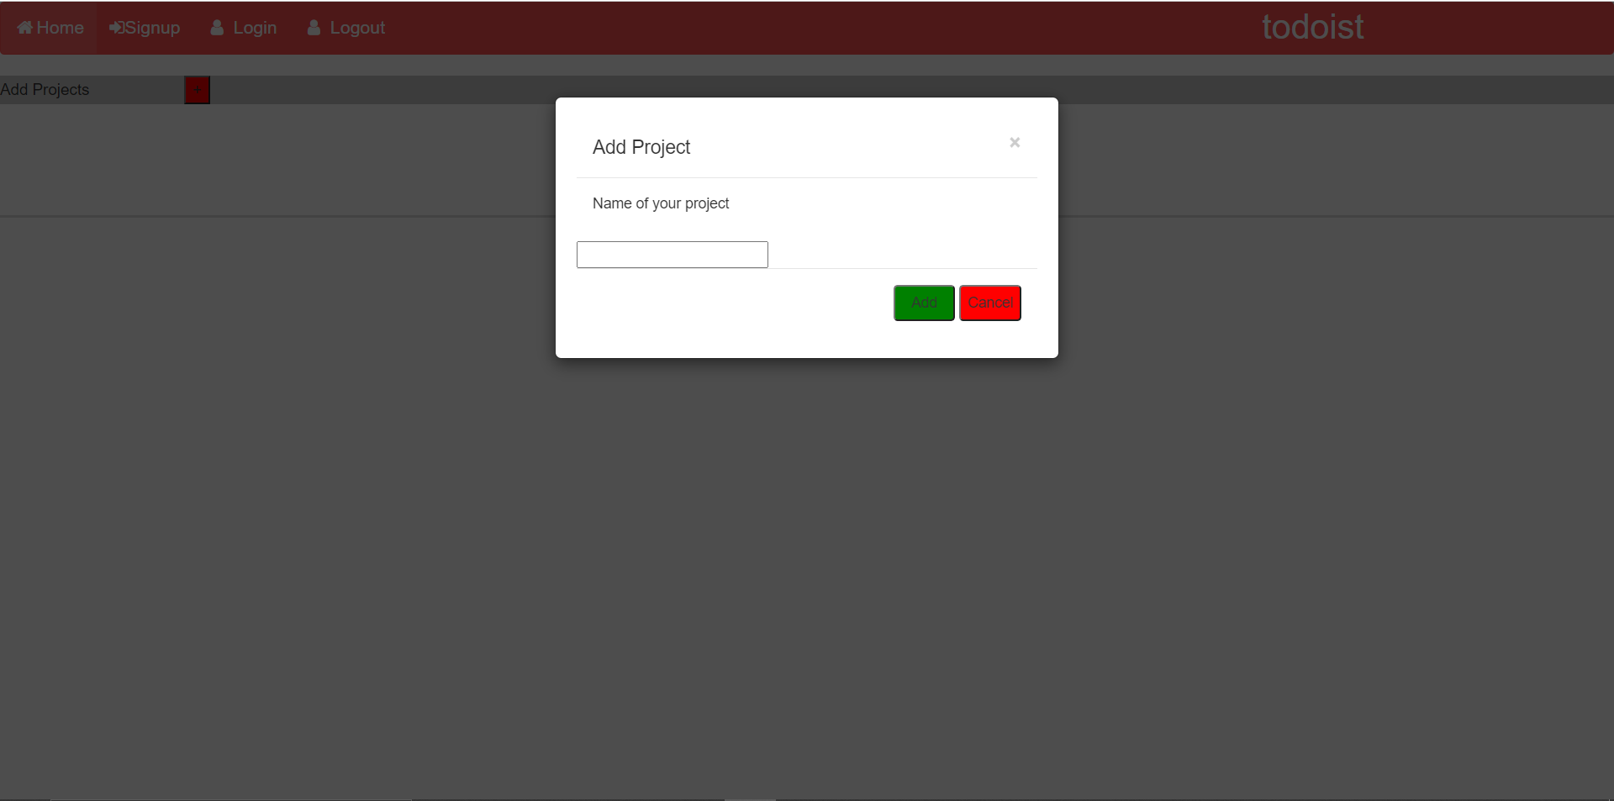
Adding projects on website

Slide 16
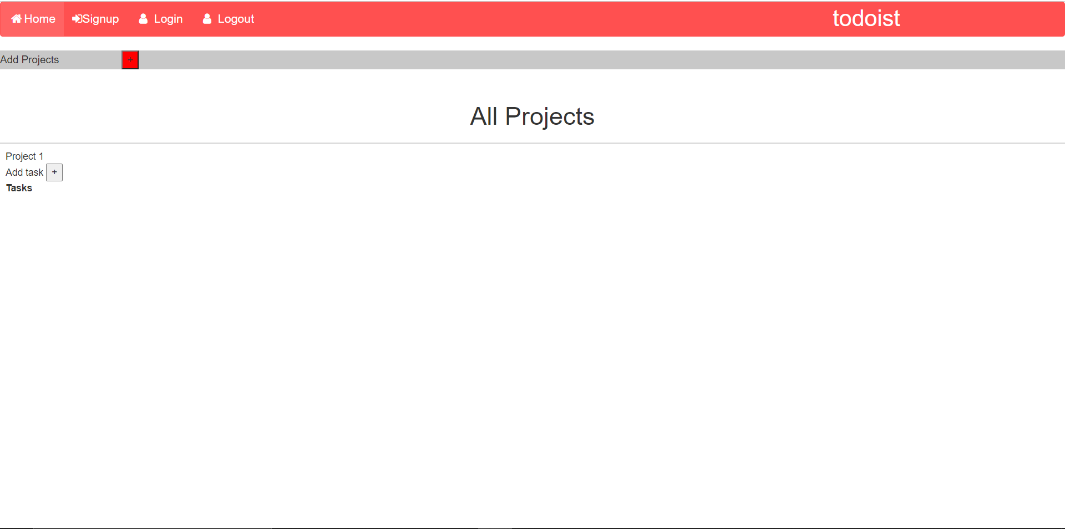
Projects display on main page

Slide 17
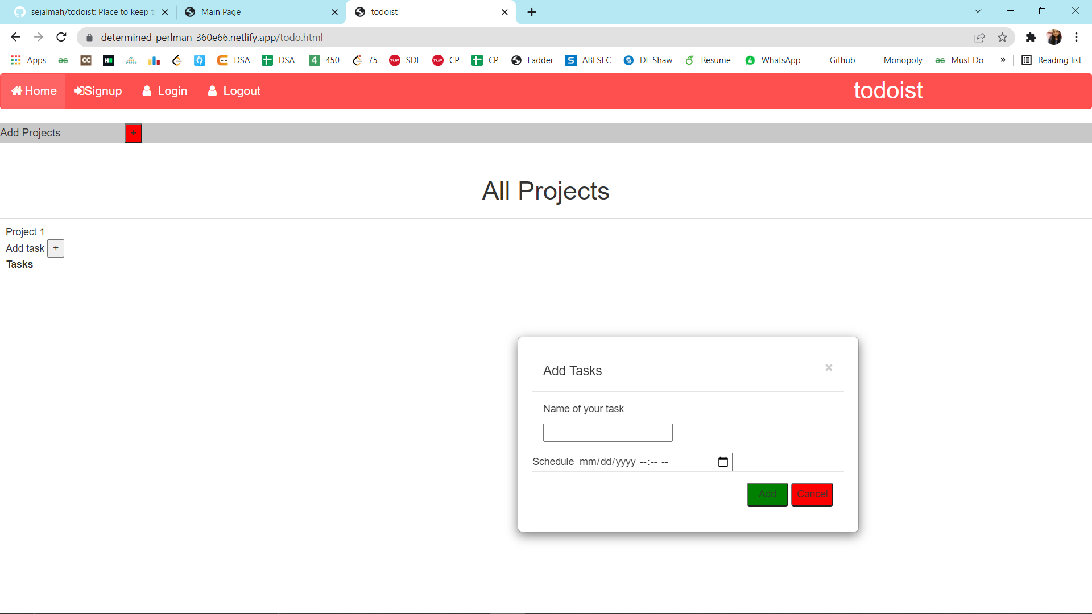
ADDING TASKS TO OUR PROJECTS

Slide 18
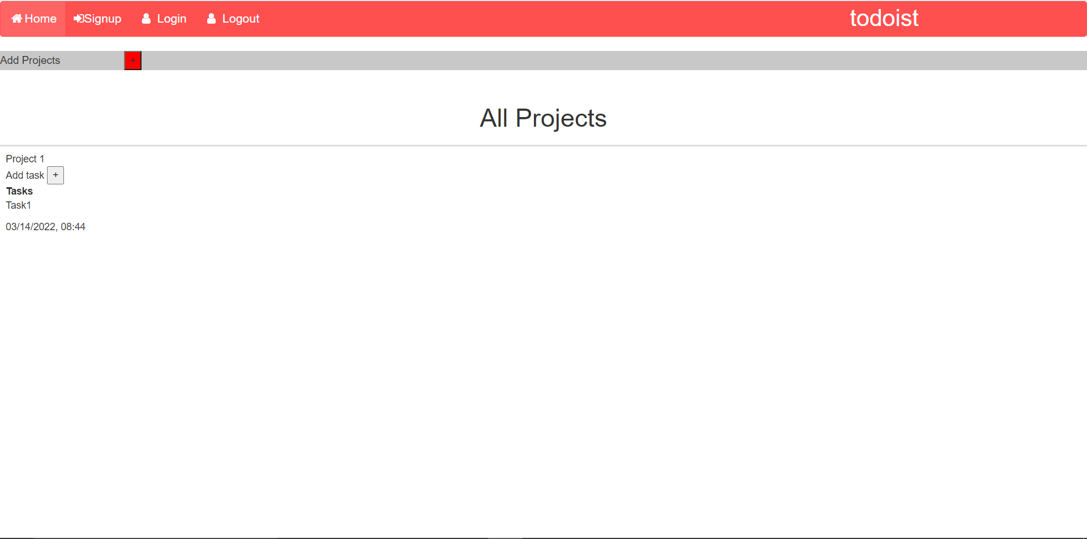
TASKS DISPLAY IN PROJECTS ON MAIN PAGE

Slide 19
REFEREENCES
https://www.w3schools.com/html/default.asp
https://www.w3schools.com/css/default.asp
https://www.w3schools.com/js/default.asp
https://www.w3schools.com/bootstrap/bootstrap_ver.asp
https://firebase.google.com/docs/functions/get-started
https://getbootstrap.com/

Slide 20
THANK YOU !

