Slide 1


SQL Analysis Project
A SQL-based analysis of a Pizza Sales dataset to identify revenue trends, top-selling pizzas, and ordering patterns. Includes time-based analysis, category insights, and advanced techniques like moving averages and basket analysis to support data-driven decisions.

Slide 2


Project Overview
Dataset Description
Tools & Skills Used
Business Questions & SQL Queries
Agenda
Key Insights
Future Enhancements

Slide 3
Project Overview
  This project focuses on analyzing a Pizza Sales dataset using SQL to derive insights related to customer ordering behavior, revenue trends, and product performance. The analysis includes basic, intermediate, and advanced SQL queries covering order patterns, revenue generation, best-selling pizzas, category distribution, weekly and monthly trends, and forecasting using window functions. The objective is to support data-driven decision-making for menu optimization and sales strategy.

Slide 4

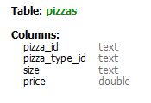
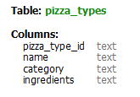
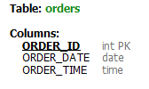
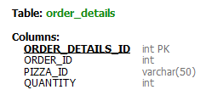
Dataset Description

Slide 5
Tools & Skills Used
  SQL
  Joins
  Aggregations
  Window functions
  Grouping & filtering
  CTEs
  Date functions

Slide 6
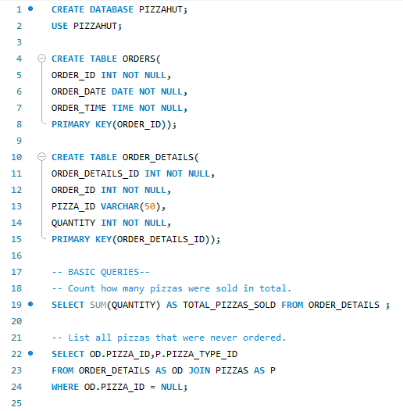
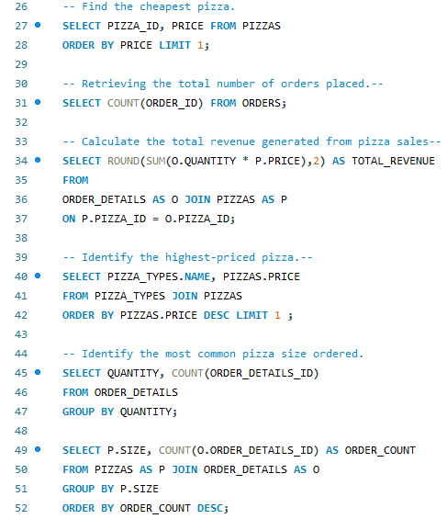
Business Questions & SQL Queries
BASIC QUERIES

Slide 7
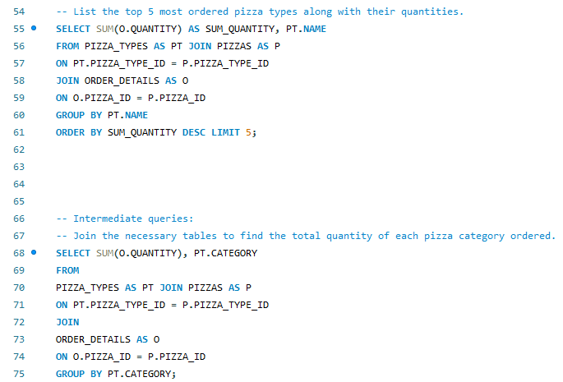
Business Questions & SQL Queries
INTERMEDIATE QUERIES

Slide 8
Business Questions & SQL Queries

Slide 9
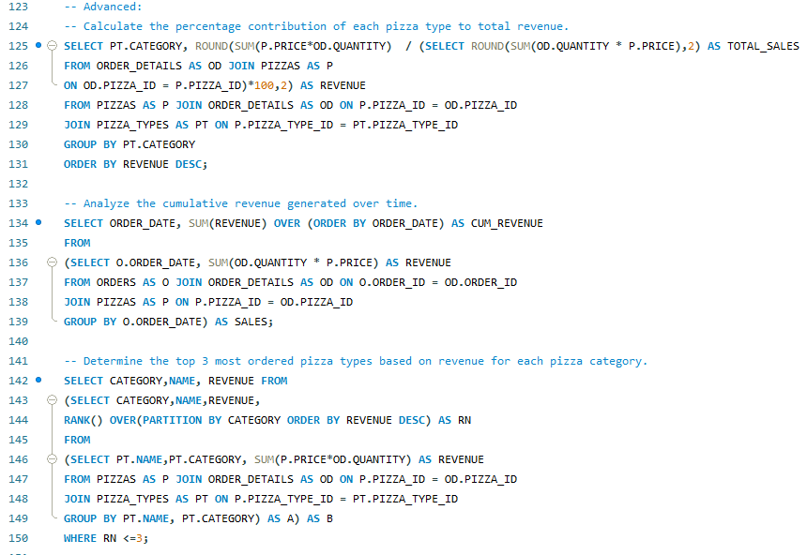
Business Questions & SQL Queries
ADVANCED QUERIES

Slide 10
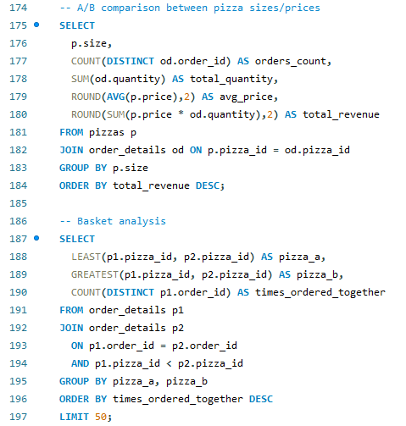
Business Questions & SQL Queries
ADVANCED QUERIES

Slide 11
Key Insights
  Large pizzas contribute the highest revenue (38%).
  Friday & Saturday are peak order days.
  6–8 PM is the busiest ordering window.
  Margherita and Pepperoni dominate sales volume.
  Category “Classic” and “Supreme drives maximum revenue.
  Weekly revenue shows an upward trend with a 3-week moving average.
  Months 5,7,11 were the most revenue holders.
  The cumulative revenue earned was 817860.05.
  The average order value was 38.30
  The average sales per day were 138.47

Slide 12
Future Enhancements
  Customer segmentation
  Predictive demand modeling
  Time-series forecasting
  Profitability analysis
  Live dashboard automation

Slide 13
  For complete SQL scripts, analysis, results, and raw data files, please check out the full repository on GitHub.

